Slide 1


A Large-Scale Chinese Multimodal NER Dataset with Specch Clues
51215901116 林奋炫

Slide 2
motivation
Most study on NER only relies on textual modality only. When texts are noisy or short,it is not sufficient to locate and classify named entities accurately.
Nowadays,the existing multi-modal NER mostly integrates text modality and visual modality, and most of the research is limited to English.
The current research on Chinese NER completely ignores valuable multi-modal information.

Slide 3
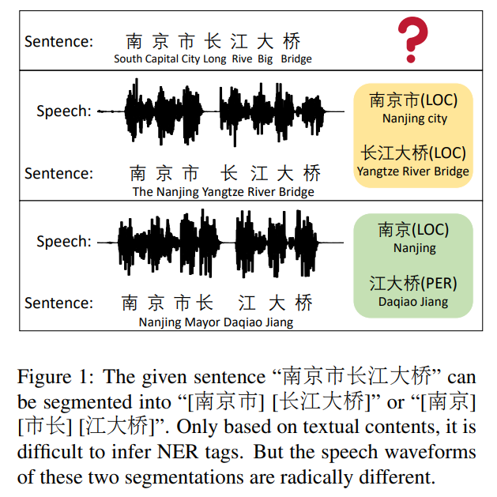
example

Slide 4
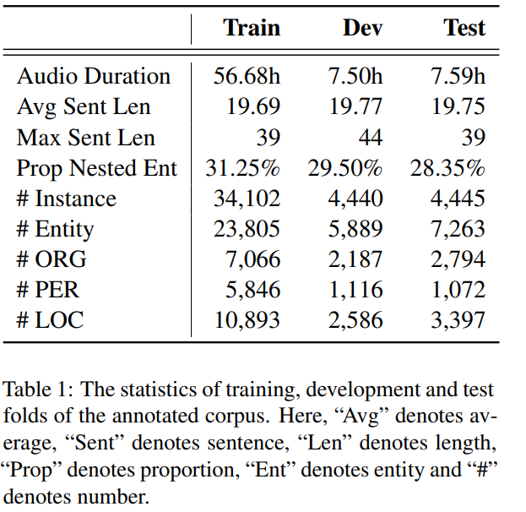
正文页面示例
Dataset Preparation
Construct a large-scale human annotated Chinese NER dataset with Textual Acoustic contents,named CNERTA.
details:
1.annote all occurences of 3 entity types(person name,location and organization) in 42,987 sentences.
2.not only the topmost entities but also nested entities are annotated in CNERTA.

Slide 5
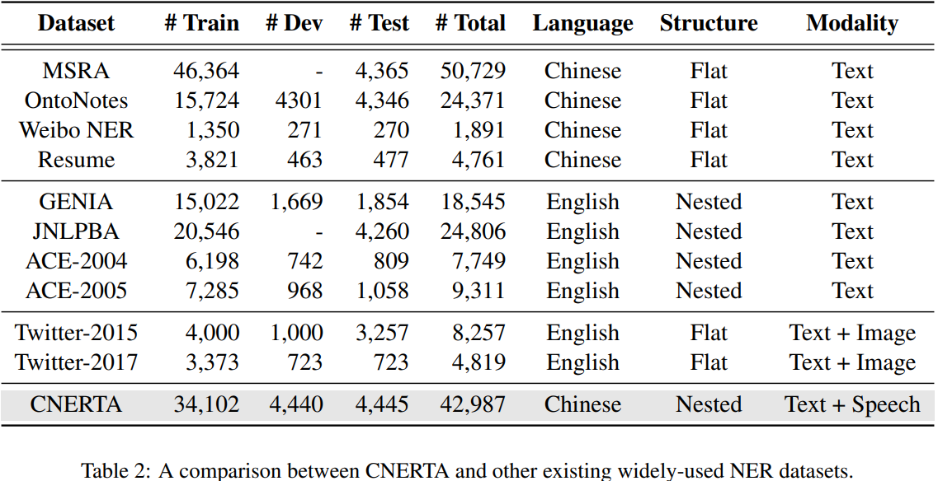
Dataset Comparison

Slide 6
正文页面示例
01 / 14
Preliminaries
1、Nested Structure Linearization
2、Acoustic Encoder

Slide 7
正文页面示例
01 / 14
Baselines
Textual-only model: BiLSTM-CRF、BERT-CRF、MacBERT-CRF
Lexicon-enhanced model: Lattice-LSTM、ZEN
Mutil-modal model: Cross-Modal Attention Module (CMA)、Multimodal Interaction Module (MMI)

Slide 8



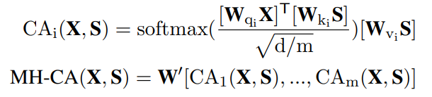

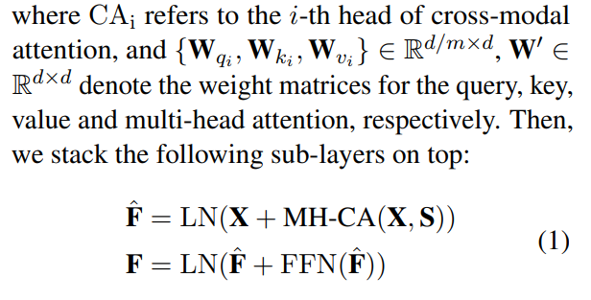
CMA Module
Given textual hidden representations and the acoustic representations
treat X as queries,and S as keys and values:
where LN means layer normalization and FFN means a fully connected feedforward network, which consists of two linear transformation with a ReLU activation . Finally, the new textual representations, which are enhanced by acoustic features, are fed into the CRF decoder to infer NER tags.

Slide 9
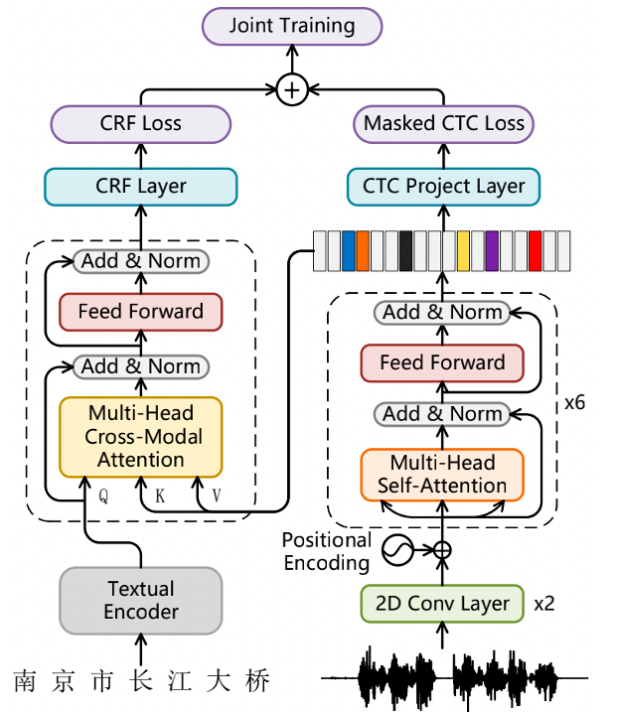
Mutilmodal Mutiltask Model (M3T)

Slide 10
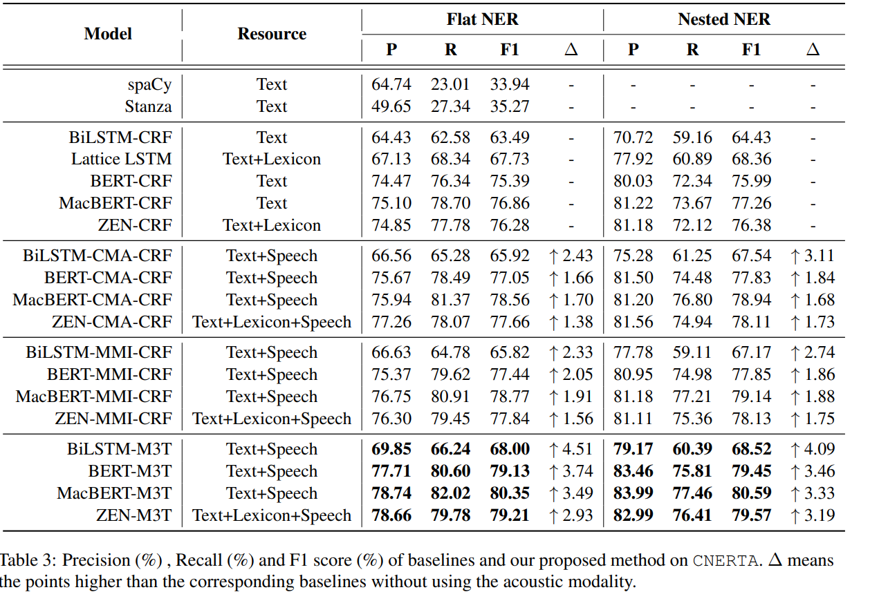
Results

Slide 11
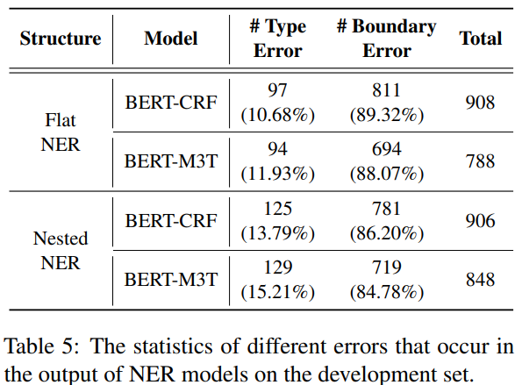
Errors Analysis

Slide 12
Conclusions
Through extensive experiments, we prove that Chinese NER models can benefit from introducing the acoustic modality and our proposed model is effective.
In the future, we are interested in mining other information contained in speech, such as rhythm,emotion, pitch, accent and stress, to boost NER.Meanwhile, we will also work on designing somespeech-text pretraining tasks for building a largescale pretrained model with multimodal capabilities

Slide 13
Thanks for your attention.
Copyright © 2021 ECNU Corporation. All rights reserved.
Tel:+86-021-62233586 Fax:+86-021-62606775
E-mail: ecnu@ecnu.com.cn Http: //www.ecnu.edu.cn

