Slide 1
UNIRE: A Uniﬁed Label Space for Entity Relation Extraction
Yijun Wang, Changzhi Sun, Yuanbin Wu, Hao Zhou, Lei Li, and Junchi Yan
王志承

Slide 2
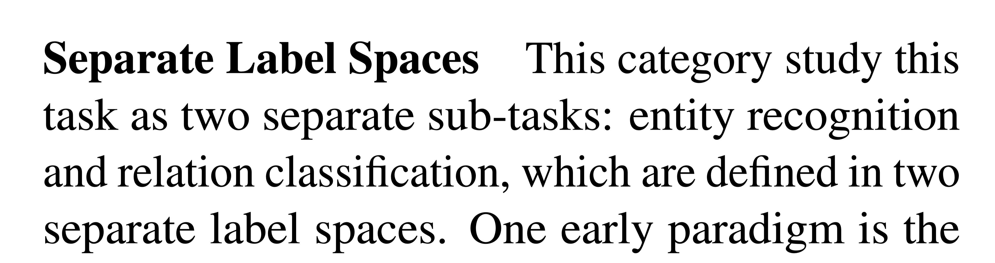
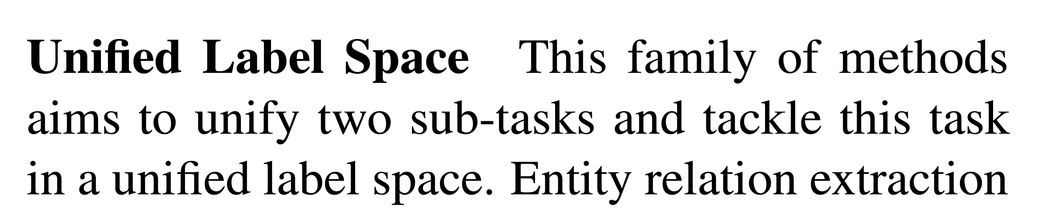
Related Works
UniRE
NER Model
RC Model
Sentences
Relations
RE Model
Sentences
Relations

Slide 3
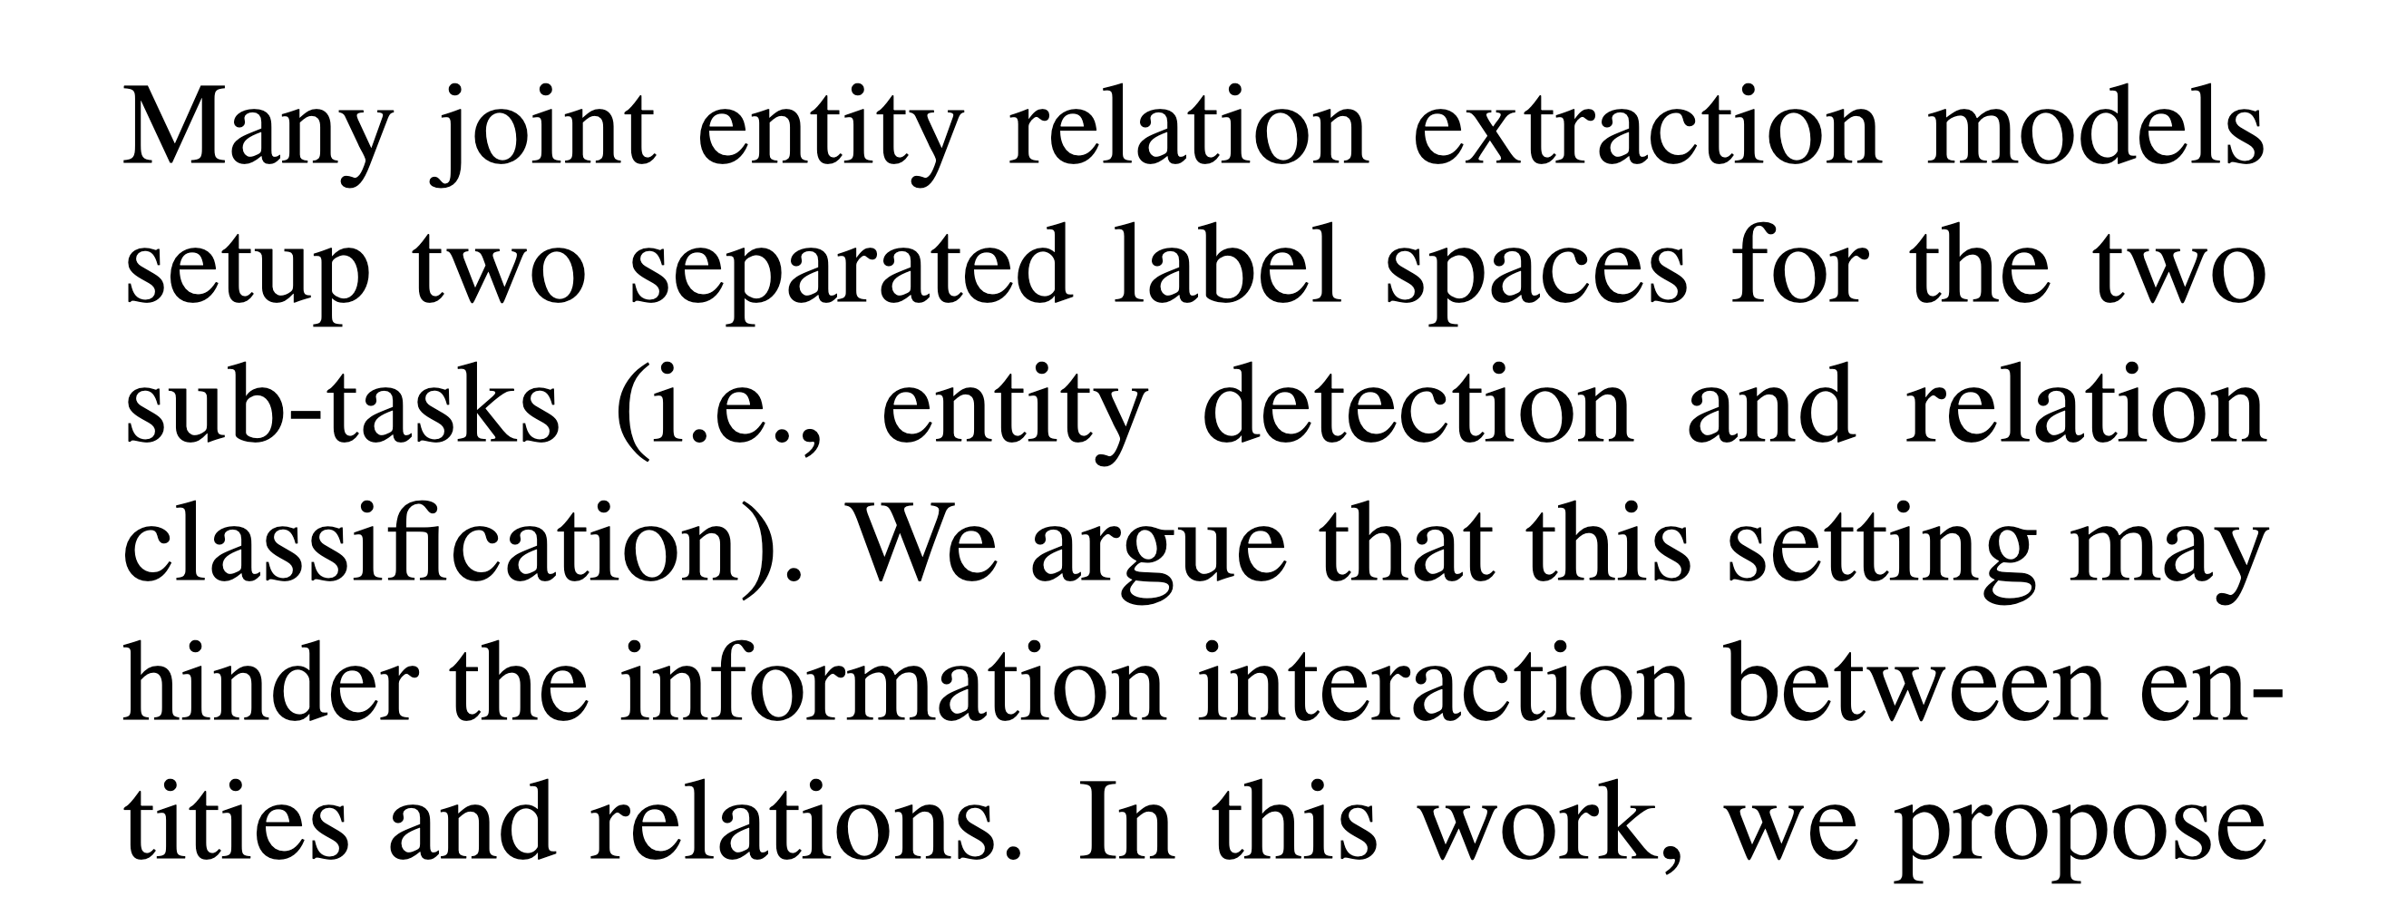
Motivation
UniRE

Slide 4
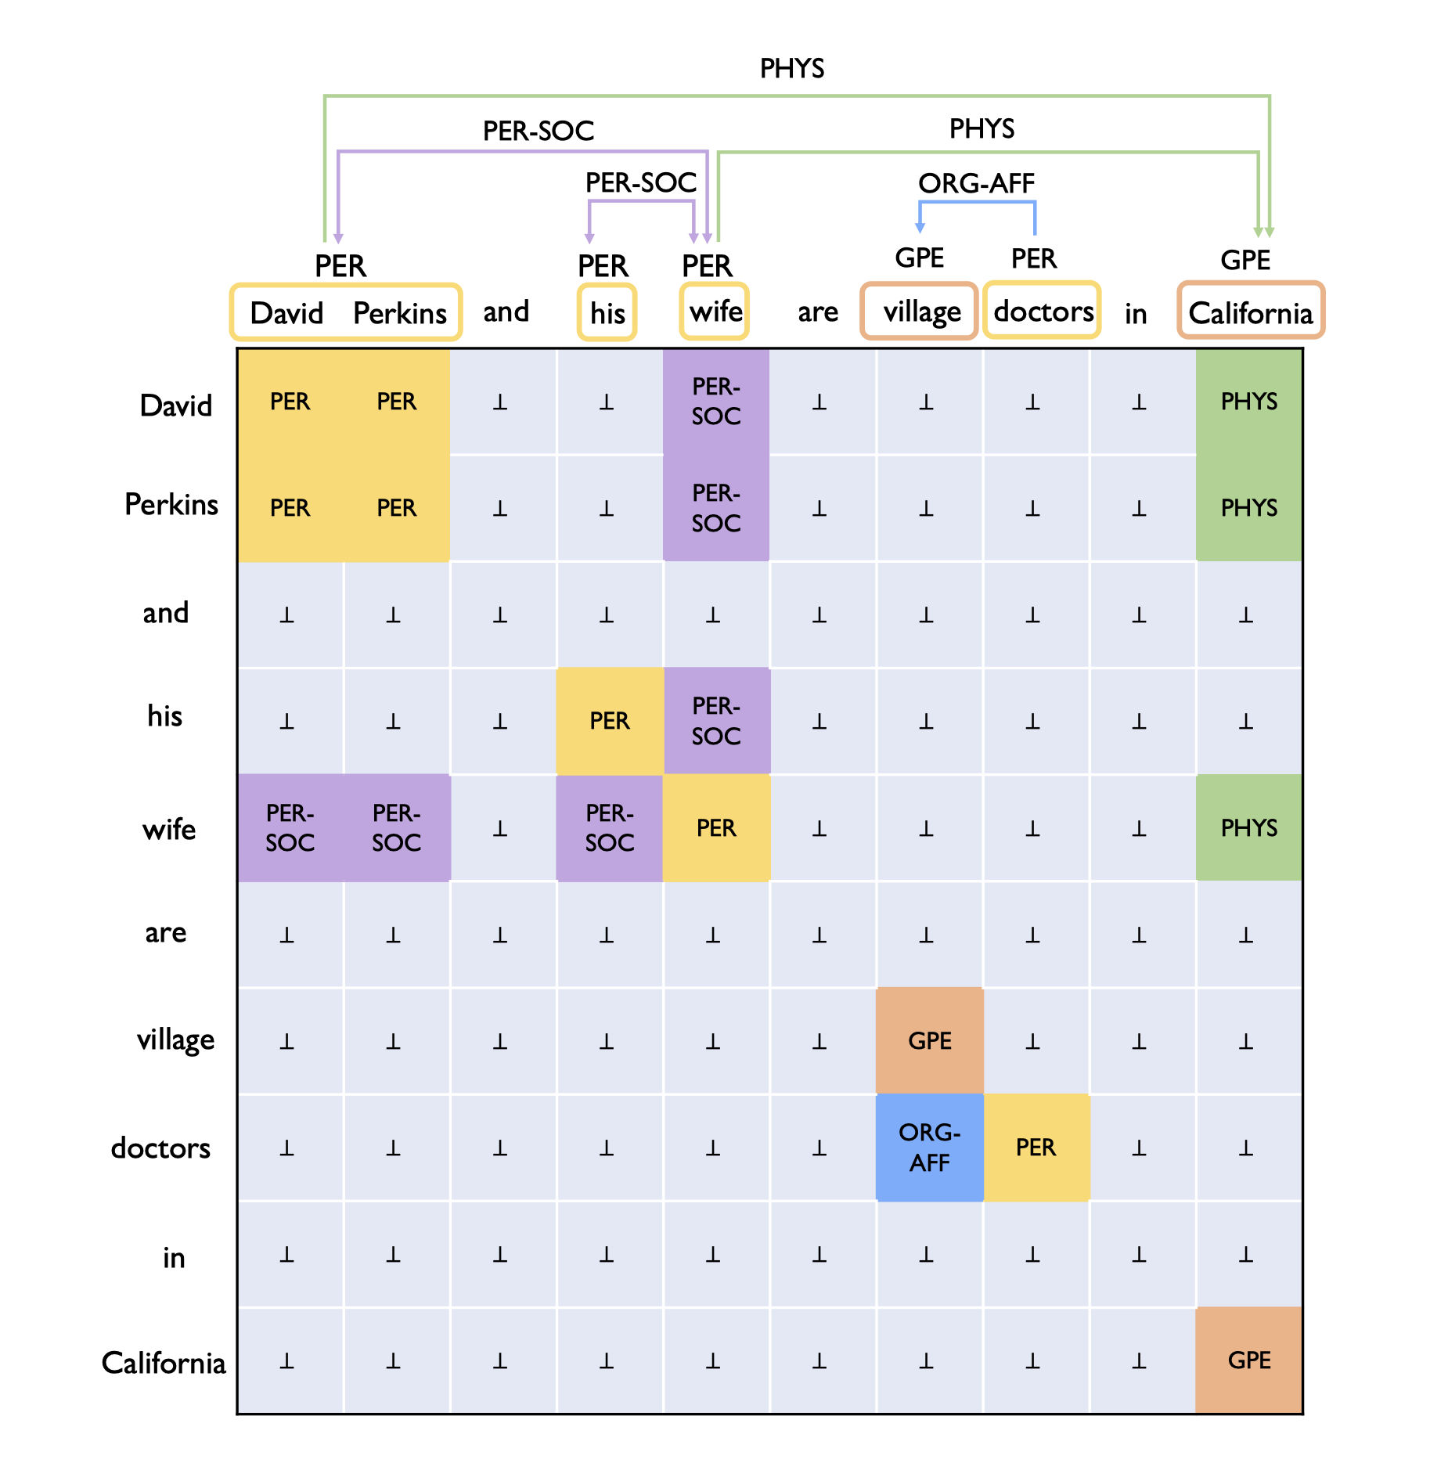
Input & Output
UniRE
Notes:
In this work, we propose to eliminate the different treatment on the two sub-tasks’ label spaces. The input of our model is a table containing all word pairs from a sentence. Entities and relations are represented by squares and rectangles in the table.

Slide 5
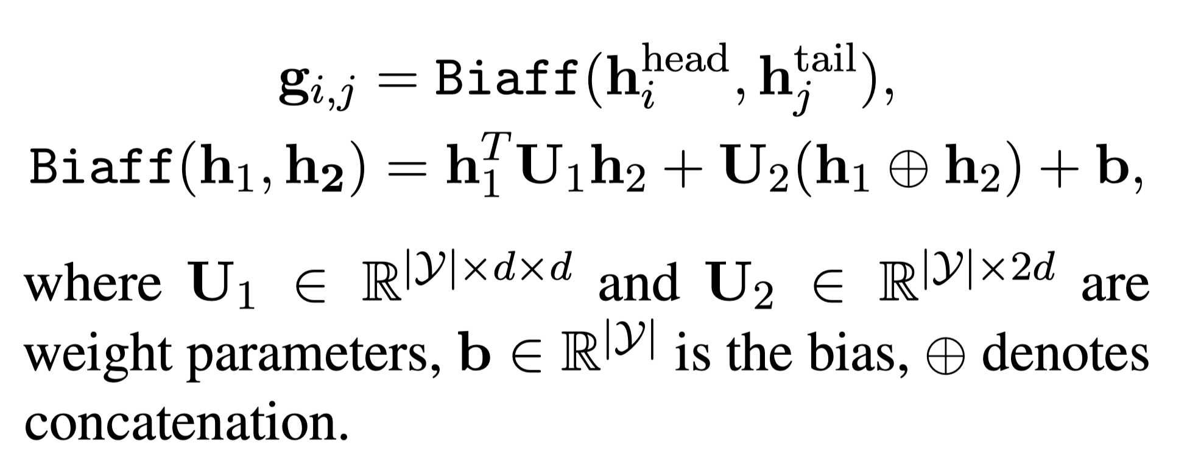
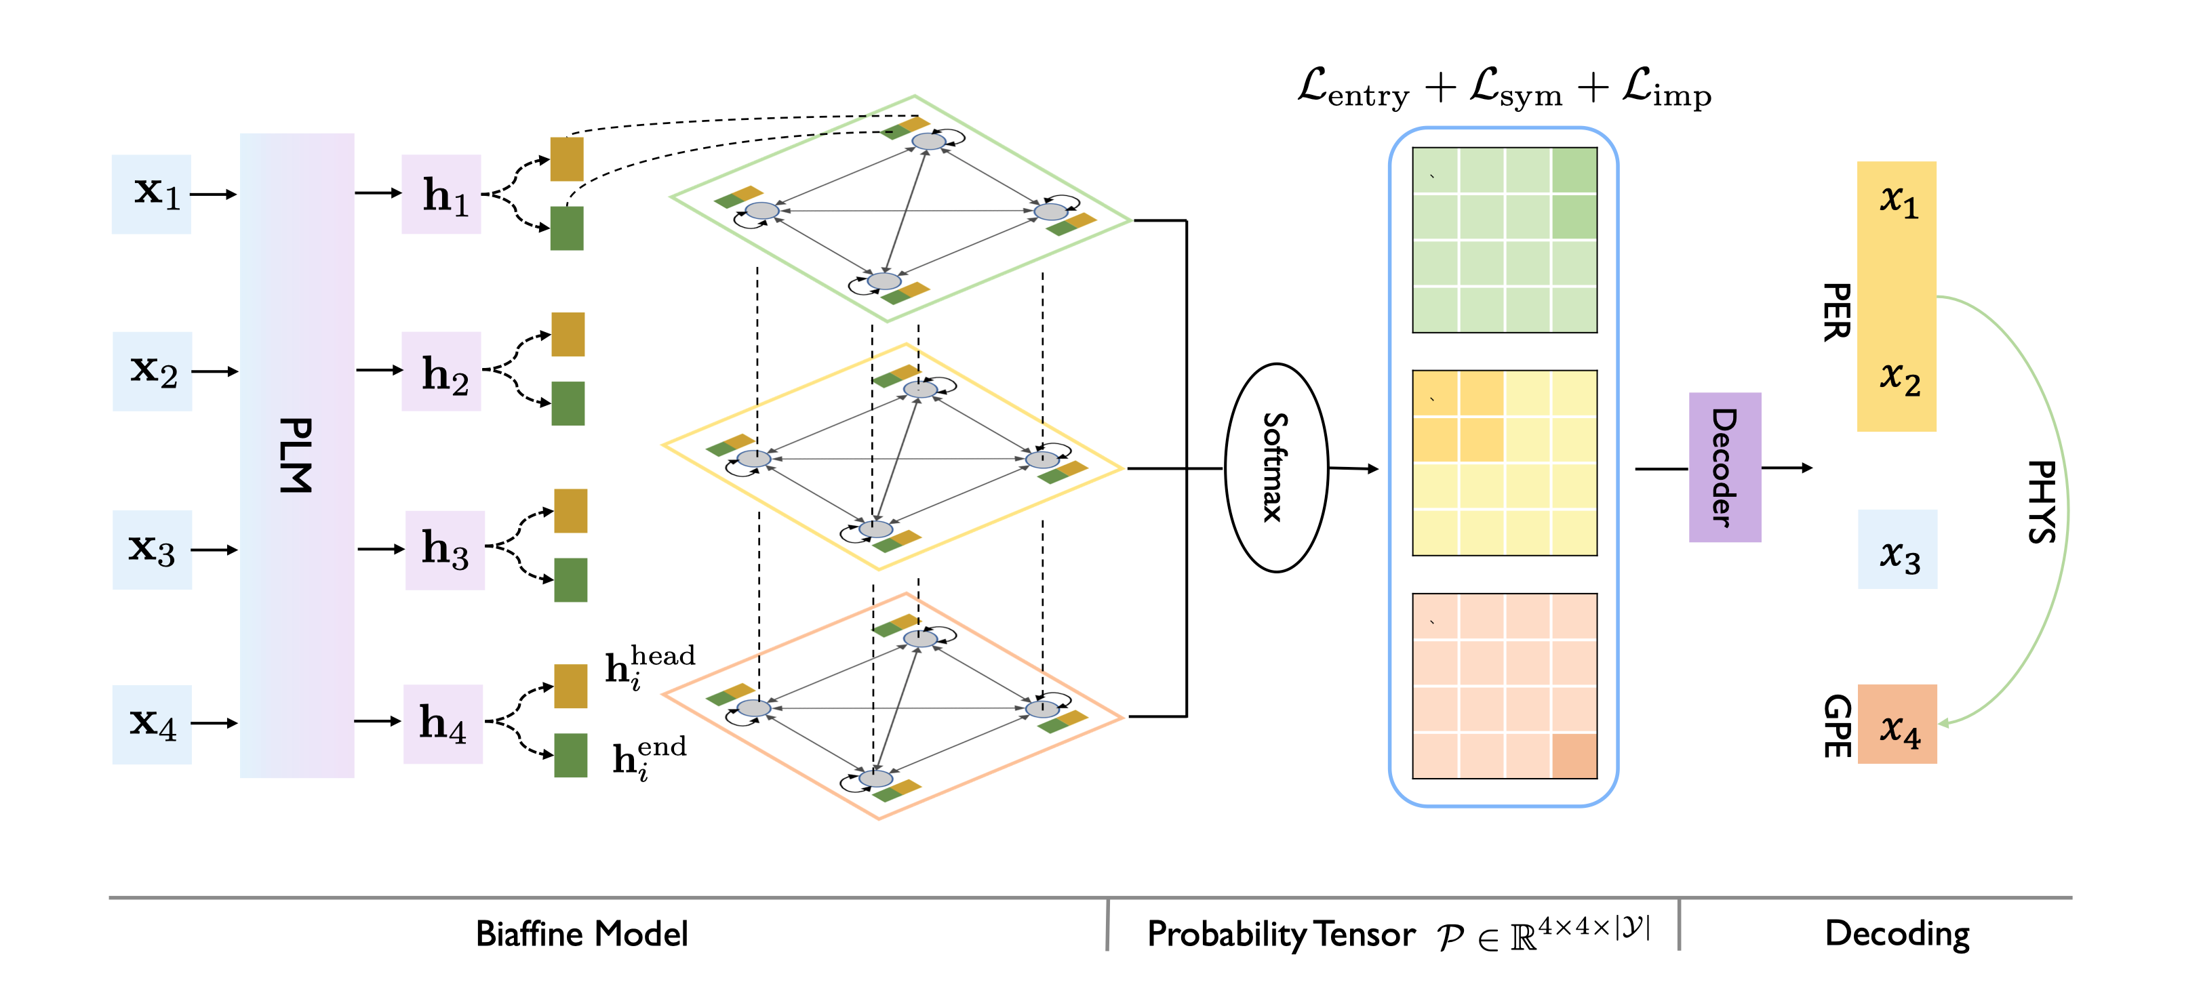
Architecture
UniRE
双纺射变换
eg.BERT

Slide 6
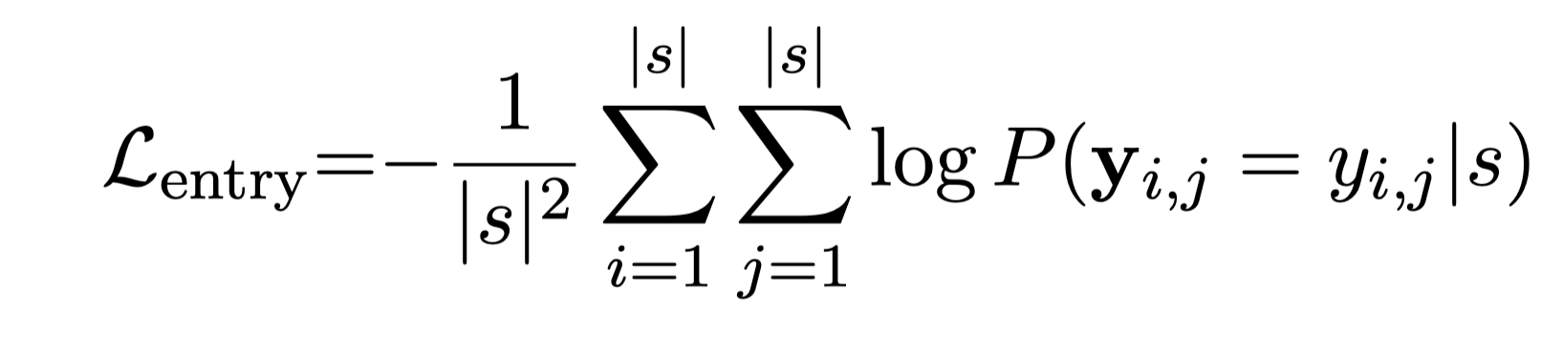
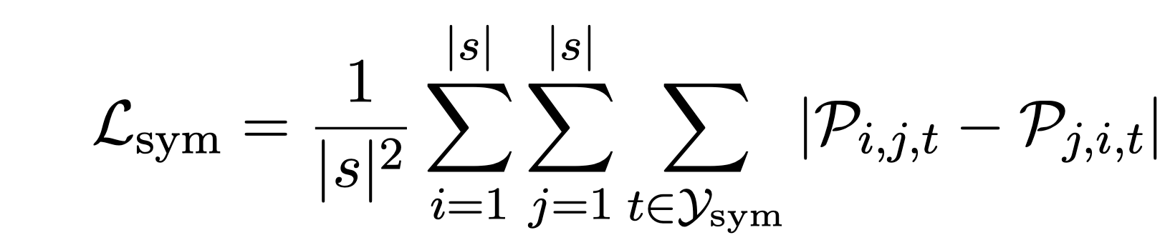
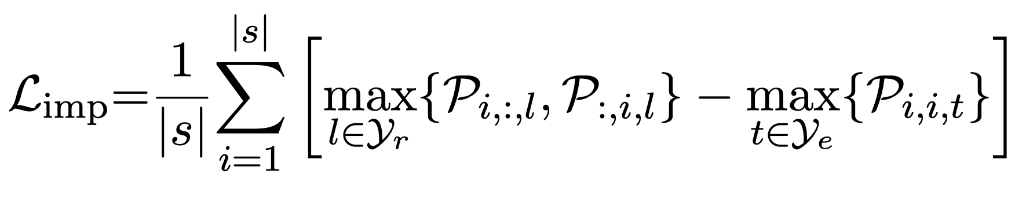
Loss Function
UniRE
Each label is independent?
No!
Structural
Constraints

Slide 7
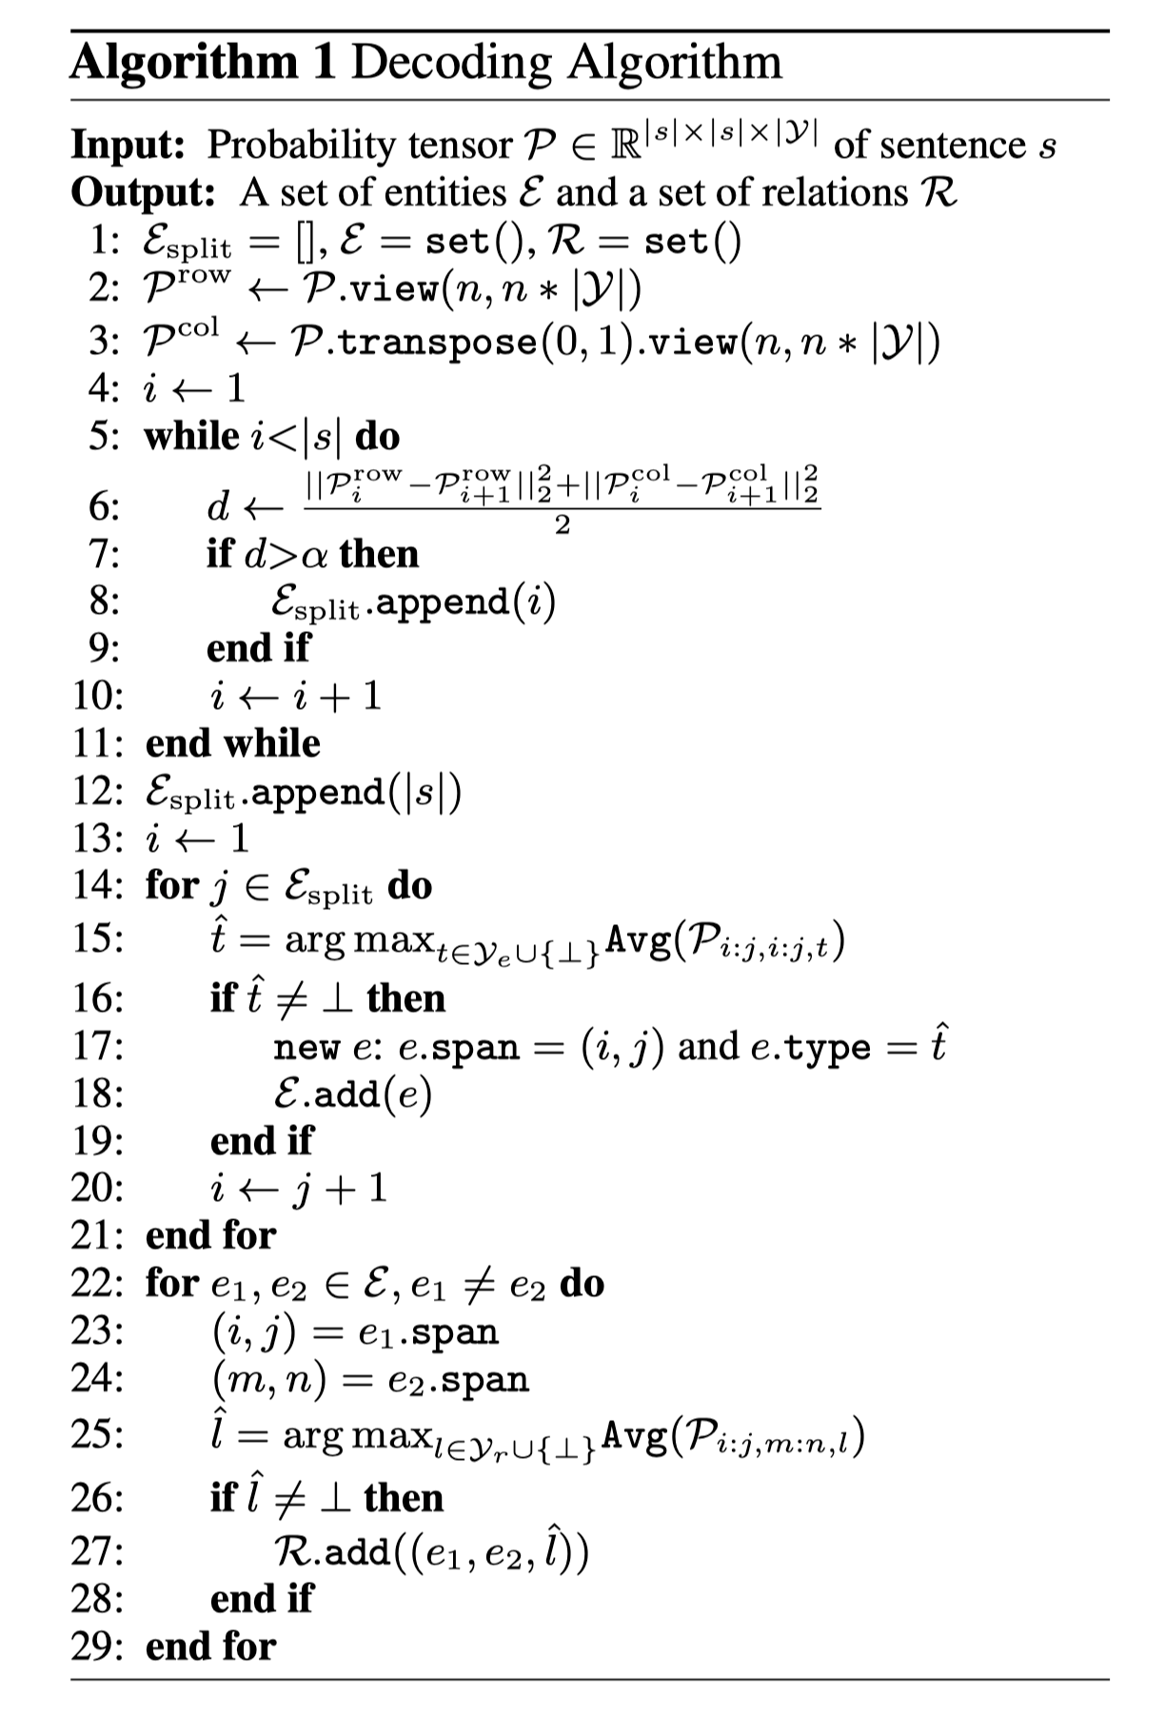
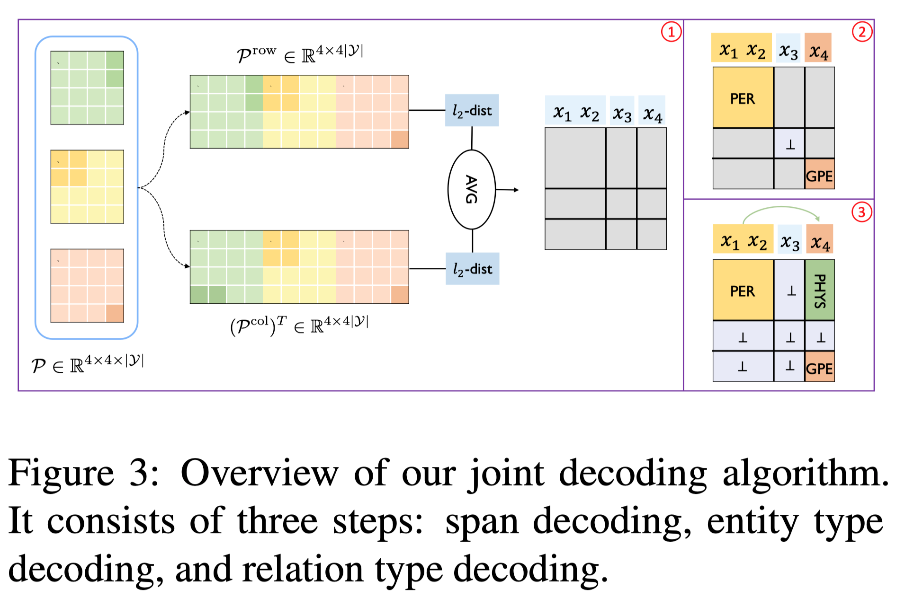
Decoding
UniRE

Slide 8
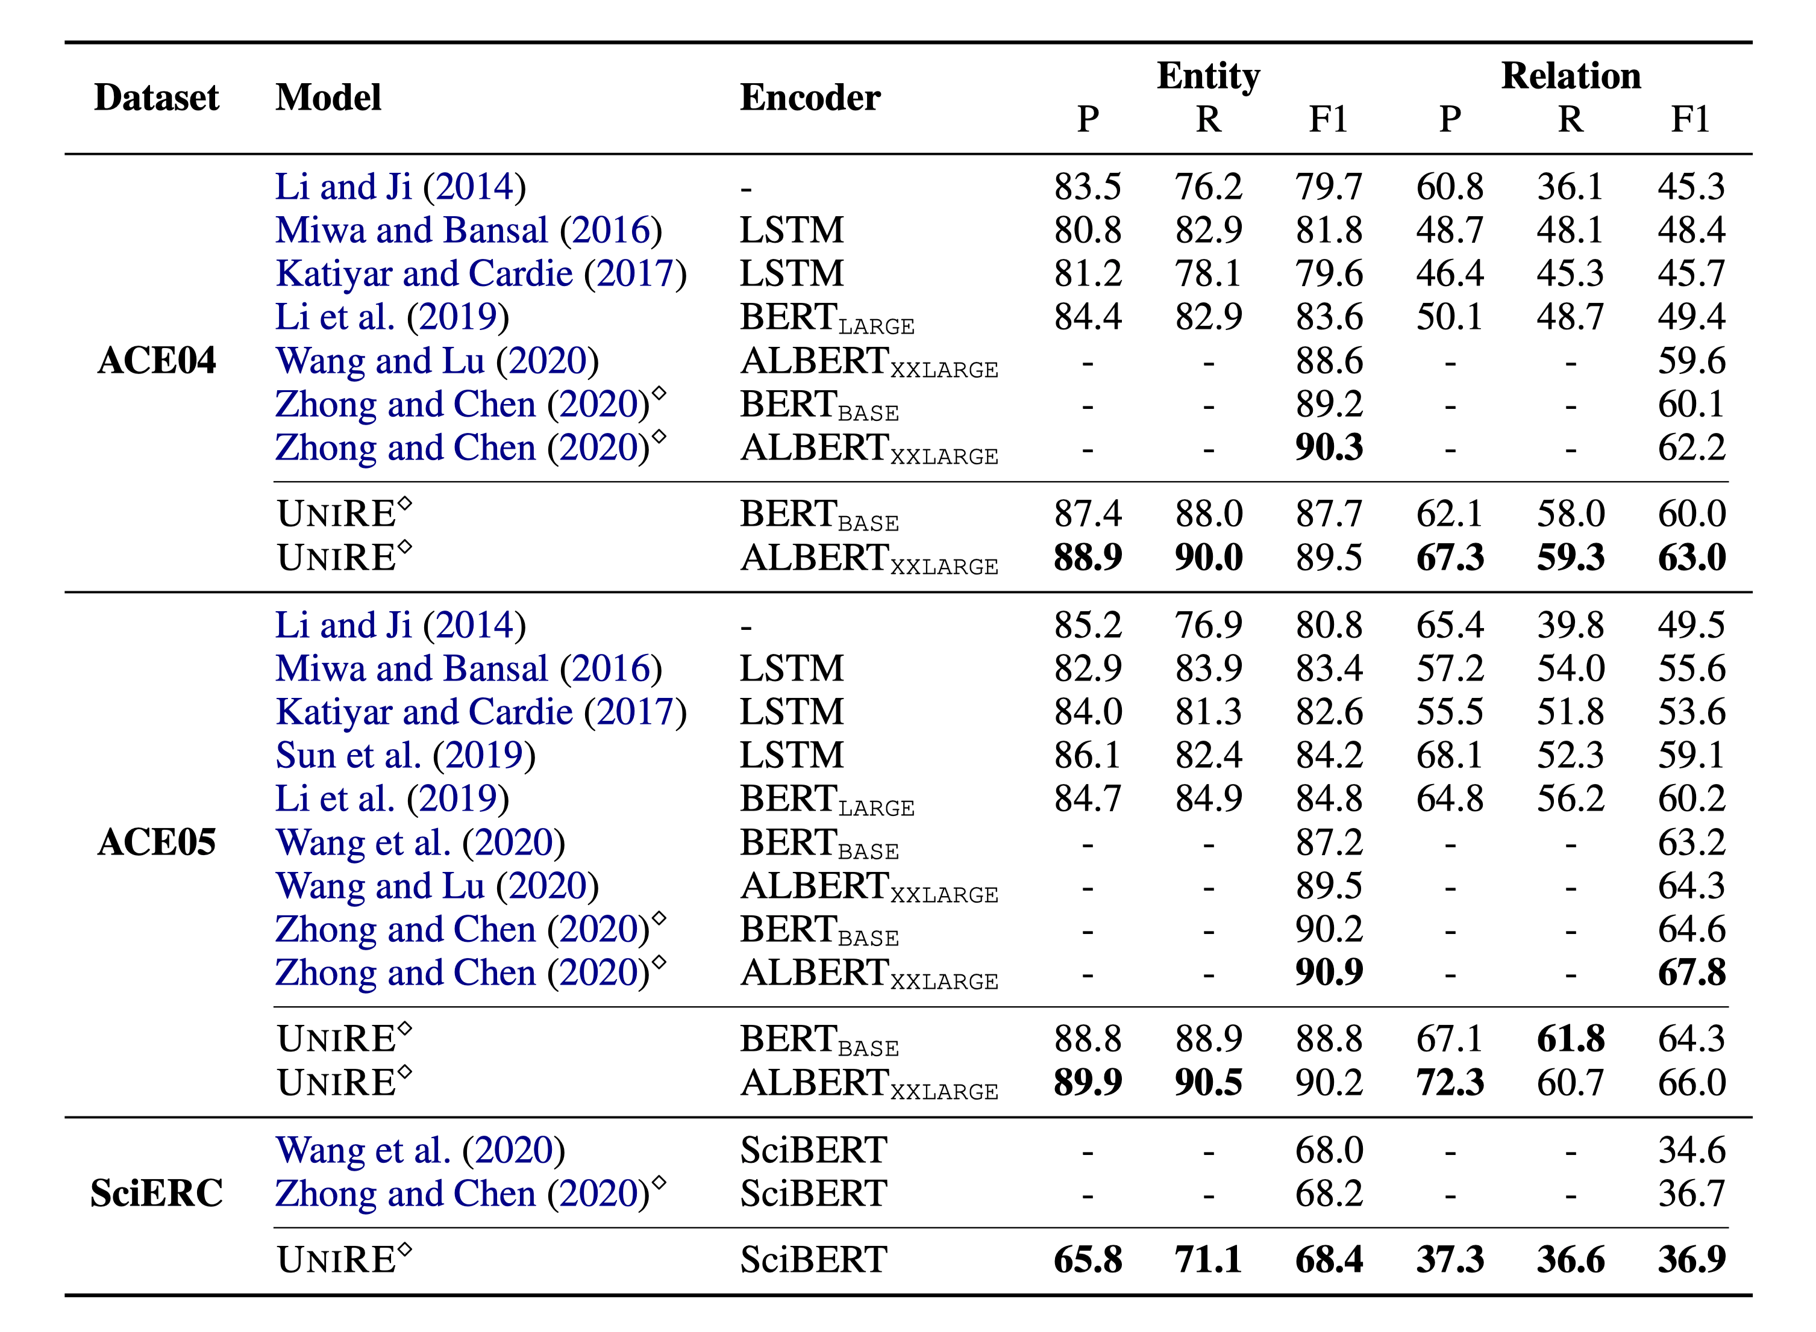
Performance
UniRE

Slide 9
Q & A

Slide 10
Thanks

