Slide 1
Low-Dimensional Hyperbolic Knowledge Graph Embeddings
汇报人：杨镇源
East China Normal University
School of Computer Science and Technology

Slide 2
Outline
Introduction
Methodology
Experiment

Slide 3
Introduction

Slide 4


Link Prediction Task
e.g. (( ) , Author, ?)
Input: query(head, rel, ?)
Model:
Entity ($e$) and Relation ($r$) Embeddings
Query embedding: query ($e_{head},r_{rel}$)
Score function: score ($q,e_{tail}$)
Output:
${\text{argm}\text{ax}}_{tail∈entities}\text{score}$($\text{query}\text{ (}e_{head},r_{rel}\text{)},$ $e_{tail}$) =

Slide 5
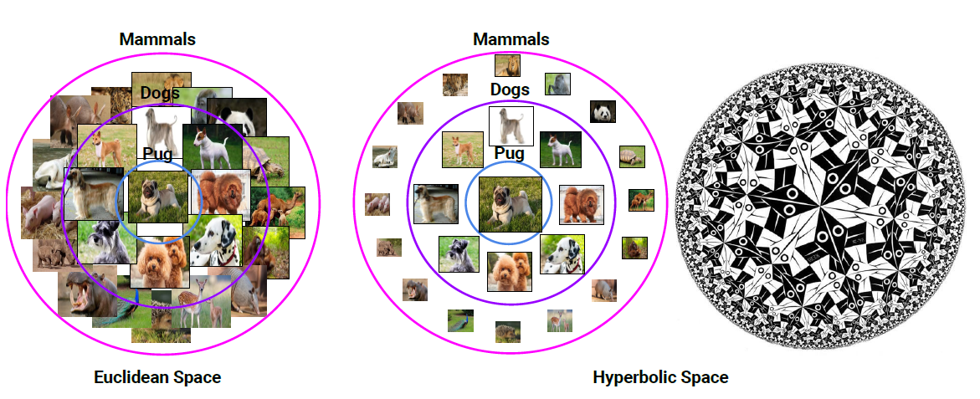
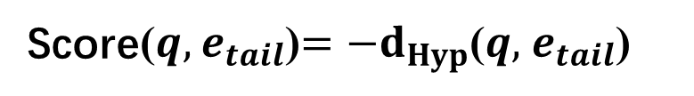
Hyperbolic Embedding
Hyperbolic space is like “continuous version of trees”
Embeddings of hierarchies
Volume grows exponentially (more “room”)
Hyperbolic KG embeddings
Score($q,$ $e_{tail}$)$=−d_{Hyp}$($q,$ $e_{tail}$)
Entities’embeddings (e) hyperbolic space

Slide 6
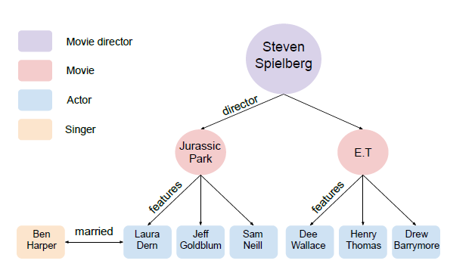
Knowledge Graph Example
Knowledge Graph can simultaneously exhibit hierarchies and logical patterns

Slide 7
Methodology

Slide 8
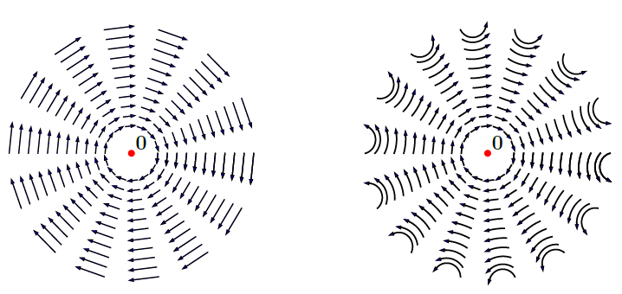
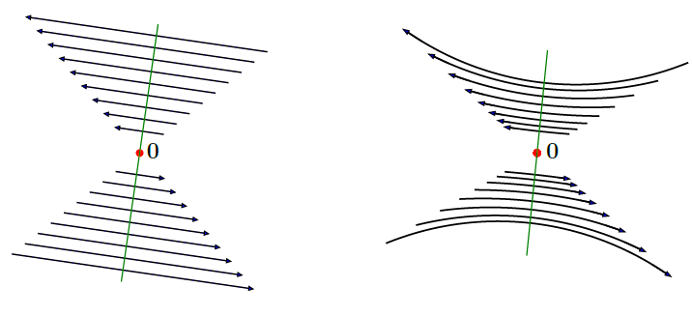
Hyperbolic Rotations and Reflections
Euclidean rotation
Hyperbolic rotation
Euclidean reflection
Hyperbolic reflection
Rotations can encode logical properties(anti-symmetry, inversion…)
Reflections can encode symmetry
Hyperbolic rotations and reflections around the origin are isometries

Slide 9
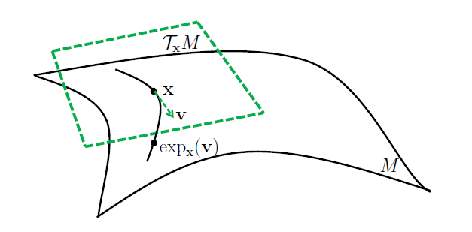
Hyperbolic Attention
Average points in the Euclidean tangent space and map back to the hyperbolic space

Slide 10


Hyperbolic Attention
tangent space mapping:
attention calculation:
weighted sum：

Slide 11
Model Summary
Input: query(head, rel, ?)
Model:
Embeddings: ($e_{head},r_{rel}$)
Relation-specific operations: $Rot{(r}_{rel})e_{head} and Ref{(r}_{rel})e_{head}$
Attention: query ($e_{head},r_{rel}$) $=Attention(Rot{(r}_{rel})e_{head} and Ref{(r}_{rel})e_{head}$)
Output: best answer
${\text{argmin}}_{tail∈entities}d_{Hyp}$($\text{query}\text{ (}e_{head},r_{rel}\text{)},$ $e_{tail}$)

Slide 12
Experiment

Slide 13
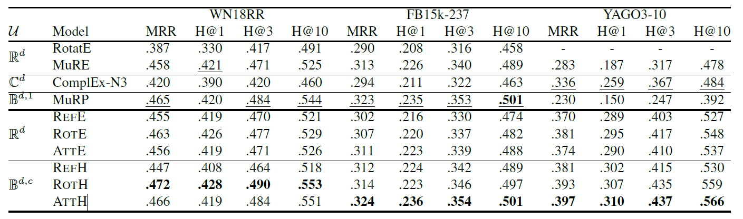
Link prediction Results

Slide 14
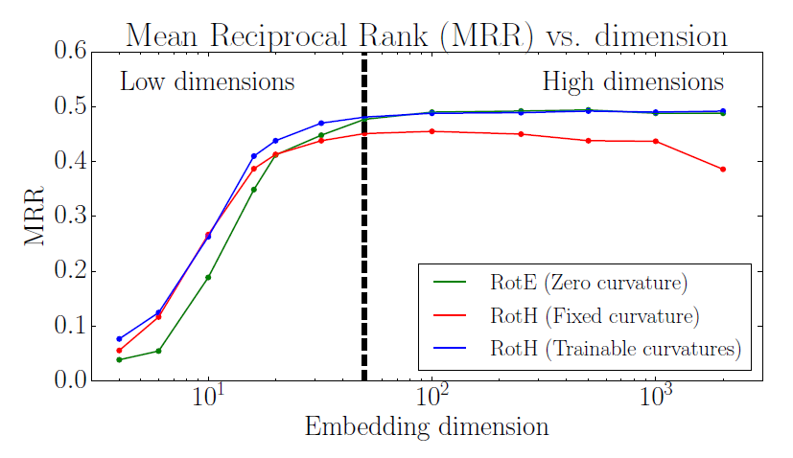
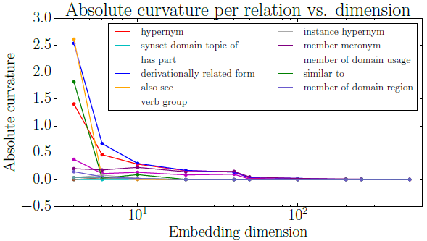
The Role of Curvature
Low dimensions: Hyperbolic > Euclidean embeddings
High dimensions: Trainable curvature recovers the Euclidean geometry while fixed curvature degrades performance

Slide 15
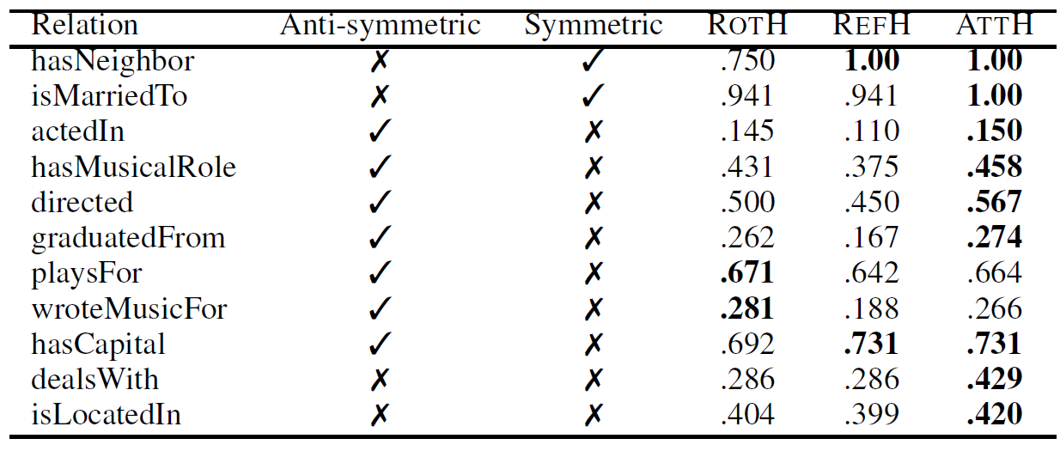
Logical patterns
Attention recovers the best geometric operation

Slide 16
Conclusion
Model:
Embeddings in hyperbolic space
Trainable curvatures
Attention-based relational operators
Results:
Outperforms SoTa methods in low dimensions
Works in both low- and high- dimensional regimes
Flexible representations to capture logical pattern

Slide 17
Thanks！

