Slide 1

Diverse and Informative Dialogue Generation with Context-Specific Commonsense Knowledge Awareness
——ACL2020
Sixing Wu, Ying Li, Dawei zhang, Yang Zhou and Zhonghai Wu
Peking University and Auburn University
汇报人：李贤
学号：51205901064
Notes:
123

Slide 2
Introduction
Open-domain dialogue response generation systems
Although such models have achieved promising performance, they still suffer from generating generic and boring responses
such as “I don't know.”
1. using the enhanced objective function
2. introducing additional contents
3. introducing large-scale knowledge graphs
Notes:
目前，开域对话生成系统有非常大的应用潜力。
尽管一些模型已经实现了非常好的性能，但是这么模型仍然会生成一些无聊的回答，例如”我不知道“
研究员们尝试从多个方面解决它
1，使用增强的目标函数
2，引入额外的内容
但是让机器完全理解 对话 依旧非常困难。
为了充当人类和机器对于之间的桥梁
3.开始引进大规模知识图谱来增强对话生成

Slide 3
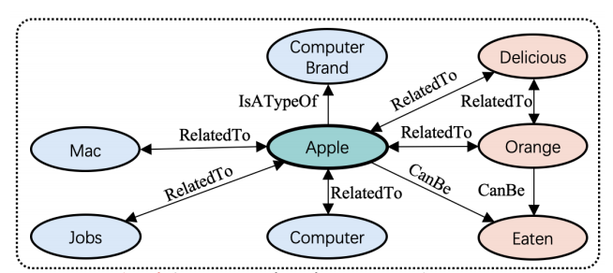
Introduction
knowledge-aware response
entity
Apple's new product is awesome
1. An entity word usually can refer to different concepts, i.e., an entity has multiple meanings
2. the related knowledge facts may cover various target topics
3. The integration of the knowledge and the dialogue generation in previous approaches is insufficient

Slide 4
Introduction
ConKADI
Context Knowledge-Aware Diverse and Informative conversation generation model
1. Felicitous Fact mechanism
2. Context-Knowledge Fusion
3.Flexible Mode Fusion

Slide 5

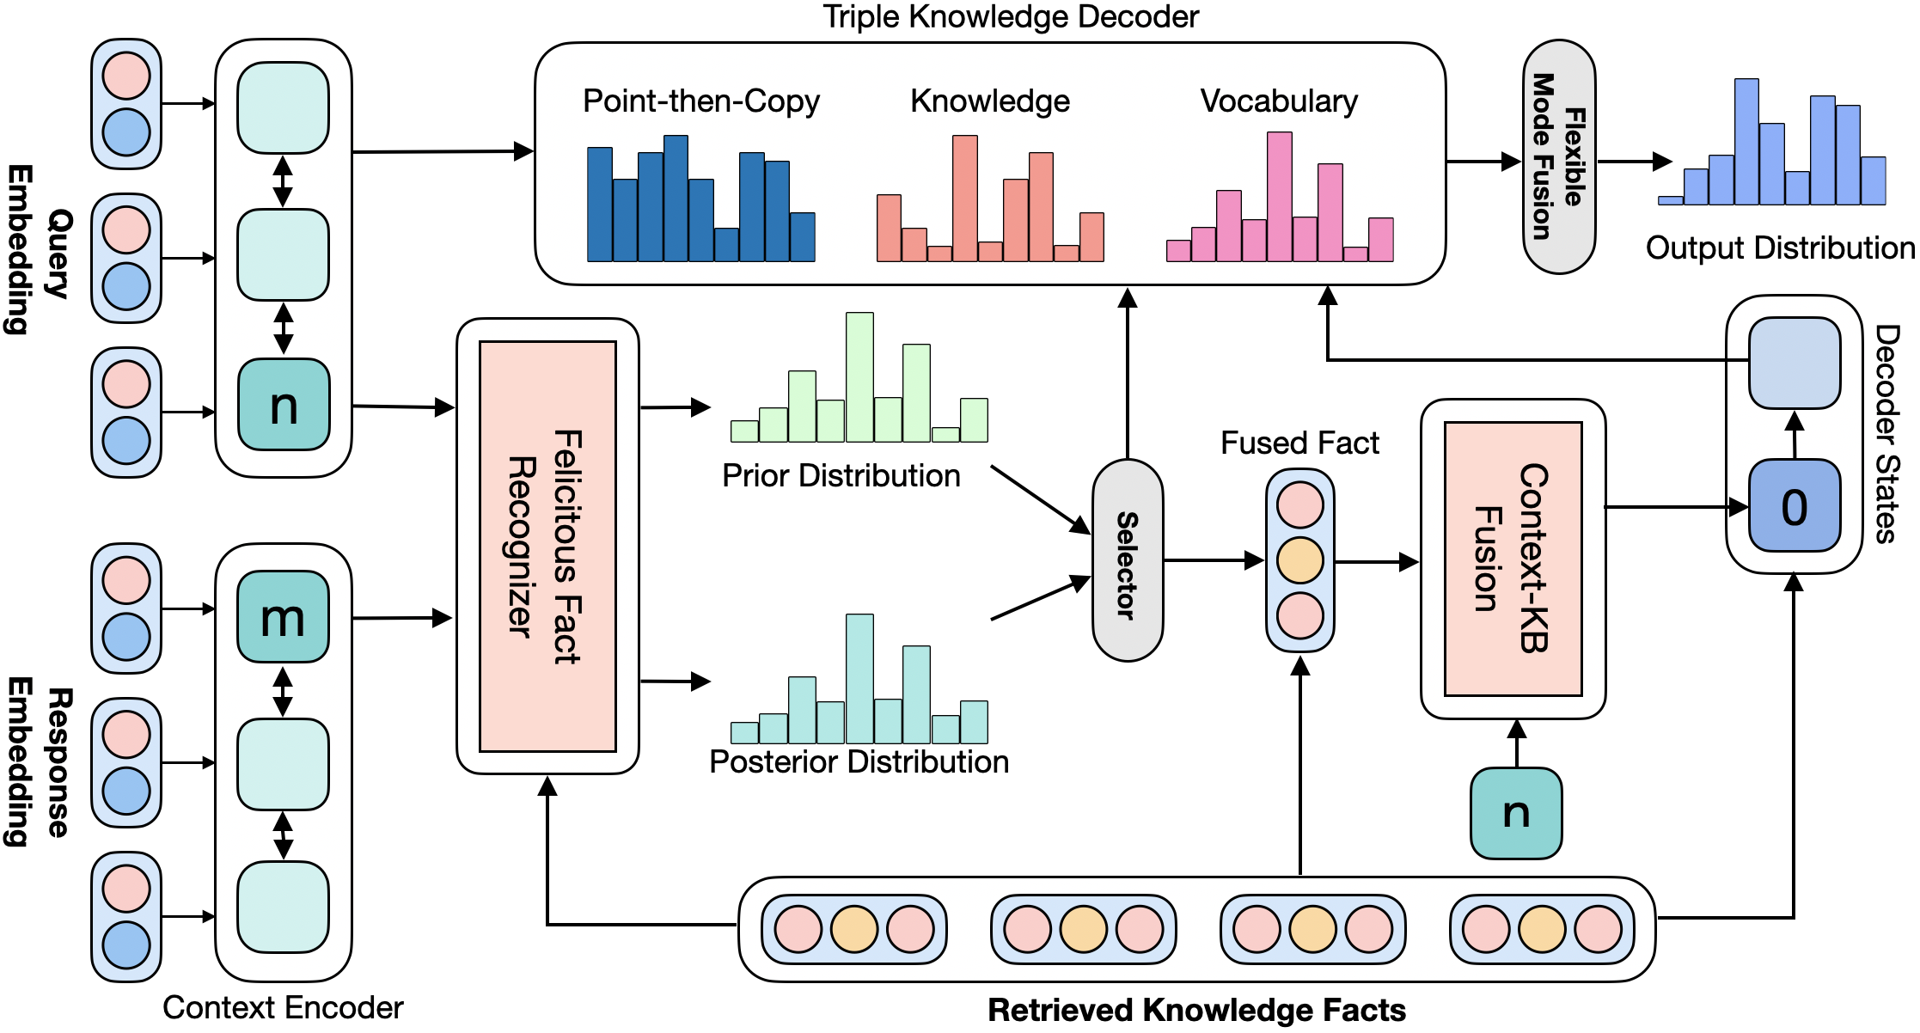
Introduction
ConKADI

Slide 6



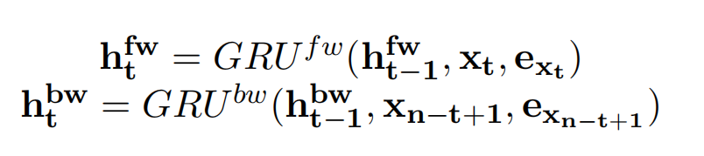
1.Felicitous Fact mechanism
Knowledge Retriever
Apple's new product is awesome
Context Encoder

Slide 7
ConKADI
双向GRU网络
提取后的知识

Slide 8
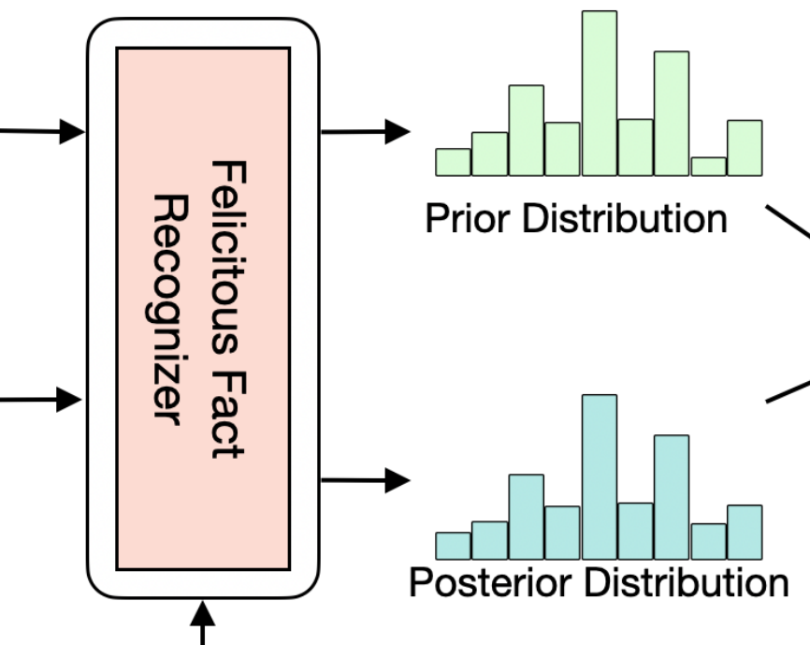
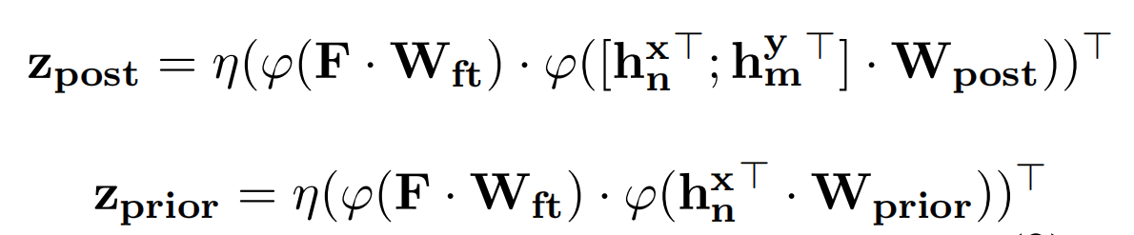

1.Felicitous Fact mechanism
reads the contextual information, then outputs a probability distribution z ∈ Rl×1 over the F
Felicitous Fact Recognizer
contextual information

Slide 9
ConKADI
双向GRU网络
有效Fact识别器
提取后的知识

Slide 10

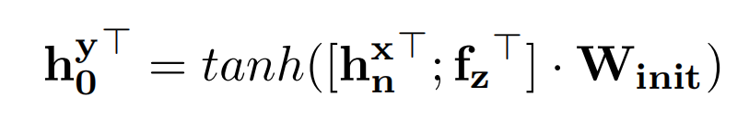
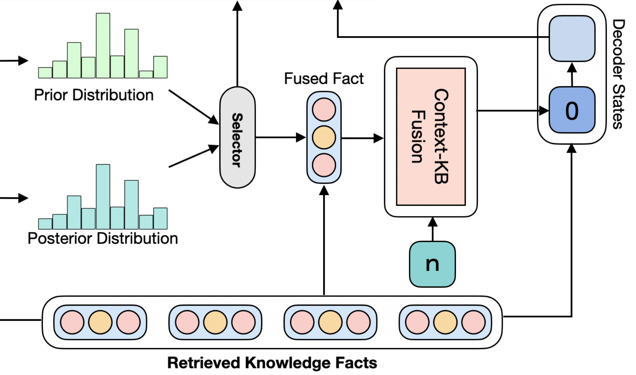
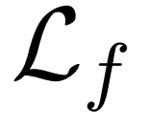
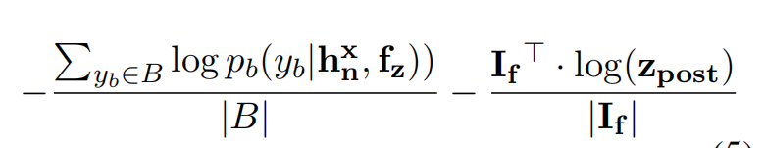
2.Context-Knowledge Fusion
the Decoder is initialized based on the fused knowledge
and the query context
GRU网络
z
F

Slide 11

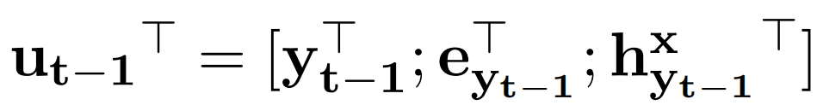
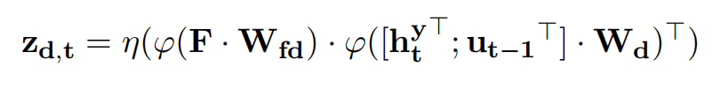
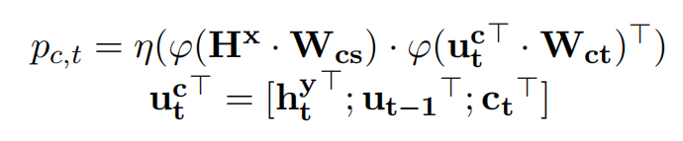
3.Flexible Mode Fusion
At each time step, the Decoder can generate one of three types of words:
Vocabulary Words:
Knowledgeable Entity Words
Copied Words

Slide 12

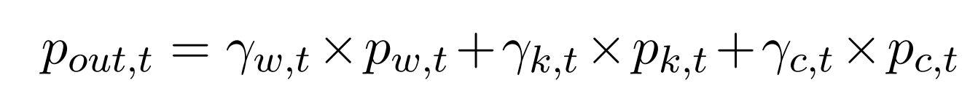


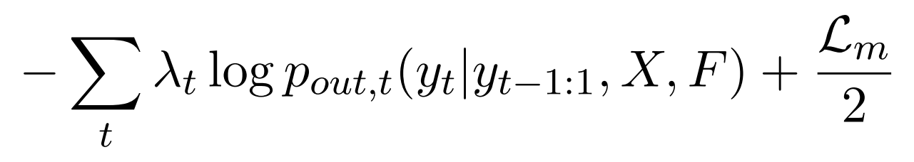
3.Flexible Mode Fusion
Previous three distributions can be fused by the
，a 2-layer MLP activated by sof tmax
Next, we optimize the fused output distribution by minimizing the , which is given by:

Slide 13
ConKADI
Decoder
双向GRU网络
有效Fact识别器
知识-文本融合
提取后的知识

Slide 14
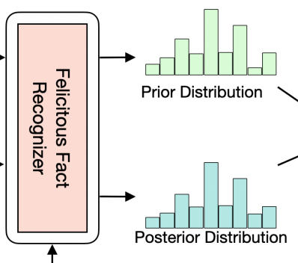

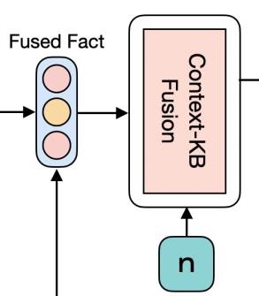
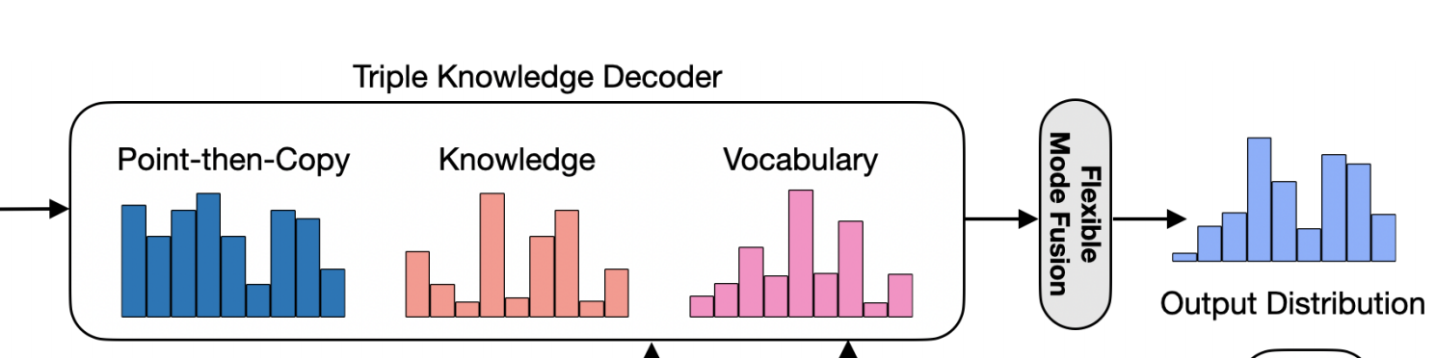
4.Training Objective
=
=

Slide 15
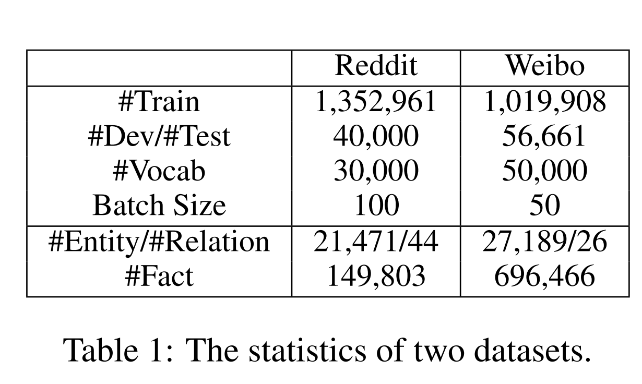
Experiments
Dataset
Both datasets are aligned with the commonsense
knowledge graph ConcetNet

Slide 16
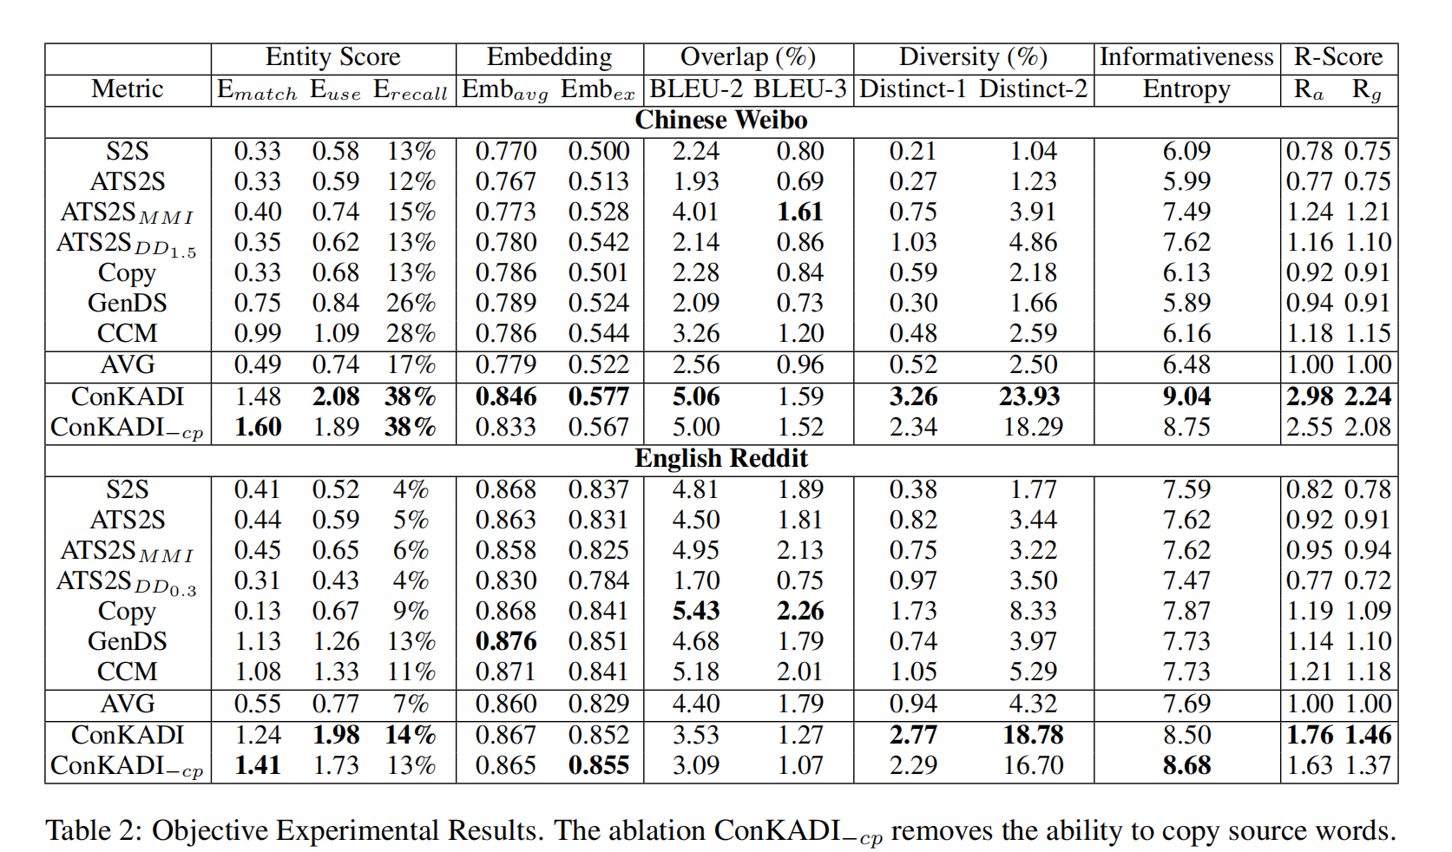
Experiments

Slide 17
Result
The proposed Felicitous Fact mechanism
can help the ConKADI focus on the facts that are highly relevant to the dialogue context, by generating a felicitous fact probability distribution over the retrieved facts
the proposed Context-Knowledge Fusion and Flexible
Mode Fusion can facilitate the integration of the knowledge in the ConKADI

Slide 18
THANK!

