Slide 1
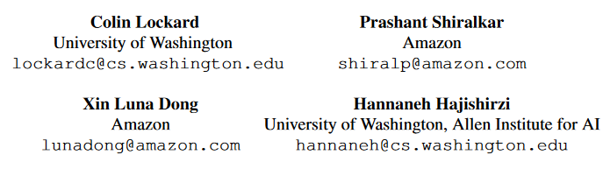
ZeroShotCeres: Zero-Shot Relation Extraction from Semi-Structured Webpages ACL2020
汇报人：林家驹 51205901095

Slide 2
Contents
Motivation
Methodology
Experiments
Discussion

Slide 3
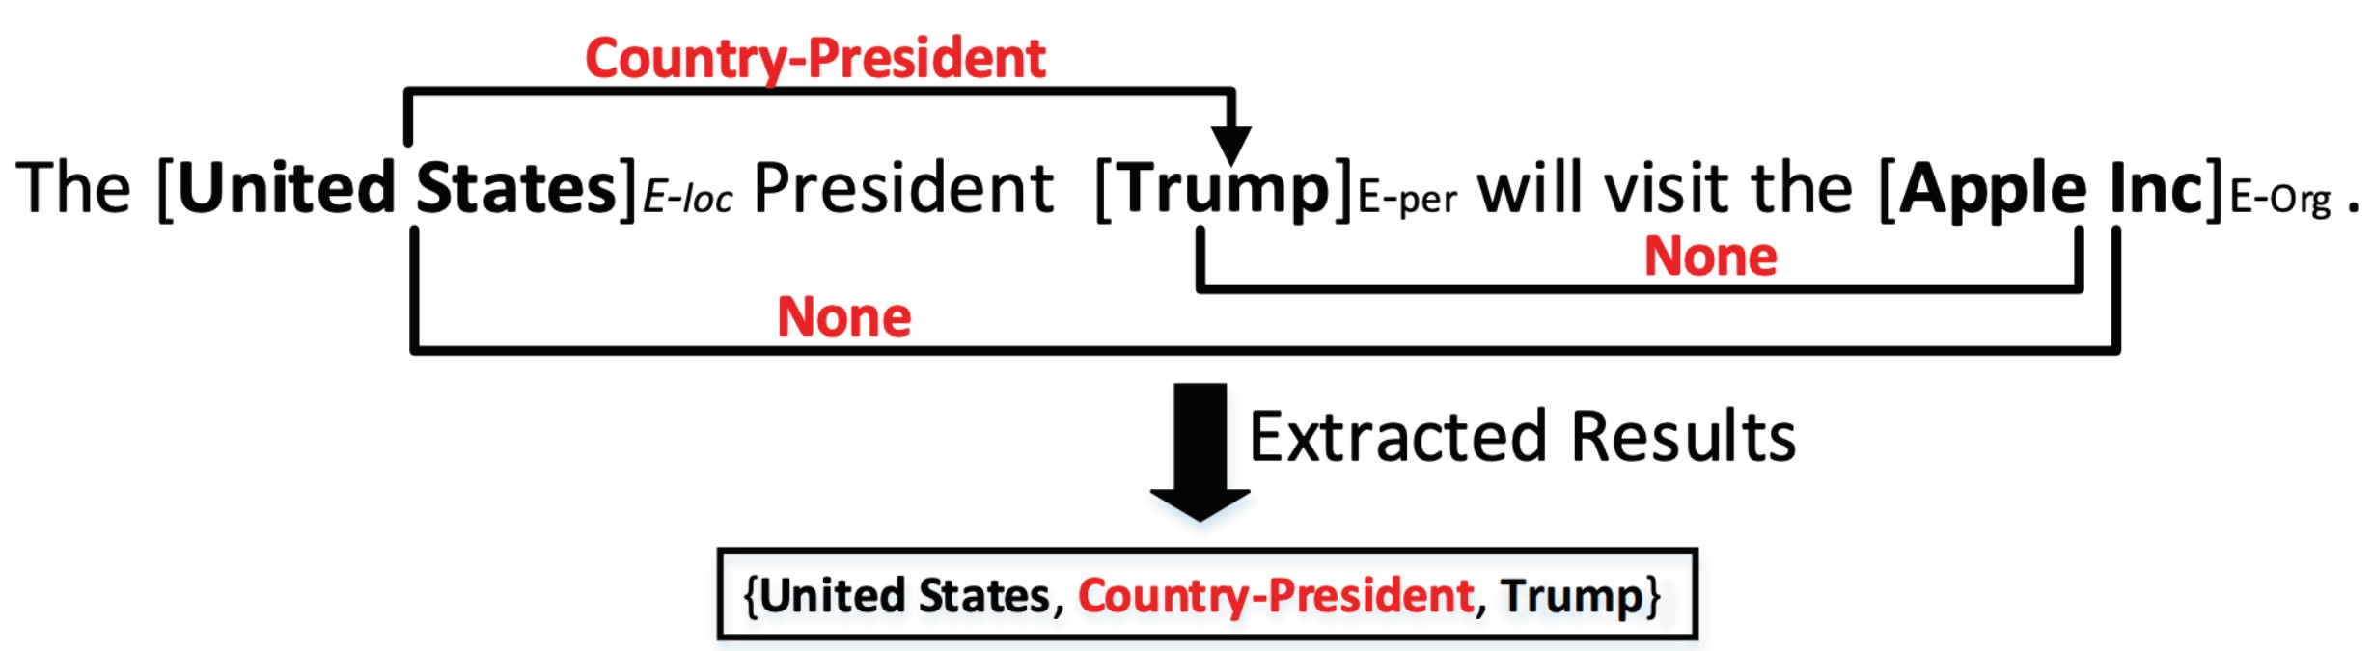
What is relation extraction?
Notes:
什么戳RE？
包括NER，本句话中包括三个实体，分别是
但是我们只抽取一个triplet <> 为什么呢？
Visit 不行 因为关系是一种属性
US apple 不行 因为此句中没有

Slide 4
Motivation
半结构化网页包含丰富的文本信息，然而由于网页结构的多变性, 相关内容的IE任务往往依赖大量的人工注释
By distant supervision ?
Such model can only learn a website-specific model based on seed knowledge for the site
Facing difficulty when it is generalized to the majority of websites with knowledge from new verticals, by long-tail specialists, and in different languages.

Slide 5
Methology
Problem definition
We assume the page topic entity (e_{topic} )has already been identified, such as by using the HTML title tag .
Our goal is to extract(subject, relation, object)knowledge triples, where the subject is e_{topic.}
what we want
Notes:
举例来说，进入一个介绍乔丹的页面，尽管这一页中有大量三元组，但是我们只要乔丹作为主语的三元组【点击】
所以 我们真正要的是
这其实对于问题的简化

Slide 6
Methology
Problem definition
ClosedIE: the assignment of each text field t to one r in {Relation}
OpenIE: Given a pair of text fields (i; j), predict whether (e_{topic}; i ; j) is a relation
Unseen-Website Extraction:
similar structured websites Zero-shot (×) same field webpages ( √ )
Unseen-Vertical Zero-shot Extraction
similar structured websites (×) same field webpages ( × )
Notes:
Closed IE 是信息抽取的一个分类， closed指relation的范围是有界的，在本文中
OpenIE 复杂得多，relation需要从句子中抽取所以我们往往会限制其复杂度，这也是为什么要指定subject
在本文中
【点击】
field is a general field of knowledge such as movies, finance, or sports.

Slide 7
Related work
DOM-based ClosedIE, DOM-based OpenIE, Multi-modal extraction.
But none of them can do OpenIE and CloseIE in a non-seen field at the same time.

Slide 8
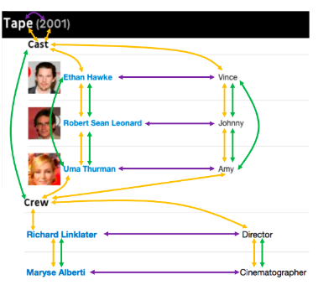
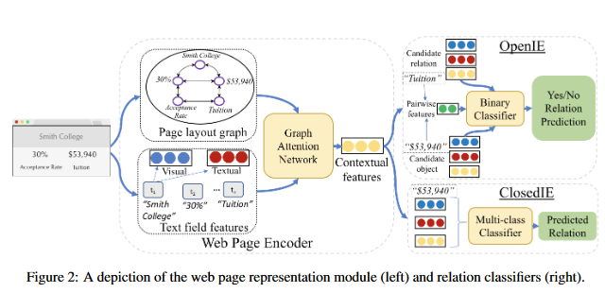


Problem definition
Model overview

Slide 9
Methodology -Web page encoder
Page layout graph
Encode page construction
Three kinds of edge
1) horizontal
2) vertical
3) DOM

Slide 10
Methodology--Web page encoder
Inital text field features
Visual feature: one-hot features representing the typeface, font weight, font style, color, and text alignment.
Textual feature :
For ClosedIE , use the average of the BERT-Base output for each token in the text field.
For OpenIE ,the precentages of pages appears in websites compose the only feature.
relation strings: common
object strings: rare
Recall the OpenIE task: Given a pair of text fields (i; j), predict whether (e_{topic}; i ; j) is a relation
Notes:
注意在OpenIE任务中，没有使用预训练模型，而是采用了简单的比例表示。
原文中说是 包含本词的page出现在本website下所有pages中的概率，简单理解就是本词语出现在不同pages之中的概率 【点击】
【点击】
回忆一下OpenIE 任务，关键是要找 一个文本对，来匹配etopic ，所以需要判断文本是属于 relation 还是 object

Slide 11

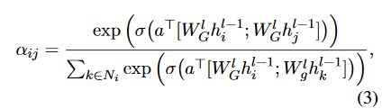

Methodology -- GAT

Slide 12


Methodology
Pre-train of GNN
perform a multi-class classification of each text field into a class c in the set {Relation, Object, Other}
To avoid over-fitting, we freeze the GNN during the full OpenIE training, and discard the linear layer W_{pre}.
Notes:
GNN训练时只以 输出text field 的简单属性 in {Relation, Object, Other}来训练 . 非常类似于OpenIE任务

Slide 13
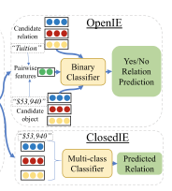



Methodology
Relation extraction
OpenIE
pairwise_{ij}, indicates the horizontal , vertical and layout distance, can filter out the impossible pairs
Since some information can be diluted in the GNN, both h^{l} and h⁰ are feed into a FNN.
ClosedIE
OpenCeres: When Open Information Extraction Meets theSemi-Structured Web
Notes:
由于OpenIE 的文本表示未包含bert输出的上下文信息，所以我们使用pairwise向量来过滤
Pairwise 包含了文本之间的物理距离与 规划距离
同时，由于GNN可能漏掉一些信息，我们也要将初始化的textfield features加入进来
具体的pairwise 算法 请看此篇文章【点击】

Slide 14
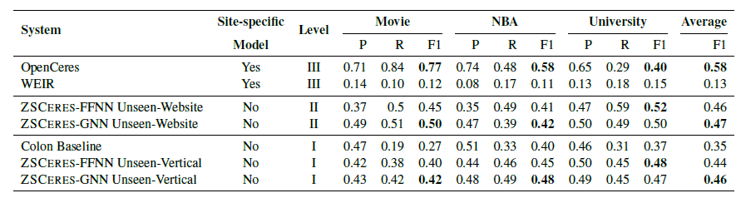
Experiments and results
Level I–Unseen-vertical Zero-shot (OpenIE only)
Level II–Zero-shot with Vertical Knowledge (easier)
Level III–Site-specific Knowledge (traditional setting)
Notes:
Level I 只在两三个vertical上训练之后 就在别的vertical中测试，只做OpenIE, 原因也很简单
Level II 在大部分VERTICAL上训练，然后在未训练的vertical上测试

Slide 15
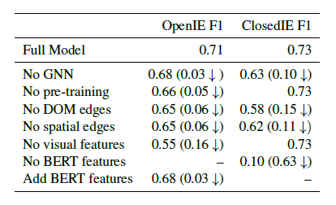
Ablation study and Discussion
Notes:
消融实验，证实了Bert的非必需性，OpenIE问题里，添加了BERT反而使得表现下降。
然而另一份研究却表明， LM与KG见有紧密的联系，注意力矩阵本就可以用来做关系抽取。
可能是因为BERT中有大量的冗余信息，污染了最终的RE结果，也可能是bert生成的的contextual embedding 不适合zeroshot任务

Slide 16
Take home massage
The layout structure can benefit the RE of websites
Deem e_{topic} as subject entity can simplify the problem
For OpenIE task , ratios of the appearance of strings can also be a critical feature.

Slide 17
Thank you
Any questions?

