Slide 1
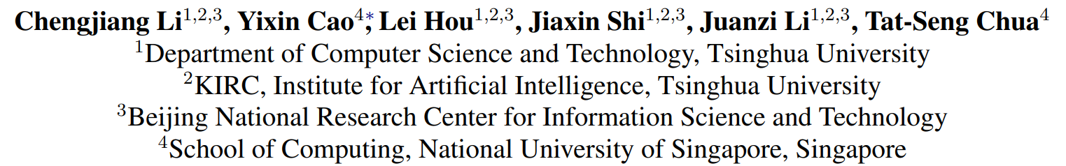
(EMNLP-IJCNLP). 2019
董家顺
51205901070
Li, Chengjiang, et al. Proceedings of the 2019 Conference on Empirical Methods in Natural Language Processing and the 9th International Joint Conference on Natural Language Processing (EMNLP-IJCNLP). 2019.

Slide 2
Motivation
KG-based models
Graph-based models

Slide 3
Motivation
KG-based models
Utilize existing KG representation learning methods to learn embeddings of entities and relations in different KGs, and then align them into a unified vector space.
This type of method can not only preserve KG structures, but also implicitly complete KG with the missing links from existing knowledge.
However, KG-based methods require a sufficient number of seed alignments, which is usually expensive to obtain.

Slide 4
Motivation
Graph-based models
Utilize Graph Convolutional Network (GCN) to enhance entity embeddings with their neighbors’ information, thus can make better use of seed alignments to propagate them over the entire graph.
However, GCN-based models are sensitive to structural differences of KGs and fail to consider relation types, which actually play an important role in entity alignment.

Slide 5
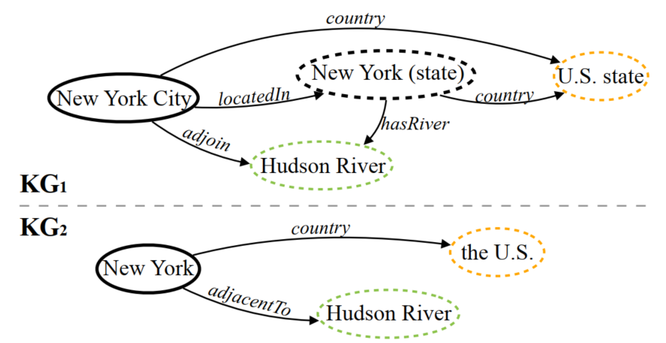
Motivation
Graph-based models -- relation types

Slide 6
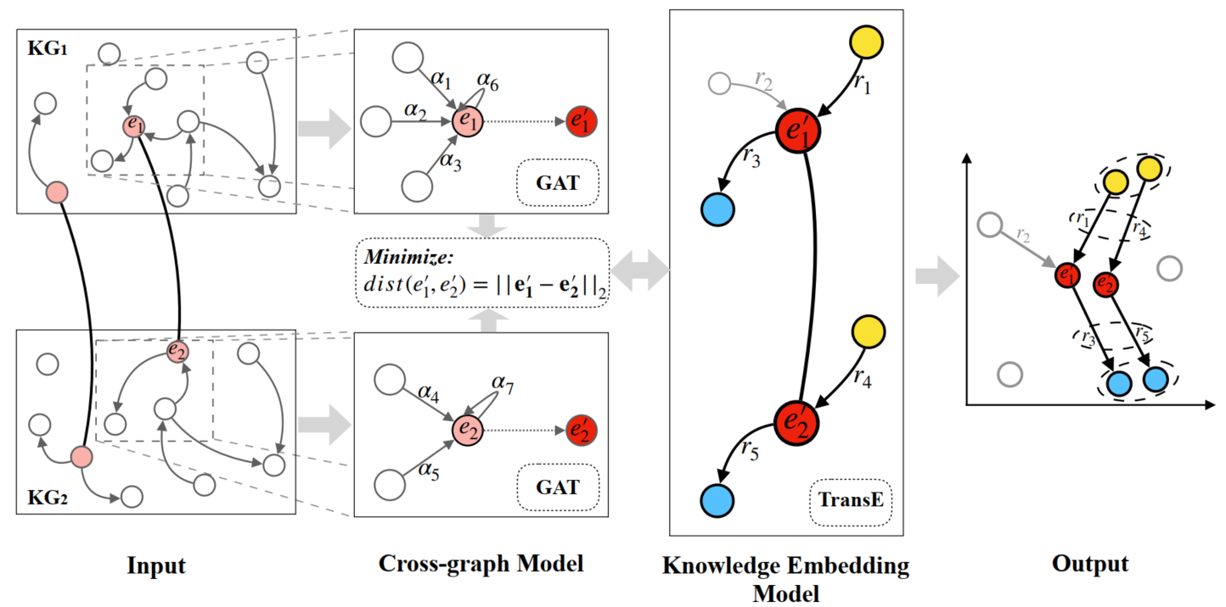
Method
Knowledge Embedding model and Cross-Graph model (KECG)

Slide 7

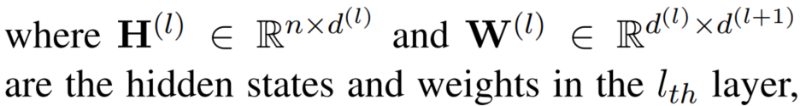
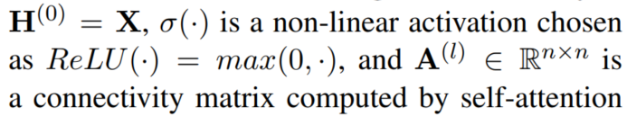
Method
Cross-graph Model -- GAT

Slide 8
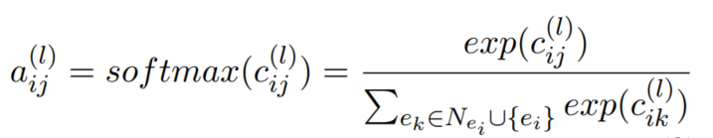
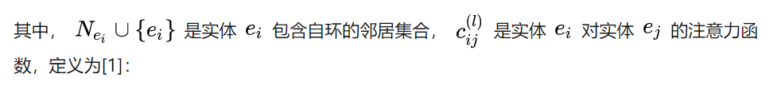
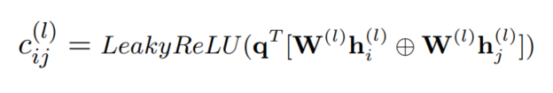
Method
Cross-graph Model

Slide 9
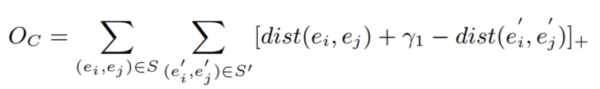
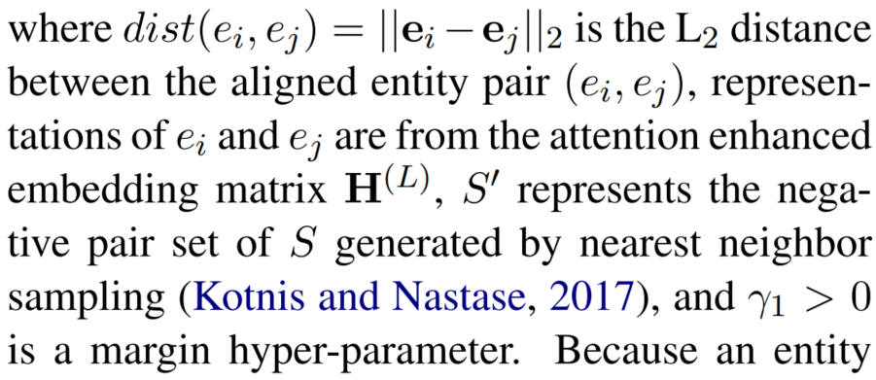
Method
Cross-graph Model

Slide 10
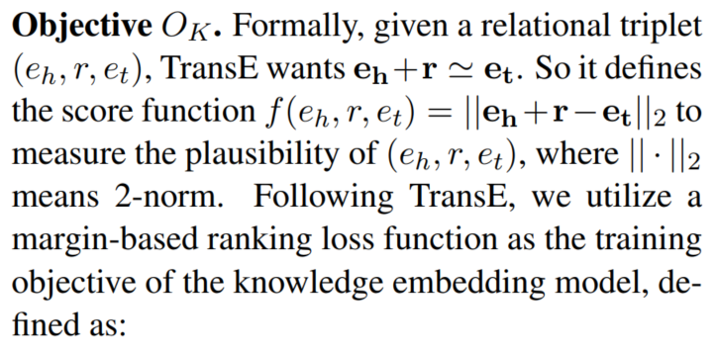
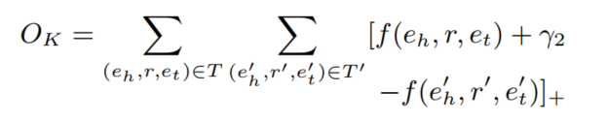
Method
Knowledge Embedding Model -- TransE

Slide 11
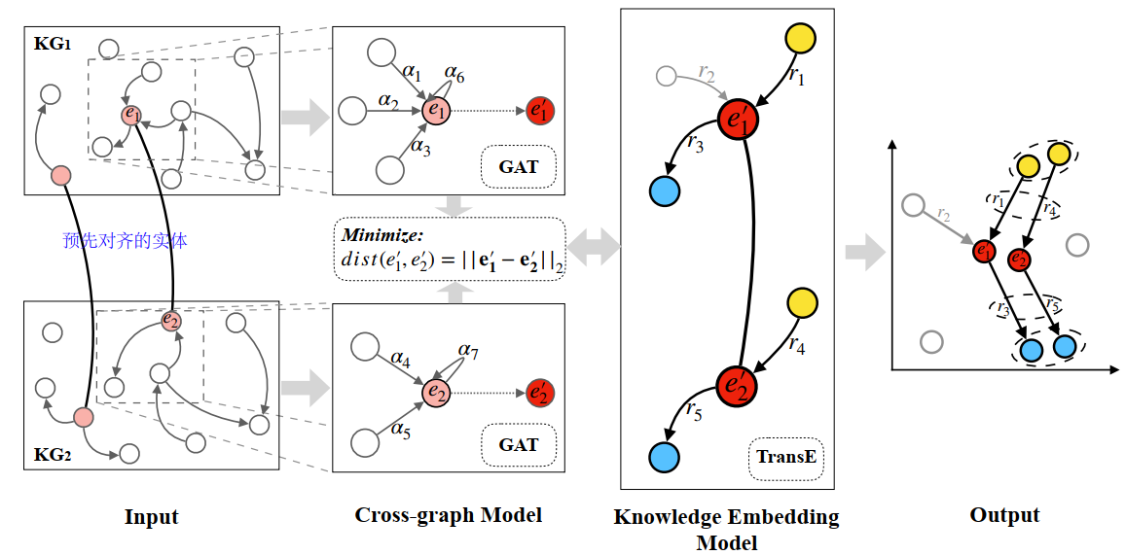

Overall Objective
Where Oc and Ok denote the objective function of the cross-graph model and the knowledge embedding model, respectively. It is worth noting that we can set different weights for Oc and Ok. But in order to treat both kinds of models equally, here, we set the same weight for them in experiments.

Slide 12
Conclusions
This paper propose a semi-supervised entity alignment method by joint Knowledge Embedding model and Cross-Graph model (KECG)
Utilize a cross-graph model to embed entities into a unified vector space by using inner-graph structure and inter-graph alignments information
Knowledge embedding model learns KG representations to implicitly complete different KGs towards consistency and model relational constraints among entities

Slide 13
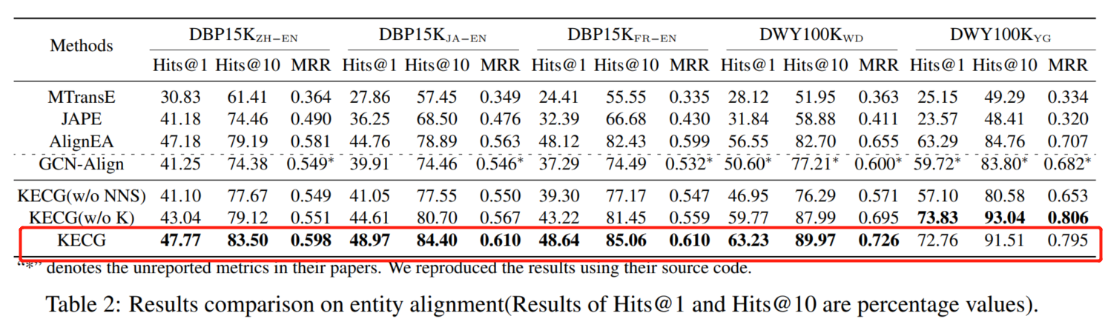
Experiments
[1] Chen M , Tian Y , Yang M , et al. Multilingual Knowledge Graph Embeddings for Cross-lingual Knowledge Alignment[C]// Twenty-Sixth International Joint Conference on Artificial Intelligence. 2017.
[2] Wang Z, Lv Q, Lan X, et al. Cross-lingual Knowledge Graph Alignment via Graph Convolutional Networks[C]. empirical methods in natural language processing, 2018: 349-357.

Slide 14
THANK YOU
Dong jiashun

