Slide 1
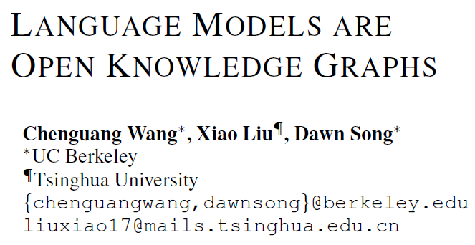
ICLR 2021
陈妍 51205901044

Slide 2
Outline
Introduction
Motivation
Contribution
Method
Experiment
Conclusion

Slide 3
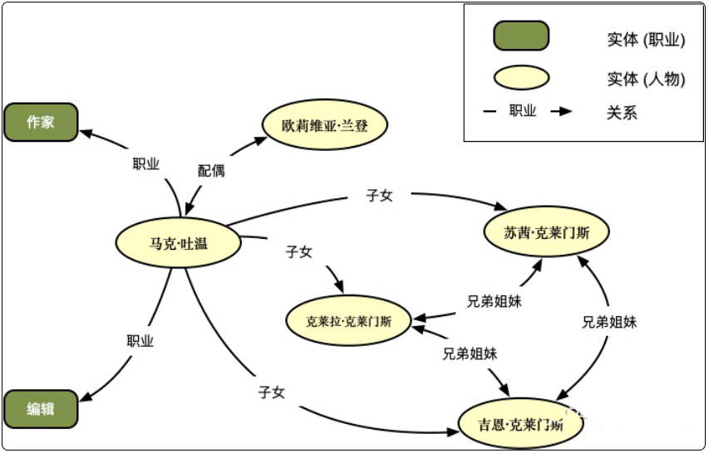
Introduction
This paper shows how to construct knowledge graphs (KGs) from pre-trained language models (e.g., BERT, GPT-2/3), without human supervision.

Slide 4
Motivation
Knowledge graph construction
1) Supervised approaches (Freebase, Wikidata)
2) Semi-supervised approaches (NELL, Knowledge Vault)
Expensive human supervision
Language Models
BERT and GPT-2/3
Work well in tasks often require human to learn relevant knowledge
Can we use the knowledge stored in pre-trained LMs to construct KGs?

Slide 5
Contribution
Show how to construct KGs from pre-trained LMs.
2. Propose an unsupervised two-stage approach, MAMA.
3. Generate a new type of KG, namely open KG.

Slide 6
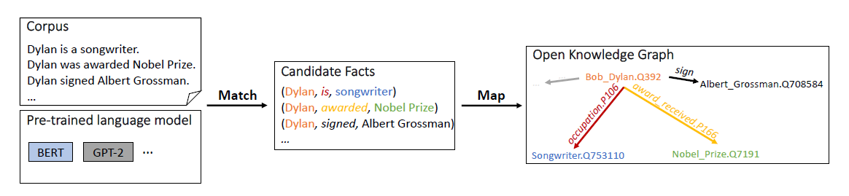
Method
MAMA - Match and Map (an unsupervised end-to-end approach)
Figure 1: Overview of the proposed approach MAMA

Slide 7
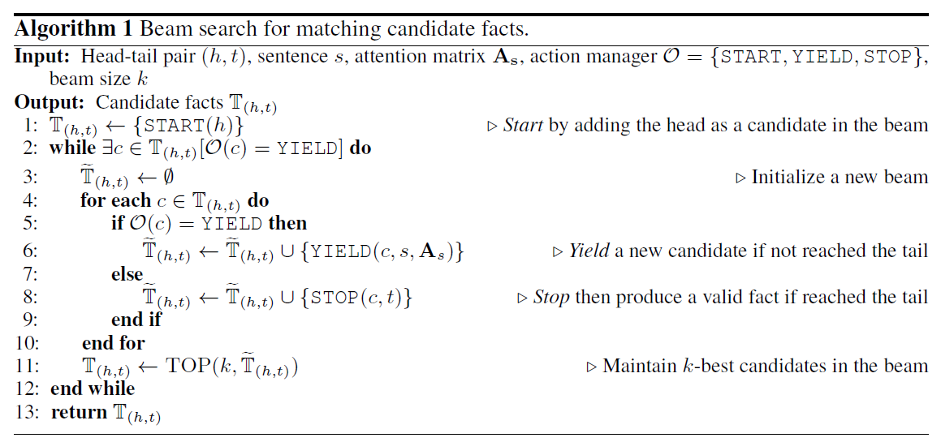
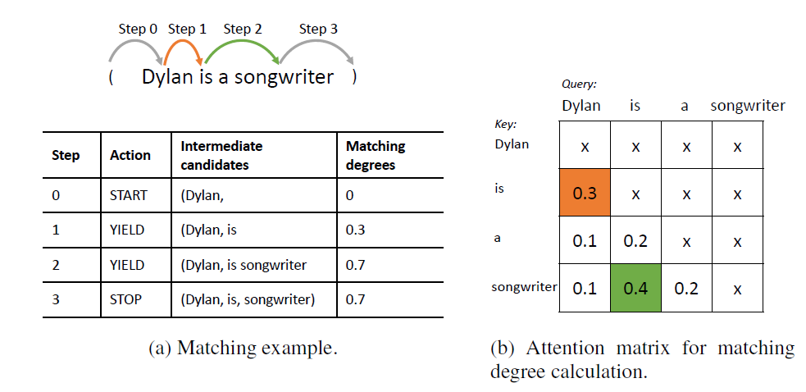
Method
Match – a search problem
“…said Jason Forcier , a vice president at battery maker A123 Systems Inc.”
Figure 2: Illustration of Match stage

Slide 8
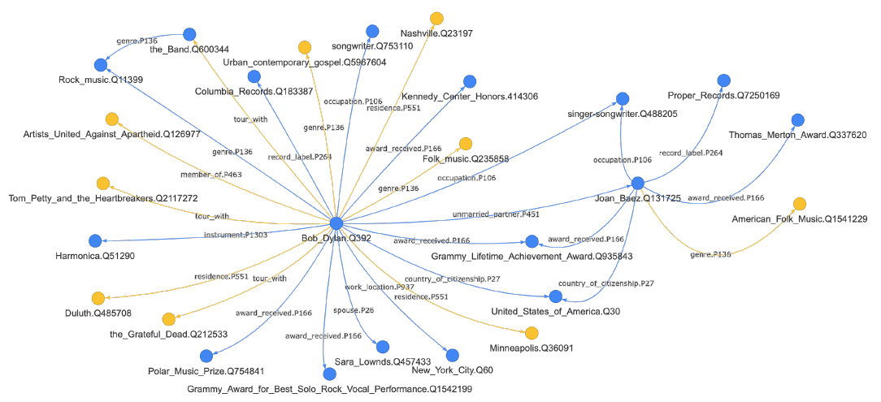
Method
Map
1) Mapped facts in KG schema
Entity linking to KG schema
Relation mapping with KG schema
2) Unmapped facts in open schema
Partially unmapped facts
Completely unmapped facts

Slide 9
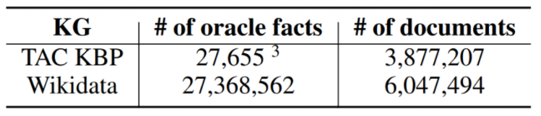
Experiment
Mapped facts in the fixed KG schema
Table 1: Dataset statistics of two knowledge graphs: TAC KBP and Wikidata

Slide 10
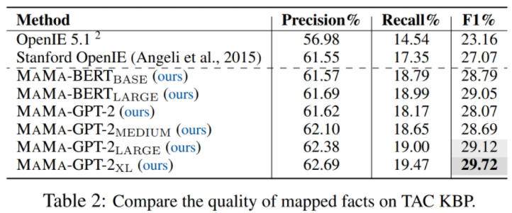
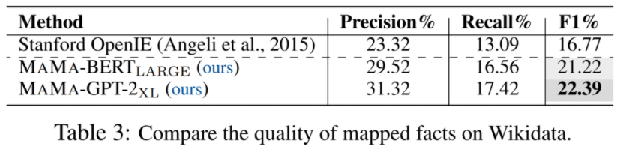
Experiment
Results on mapped facts

Slide 11
Experiment
Analysis of unmapped facts
The quality of unmapped facts is verified.
35.3% of the unmapped facts are true on Wikidata.
2）Accurate entity detection is desired.
45.5% of the untrue unmapped facts on Wikidata are due to the incorrect entities detected by the spaCy

Slide 12
Conclusion
Improvement plan:
Identify more accurate entities by relying on attention weights in LMs
Investigate stronger entity linkers and learn a more robust relation mapping through weak or distant supervision
Investigate more sophisticated approaches to generate more accurate relation phrases

