Slide 1
Multi-Task Identification of Entities, Relations, and Coreference for Scientific Knowledge Graph Construction. (科学知识图谱构建中实体,关系和共指的多任务识别)
蔡修远
知识分析与处理
Notes:
Doing scientific information extraction in scientific abstract and construct the knowledge graph EMNLP 2018

Slide 2
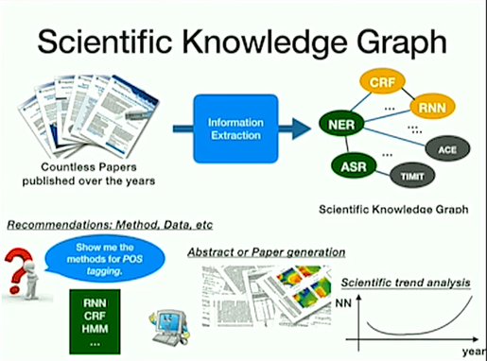

Slide 3
Information extraction in scientific articles
Task: identify entities and relations in a document
What is the task of the paper?
What method did the paper use to solve the task?
What dataset did the paper use?

Slide 4
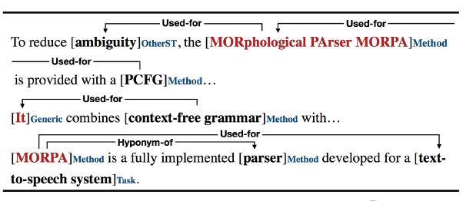
Challenges for scientific IE
Information extraction is challenging but great progress for general domain
Even more challenging for scientific domain
limited annotated data – expert annotations
Most relations exist across sentences

Slide 5
This paper: General Framework for Scientific IE
SciERC：new dataset for scientific information extraction
Expert annotations
Entities, relations and coreferences
SciIE: unified multi-task learning framework to identify Entities, relations and coreferences
Shares span representations across low-level tasks
Avoid cascading errors between tasks
SciKG: construct scientific knowledge graph
Notes:
Span 区间范围 annotators perform a greedy annotation for spans and always prefer the longer span whenever ambiguity occurs. Nested spans are allowed when a subspan has a relation/coreference link with another term outside the span.
这里的span的含义我认为是不同备选实体之间的组合, 也就是名词短语. 并且可以检测出重合的span.

Slide 6
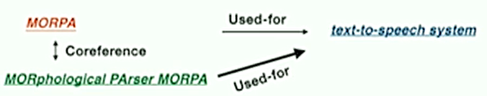
SciERC Dataset
Annotation on paper abstracts for three tasks:
Entity extraction, relation extraction, coreference resolution
Annotate relations across sentences using coreference links as anchors
To reduce ambiguity, the MORphological Parser MORPA is provided with a PCFG…
MORPA is a fully implemented parser developed for a text-to-speech system.

Slide 7
SciERC Dataset
Comprehensive annotations on 500 paper abstracts on three tasks:
Entities: 8k
Relations: 5k
Coreference: 3k
Properties:
Extends property types and relation types from the previous dataset
Adds cross-sentence annotations
6 entity types( task, method, material …) and 7 relation types(used-for, feature-of, part-of, compare …)

Slide 8
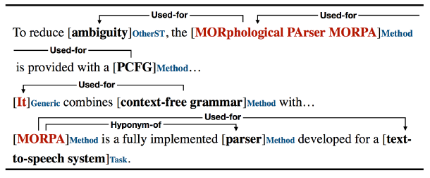

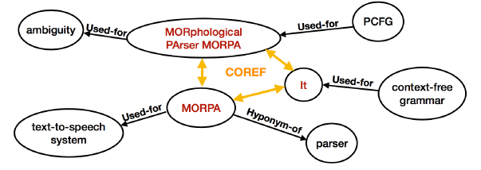
SciERC task
Current work in information extraction:
Pipeline system + hand engineered features:
Cascading errors
Hard to generalize
Notes:
Pipeline system 流水线系统 addresses these tasks as independent components of a pipeline
multi-task setup that shares parameters across low-level tasks, making predictions by leveraging context across the document through coreference links.
hand engineered features 人工提取的特征

Slide 9
Our method
SciIE: unified multi-task learning framework to identify Entities, relations and coreferences resolution
Avoid Cascading errors: sharing span representations for all three spans by enumerating spans
No hand engineered features
Can be applied to other domains with limited training resources
Notes:
multi-task 意味着三个任务的底层向量是共享的

Slide 10
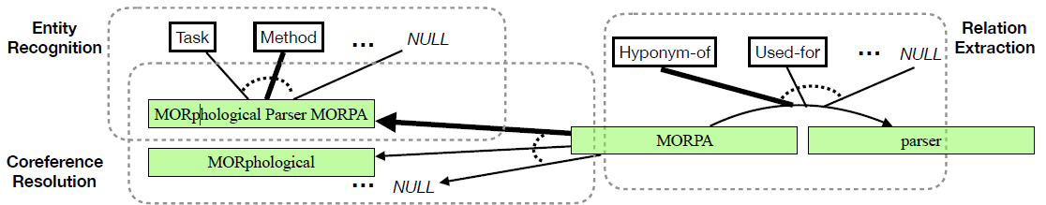
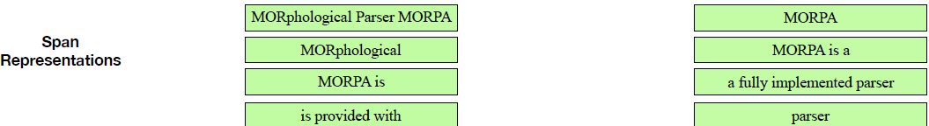
SciIE: multi-task model for Entities, relations and coreferences
Notes:
盖兰图 sentences as the bottom layer BiLSTM to module the sentence
Span representation allow nested span

Slide 11




problem Definition
input
Sequence of words
the set of all possible within-sentence word
sequence spans
output
1 the entity types E for all spans S
2 the relations R for all pair of spans S × S
3 the coreference links C for all spans in S
Notes:
E 实体类型
R 实体关系
C 每一个span都有一个数值对应,

Slide 12
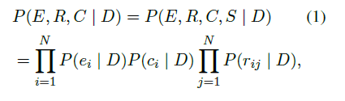
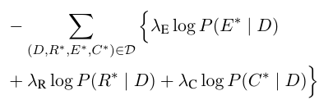
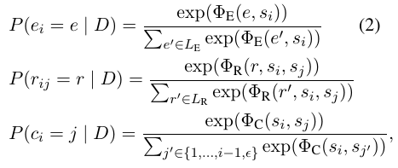
Model Definition
conditionally independent given D:
Loss function

Slide 13




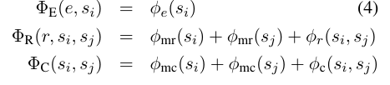
Scoring architecture
how likely a span si has an entity type e
how likely two spans are associated in a relation r
Notes:
一元计算单元 二元计算单元

Slide 14
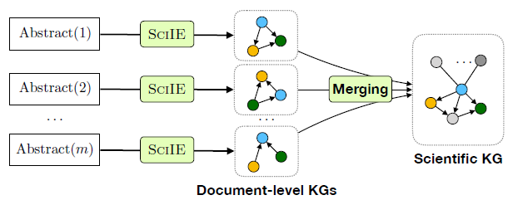
Scientific knowledge graph construction
Number of abstracts: 110k abstracts from 12 AI conference published since 1995

Slide 15
Experimental setup
Dataset :
Our new SciERC: 500 annotated paper abstracts in four AI communities( NLP, speech, vision, machine learning) from Semantic scholar Corpus
Baselines(state-of-the-art IE system for the general domain):
E2E Rel: state-of-the-art joint entity and relation extraction system
E2E Coref: state-of-the-art coreference system combined with ELMO.
Notes:
ACE 2005多语种培训语料库包含完整的英语、阿拉伯语和汉语训练数据,用于2005年自动内容提取(ACE)技术评估。

Slide 16
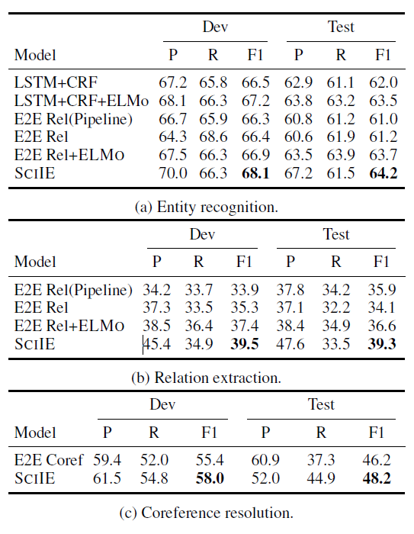
Results on SciERC Dataset
SciIE outperforms state-of-the-art IE system for the general domain
Notes:
Comparison with previous systems on the development and test set for our three tasks. For coreference resolution, we report the average P/R/F1 of MUC, B3, and CEAF4 scores.

Slide 17
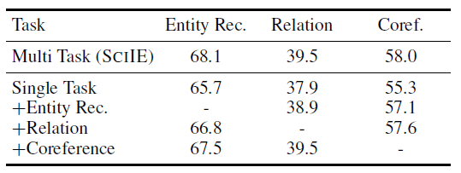
Ablations
Notes:
实际上ablation study就是为了研究模型中所提出的一些结构是否有效而设计的实验。
比如你提出了某某结构，但是要想确定这个结构是否有利于最终的效果，
那就要将去掉该结构的网络与加上该结构的网络所得到的结果进行对比，这就是ablation study

Slide 18
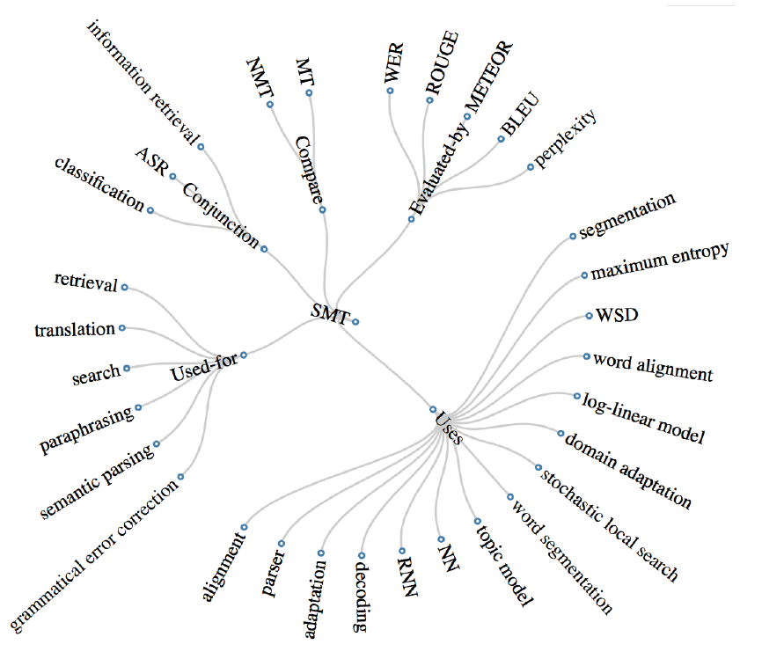

Slide 19
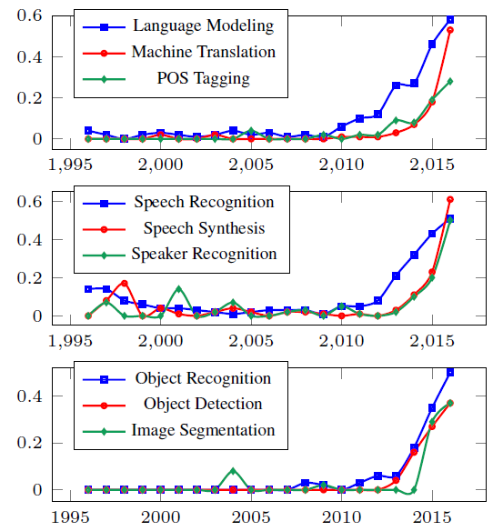
Trend analysis
Historical trend for top applications of the key phrase neural network in NLP, speech, and CV conference papers we collected. y-axis indicates
the ratio of papers that use neural network in the
task to the number of papers that is about the task.

Slide 20
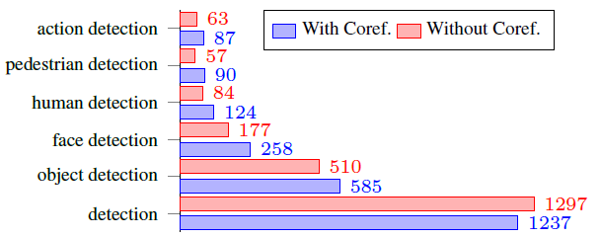
Entity disambiguation by linking through coreference
Generic phrase counts decrease
Specific phrase counts increase
Notes:
Frequency of detected entities with and without coreferece resolution: using coreference reduces the frequency of the generic phrase detection while significantly increasing the frequency of
specific phrases. Linking entities through coreference helps disambiguate phrases when generating the knowledge graph.

Slide 21
Contributions
SciERC: a new, unified dataset for Entities, Relations, and Coreference in Scientific articles.
SciIE: Multitask learning setting significantly boost performance through shared span representation.
state-of-the-art results in scientific IE and the general domain
joint framework with no hand-engineered features
SciKG: constructing a scientific knowledge graph
The remaining:
extends the framework to other domains in information extraction
improving the performance using semi-supervised techniques and providing in-domain features

