Slide 1
DIVINE: A Generative Adversarial Imitation Learning Framework for Knowledge Graph Reasoning
EMNLP 2019
Ruiping Li and Xiang Cheng
State Key Laboratory of Networking and Switching Technology, Beijing University of Posts and Telecommunications
汇报人：胡梦琦

Slide 2
Outline
Research background
Preliminaries
Methodology
Experiments
Conclusions

Slide 3
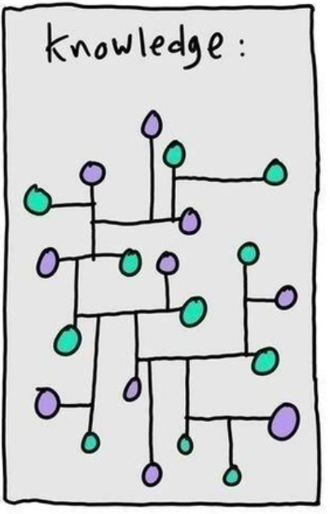
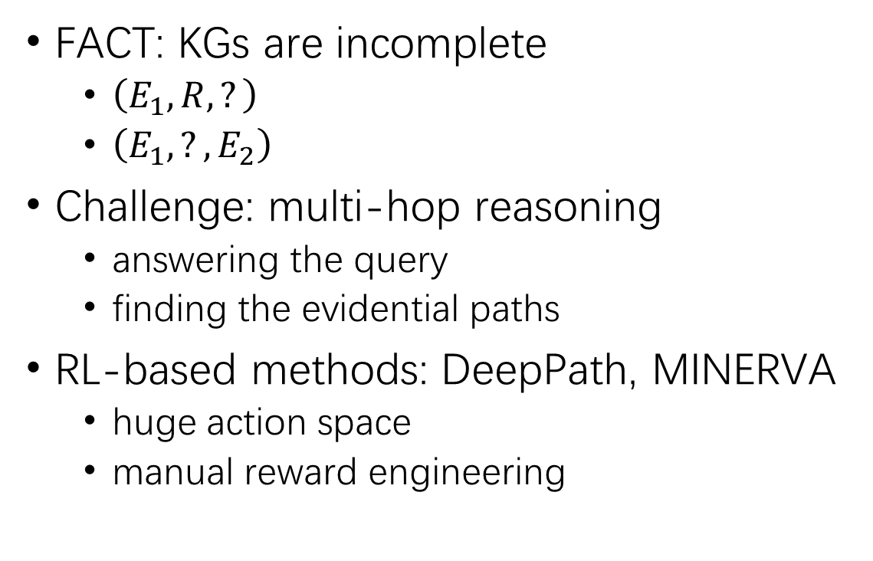
Research background
FACT: KGs are incomplete
$\left(E_{1},R, ?\right)$
$\left(E_{1}, ?,E_{2}\right)$
Challenge: multi-hop reasoning
answering the query
finding the evidential paths
RL-based methods: DeepPath, MINERVA
huge action space
manual reward engineering
link prediction
fact prediction

Slide 4
Contributions
present a plug-and-paly framework based on GAIL*
propose a path-based GAIL
design an automated sampler
GAIL：Generative Adversarial Imitation Learning

Slide 5
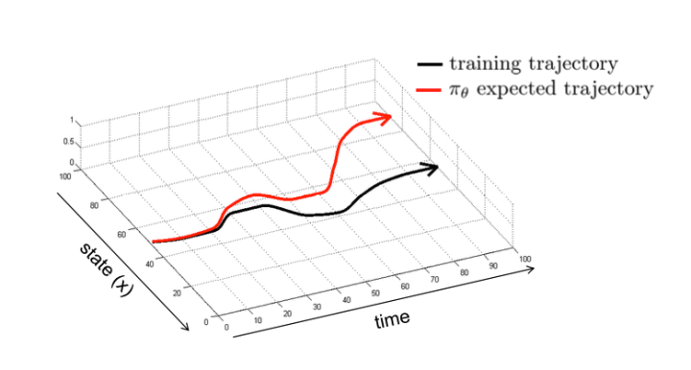
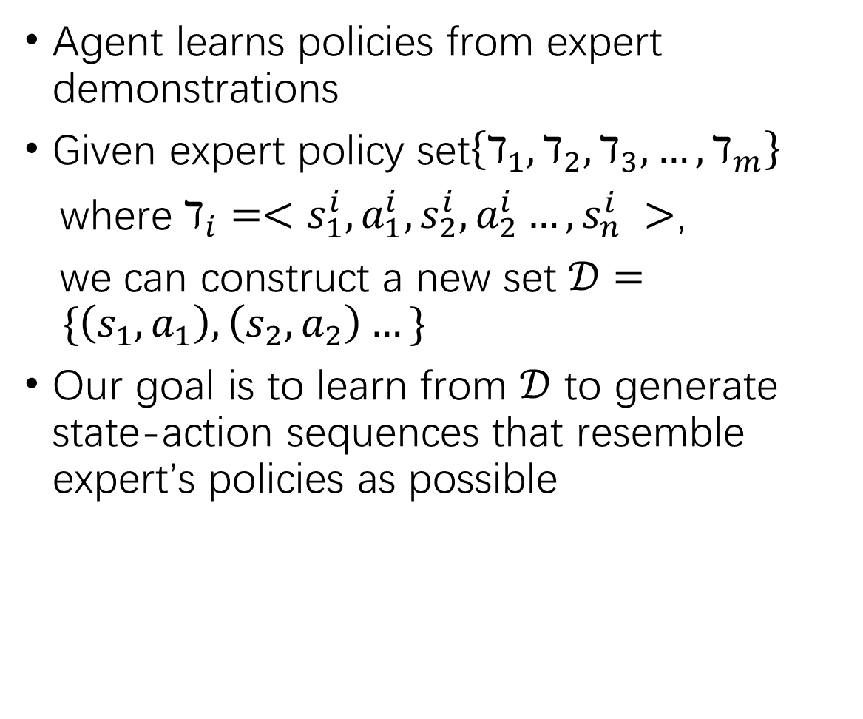
Preliminaries - Imitation Learning
Agent learns policies from expert demonstrations
Given expert policy set$\left\{ℸ_{1},ℸ_{2},ℸ_{3},…,ℸ_{m}\right\}$
where $ℸ_{i}=<s_{1}^{i},a_{1}^{i},s_{2}^{i},a_{2}^{i}…,s_{n}^{i} >$,
we can construct a new set $𝒟= \{\left(s_{1},a_{1}\right),\left(s_{2},a_{2}\right)…\}$
Our goal is to learn from $𝒟$ to generate state-action sequences that resemble expert’s policies as possible

Slide 6
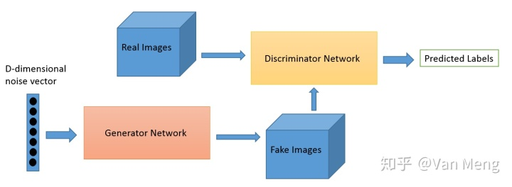
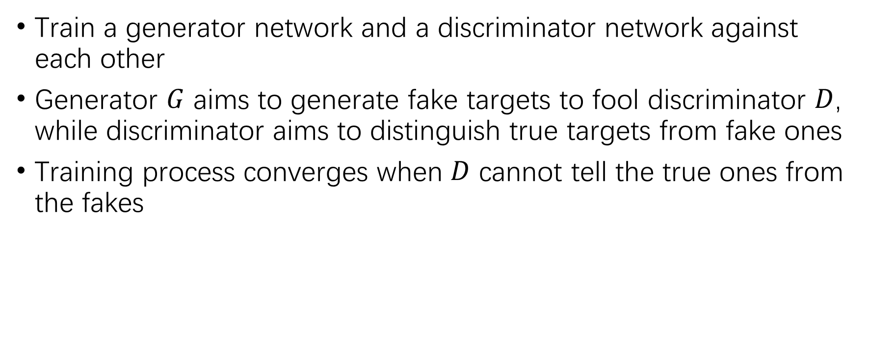
Preliminaries – Generative Adversarial Training
Train a generator network and a discriminator network against each other
Generator $G$ aims to generate fake targets to fool discriminator $D$, while discriminator aims to distinguish true targets from fake ones
Training process converges when $D$ cannot tell the true ones from the fakes

Slide 7
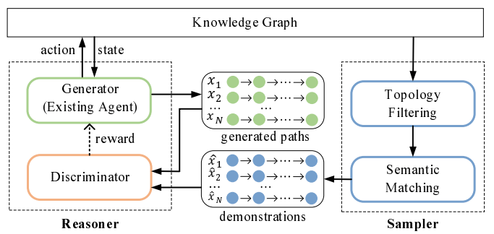
Methodology
Framework Overview
G: policy-based agent, generating evidential paths
D: distinguish generated paths from demonstrations

Slide 8



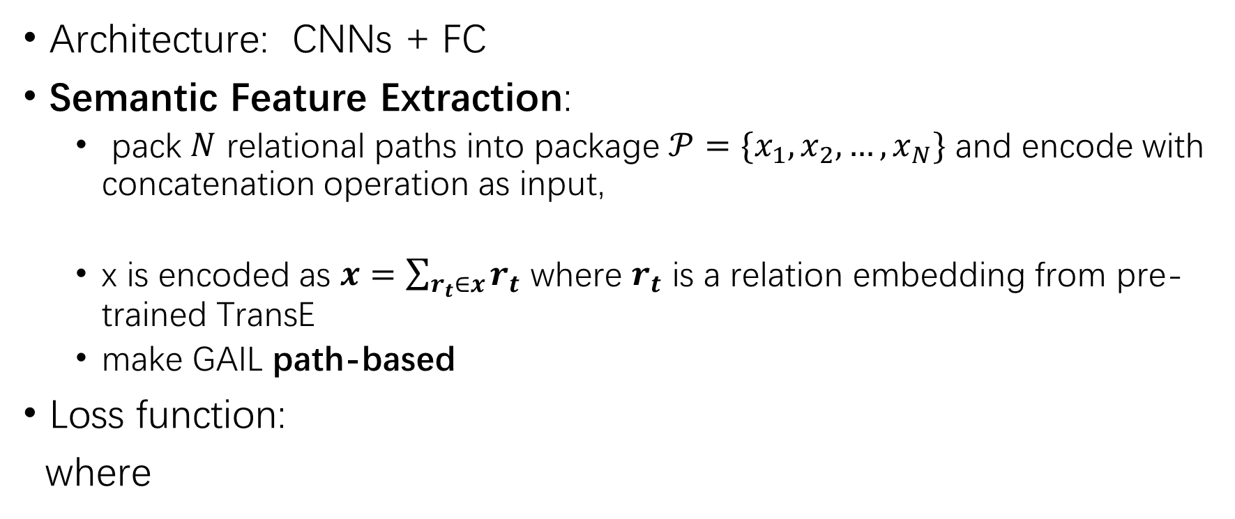
Discriminator
Architecture: CNNs + FC
Semantic Feature Extraction:
pack $N$ relational paths into package $𝒫=\{x_{1},x_{2},…,x_{N}\}$ and encode with concatenation operation as input,
x is encoded as $x=\sum_{r_{t}∈x}{r_{t}}$ where $r_{t}$ is a relation embedding from pre-trained TransE
make GAIL path-based
Loss function:
where

Slide 9

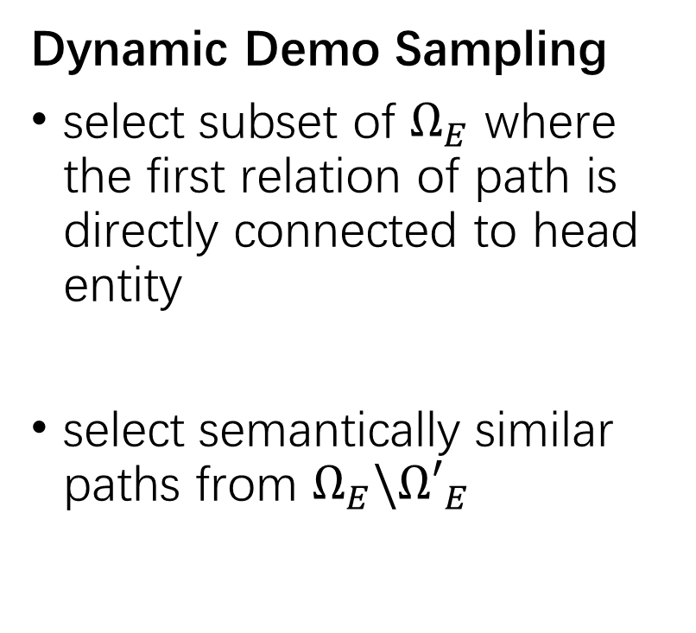
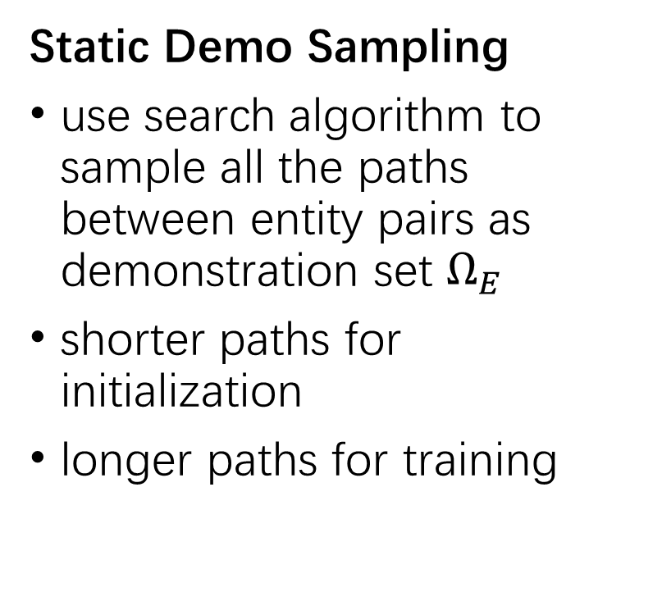
Demonstration Sampler
Challenge: high-quality demonstrations vs. considerable manual efforts
Static Demo Sampling
use search algorithm to sample all the paths between entity pairs as demonstration set $Ω_{E}$
shorter paths for initialization
longer paths for training
Dynamic Demo Sampling
select subset of $Ω_{E}$ where the first relation of path is directly connected to head entity
select semantically similar paths from $Ω_{E}\backslash {Ω′}_{E}$

Slide 10

Experiments
Datasets
Metrics
MRR
MAP
Hits@k

Slide 11
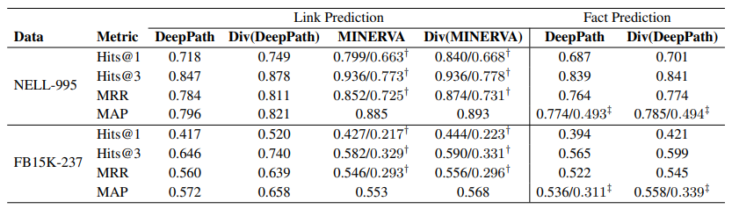
Experiments
Baselines: DeepPath, MINERVA, DIV(*)
†: rank entities according to the probability that the agent can reach the entity along evidential paths
‡: rank all the positive and negative triples for a given query relation

Slide 12
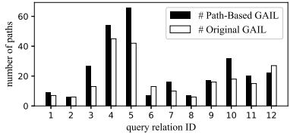
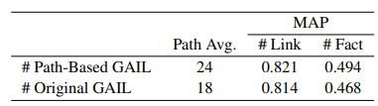
Effectiveness of the Path-Based GAIL Method
To validate the effectiveness and diversity of proposed path-based GAIL
train the policy-based agent in DeepPath on NELL-995

Slide 13
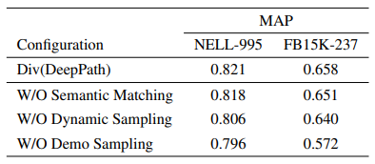
Ablation Studies
Re-train the framework by ablating certain components:
W/O Semantic Matching: no semantic matching is performed
W/O Dynamic Sampling: only adopt the static demo sampling
W/O Demo Sampling: degenerate to original DeepPath
Observations:
Performance improved even with static sampling
High-quality demonstrations are crucial

Slide 14
Conclusion & Food for Thought
Conclusion
Plug-and-play
Generative Adversarial Imitation Learning
No reward function engineering
Automatic sampling
Food for Thought
Plain methods may work
Inspiration comes from knowledge transfer

