Slide 1
GCC: Graph Contrastive Coding for Graph Neural Network Pre-Training
Jiezhong Qiu,Qibin Chen,Yuxiao Dong,Jing Zhang
Hongxia Yang,Ming Ding,Kuansan Wang,Jie Tang∗
KDD20
张震
51205901120

Slide 2
Outline
Motivation
The GNN Pre-training Problem
GCC Framework
Experiments
Conclusion

Slide 3
Motivation
Graph representation learning has emerged as a powerful technique for addressing various downstream such as node classification, similarity search, and graph classification.
Inspired by the recent advances in pre-training from natural language processing(BERT) and computer vision(ResNet,ImageNet).

Slide 4
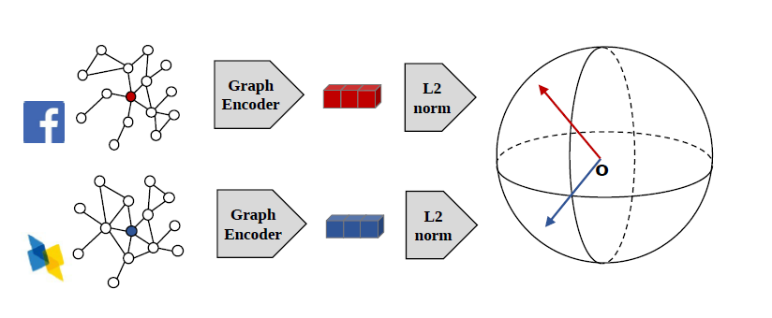
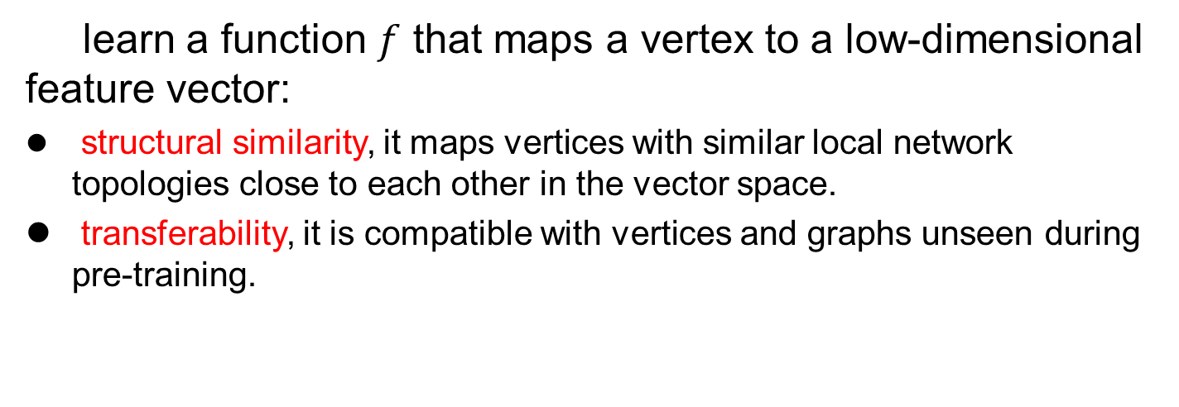
The GNN Pre-training Problem
learn a function $f$ that maps a vertex to a low-dimensional feature vector:
structural similarity, it maps vertices with similar local network topologies close to each other in the vector space.
transferability, it is compatible with vertices and graphs unseen during pre-training.

Slide 5
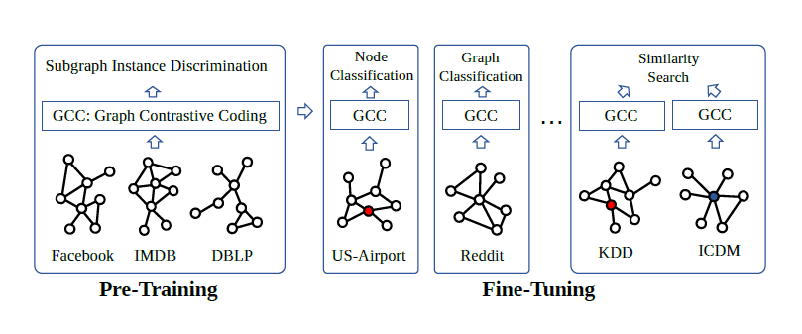
Graph Contrastive Coding(GCC)

Slide 6
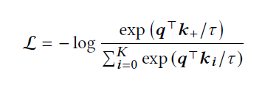
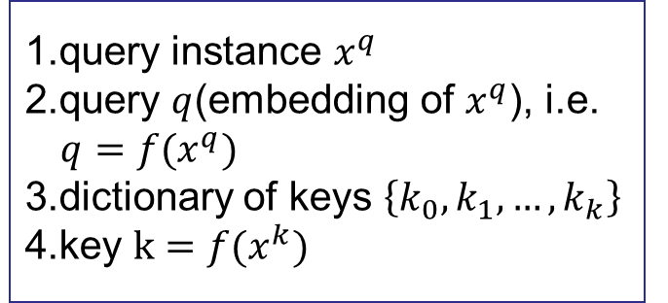
GCC Pre-training
Pre-training task: subgraph instance discrimination
InfoNCE Loss: output instance representations that are capable of capturing the similarities between instances
1.query instance $x^{q}$
2.query $q$(embedding of $x^{q}$), i.e. $q=f(x^{q})$
3.dictionary of keys $\left\{k_{0},k_{1},…,k_{k}\right\}$
4.key $k=f(x^{k})$
Contrastive learning for graphs?
Q1 :How to define instances in graph?
Q2:How to define(dis) similar pairs?
Q3:What are the proper encoders?

Slide 7
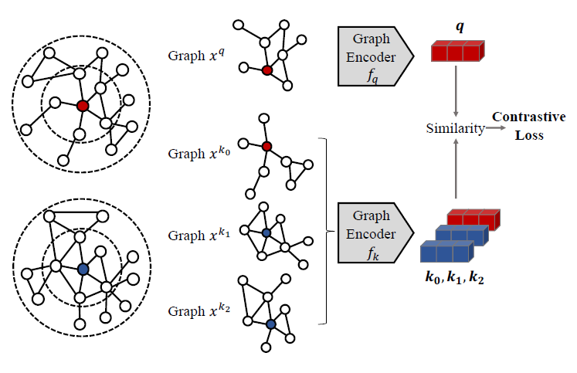
GCC Pre-training
Q1 :How to define instances in graph?
Q2:How to define(dis) similar pairs?
Q3:What are the proper encoders?

Slide 8
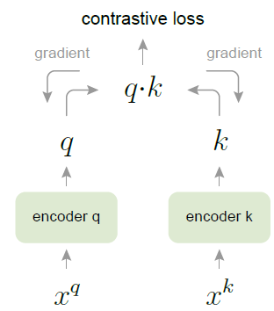
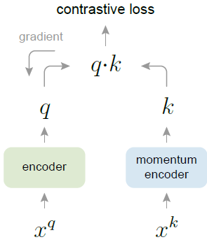
GCC Pre-training: Learning Algorithms
Optimizing Contrastive loss: to effectively build and maintain the K-size dictionary
End-to-end
(E2E)
Momentum Contrast
(MoCo)

Slide 9
GCC Fine-tuning
Full fine-tuning
Freezing fine-tuning
Full fine-tuning
Freezing fine-tuning
Graph Encoder
Graph Encoder
classifier
classifier
Label
Label
Feature Extractor

Slide 10
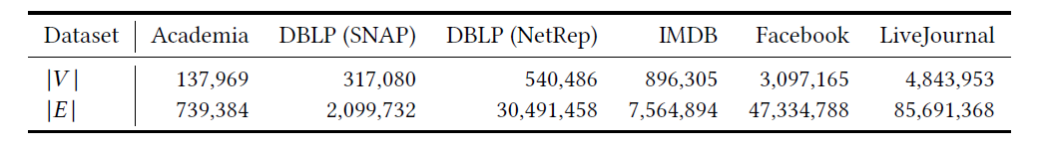
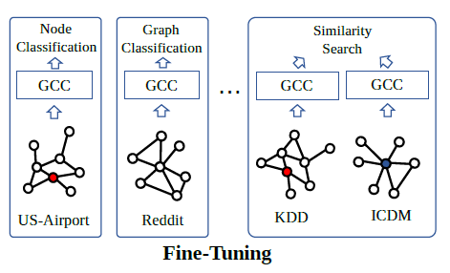
Experiments
Six real-world information networks for pre-training:
Fine-tuning tasks:
Node classification
Graph classification
Top-k similarity search

Slide 11
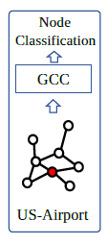
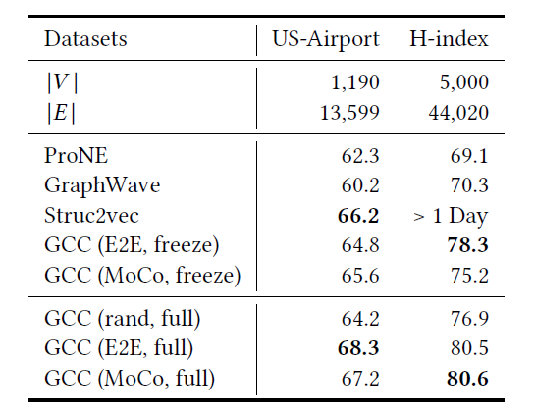
Experiments
Task 1 Node classification: to predict unknown node labels in a partially labeled network
Not trained on either US-Airport or H-index
Fine-tuning on the US-Airport or H-Index

Slide 12
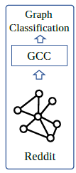
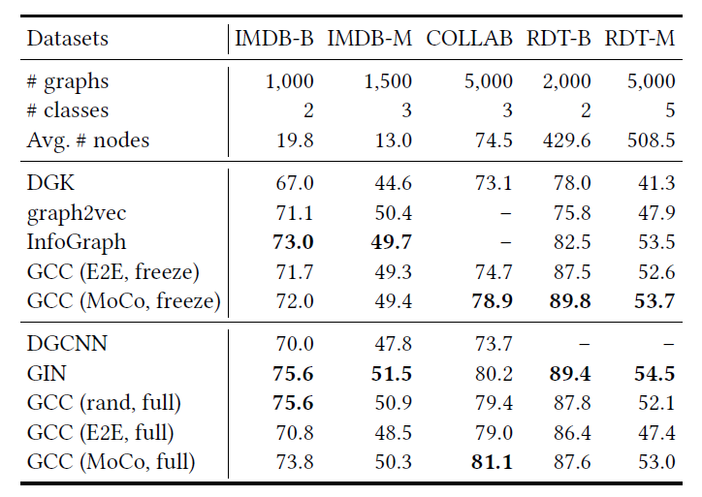
Experiments
Task 2 Graph classification: to predict the label of the graph

Slide 13
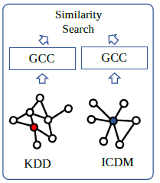
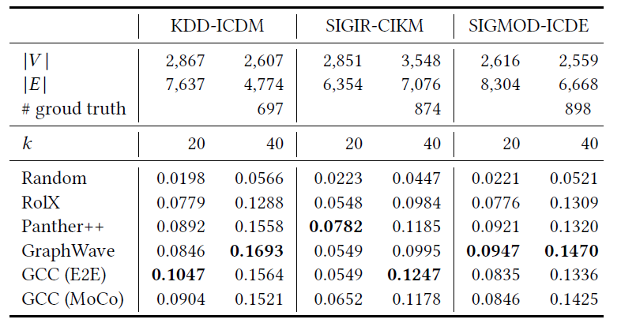
Experiments
Task 3 Top-k Similarity Search：to fine the most similar vertex from two graphs

Slide 14
Conclusion
We study the pre-training of GNN with the goal of characterizing and transferring structural representations in social and information networks.
We present Graph Contrastive Coding, which is a graph-based contrastive learning framework to pre-train GNN.
The pre-trained GNN achieves competitive performance to its supervised trained-from-scratch counterparts in 3 graph learning tasks on 10 praph datasets.

Slide 15
Thank you!

