Slide 1

Improving Question Answering with External
Knowledge
EMNLP MRQA 2019
Xiaoman Pan, Kai Sun, Dian Yu, Heng Ji, Dong Yu
Rensselaer Polytechnic Institute/ CMU/ Tencent AI Lab

Slide 2

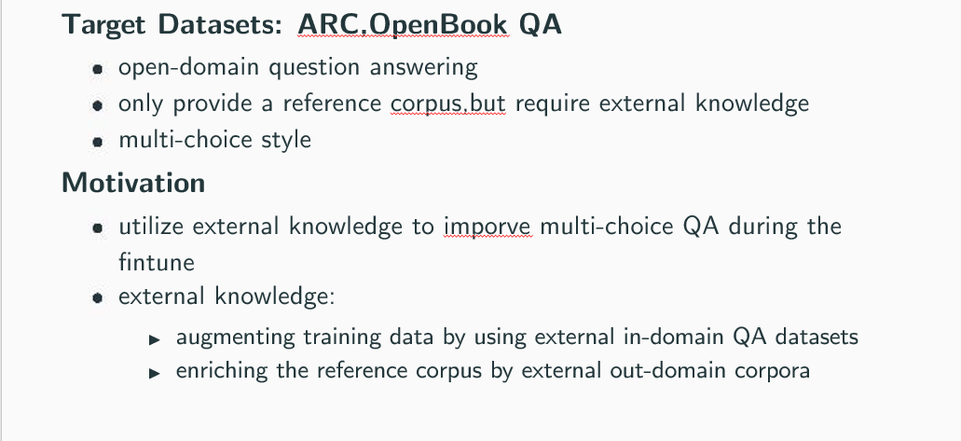
This Work
Target Datasets: ARC, Open Book QA
open-domain question answering
only provide a reference corpus, but require external knowledge
multi-choice style
Motivation
utilize external knowledge to improve multi-choice QA during the
ﬁntune
external knowledge:
I augmenting training data by using external in-domain QA datasets
I enriching the reference corpus by external out-domain corpora
ARC Sample
Which technology was developed most recently?
A. cellular telephone B. television
C. refrigerator D. airplane
1

Slide 3

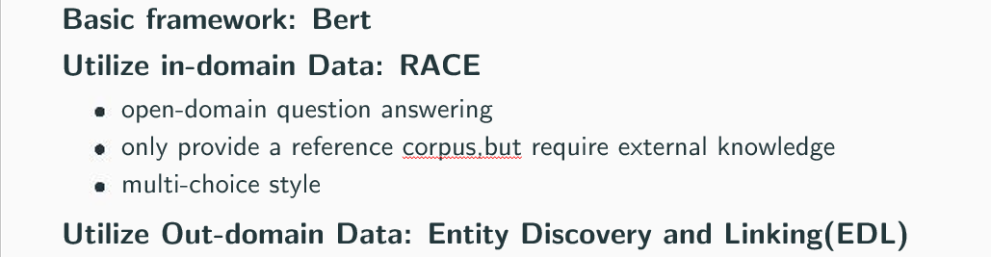
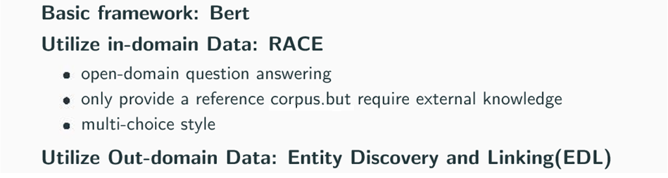

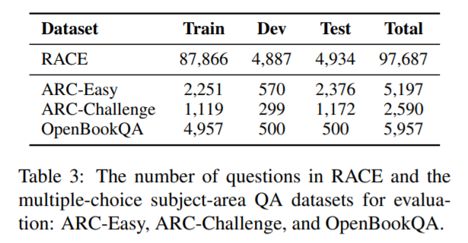
Method Overview
Basic framework: Bert
Utilize in-domain Data: RACE
open-domain question answering
only provide a reference corpus,but require external knowledge
multi-choice style
Utilize Out-domain Data: Entity Discovery and Linking(EDL)
2

Slide 4

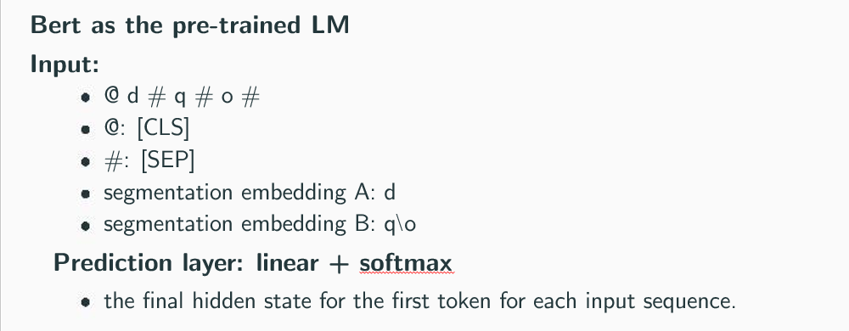
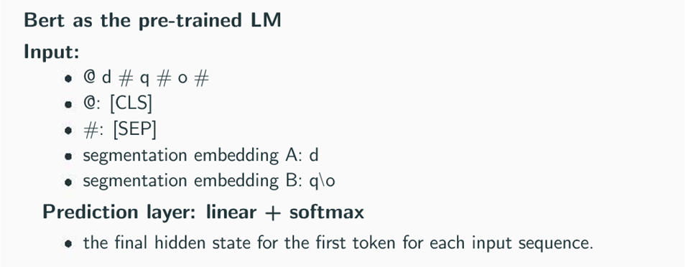
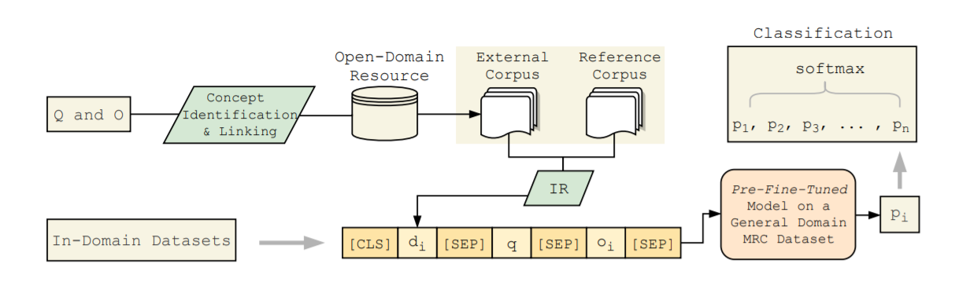
Method - Basic Framework
Bert as the pre-trained LM
Input:
@ d # q # o #
@: [CLS]
#: [SEP]
segmentation embedding A: d
segmentation embedding B: q\o
Prediction layer: linear + softmax
the ﬁnal hidden state for the ﬁrst token for each input sequence.
3

Slide 5

Method - EDL
EDL goal: Enrich the reference documents
Entity Discovery:
goal: extract entity mentions from text
all noun phrases as entity mentions
Entity Linking:
two sub-tasks: candidate generation & entity disambiguation
entity mentions:
candidates entities:
4

Slide 6


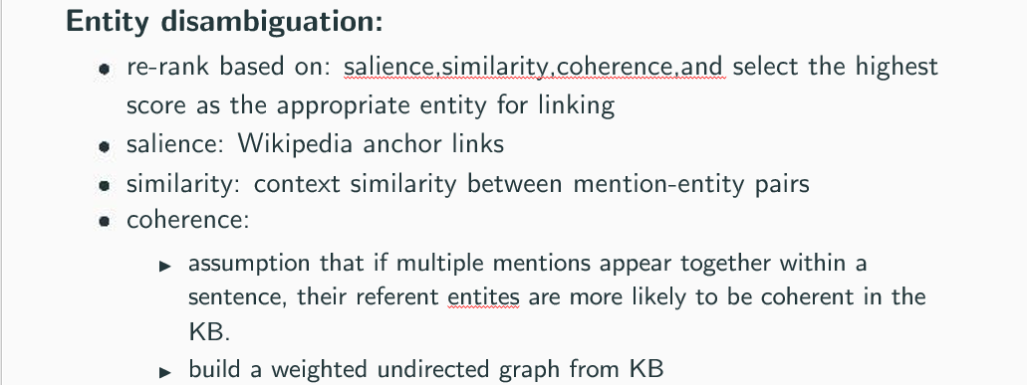
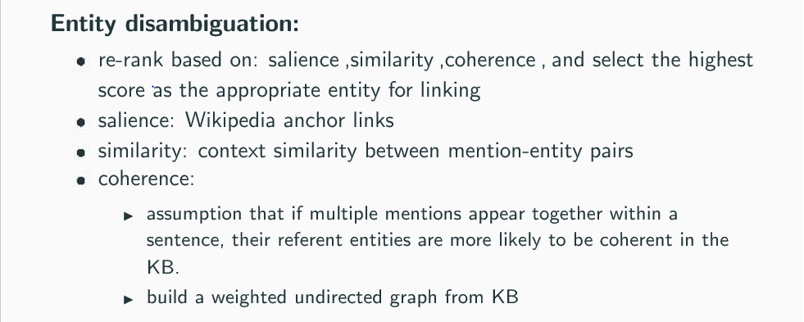
Entity Linking: candidate generation & entity dis-
ambiguation
I Example:
- M : the word Jaguar appears as link anchor in Wikipedia 927 times
- W : in 466 cases it links to the article Jaguar Cars
Candidate generation:
dictionary-based approach
5

Slide 7

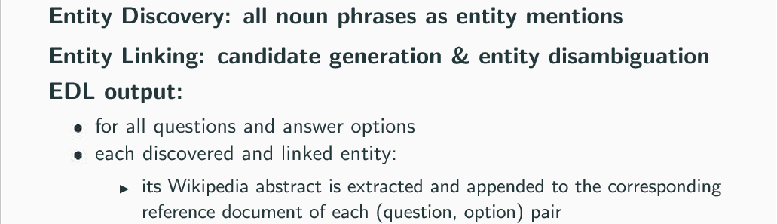
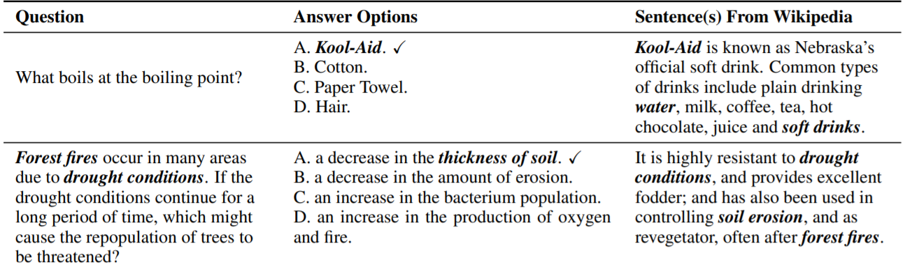
Method - EDL
Entity Discovery: all noun phrases as entity mentions
Entity Linking: candidate generation & entity disambiguation
EDL output:
for all questions and answer options
each discovered and linked entity:
I its Wikipedia abstract is extracted and appended to the corresponding
reference document of each (question, option) pair
7

Slide 8

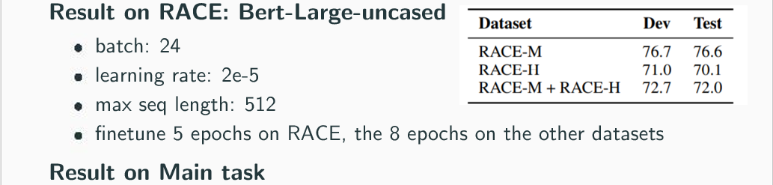
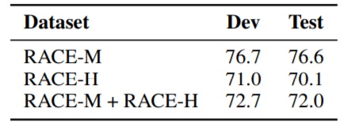
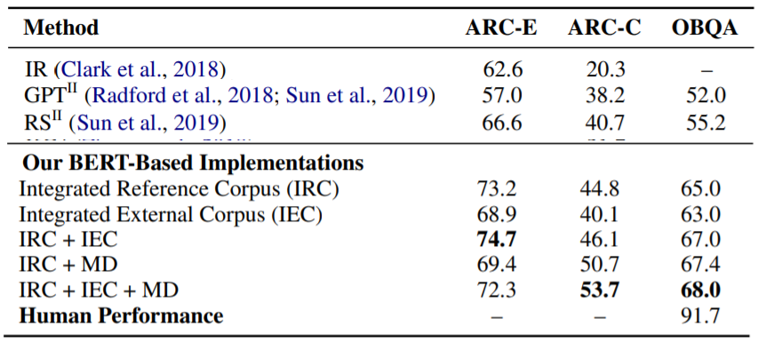
Experiment
Result on RACE: Bert-Large-uncased
batch: 24
learning rate: 2e-5
max seq length: 512
ﬁnetune 5 epochs on RACE, the 8 epochs on the other datasets
Result on Main task
8

Slide 9

Thank You for listening!

Slide 10
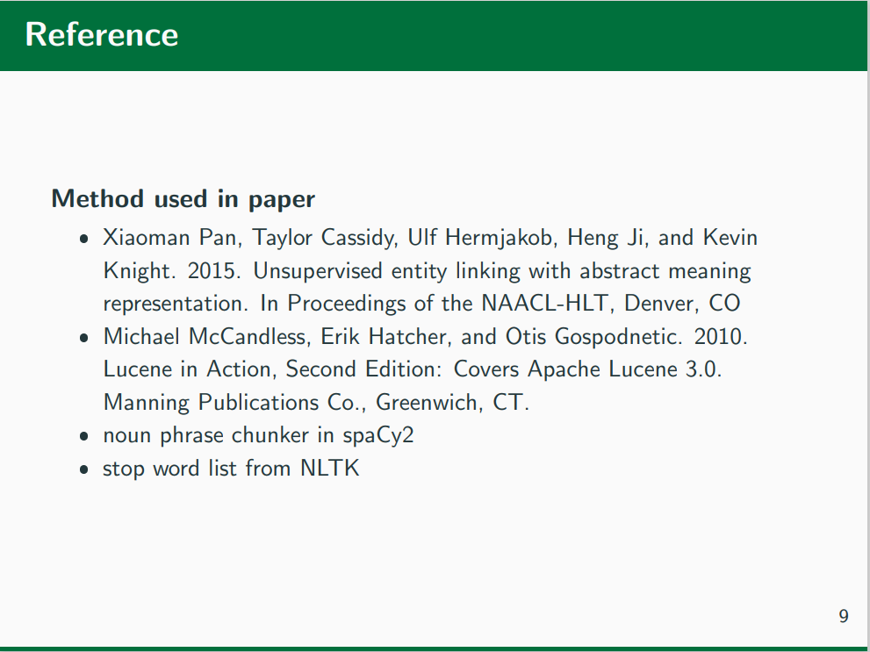

Entity Linking: candidate generation & entity dis-
ambiguation
Entity disambiguation:
re-rank based on: salience ,similarity ,coherence , and select the highest
score as the appropriate entity for linking
salience: Wikipedia anchor links
similarity: context similarity between mention-entity pairs
coherence:
I assumption that if multiple mentions appear together within a
sentence, their referent entities are more likely to be coherent in the
KB.
I build a weighted undirected graph from KB
6

