Slide 1
Knowledge Aware Conversation Generation with Explainable Reasoning over Augmented Graphs
11.5 陈柯宇

Slide 2
Catalogue
Introduction
Abstract & Contributions
Proposed Framework
Experiment Result & Analysis

Slide 3
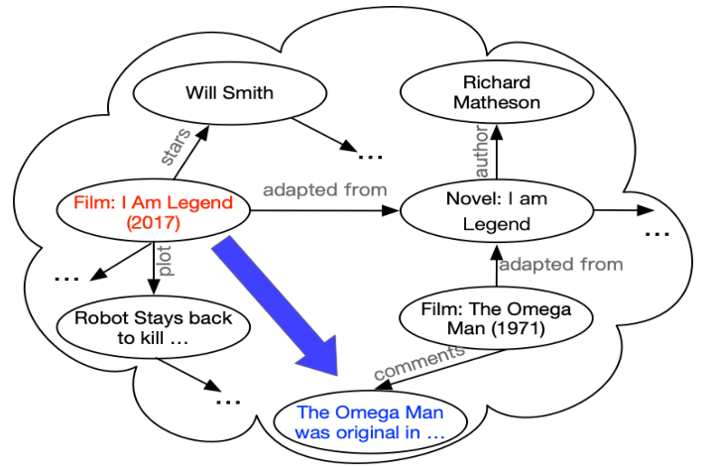
How a KB-based QA works?
If here comes a User Utterance:
I prefer the ending in “I Am Legend” directed by Francis Lawrence.

Slide 4
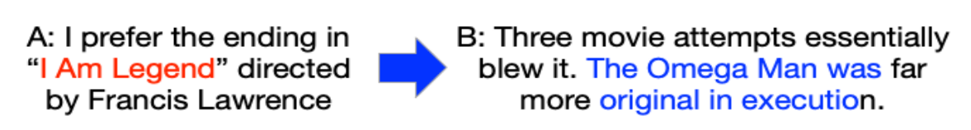
A naïve solution
Intent Classification
Entity Linking
Relation Detection
Response Generation
A sample conversation may look like:

Slide 5
Challenges and Shortcomings
KBQA suffers from information insufficient for response generation.
(e.g. Use a single word to facilitate generation)
Fusion of graph structure and knowledge texts is necessary, but little study on that.

Slide 6
Main Contributions
The first attempt that unifies knowledge triples and text as a graph
Flexible multi-hop knowledge graph reasoning in dialogue system
Graph-based knowledge selection mechanism
Machine Reading Comprehension(MRC) for graph reasoning process

Slide 7
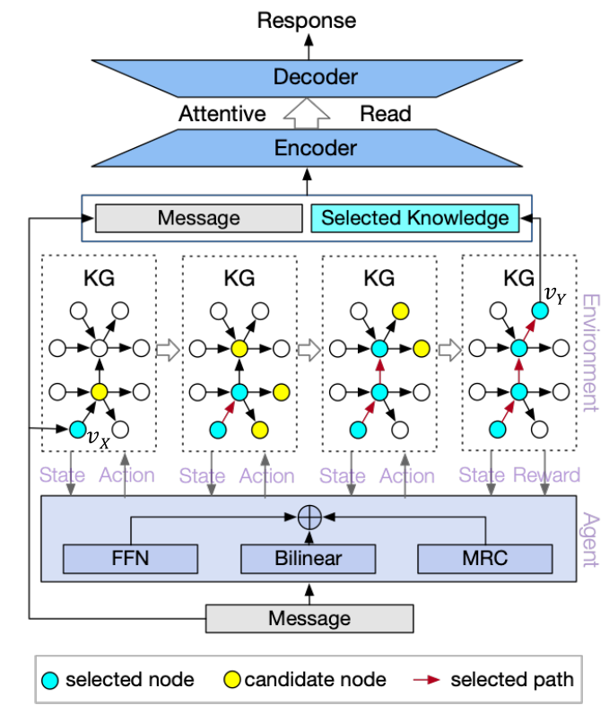
Model Overview
Augmented Knowledge Graph Chatting Machine (AKGCM)

Slide 8
Augmented Knowledge Graph
factoid KG
non-factoid knowledge

Slide 9
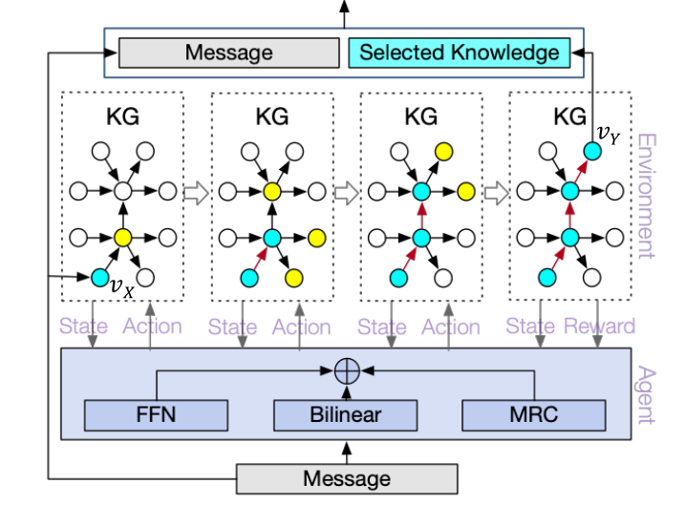
Knowledge Selection on graph
RL-based KG reasoning
A POMDP model is used

Slide 10
RL-Based KG Reasoning
States: Current location of RL agent in KG
Actions: All outgoing edges of the vertex
Transition: Described by transition function
Rewards: +1 if current vertex is ground-truth

Slide 11
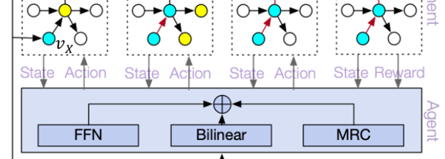
Policy Network
FFN: Encode dialogue history
Bilinear: Local view (similarity evaluation)
MRC: Global view (find answer from document)

Slide 12

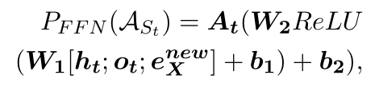

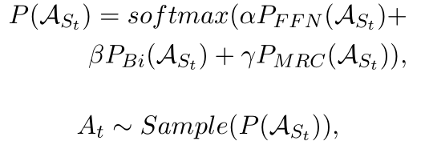
Policy Network
FFN:
Bilinear:
MRC:
Policy:

Slide 13
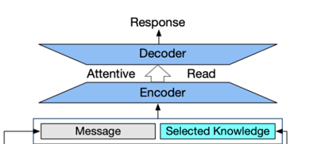
Knowledge Aware Generation
A text summarization model
Input: Embedding of knowledge and message
Output: Generated response

Slide 14
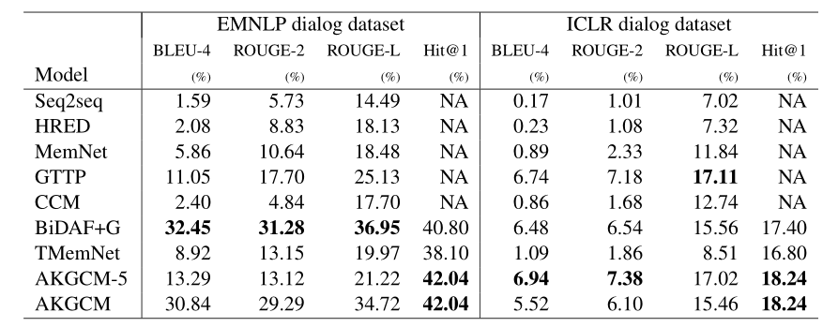
Experiment Result
Automatic Evaluations
Dataset: EMNLP/ICLR dataset
Evaluation Index: BLEU, ROUGE, Hit@1
Human Evaluations

Slide 15
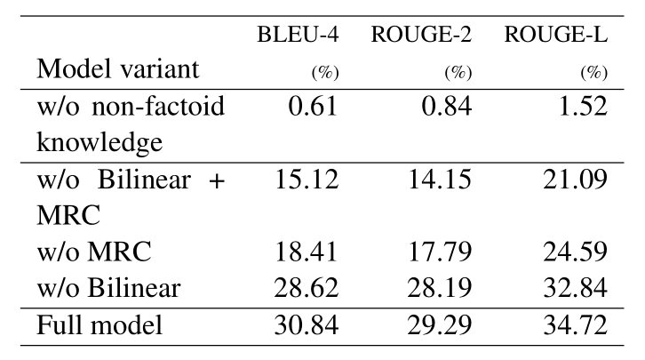
Model Analysis
AKGCM without some crucial part:
(Ablation Test)

Slide 16
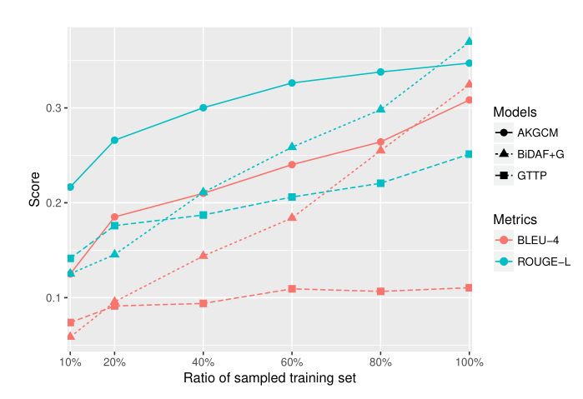
Model Analysis
Model Generalization:
(Gradually reduce the ratio of training data)

Slide 17
Thank you for listening!
Q & A

