Slide 1
Dialogue-Based Relation Extraction
Dian Yu¹ Kai Sun² Claire Cardie² Dong Yu¹
¹Tencent AI Lab, Bellevue, WA
²Cornell University, Ithaca, NY
汇报人：孟浩东
学号：51205901079

Slide 2
Introduction
Cross-sentence relation extraction
Vs. sentence-level relation extraction (e.g., NYT, TACRED)
Identify relations between two arguments that are not mentioned in the same sentence or relations that cannot be supported by any single sentence
Previous Work
Focus on texts from formal genres such as professionally written and edited news reports or well-edited websites
This Work
An initial step toward studying relation extraction in dialogues

Slide 3
Introduction
S1: Hey Pheebs.
S2: Hey!
S1: Any sign of your brother?
S2: No, but he’s always late.
S1: I thought you only met him once?
S2: Yeah, I did. I think it sounds y’know big sistery, y’know, ‘Frank’s always late.’
S1: Well relax, he’ll be here.
Argument pair | Trigger | Relation type
R1 (Frank, S2) | brother | per: siblings
R2 (S2, Frank) | brother | per: siblings
R3 (S2, Pheebs) | none | per: alternate_names
R4 (S1, Pheebs) | none | unanswerable

Slide 4
Data Construction
Use the transcripts of all ten seasons (263 episodes) of Friends
1,788 dialogues
Annotate relational triples in each scene in all transcripts and form a dialogue by extracting the shortest snippet of contiguous turns that covers all annotated relation triples and sufficient supportive contexts in this scene
36 relation types (8,068 triples)
Slot descriptions of the Slot Filling (SF) task in the Text Analysis Conference Knowledge Base Population (TAC-KBP)
New relation types (e.g., per: neighbor)

Slide 5
Data Construction
Trigger annotation
Fine-grained explanations, which are seldom provided in previous relation extraction datasets
Speaker name anonymization
Rachel --> S1
Phoebe --> S2
…

Slide 6
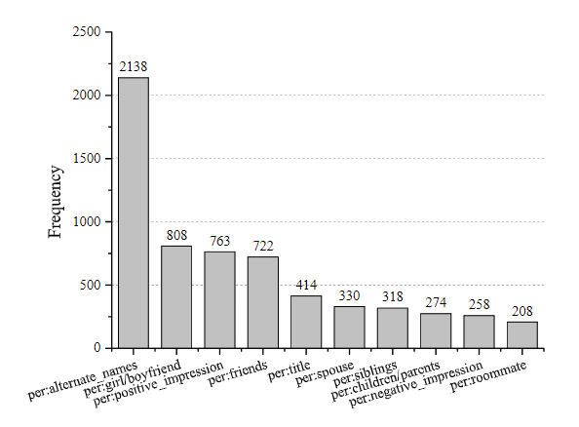
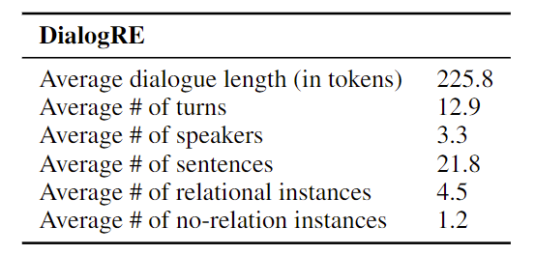
Data Construction
Statistics per dialogue of DialogRE
Relation type distribution in DialogRE

Slide 7

Metrics
Standard Setting (F1)
Given a dialogue $D=s_{1}:t_{1}, s_{2}:t_{2}, …, s_{m}:t_{m}$ and an argument pair $\left(a_{1}, a_{2}\right)$, regard $D$ as document $d$, and the expected output is the relation type(s) between $a_{1}$ and $a_{2}$ based on $d$

Slide 8
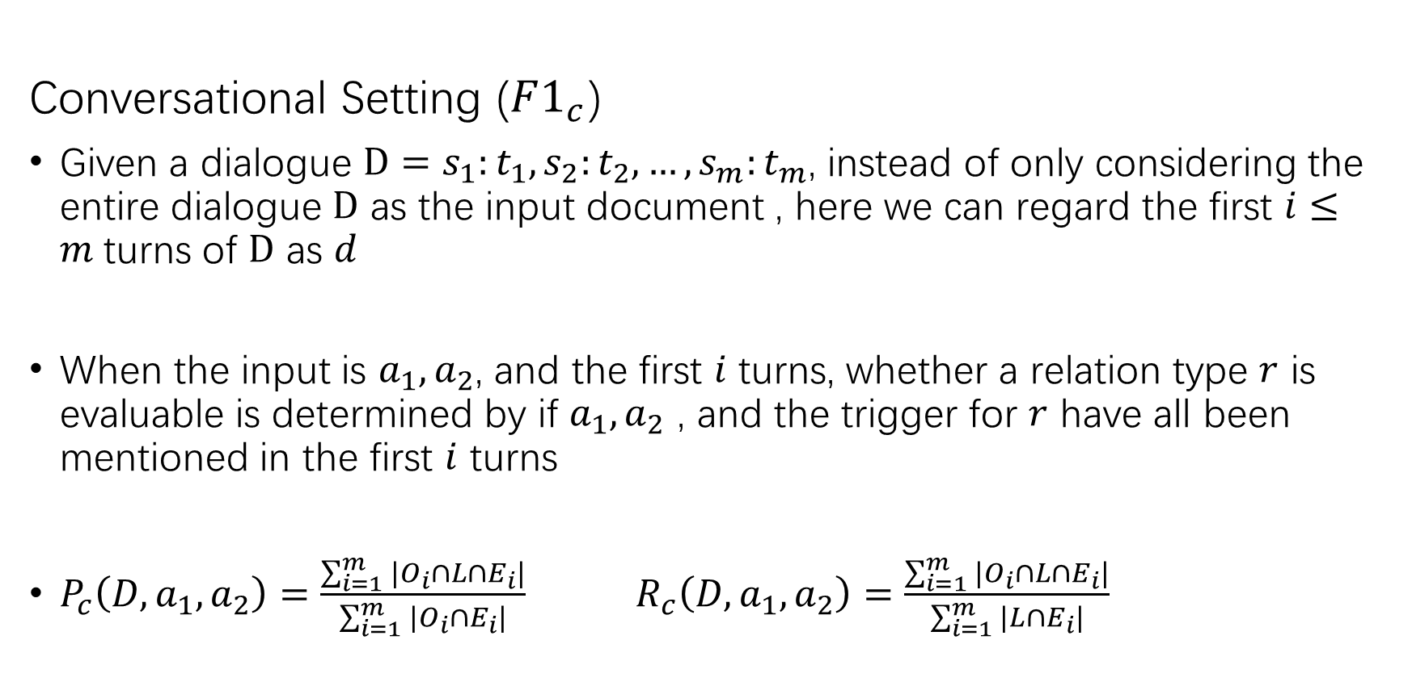
Metrics
Conversational Setting ($F1_{c}$)
Given a dialogue $D=s_{1}:t_{1}, s_{2}:t_{2}, …, s_{m}:t_{m}$, instead of only considering the entire dialogue $D$ as the input document , here we can regard the first $i≤m$turns of $D$ as $d$
When the input is $a_{1}, a_{2}$, and the first $i$ turns, whether a relation type $r$ is evaluable is determined by if $a_{1}, a_{2}$ , and the trigger for $r$ have all been mentioned in the first $i$ turns
$P_{c}\left(D,a_{1},a_{2}\right)=\frac{\sum_{i=1}^{m}{|O_{i}∩L∩E_{i}|}}{\sum_{i=1}^{m}{|O_{i}∩E_{i}|}}$ $R_{c}\left(D,a_{1},a_{2}\right)=\frac{\sum_{i=1}^{m}{|O_{i}∩L∩E_{i}|}}{\sum_{i=1}^{m}{|L∩E_{i}|}}$

Slide 9
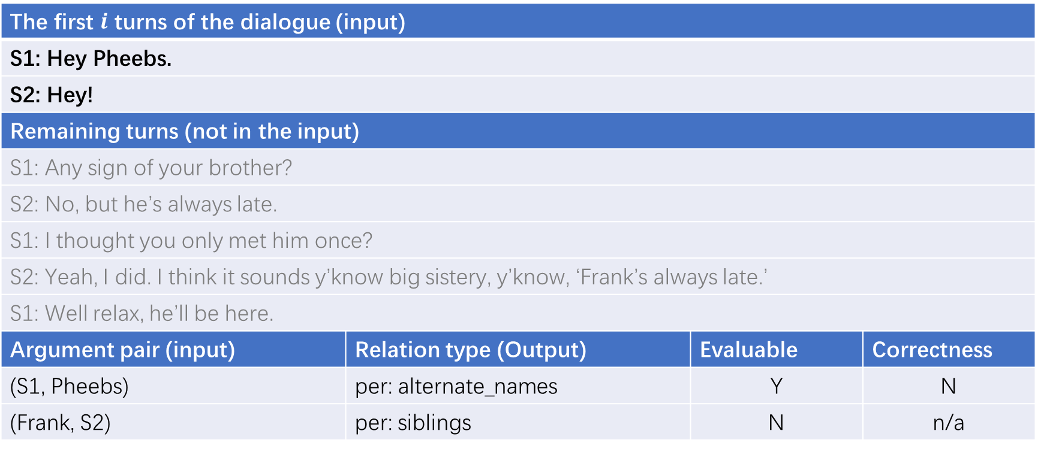
Metrics
Argument pair | Trigger | Relation type
R1 (Frank, S2) | brother | per: siblings
R2 (S2, Frank) | brother | per: siblings
R3 (S2, Pheebs) | none | per: alternate_names
R4 (S1, Pheebs) | none | unanswerable
The first $i$ turns of the dialogue (input)
S1: Hey Pheebs.
S2: Hey!
Remaining turns (not in the input)
S1: Any sign of your brother?
S2: No, but he’s always late.
S1: I thought you only met him once?
S2: Yeah, I did. I think it sounds y’know big sistery, y’know, ‘Frank’s always late.’
S1: Well relax, he’ll be here.
Argument pair (input) | Relation type (Output) | Evaluable | Correctness
(S1, Pheebs) | per: alternate_names | Y | N
(Frank, S2) | per: siblings | N | n/a

Slide 10
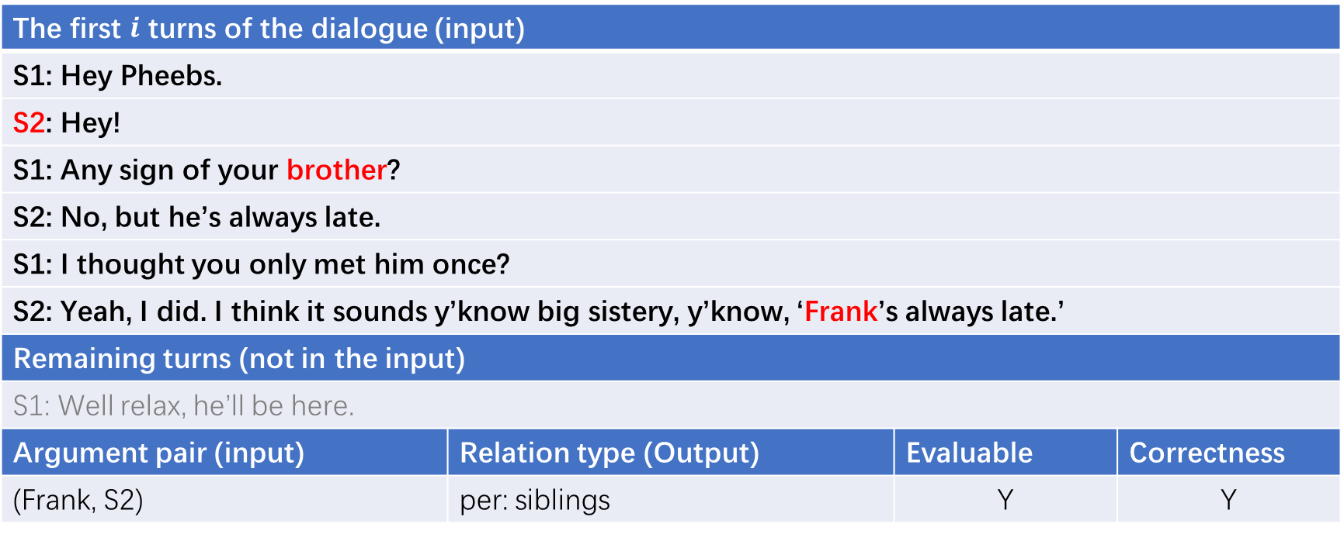
Metrics
Argument pair | Trigger | Relation type
R1 (Frank, S2) | brother | per: siblings
R2 (S2, Frank) | brother | per: siblings
R3 (S2, Pheebs) | none | per: alternate_names
R4 (S1, Pheebs) | none | unanswerable
The first $i$ turns of the dialogue (input)
S1: Hey Pheebs.
S2: Hey!
S1: Any sign of your brother?
S2: No, but he’s always late.
S1: I thought you only met him once?
S2: Yeah, I did. I think it sounds y’know big sistery, y’know, ‘Frank’s always late.’
Remaining turns (not in the input)
S1: Well relax, he’ll be here.
Argument pair (input) | Relation type (Output) | Evaluable | Correctness
(Frank, S2) | per: siblings | Y | Y

Slide 11
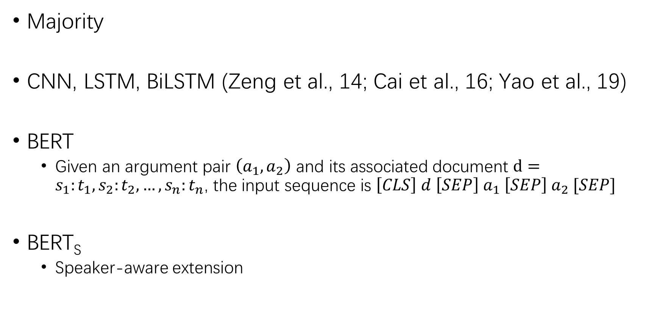
Baselines
Majority
CNN, LSTM, BiLSTM (Zeng et al., 14; Cai et al., 16; Yao et al., 19)
BERT
Given an argument pair $\left(a_{1}, a_{2}\right)$ and its associated document $d=s_{1}:t_{1}, s_{2}:t_{2}, …, s_{n}:t_{n}$, the input sequence is $\left[CLS\right] d \left[SEP\right] a_{1} \left[SEP\right] a_{2} [SEP]$
BERT_{S}
Speaker-aware extension

Slide 12


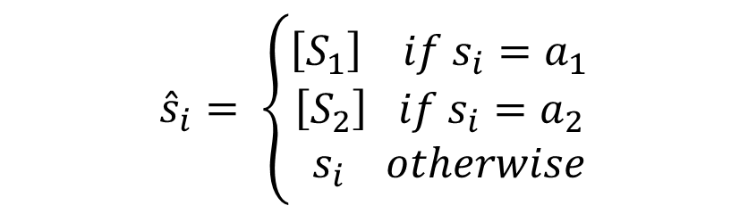
Speaker-Aware Extension
BERT_{S}
Given an argument pair $\left(a_{1}, a_{2}\right)$ and its associated document $d=s_{1}:t_{1}, s_{2}:t_{2}, …, s_{n}:t_{n}$, we construct $\hat{d}={\hat{s}}_{1}:t_{1}, {\hat{s}}_{2}:t_{2}, …, {\hat{s}}_{n}:t_{n}$ and ${\hat{a}}_{1},{\hat{a}}_{2}$
The input sequence isis $\left[CLS\right]\hat{d}\left[SEP\right]{\hat{a}}_{1}\left[SEP\right]{\hat{a}}_{2}[SEP]$
$${\hat{s}}_{i}= \left\{\begin{aligned}\left[S_{1}\right] if s_{i}=a_{1} \\ \left[S_{2}\right] if s_{i}=a_{2} \\ { s}_{i} otherwise\end{aligned}\right.$$
$${\hat{a}}_{i}= \left\{\begin{aligned}\left[S_{1}\right] if ∃i(s_{i}=a_{i}) \\ a_{i} otherwise\end{aligned}\right.$$

Slide 13
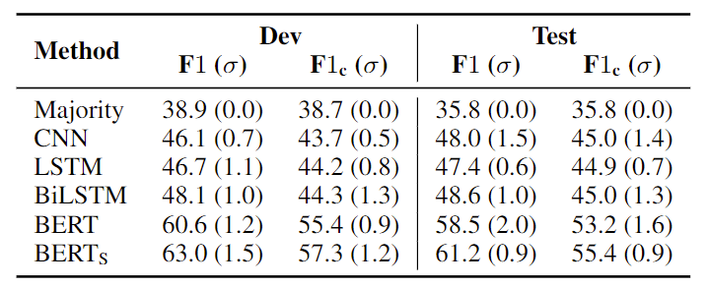
Results
Performance of relation extraction methods on DialogRE in both the standard and conversational settings

Slide 14
Discussion
All transcripts for annotation are from Friends, which may limit the diversity of scenarios and generality of the relation distributions
Dialogues in Friends presents less variation based on linguistic features than natural conversations

Slide 15
Summary
Present DialogRE, the first human-annotated dialogue-based relation extraction dataset
Design a new metric to evaluate the performance of relation extraction methods in a conversational setting
Establish a set of baseline results and demonstrate the importance of explicit recognition of speaker arguments in dialogue-based relation extraction

Slide 16
Thanks!

