Slide 1
Improving Conversational Recommender Systems via Knowledge Graph based Semantic Fusion 基于知识图谱的语义融合改进会话推荐系统
张钰波
Nov. 5, 2020

Slide 2
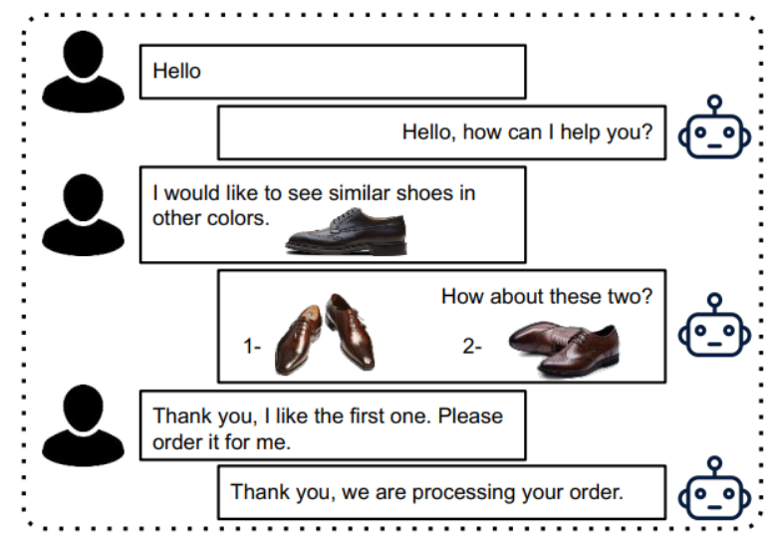
Research Background
What is a Conversational recommender systems (CRS)？
CRS aim to recommend high-quality items to users through interactive conversations.

Slide 3
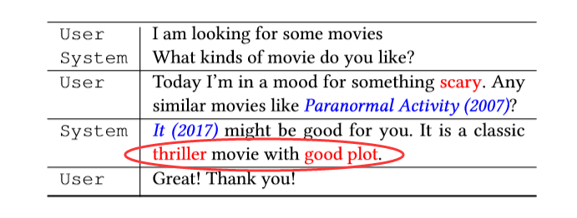
Research Background
Currently existing problems
Lack of sufficient contextual information.
There is a semantic gap between natural language expression and item-level user preference.

Slide 4
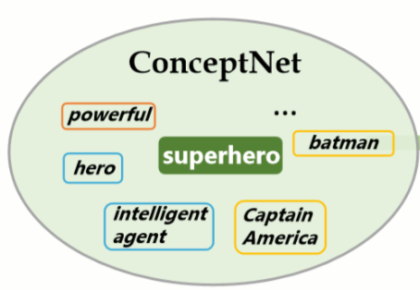
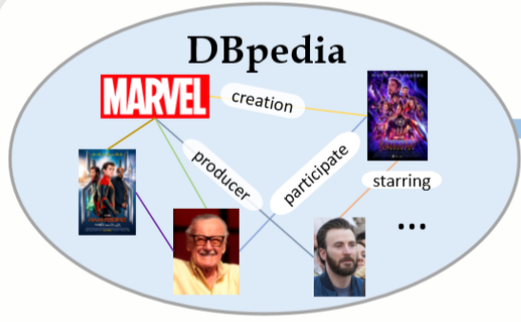
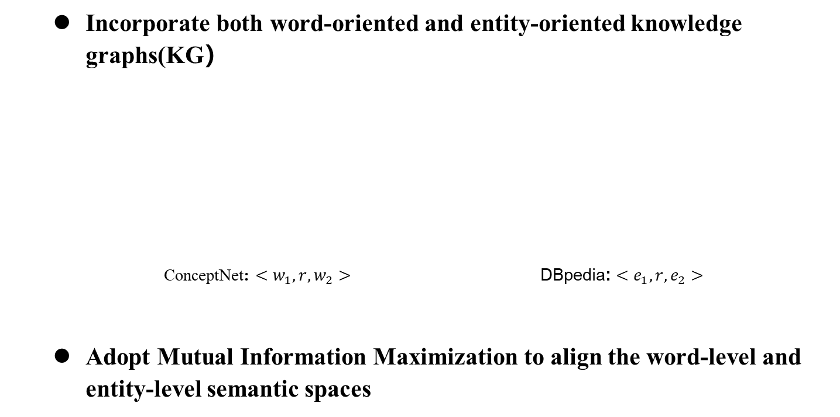
Innovation
Incorporate both word-oriented and entity-oriented knowledge graphs(KG）
ConceptNet: $<w_{1},r,w_{2}>$ DBpedia: $<e_{1},r,e_{2}>$
Adopt Mutual Information Maximization to align the word-level and entity-level semantic spaces

Slide 5
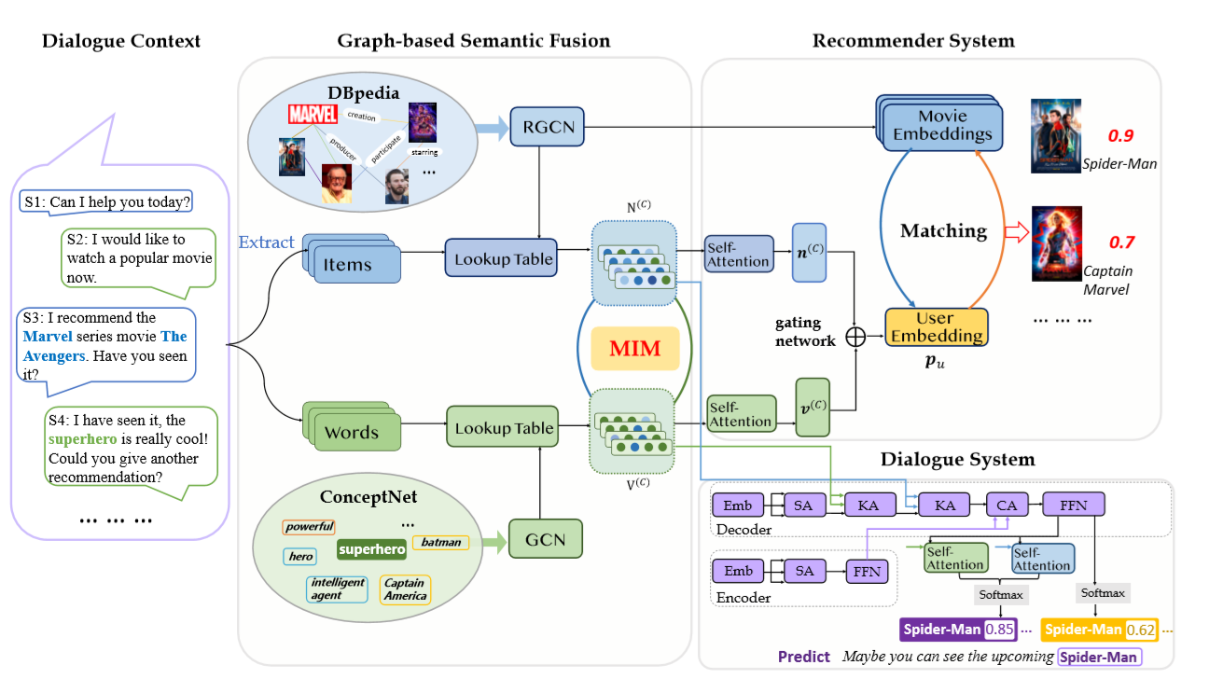
Approach
KG-enhanced Recommender Module
Gate mechanism:
$$p_{u}= β∙v^{\left(c\right)}+\left(1−β\right)∙n^{\left(c\right)}$$
$$β=σ(W_{gate}\left[v^{\left(c\right)};n^{\left(c\right)}\right])$$
Probability:
$${Pr}_{rec}\left(i\right)=softmax\left(p_{u}^{T}∙n_{i}\right)$$
Cross-entropy:
$$L_{rec}=−\sum_{j=1}^{N}{\sum_{i=1}^{M}{\left((1−y_{ij}\right)∙\log\left(1−{Pr}_{rec}^{\left(j\right)}\left(i\right)\right)+y_{ij}∙\log\left({Pr}_{rec}^{\left(j\right)}\left(i\right)\right))+λ∗L_{MIM}}}$$
Gate mechanism:
𝒑_𝑢= 𝛽∙𝒗^((𝑐) )+(1−𝛽)∙𝒏^((𝑐) )
𝛽=𝜎(𝑾_𝑔𝑎𝑡𝑒 [𝒗^((𝑐) );𝒏^((𝑐) ) ])
Probability:
〖𝑃𝑟〗_𝑟𝑒𝑐 (𝑖)=𝑠𝑜𝑓𝑡𝑚𝑎𝑥(𝒑_𝑢^𝑇∙𝒏_𝑖 )
Cross-entropy:
𝐿_𝑟𝑒𝑐=−∑24_(𝑗=1)^𝑁▒∑24_(𝑖=1)^𝑀▒〖((1−𝑦_𝑖𝑗 )∙log⁡(1−〖𝑃𝑟〗_𝑟𝑒𝑐^((𝑗) ) (𝑖))+𝑦_𝑖𝑗∙log⁡(〖𝑃𝑟〗_𝑟𝑒𝑐^((𝑗) ) (𝑖)))+𝜆∗𝐿_𝑀𝐼𝑀 〗
KG Fusion via Mutual Information Maximization
$$MI\left(X,Y\right)=D_{KL}(p(X,Y)||p\left(X\right)p\left(Y\right))$$
𝑀𝐼(𝑋,𝑌)=𝐷_𝐾𝐿 (𝑝(𝑋,𝑌)||𝑝(𝑋)𝑝(𝑌))
$$MI\left(X,Y\right)≥𝔼_{P}\left[g\left(x,y\right)\right]−𝔼_{N}\left[g(x^{′},y^{′})\right]$$
$$g\left(e,w\right)=σ(n_{e}^{T}·T·v_{w})$$
𝑀𝐼(𝑋,𝑌)≥𝔼_𝑃 [𝑔(𝑥,𝑦)]−𝔼_𝑁 [𝑔(𝑥^′,𝑦^′)]
𝑔(𝑒,𝑤)=𝜎(𝒏_𝑒^𝑇·𝑻·𝒗_𝑤)
$$v_{w}^{\sim }=V^{(c)}∙α$$
$$α=softmax(b^{T}∙tanh⁡(W_{α}V^{(c)}))$$
𝒗_𝑤^~=𝑽^((𝑐))∙𝜶
𝜶=𝑠𝑜𝑓𝑡𝑚𝑎𝑥(𝒃^𝑇∙tanh⁡(𝑾_𝛼 𝑽^((𝑐))))

Slide 6
Approach
KG-enhanced Response Generation Module
$${ A}_{1}^{n}=MHA(A_{0}^{n}, V^{\left(c\right)},V^{\left(c\right)})$$
〖 𝑨〗_1^𝑛=𝑀𝐻𝐴(𝑨_0^𝑛, 𝑽^((𝑐) ),𝑽^((𝑐) ))
${ A}_{0}^{n}=MHA(R^{n−1},R^{n−1}$, $R^{n−1}$)
〖 𝑨〗_0^𝑛=𝑀𝐻𝐴(𝑹^(𝑛−1),𝑹^(𝑛−1), 𝑹^(𝑛−1))
$${ A}_{2}^{n}=MHA(A_{1}^{n}, N^{\left(c\right)},N^{\left(c\right)})$$
〖 𝑨〗_2^𝑛=𝑀𝐻𝐴(𝑨_1^𝑛, 𝑵^((𝑐) ),𝑵^((𝑐) ))
$${ A}_{3}^{n}=MHA(A_{2}^{n},X,X)$$
〖 𝑨〗_3^𝑛=𝑀𝐻𝐴(𝑨_2^𝑛,𝑿,𝑿)
$R^{n}=FFN(A_{3}^{n})$
𝑹^𝑛=𝐹𝐹𝑁(𝐴_3^𝑛)
Self-attention
Cross-attention

Slide 7
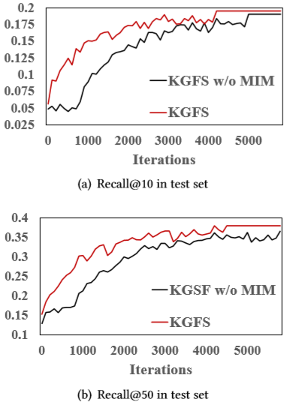
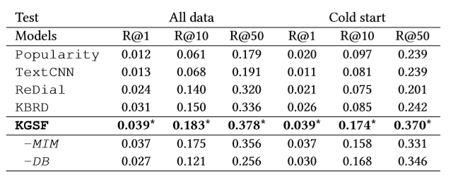
Evaluation
Evaluation on Recommendation Task
Only utilize the entities or items
Incorporating one external KG information
Incorporating two external KGs information

Slide 8
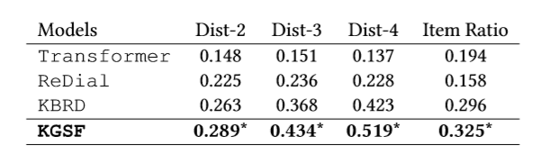
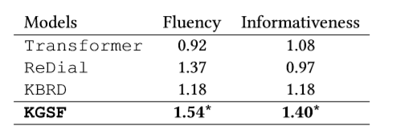
Evaluation
Evaluation on Conversation Task
Automatic Evaluation
Human Evaluation

Slide 9
Enlighten
Enrich data.
Solve the sparsity and cold start problems of traditional recommendation systems.
Cross-domain recommendation through multiple knowledge graphs.

Slide 10
Concluding remarks
Thank you!

