Slide 1
KagNet: Knowledge-Aware Graph Networks for Commonsense Reasoning
Bill Yuchen Lin Xinyue Chen Jamin Chen Xiang Ren {yuchen.lin,jaminche,xiangren}@usc.edu, kiwisher@sjtu.edu.cn
Computer Science Department, University of Southern California
Computer Science Department, Shanghai Jiao Tong University Patrick P. C. Lee, The Chinese University of Hong Kong
Notes:
常识推理的知识感知图网络

Slide 2
Background

Slide 3

Introduction
Common sense reasoning : Common sense reasoning refers to making machines have the same reasoning assumptions as humans
Making machines possess common sense reasoning capabilities has become the bottleneck of artificial intelligence
Notes:
使机器像人一样具备对平常情况做推理假设的能力
使机器具备常识推理能力已成为人工智能的瓶颈

Slide 4
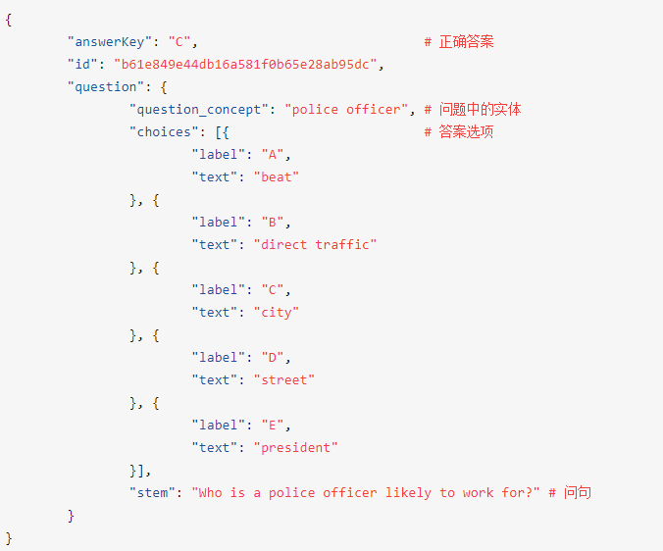
CommonsenseQA
Recently, many data sets related to machine question answering (reasoning) have been produced. A typical representative is CommonsenseQA. The data organization of this data set is:
For this data set form, the task of common sense question answering (reasoning) is to select the correct answer from the set of candidate answers. Because the wrong answer is usually also contextual, it increases the difficulty of reasoning.

Slide 5
Knowledge-Aware Graph Networks

Slide 6
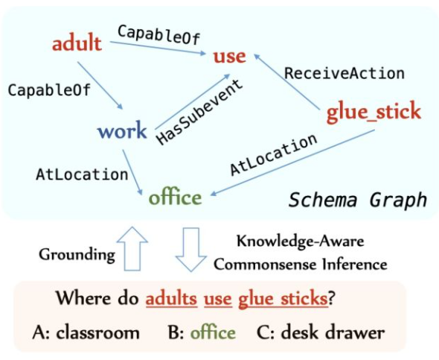
Problem statement
• schema graph grounding
• graph modeling for inference

Slide 7
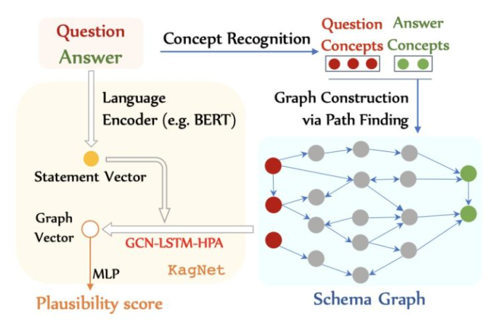
Reasoning Workflow
• Step 1, For each question-answer pair, the author retrieves a subgraph from ConceptNet and named it schema graph
• Step 2. Propose the KAGNET framework to model the schema graph. The architecture of this framework is the GCN-LSTM-HPA architecture, and the purpose of this architecture is to generate a path-based representation of the schema graph
Notes:
提出KAGNET框架对schema graph进行建模。该框架的架构是GCN-LSTM-HPA架构，该架构的目的是对shema graph生成基于路径的关系图的表示。

Slide 8
Schema Graph Grounding

Slide 9
Concept Recognition
•N-gram matching: the token in the sentence is matched with the vertex set of ConceptNet for
n-gram matching
Note: Effectively extracting contextual knowledge from noisy knowledge sources is still an open question
Schema Graph Construction
• Take a direct and effective method: Find a path between the Concept mentioned in Q and A directly
For a Concept in the question and a Concept in the candidate, find the path between them that is less than k and add it to the figure
Path Pruning via KG Embedding
• The schema graph obtained at the beginning contains a lot of noise and needs to be pruned.
First divide the path into the form of triples
Use knowledge graph embedding algorithms, to calculate the confidence of each triplet and Multiply the confidence of all triples under the path
Discard paths with confidence less than a given threshold

Slide 10
Knowledge-Aware Graph Network

Slide 11
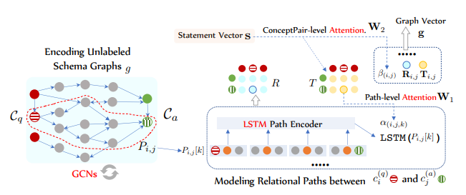
• Step 1, Use GCN to encode the graph
• Step 2, Use LSTM to encode the path between Cq and Ca to capture multi-hop relational Information
• Step 3, Use hierarchical path-based attention to calculate the path relationship between the relational schema graph and QA pair

Slide 12


Graph Convolution Networks
GCN can update the data node representation of the graph structure through the pooling features of neighboring nodes
Calculation of GCN on the schema graph:
Use the concept embedding obtained by pre-training as the initial representation of the GCN calculation graph node：

Slide 13





Relational Path Encoding
Define the k-path between the i concept in the question and the j concept in the candidate answer as :
• The relation vector is obtained by KGE pre-training;
• The concept vector is the top-level output of the GCN in the previous link;
• Each triple is represented as: the concatenation of the three vectors of head entity, tail entity, and relationship
Use LSTM to encode a sequence of triple vectors to get the path vector:

Slide 14



mean-pooling
can be regarded as the potential relationship between the concept in the question and the concept in the candidates.
1. The Relation Network method is used here:
•
• statement vector s is the representation of LM encoder
2. Calculate graph vector by mean-pooling: This calculation method is called GCN-LSTM-mean
g Means average pooling：
3. The plausibility score of the final candidate:

Slide 15
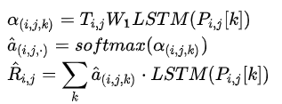


Hierarchical Attention Mechanism
Considering that different paths are of different importance to reasoning, mean-pooling is not a preferable way.
The hierarchical path-based attention mechanism can selectively gather important path vectors and more important QA concept pairs.
path-level：
2. concept-pair level：
3. graph vector：

Slide 16
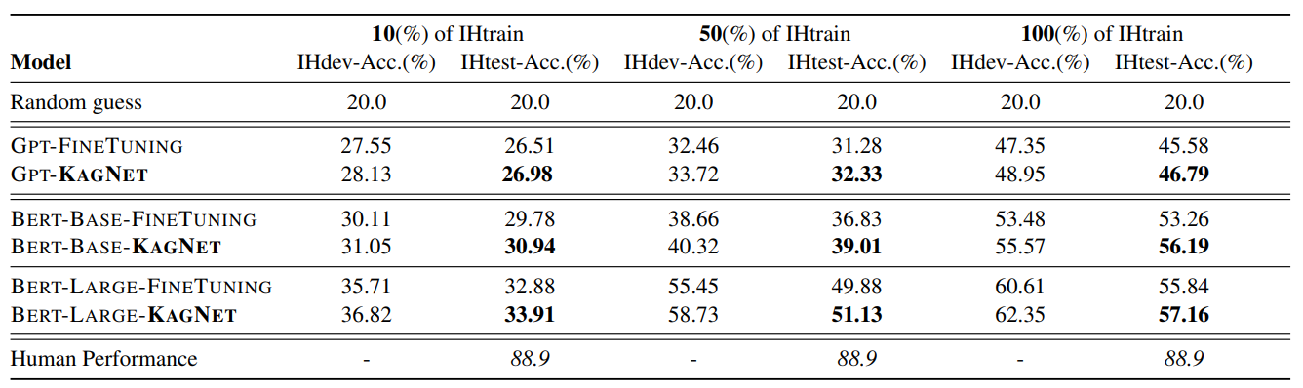
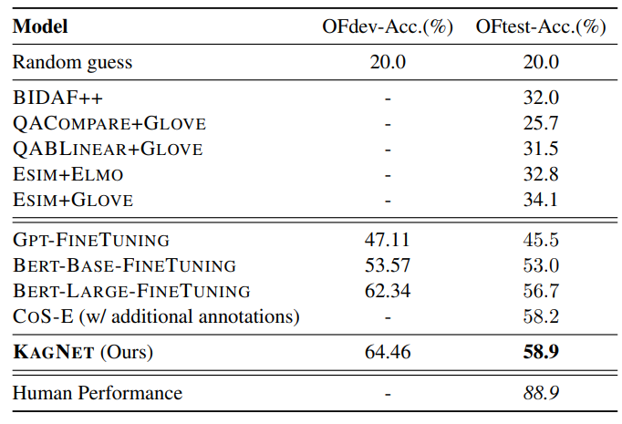
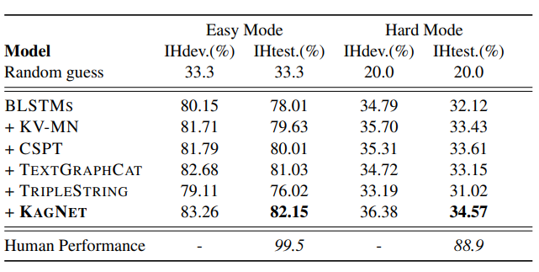

Slide 17
Conclusion

Slide 18
Advantage
• Introduced ConceptNet
• Use hierarchical attention to calculate relevance score
• Interpretability of results and transparency of model behavior

Slide 19
Disadvantage
• negative reasoning
• comparative reasoning strategy
• subjective reasoning

