Slide 1
Transfer in Deep Reinforcement Learning using Knowledge Graphs
Name：Zhang Tao
ID：51205901088
Date：12 Nov

Slide 2


Motivation
Deep Reinforcement Learning

Slide 3
Motivation
Deep Reinforcement Learning

Slide 4
Motivation
Deep Reinforcement Learning
Text-Adventure Games

Slide 5
Motivation
Deep Reinforcement Learning
Text-Adventure Games
KG-DQN
Knowledge Graph
Deep Q Learning
Transfer

Slide 6
Motivation
Deep Reinforcement Learning
Text-Adventure Games
KG-DQN
Knowledge Graph
Deep Q Learning
Transfer

Slide 7
KG-DQN
Knowledge Graph Representation
Open Information Extraction (OpenIE)
current room type ‘has’ items
<chamber , has , bed stand>
current room ‘link’entrances and exits
<basement , has , exit to north>
room ‘direct to’ room
<chamber , east of , basement>
“you”node
<you , have , cubical key>

Slide 8
KG-DQN
Knowledge Graph Representation
Open Information Extraction (OpenIE)
current room type ‘has’ items
<chamber , has , bed stand>
current room ‘link’entrances and exits
<basement , has , exit to north>
room ‘direct to’ room
<chamber , east of , basement>
“you”node
<you , have , cubical key>

Slide 9
KG-DQN
Knowledge Graph Representation
Open Information Extraction (OpenIE)
current room type ‘has’ items
<chamber , has , bed stand>
current room ‘link’entrances and exits
<basement , has , exit to north>
room ‘direct to’ room
<chamber , east of , basement>
“you”node
<you , have , cubical key>
Persist after each action
Update after each action

Slide 10
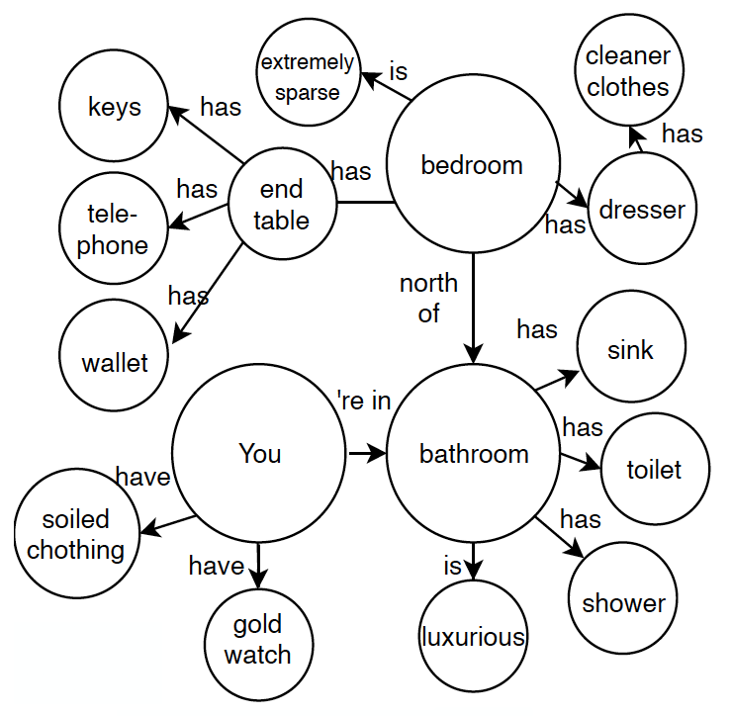

KG-DQN
Knowledge Graph Representation
Open Information Extraction (OpenIE)
current room type ‘has’ items
<chamber , has , bed stand>
current room ‘link’entrances and exits
<basement , has , exit to north>
room ‘direct to’ room
<chamber , east of , basement>
“you”node
<you , have , cubical key>

Slide 11
KG-DQN
Knowledge Graph Representation
Open Information Extraction (OpenIE)
current room type ‘has’ items
<chamber , has , bed stand>
current room ‘link’entrances and exits
<basement , has , exit to north>
room ‘direct to’ room
<chamber , east of , basement>
“you”node
<you , have , cubical key>

Slide 12
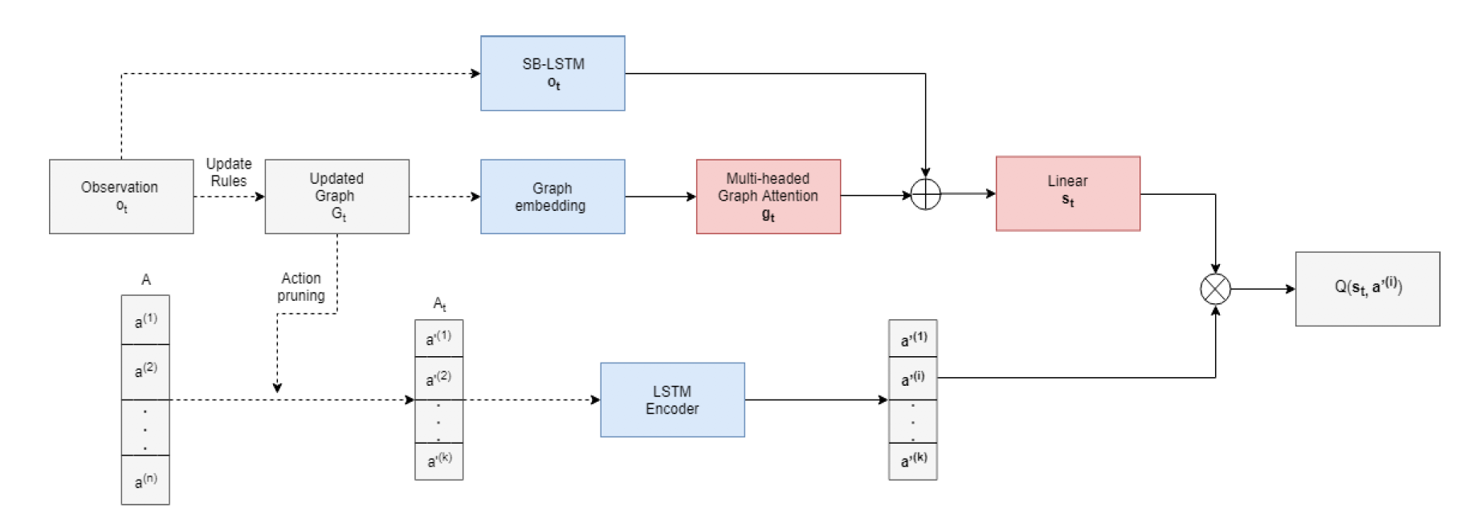
KG-DQN
Deep Q Learning

Slide 13
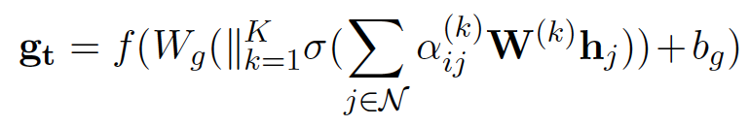
KG-DQN
Deep Q Learning

Slide 14

KG-DQN
Deep Q Learning

Slide 15
KG-DQN
Deep Q Learning

Slide 16

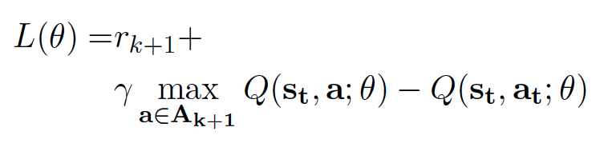
KG-DQN
Deep Q Learning

Slide 17
Motivation
Deep Reinforcement Learning
Text-Adventure Games
KG-DQN
Knowledge Graph
Deep Q Learning
Transfer

Slide 18
Transfer
Knowledge Graph Seeding
Text-adventure games
Horror
Seeding
Sci-fi
Give the agent a strong prior
Soap opera
......

Slide 19
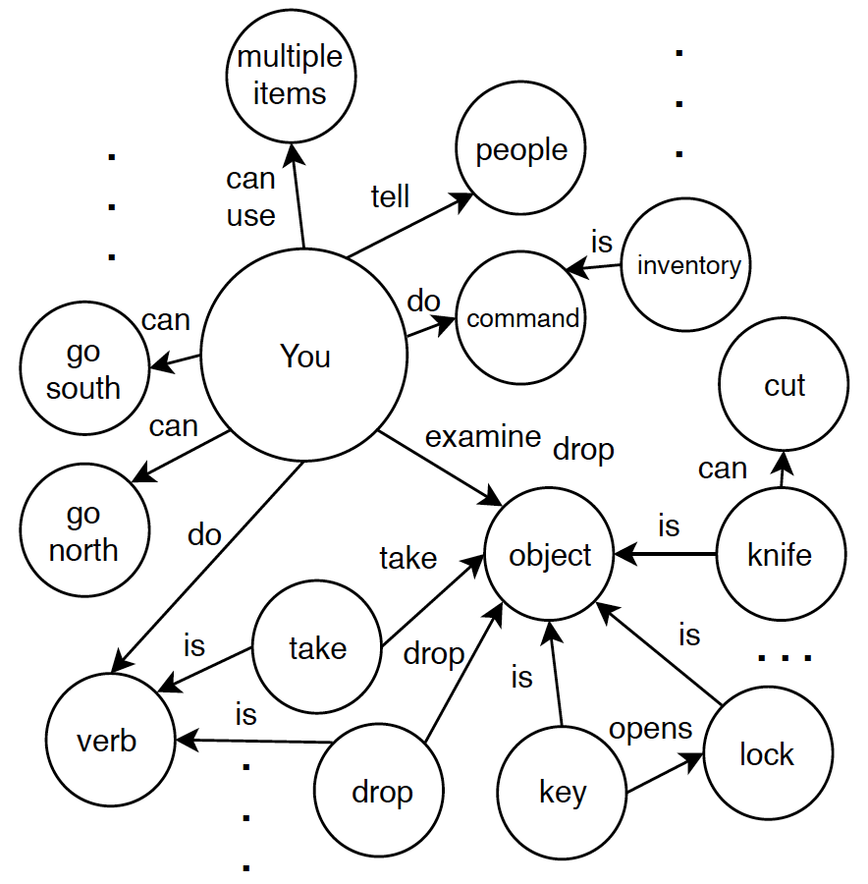
Transfer
Knowledge Graph Seeding
Text-adventure games
Give the agent a strong prior
Horror
Seeding
Sci-fi
Soap opera
......

Slide 20
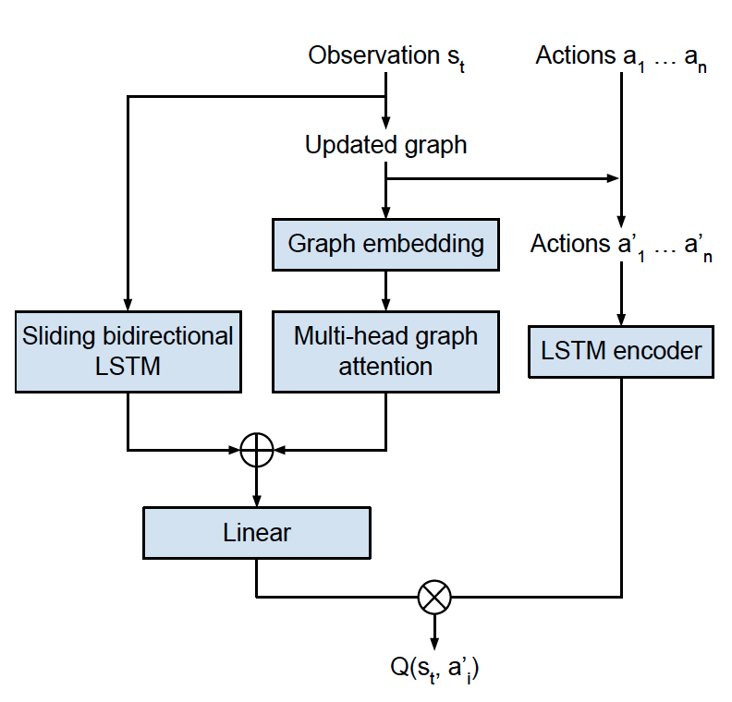
Transfer
Task Specific Transfer
Source task
QA
same
domain
Initialize parameters
Q-net
Target task
Notes:
与Rusu等(2016)不同的是，我们并没有冻结源任务上训练的深层Qnetwork的参数，也没有使用双子网络共同做出决策，而是只用它来初始化目标任务深层Q-网络的参数。这样做是为了考虑到虽然图嵌入可以在游戏之间转移，但由于游戏之间的结构差异，从游戏中提取的实际图是不可转移的。

Slide 21
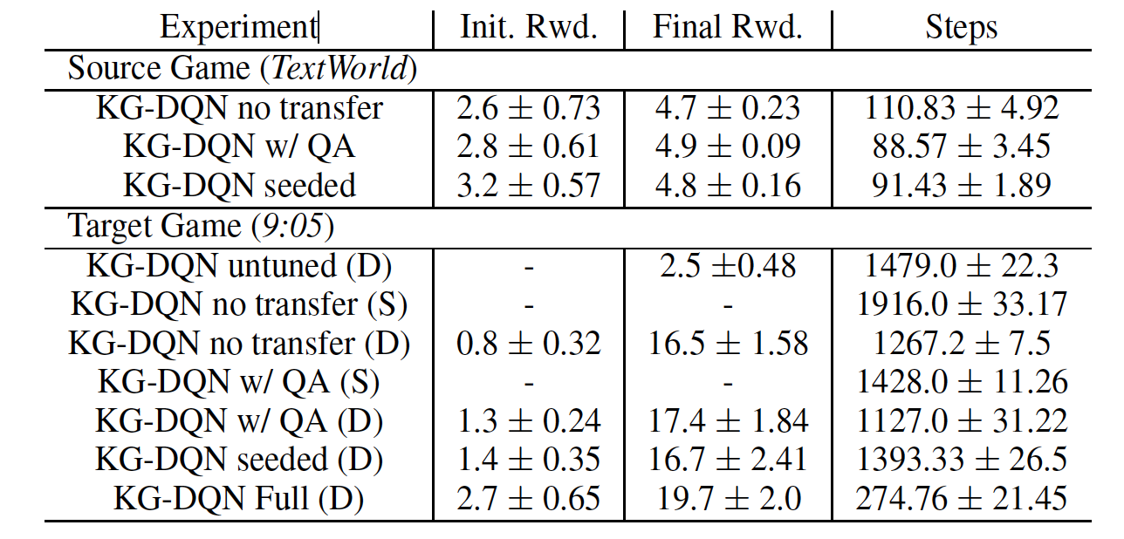
Experiments

Slide 22
Transfer
Task Specific Transfer
Source task
QA
same
domain
Initialize parameters
Q-net
Target task
Notes:
与Rusu等(2016)不同的是，我们并没有冻结源任务上训练的深层Qnetwork的参数，也没有使用双子网络共同做出决策，而是只用它来初始化目标任务深层Q-网络的参数。这样做是为了考虑到虽然图嵌入可以在游戏之间转移，但由于游戏之间的结构差异，从游戏中提取的实际图是不可转移的。

Slide 23
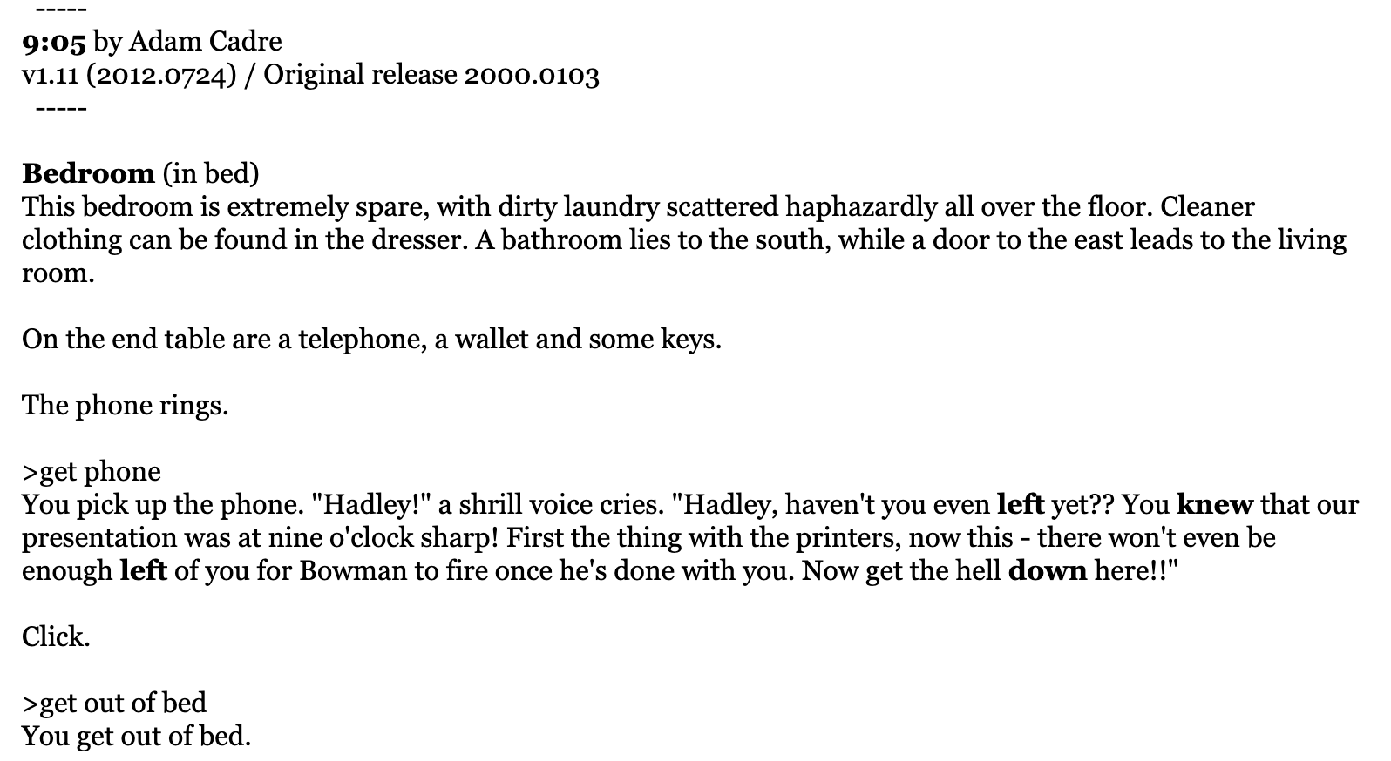
GAME

Slide 24
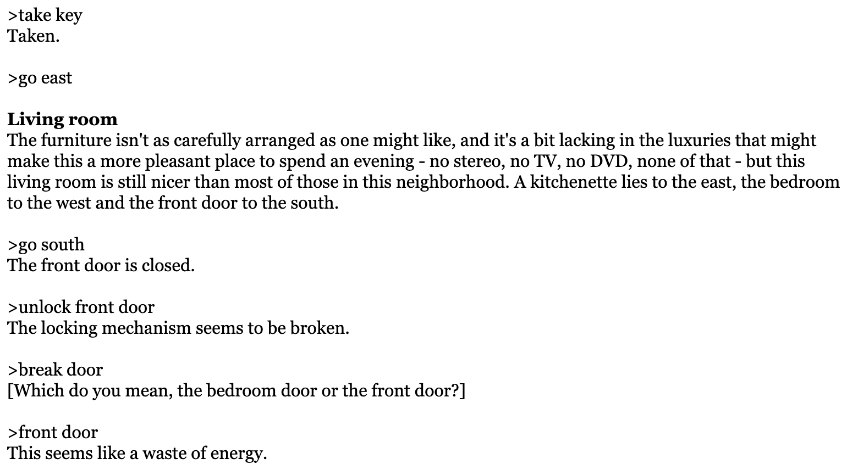
GAME

Slide 25
THANK YOU
Name：Zhang Tao
ID：51205901088
Date：12 Nov

