Slide 1
WEB-SCRAPING
The technique to extract data from websites.

Slide 2

WEB Scraping :-
Web scraping is a technique used to extract data from websites. It involves the automated process of sending HTTP requests to a website, retrieving the HTML content, and then parsing that content to extract specific information. This information can include text, images, links, and other types of data present on the web pages.

Slide 3
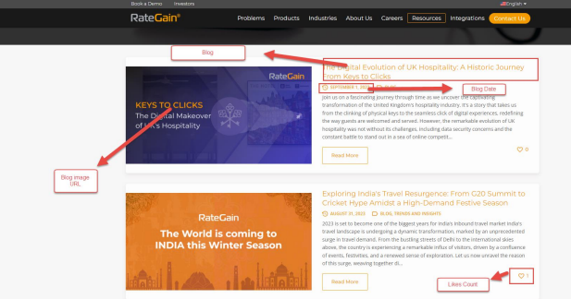
Scraping task
● Blog title: To capture the titles of the blog posts.
● Blog date: To retrieve the publication dates of each blog post.
● Blog image URL: To extract blog image associated URL’s.
● Blog likes count: To get the blog likes count

Slide 4
Approach
Reading the given documentations.
Visiting the website to get the contents idea.
Analyze the way to scrap particular data from a website.
Researched the way to get data dynamically from multiple pages.
Connected the code to website for real time data.
Implementation of logic according to requirement of data.
Manual testing of tabulation of data.
Exporting data to desired format.

Slide 5


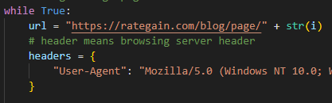
Logic and Coding Section
Importing required libraries.
Initialized empty lists to get data or store data for exporting.
Initialized empty lists to get data or store data for exporting.
Started loop to get all blog data.
Defined website and header (Browsing header server).

Slide 6
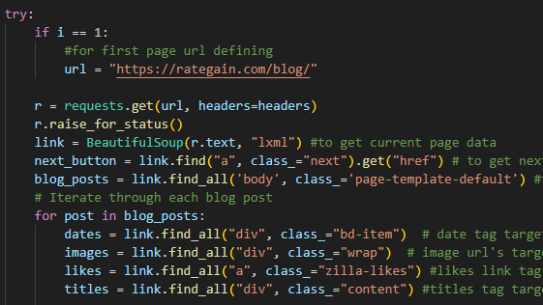
Main Loop initialization :-
Started try block to get data from pages until met error.
Introduced code for first page targeting.
Connected code to website.
Extracted complete webpage raw data.
Triggered next page button as “next_button” .
Started main post targeting tag loop.
Targeted each post required data tags.

Slide 7

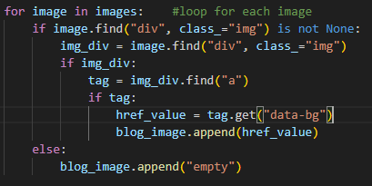
Adding Data to Lists & Making CSV
To get date data a for loop is initiated.
Data appended on each iteration.
For Image started a for loop and targeted inner tag.
Appended data in blog_image list made in beginning for each iteration.
For empty data inserted/appended keyword “empty” in the list.

Slide 8
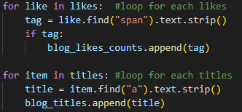
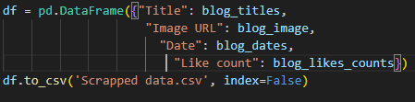
To get like data a for loop is initiated.
Data appended on each iteration.
Similarly, to get Titles data a for loop is initiated.
Data appended on each iteration.
Made all collected data into a dictionary.
Send data to CSV format to the active directory.

