Slide 1

TheraBot
A Product By The Whyte Company

Slide 2
TheraBot
1
A Product By The Whyte Company
The Problem
The Mental State of India and Psychology

Slide 3
1
The Problem
The Mental State of India and Psychology

Slide 4
Mental Health
Mental health is a growing concern in India, with an increasing number of people facing mental health challenges. However, the scarcity of mental health professionals and therapeutic resources is a significant issue.

Slide 5
Statistics
Mental Disorders
Globally, India has the highest number of people suffering from some form of mental condition, with every 3 out of 10 Indians suffering from depression or anxiety.
3/10

Slide 6
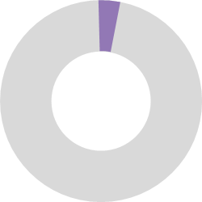
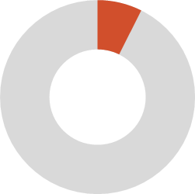
State of Therapy in India
India has only 0.3 psychiatrists per 100k people
India has only 0.86 psychologists per 100k people

Slide 7
The Wait Times
2
Start
Sessions
Diagnosis
Medical
End
The Solution
TheraBot: Assisting in Efficient Therapy
3 to 6 weeks for first session
Each session is about 24-48 hrs
1-2 weeks for a diagnosis
2-4 weeks for special medicine
Therapy can take years to end

Slide 8
2
The Solution
TheraBot: Assisting in Efficient Therapy

Slide 9
How Does TheraBot Help?
TheraBot streamlines initial diagnosis through natural conversations, delivering detailed patient insights to help therapists address root problems efficiently.

Slide 10



How Does TheraBot Work?
25%
50%
100%
3
The Customer
Where does TheraBot fit in?
Initial
Intermediate
Final
TheraBot gets to know more about you through casual conversation
TheraBot pinpoints your underlying mental problems and records it
TheraBot provides you with resources to help, and makes a synopsis for your therapist

Slide 11
3
The Customer
Where does TheraBot fit in?

Slide 12
The Customer Base
2+ Million
150K
5-10K
Therapists, psychiatrists and psychologists
Mental Health Institutes
Research centers

Slide 13
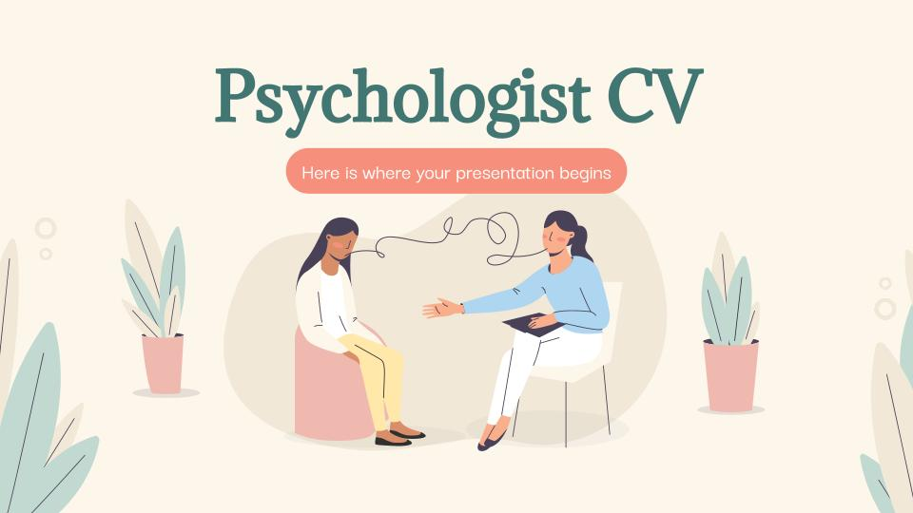
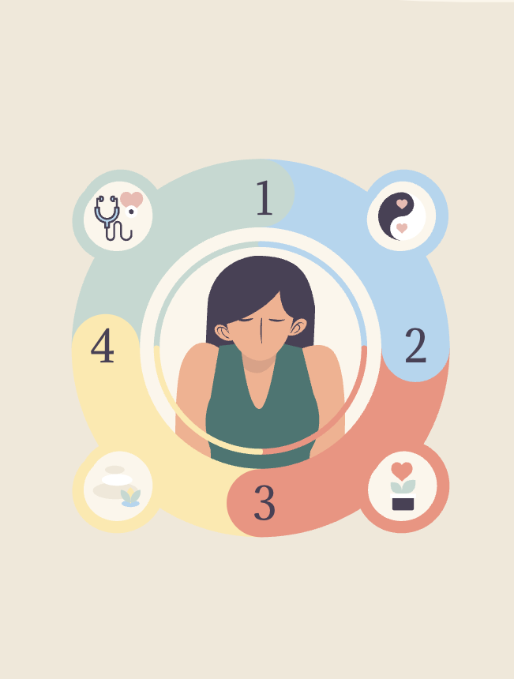
The User Base
970 million
The amount of people that could be using TheraBot
TheraBot is a web based application, which means it can be accessed from any device with an internet connection.
This expands the user base to include both new therapy patients and individuals curious about their mental health.

Slide 14
970 million
4
The Market
The amount of people that could be using TheraBot
Is TheraBot a viable product?

Slide 15
4
The Market
Is TheraBot a viable product?

Slide 16
Funding for Mental Health
Government
Increased from 38 crores to 500 crores
Private
Increased from 100 crores to 700 crores
Research
Increased from 100 crores to 200 crores
Data shown graphically is in terms of 100 crores per y axis unit. Data is from publicly available sources for 2019 and 2024 estimates for India.

Slide 17


Why TheraBot Over the Other?
TheraBot
Replacement for traditional therapy
Cannot be used alongside actual therapist
No medical basis
Used alongside human therapist
Helps in initial diagnosis, allowing full control to therapist
Can help with medical recommendation, as final dosage relies on medical expert

Slide 18
Marketing Strategy
Online
Government
Free Trials
Education
Institution
Testimonials
4
therabotAI.glitch.me provides an online interface for our customers
TheraBot can approach government for funding
Investment
The individual customer can opt for free trials
TheraBot can be used in colleges to assist graduates
Hello Sharks! Are You In?
TheraBot is advertised via testimonials and social proof
TheraBot is provided to mental institutions specifically fitting their needs

Slide 19
4
Investment
Hello Sharks! Are You In?

Slide 20
What We Ask For
Thanks!
6 lakhs for 15 percent of TheraBot.io
This includes:
Access to advertising options of the site (With approval from our side)
Ownership of 15 percent of TheraBot and subsidiaries
A designation at company board meetings
Sources:
National Health Survey of India
World Health Organization
National Mental Health Program
National Institute of Mental Health and Neuroscience

Slide 21
Thanks!
Sources:
National Health Survey of India
World Health Organization
National Mental Health Program
National Institute of Mental Health and Neuroscience

