Slide 1
Entertainer Data Analysis By Preeti R
Email Id-
rituganesh01@gmail.com

Slide 2

Introduction
The entertainment industry provides a much-needed respite from the stress of daily life, offering a diverse array of media formats such as film, television, radio, and print. From movies and TV shows to music and literature, these platforms offer moments of relaxation and joy, making life's challenges easier to bear. Comprising various sub-industries, it encompasses mass media companies that control the distribution and production of entertainment, serving as a beacon of creativity and connection in an increasingly fast-paced world.

Slide 3

Data Cleaning Process
1- Merged the data from three separate Excel sheets into one final Excel sheet named "Entertainer Cleaned Data" using Power BI.
2- Created a new column in the combined dataset named "Profession" to categorize entertainers based on their respective fields or areas of expertise.
3-Replaced any blank spaces in the "Year of Death" column with the placeholder "Alive" to indicate that the entertainer is still living.
4- Calculated the age of each entertainer at the time of their breakthrough by subtracting their "Birth Year" from their "Year of Breakthrough", resulting in a new column named "Age at Breakthrough".
5-Determined the number of active years for each entertainer by subtracting their "Year of Breakthrough" from their "Year of Last Major Work", generating a new column named "Active Years".
6-Replaced any blank spaces in the "Year of First Oscar/Grammy/Emmy" column with "NA" to indicate missing data or that the entertainer hasn't received such an award.

Slide 4
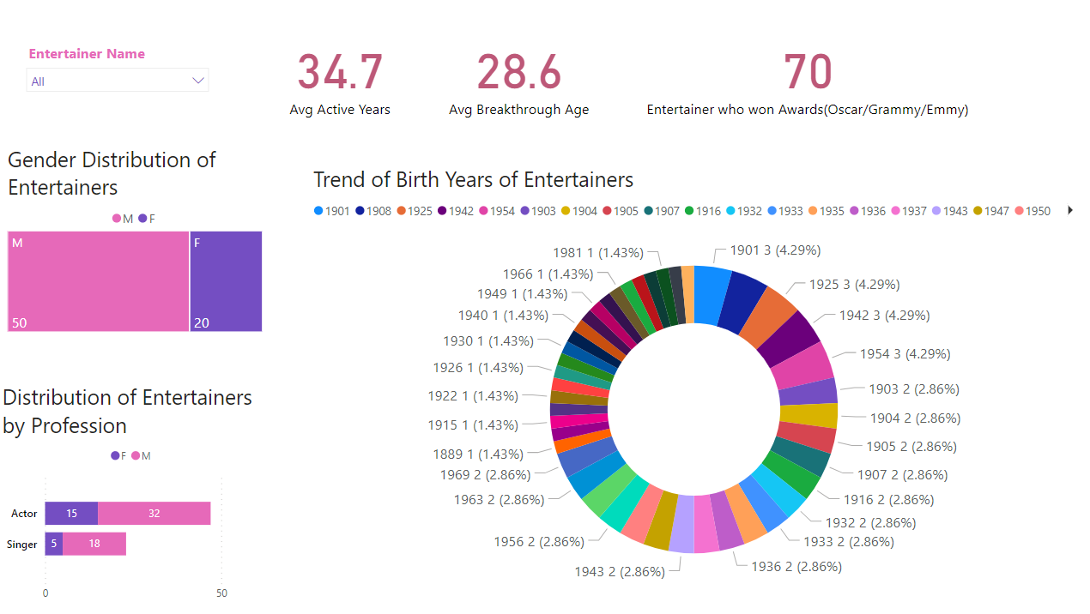
Data Visuals

Slide 5
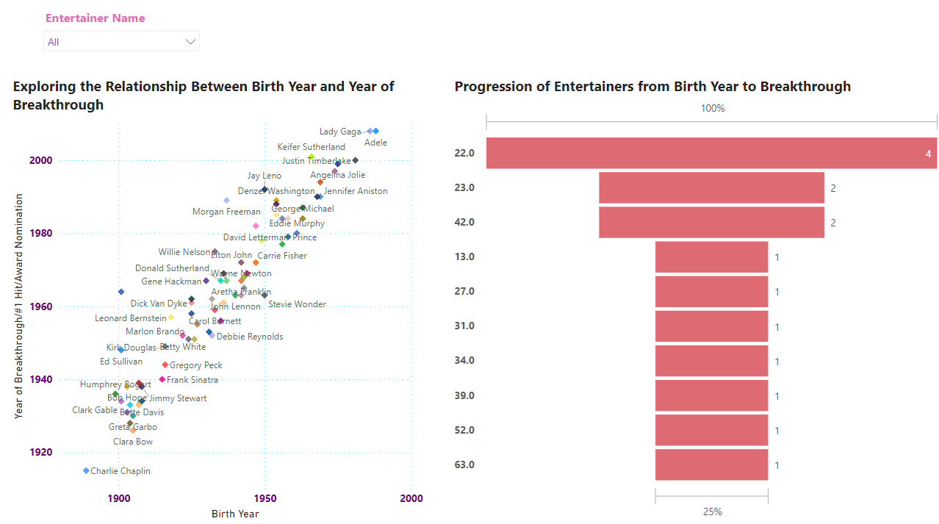
Data Visuals

Slide 6
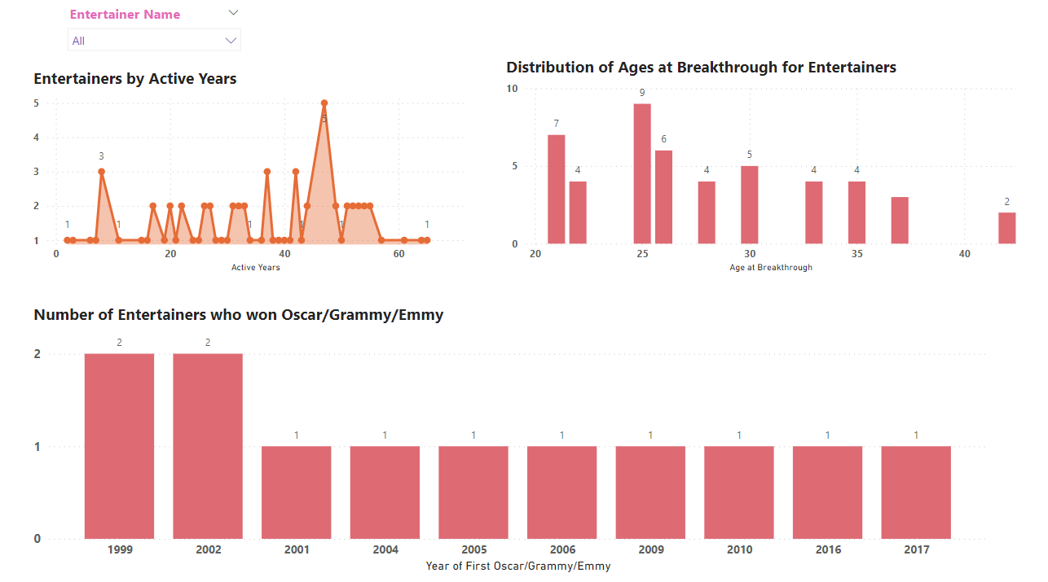
Data Visuals

Slide 7
Summary
1- Gender Distribution of Entertainers- Total Entertainers: 70 (50 Male, 20 Female)
2- Distribution of Entertainers by Profession-
Actors: 32 Male, 15 Female
Singers: 18 Male, 5 Female
3- Trend of Birth Years of Entertainers-
Majority of birth years have 1 or 2 entertainers, few have 3
Most common birth years: 1901, 1908, 1925, 1942, 1954 (each with 3 entertainers)
4- Relationship Between Birth Year and Year of Breakthrough-
Earliest Birth Year: 1889 (Charlie Chaplin)
Latest Birth Year: 1988 (Lady Gaga)
Breakthrough Years: 1915 to 2008

Slide 8
Summary
5- Progression of Entertainers from Birth Year to Breakthrough- Notable breakthroughs include Aretha Franklin at 25 and Louis Armstrong at 63, showcasing the varying timelines and trajectories of success within the entertainment industry.
6- Entertainers by Active Years- Analyzing the distribution of active years among entertainers sheds light on the duration of their careers. The highest count of entertainers at age 47 suggests a peak period of activity, while the range of active years from 1 to 5 showcases the diversity of career spans.
7- Distribution of Ages at Breakthrough for Entertainers- Exploring the ages at which entertainers achieved breakthrough success reveals interesting insights. With age 25 boasting the highest count of entertainers at 9, this analysis highlights the significance of early achievements in shaping careers within the entertainment industry.
8- Number of Entertainers who won Oscar/Grammy/Emmy- This data examines the awards received by entertainers over the years. The highest count of entertainers in 1962, with 4 individuals, underscores a notable year for industry recognition. This analysis offers valuable insights into the acknowledgment and acclaim received by notable figures in entertainment history.

Slide 9
Thank You

