Slide 1
SCRIPTERS
Food Recipe Sharing App Development
Members-
Sarthak Jain Sumit Pandey Suraj Sagar Samprad Neupane

Slide 2
Abstract
The Food Recipe Sharing App which is a web app designed for users to share, discover, and save recipes offering features like meal planning and nutrition tracking. This app fits for different user roles (chefs, home cooks, and admin) and provides functions such as recipe submission, search and filter options, meal planning dashboards, and a review system for the engagement of community. This web app is using React.js for the front end and Node.js for the back end, the app ensures a user-friendly experience with database management (MongoDB). The key features include user registration and profile management, photo/video-integrated step-by-step recipe submissions, required filters, and friendly design for easy access. The web app contains a chatbot which helps to sort out the specific type of food according to the mood/interest/occasion. In the app the user can give their valuable feedback including their experiences by giving stars rating and uploading the videos and images.

Slide 3
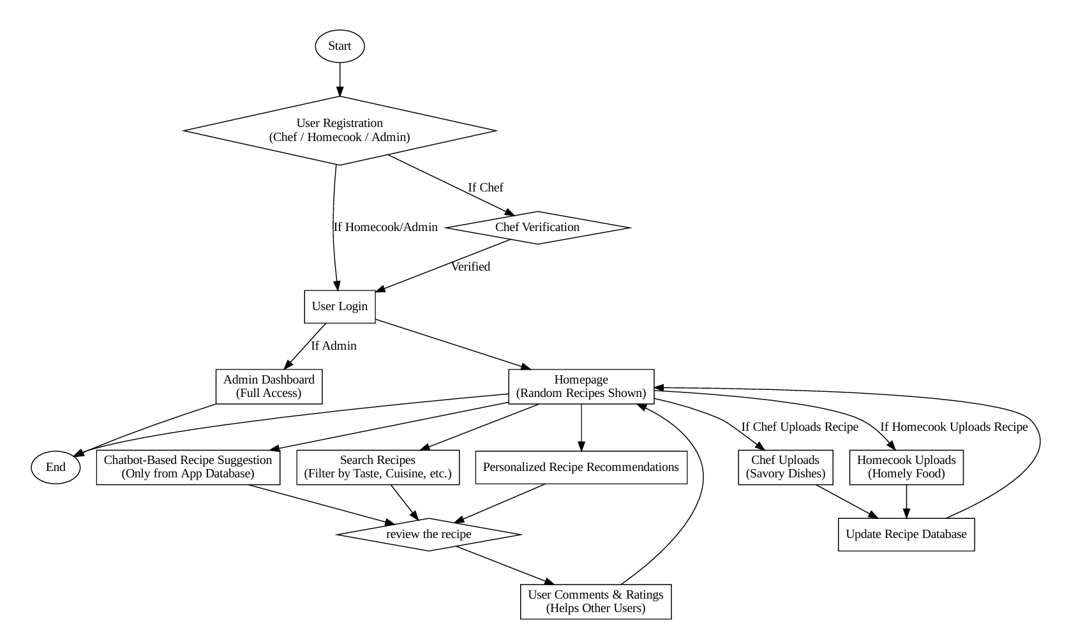
Workflow

Slide 4
Tech-Stack
Frontend:
React.js – For building a dynamic and responsive user interface.
Backend:
Node.js – JavaScript runtime for server-side.
Python-secondary back-end for AI integrated feature
Database:
MongoDB – For storing user data, recipes, comments, and meal plans.
AI Chatbot Integration:
OpenAI API – For enhanced conversational capabilities.

Slide 5
Features
User Authentication & Profile Management
2. Recipe Management
3. Search & Discovery
Advanced Search
Smart Filters
Ai Recommendations
4. Meal Planning & Nutrition Tracking
Weekly Meal Planner
Nutritional Breakdown
5. AI-Powered Chatbot Assistant
6.User-Friendly UI with responsive design

Slide 6
Project Impact
Healthier Eating: Personalized meal planning and nutritional tracking help users make better food choices and achieve dietary goals.
Enhanced Cooking Skills: Recipe sharing, AI assistance, and step-by-step guidance improve users' culinary abilities.
Personalized Experience: AI-driven recommendations and smart filters ensure content is tailored to individual preferences and needs.
Convenience & Time-Saving: Meal planning, shopping lists, and advanced search features save users time and streamline meal preparation

Slide 7
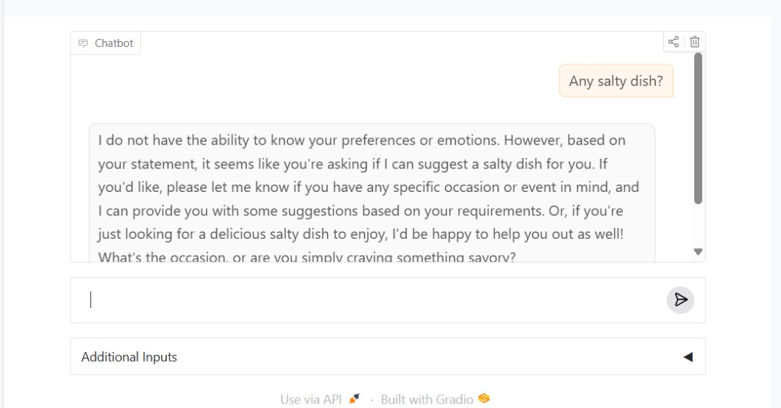
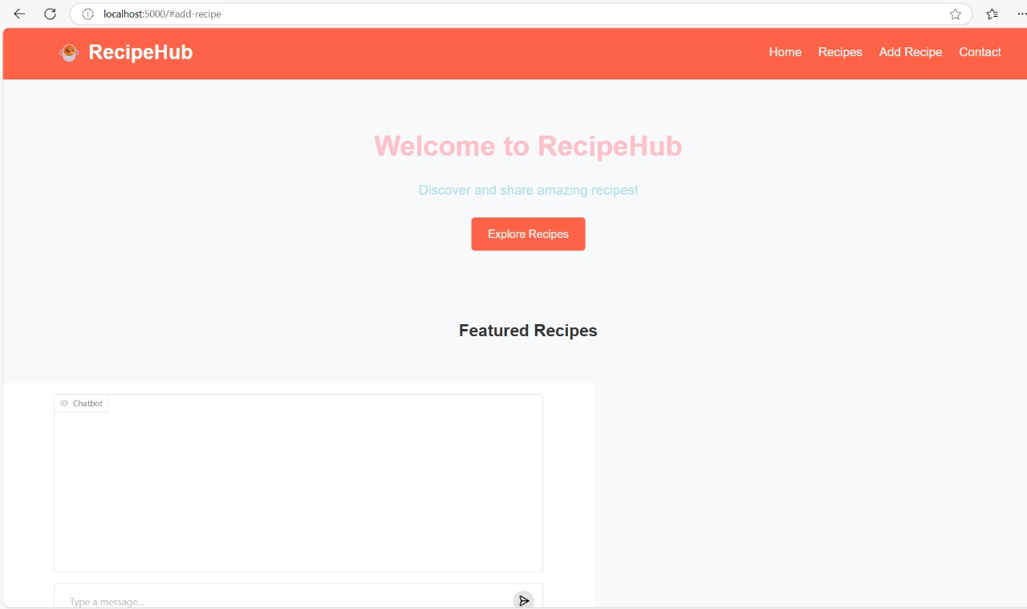
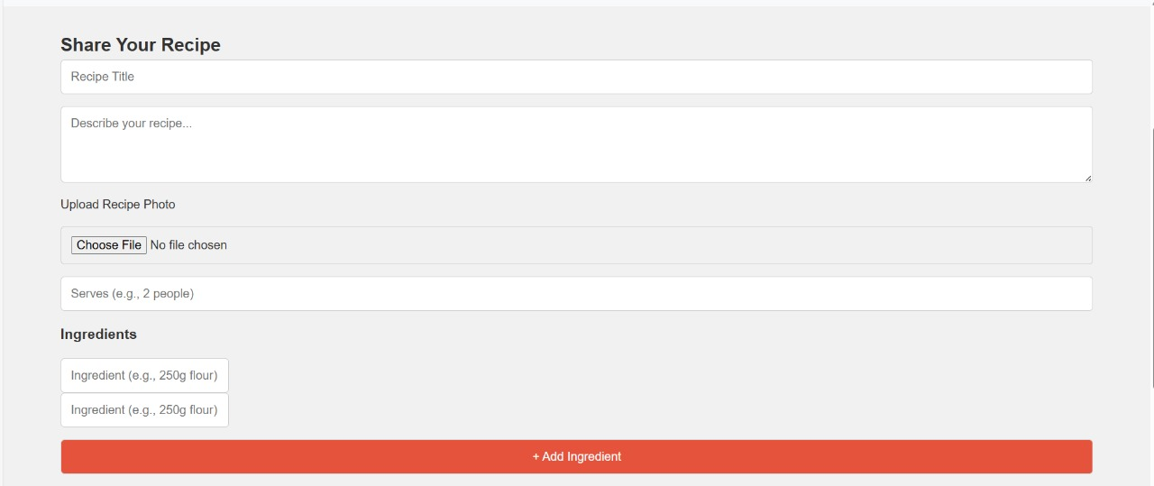
RecipeHub

Slide 8
Future Implementation
Zero Waste Focus
One-to-one assist

