Slide 1
PROGRESS REVIEW
NextGen Rakshak
Smart Edge-AI System to Reunite Lost Children with Their Families at Crowded Public Events — Final Year Capstone Project
Group 6 | Guide: Dr. A. B. Pawar

Slide 2
THE PROBLEM
Children Get Lost. The First Hour Decides Everything.
Golden Hour
The first 60–90 minutes after a child goes missing matter most — after that, the chances of a quick, safe recovery drop fast.
Networks Jam Up
Lakhs of people at one venue means mobile networks choke exactly when they're needed most.
Manual Search Is Slow
Announcements and printed photos depend on someone noticing and remembering a face — too slow at scale.

Slide 3
OUR SOLUTION
Put the Search Party in Everyone's Pocket
Every volunteer's phone quietly checks nearby faces against the missing child's photo using AI that runs on the phone itself.
No Internet Needed
Phones relay alerts to each other directly (Bluetooth / Wi-Fi), so the search keeps going even offline.
Privacy by Design
No face photo or video is ever uploaded. Matching happens entirely on the volunteer's device.
Human Confirms
AI only suggests a possible match — a real person always confirms before anyone is dispatched.

Slide 4
HOW IT WORKS
From Alert to Reunion — Step by Step
1
Officer files an alert at the kiosk (photo + child details)
2
Cloud turns the photo into a small face "fingerprint" (just numbers)
3
Alert reaches volunteers nearby via push notification — and via phone-to-phone relay if offline
4
Volunteer scans the crowd; matching runs on their phone, live
5
On a likely match, the app asks the volunteer to visually confirm
6
Confirmed sighting (location + time) appears instantly on the officer's dashboard for dispatch

Slide 5
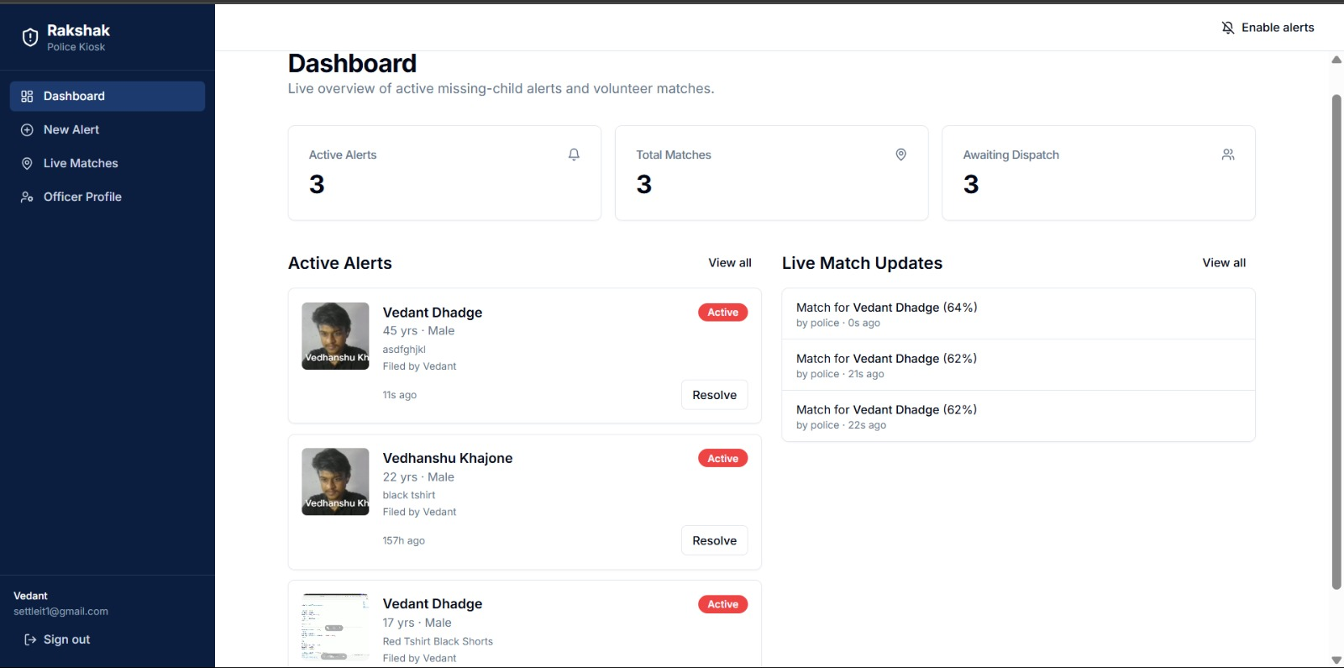
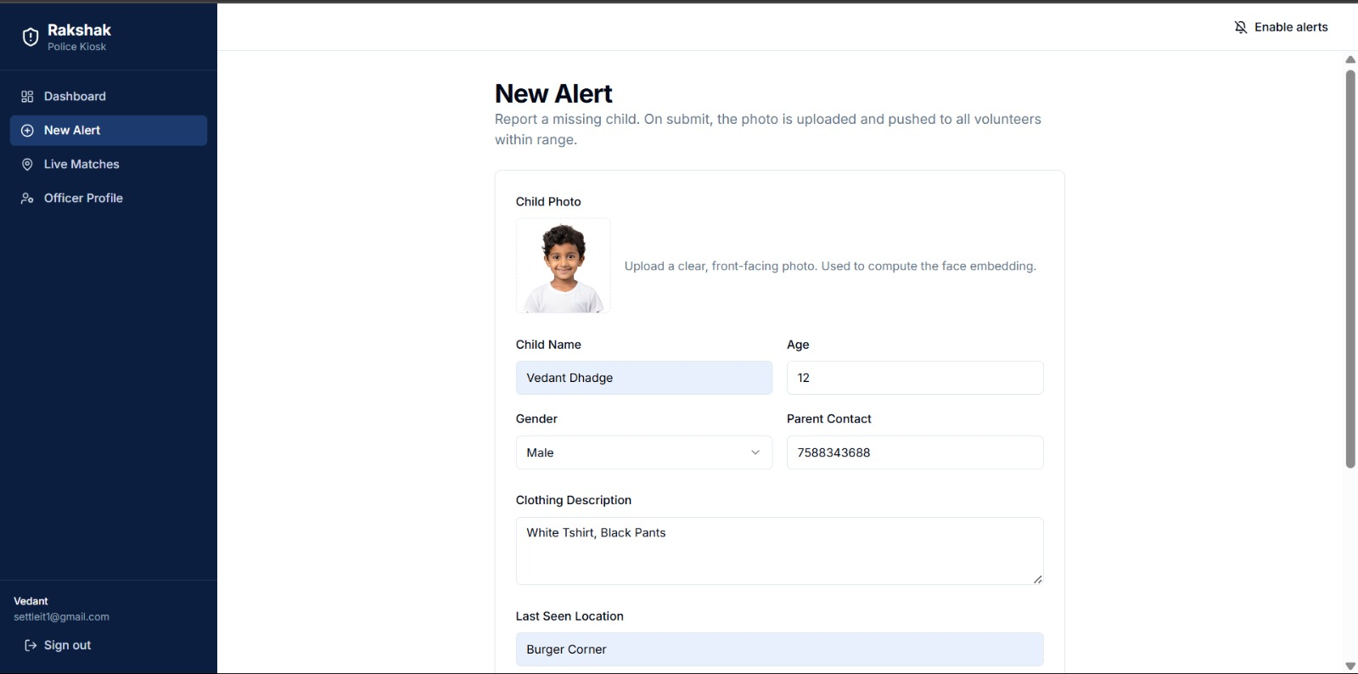
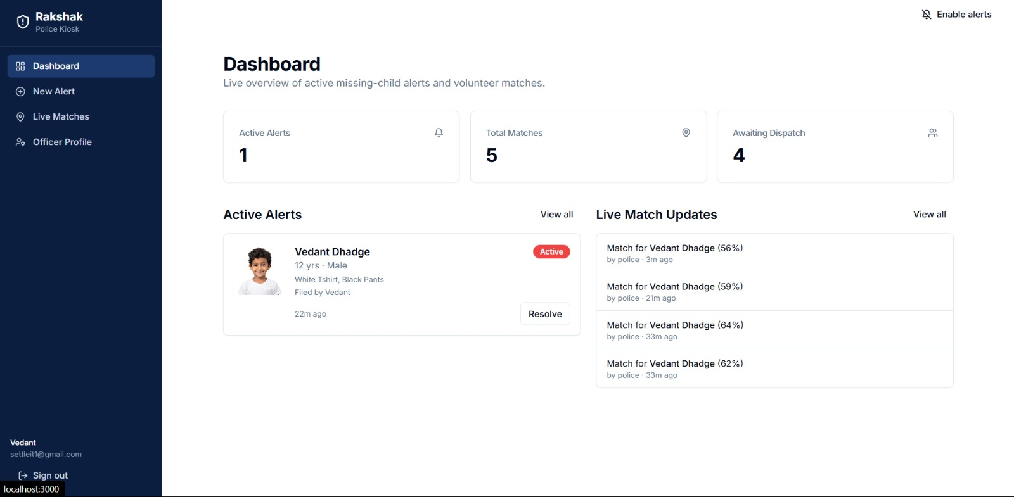
BUILT & WORKING — POLICE WEB PORTAL
Officer Dashboard, New Alert, Live Matches
Left → right: live dashboard, filing a new alert, reviewing a volunteer's sighting

Slide 6
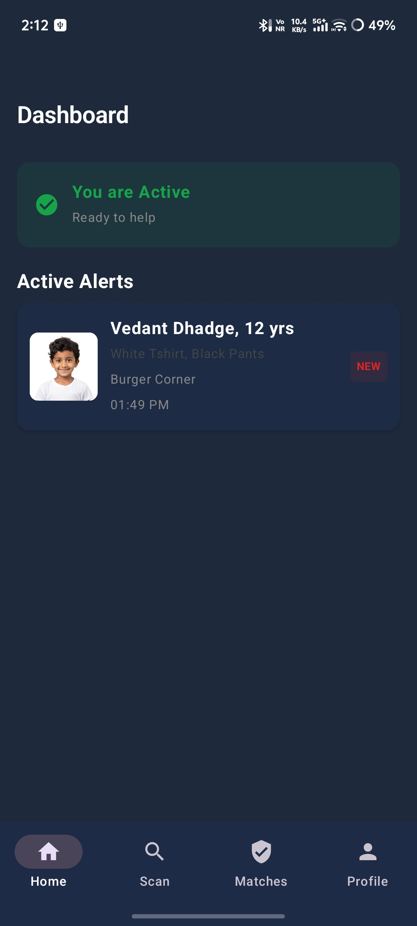
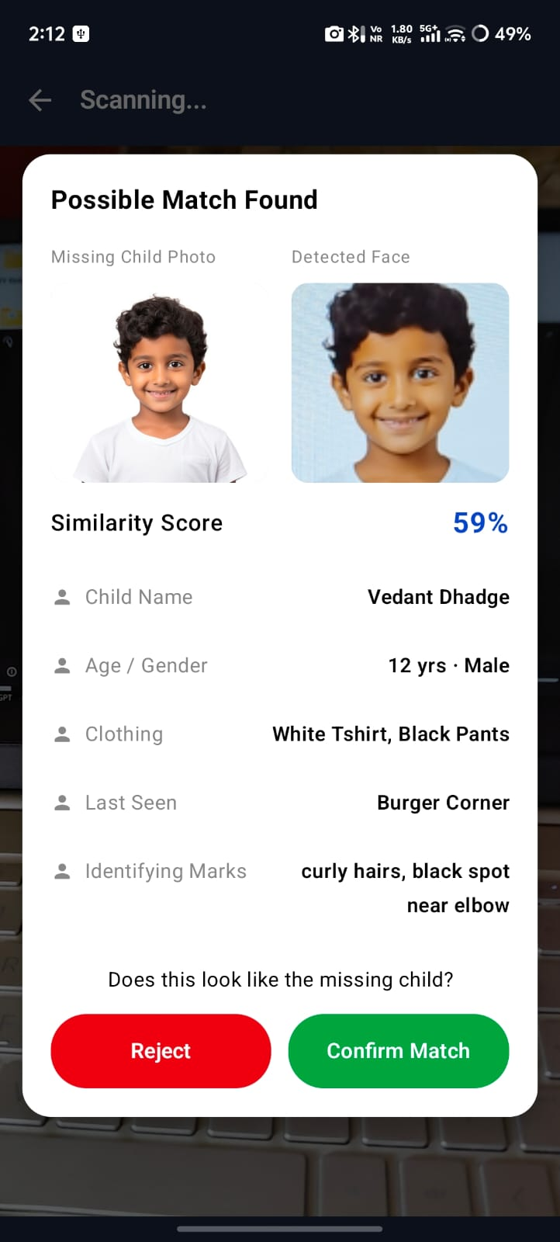
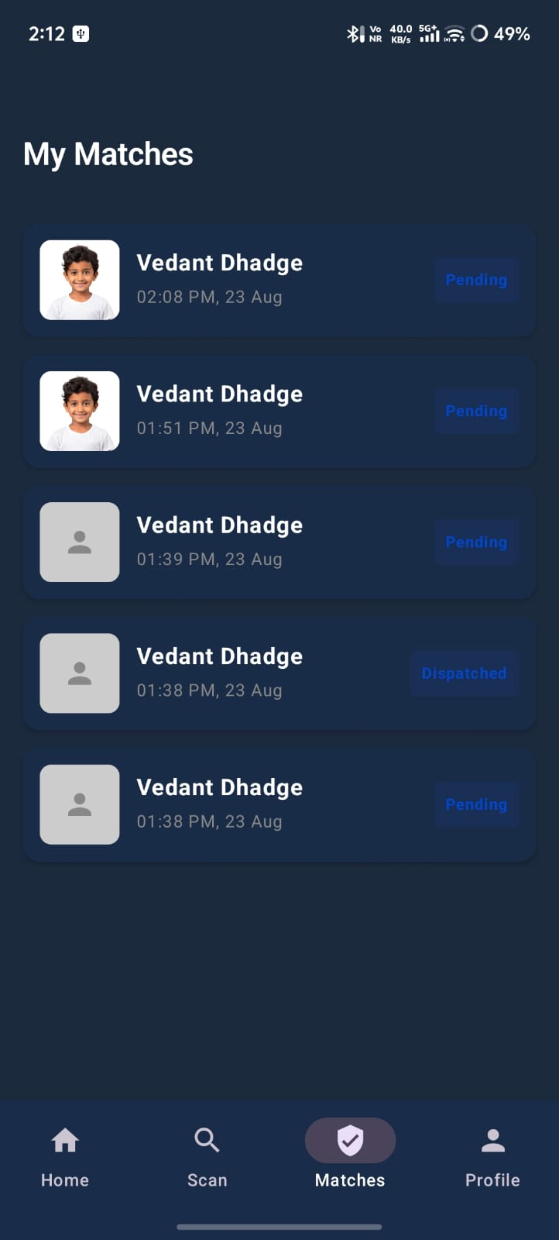
BUILT & WORKING — VOLUNTEER MOBILE APP
Scan the Crowd, Confirm a Match, Track Status
Left → right: home with active alert, live match found on-device, volunteer's match history

Slide 7
PROGRESS
What's Done vs. What's Left
Police Web Portal
Done
Volunteer Mobile App
Done
On-Device AI Face Matching
Done
Cloud Backend (alerts, push, expiry)
Done
Offline Phone-to-Phone Relay
Done
Raspberry Pi Gate Camera (optional)
Not started — stretch goal

Slide 8
WHY IT STANDS OUT
Not Just Another Missing-Person App
▸ Privacy-first
No bystander's face, photo, or video ever leaves the phone — only numbers (a "fingerprint") are used.
▸ Works without internet
Most systems die when networks jam; ours keeps relaying alerts phone-to-phone.
▸ Human always decides
AI narrows down candidates; a volunteer visually confirms before dispatch — no automated "found" decisions.

Slide 9
NEXT STEPS
What's Left Before Final Submission
• (Optional) Raspberry Pi fixed-camera node at entry/exit gates
• More field-style testing at a mock event
• Polish UI details and rehearse the live demo

Slide 10
TEAM
Group 6
09 Bankar Smitraj Dinkar
11 Bhakare Tanishka Sharad
34 Dhadge Vedant Sanjay
94 Narkhede Atharva Anantkumar
Guide: Dr. A. B. Pawar | Coordinator: Dr. S. R. Deshmukh | HOD: Dr. M. A. Jawale
Thank You

