Slide 1
INDIVIDUAL PROGRESS REVIEW
NextGen Rakshak — Backend, Cloud Functions & ML Pipeline
Smitraj Bankar · Roll No. 09
Weeks 1–6 · Weeks 1–2 team-wide, Weeks 3–6 individual track

Slide 2
WEEK 1-2
Team-Wide: Research & Architecture
Week 1 — Research Gap
Studied TrackChild, Khoya-Paya, GHAR, ReUnite — all reactive, server-dependent, fail under network congestion. NCRB: 98,375 missing children (2024). Confirmed no existing system combines instant decentralized alerts + on-device recognition + offline mesh.
Week 1 — Tech Survey
Studied MobileFaceNet + TFLite for edge inference, ML Kit face detection, Nearby Connections API for peer-to-peer comms — the three pillars the architecture is built on.
Week 2 — Architecture
Defined the 3-component system: Police Kiosk (Next.js), Volunteer App (Kotlin), Offline Mesh (Nearby Connections). Documented alert propagation: kiosk → FCM → volunteers, plus multi-hop store-and-forward for offline.
Week 2 — Design Artifacts
UI wireframes for both apps, Firestore schema (alerts / volunteers / matches / roles), tech-stack finalized, communication protocols documented.

Slide 3
WEEK 3
Studying Firebase Cloud Functions
▸ Studied Firebase Cloud Functions v2 for serverless backend — no server to provision, functions run on Firestore events.
▸ Focus: how to compute a face embedding server-side, and how to broadcast an alert the moment it's filed.
Key idea learned: Firestore triggers
onDocumentCreated("alerts/{alertId}", async (event) => {
// fires automatically the instant an officer saves an alert
const embedding = await computeEmbedding(photo) // 128 numbers
await broadcastAlert(alertId, childName, geoLocation)
})
No polling, no manual trigger — the write itself IS the trigger. This became the backbone of onAlertCreated / onMatchCreated built in Week 5.

Slide 4
RESULTS · WEEK 3
MobileFaceNet Weight Pipeline — Built & Measured
WHAT was done
Source real, licensed face-recognition weights and turn one model into two matching artefacts (phone + server) instead of two separately-trained models that could drift apart.
HOW it was done
Downloaded the pretrained TF1 frozen graph, converted it to a TF2 SavedModel, then quantized one branch to a mobile .tflite while copying the other as-is for the server — a single source, two consumers.
MEASURABLE RESULT
Model size (device): 5.9 MB → 1.5 MB (74.6% smaller, dynamic-range quantized)
Output shape: 128-dim embedding, already L2-normalized by the graph
Parity check (tflite vs. server SavedModel): cosine = 0.99967 (pass bar was ≥ 0.99)
Verdict: Quantization did not damage the model — device and server produce near-identical embeddings for the same face.

Slide 5
WEEK 4
Testing Functions + Firestore, Vercel Deployment
Testing Cloud Functions + Firestore
Ran early Cloud Functions against a live Firestore instance — verified reads/writes to alerts and volunteers collections, checked emulator vs. deployed behaviour, confirmed trigger firing on document create/update before building real logic on top.
Vercel Deployment (Web Portal)
Deployed the Next.js kiosk portal to Vercel for an always-on interactive test environment — let the team click through the real dashboard/login/profile pages from any browser instead of only localhost, speeding up UI feedback and demo readiness.

Slide 6
RESULTS · WEEK 4
Cloud Functions + Firestore — Tested Live
WHAT was done
Confirm the serverless pipeline actually behaves correctly against a real database before more logic gets built on top of it, and give the team an always-on build to click through instead of only localhost.
HOW it was done
Created real alert documents in Firestore, watched the trigger fire, and read back structured logs instead of guessing; deployed the web portal to Vercel for a shared, always-reachable test URL.
MEASURABLE RESULT
Trigger → embedding latency: ~1–3 seconds per alert after a warm start
Verification method: structured log check — "Embedding written" { dims: 128 } on every test alert
Deployed function limits confirmed: 1 GiB memory, 120s timeout, region us-central1 — well inside budget
Web portal reachability: moved from localhost-only to a shared Vercel URL the whole team could test
Verdict: Pipeline verified end-to-end on live infrastructure, not just in theory — every embedding written carried the expected 128 dimensions.

Slide 7
WEEK 5
Built the Cloud Functions Pipeline
1 · onAlertCreated
Fires when an officer files an alert. Downloads the photo from Storage, runs face detection (BlazeFace) + crop, feeds it to MobileFaceNet → 128-d embedding, writes it back to the alert doc.
2 · broadcastAlert (FCM)
Reads every volunteer's fcmToken, geofences to 2 km via haversine distance on lastLocation, sends a multicast push in batches of 500, prunes dead tokens automatically.
3 · onMatchCreated
Fires when a volunteer reports a sighting. Looks up the alert's filing officer and pushes a "New Match Sighting — X% confidence" notification to their kiosk.
▸ Firestore triggers wired end-to-end and deployed live to Firebase (not just tested locally).
▸ Verified full loop on the deployed Vercel + Firebase pair: file alert → embedding appears → volunteers get pushed.

Slide 8
RESULTS · WEEK 5
Three Firestore Triggers — Implemented & Deployed
WHAT was done
Turn the studied theory into the three real functions the whole alert-to-match loop depends on: compute + broadcast on alert creation, notify on match creation.
HOW it was done
Wrote onAlertCreated (embed + broadcast), broadcastAlert (FCM push with geofencing), and onMatchCreated (push to filing officer) as Firestore-native triggers — no polling, no cron for the hot path.
MEASURABLE RESULT
FCM batching: auto-chunks at 500 tokens/request (the hard API cap) — no manual limit-watching needed
Geofence radius: 2 km via haversine distance; fail-open — a volunteer with no location is still notified
Firestore batch safety: writes chunked at 500 docs/batch (Firestore's hard limit) so a large sweep can't fail outright
Dead-token cleanup: invalid/expired FCM tokens auto-pruned from Firestore on send failure
Verdict: A busy event with hundreds of volunteers and a backlog of stale alerts cannot break these functions — every hard limit in the pipeline is handled, not assumed away.

Slide 9
WEEK 6
ML Weights Pipeline + Backend Hardening
MobileFaceNet weight sourcing
Sourced pretrained MobileFaceNet_9925_9680.pb (sirius-ai/MobileFaceNet_TF, Apache-2.0, 99.25% LFW accuracy). Built freeze_to_savedmodel.py + convert_models.py: one TF1 frozen graph → quantized Android .tflite (1.5 MB) AND a TensorFlow SavedModel for the server — same weights, so on-device and server embeddings line up.
Node.js 22 + firebase-functions v7 upgrade
Migrated all Cloud Functions off Node 20 ahead of its Oct-2026 decommission — upgraded runtime + firebase-functions to v7, re-tested every trigger (onAlertCreated, onMatchCreated, expireAlerts) still deploys and fires correctly.
verify_parity.py — proving both artifacts agree
cosine(tflite_output, savedmodel_output) for the same face crop
=> 0.99967 (threshold for "pass" is >= 0.99)
Confirms: Android .tflite and server SavedModel are the SAME model,
so a phone-side embedding and a server-side embedding are directly comparable.

Slide 10
RESULTS · WEEK 6
Threshold Tuned by Measurement, Runtime Upgraded
WHAT was done
Replace a guessed match threshold with a measured one, and move the backend off a Node runtime days from its end-of-life — both are correctness/stability issues, not features.
HOW it was done
Ran 36 real photo pairs through the actual quantized model using the app's own crop geometry; compared same-person vs. different-person score bands to find a safe cut. Then swapped Node 20 → 22 and firebase-functions v6 → v7 and re-verified every trigger still deploys and fires.
MEASURABLE RESULT
Test set: 36 pairs — 15 same-person, 21 different-person, real photos
Same-person score range: 0.7142 – 0.9899
Different-person score range: 0.0864 – 0.3551
Old threshold (0.75) result: 0 / 21 false matches, but 5 / 15 genuine matches MISSED (33%)
New threshold (0.55) result: 0 / 21 false matches, 0 / 15 missed — 100% correct on this set
Runtime migration: Node 20 → 22, firebase-functions v6 → v7 — all triggers redeployed and re-verified firing
Verdict: 0.55 is not a guess — it sits in the middle of a measured 0.36-wide gap between the two score bands, with room to spare on both sides.

Slide 11
TECHNICAL DEEP-DIVE
functions/src/
Cloud Functions Architecture (built by Smitraj)
onAlertCreated trigger: alert doc created
→ download photo (own bucket only, no SSRF) → BlazeFace crop → MobileFaceNet → 128-d embedding written back
broadcastAlert runs inside the same trigger
→ haversine geofence (2 km, fail-open) → FCM multicast in batches of 500 → prunes dead tokens
onMatchCreated trigger: volunteer reports sighting
→ looks up alert.createdBy.uid → pushes "New Match — X%" to that officer's kiosk
expireAlerts scheduled, every 30 min
→ marks alerts older than 8h resolved → triggers onAlertResolved → purges embedding + deletes photo from Storage

Slide 12
TECHNICAL DEEP-DIVE
Measuring the Right Match Threshold
36 real photo pairs run through the actual quantized .tflite with the app's own crop geometry:
Same person — 15 pairs
cosine similarity range: 0.7142 – 0.9899
Different people — 21 pairs
cosine similarity range: 0.0864 – 0.3551
Empty separation band: 0.3551 → 0.7142 (any threshold here scores all 36 pairs correctly)
Synopsis default: 0.75
0/21 false matches, but 5/15 genuine same-person pairs missed — sits inside the same-person band, too strict.
Configured: 0.55 (chosen)
0/21 false matches, 0/15 missed — centred in the empty band, ~0.19 headroom either side for harder real-world pairs.
Reasoning: a missed child is the failure the system exists to prevent; a false candidate only costs a volunteer one tap — every match is human-confirmed anyway.

Slide 13
ENGINEERING CARE TAKEN
Small Decisions That Matter
No SSRF surface
fetchAlertImage never fetches a caller-given URL — it resolves the path inside our own Storage bucket only. Stops an attacker pointing the function at internal/cloud-metadata hosts.
Fail-open geofencing
A volunteer with no recorded location is still notified rather than silently skipped — better to over-notify than lose a nearby helper.
Batch-safe Firestore writes
expireAlerts and clearMatchImages chunk updates at 500 writes (Firestore's batch cap) so a busy-event backlog can't silently fail to sweep.
Privacy is enforced, not promised
onAlertResolved deletes the Storage photo and clears the embedding the moment a case closes — the "data doesn't outlive the case" claim is code, not policy.

Slide 14
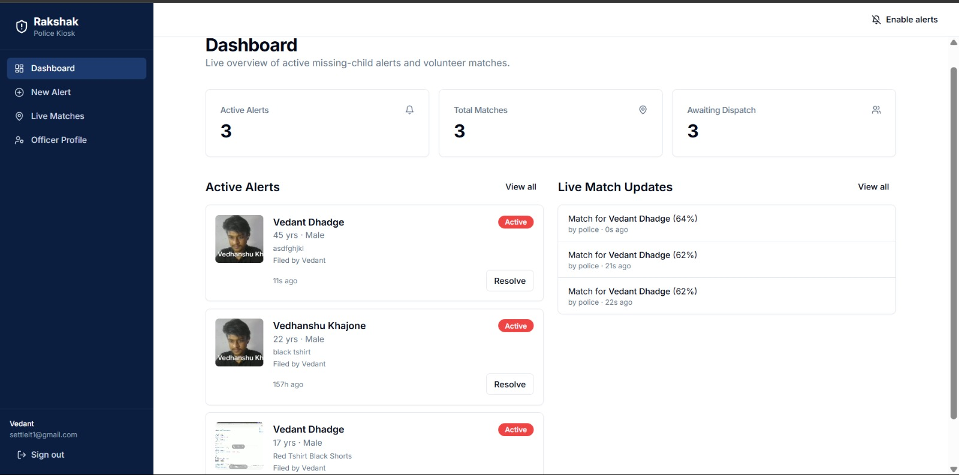
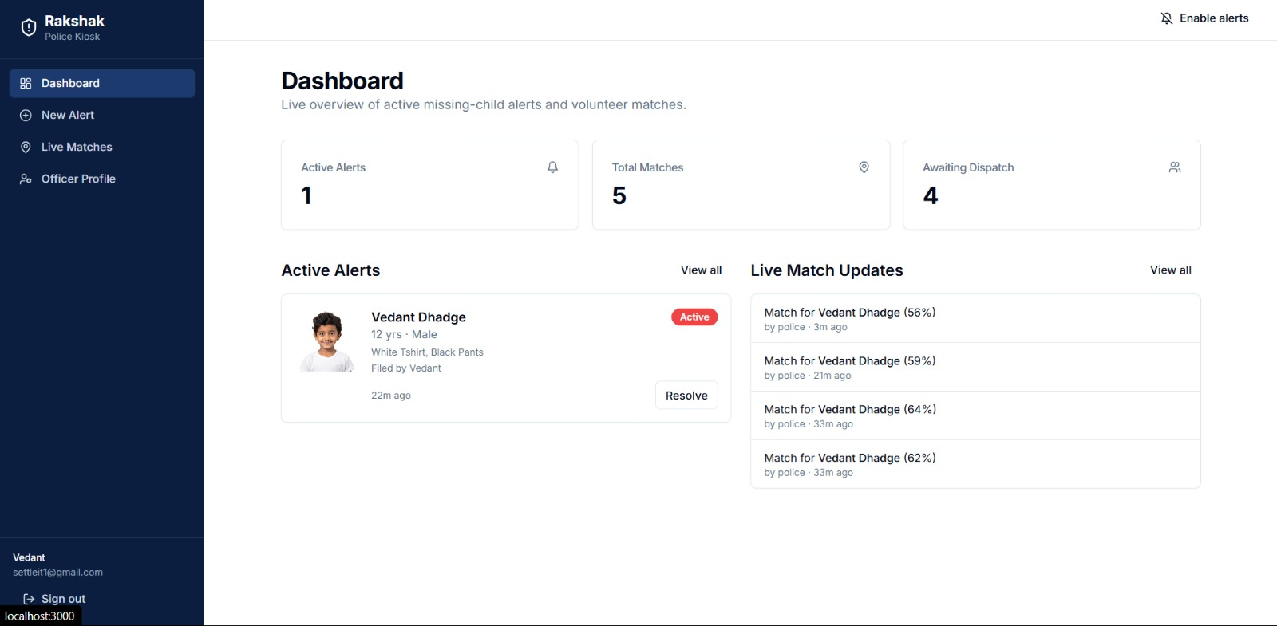
RESULT
Deployed and Working End-to-End
Live dashboard fed by onAlertCreated/onMatchCreated · match review powered by the embedding pipeline above

Slide 15
SUMMARY
Weeks 3–6 at a Glance
Week 3
Studied Cloud Functions — embedding computation & alert broadcast design
Week 4
Tested Functions + Firestore live; deployed web portal to Vercel
Week 5
Implemented onAlertCreated, broadcastAlert (FCM), onMatchCreated — deployed to Firebase
Week 6
Sourced + converted MobileFaceNet weights (tflite + SavedModel), tuned threshold to 0.55, upgraded to Node 22 / firebase-functions v7

Slide 16
Thank You
Smitraj Bankar (Roll 09) · NextGen Rakshak
Guide: Dr. A. B. Pawar · Coordinator: Dr. S. R. Deshmukh · HOD: Dr. M. A. Jawale

