Slide 1
PHARMACEUTICAL INTELLIGENCE WITH DATA ANALYTICS
Heart Disease
Prediction
Using Machine Learning to Enable Early Clinical Detection
ML Group Project | 2026
300
14
3
Patients
Features
Models

Slide 2
PROJECT OVERVIEW
Area of Study
Problem Gap
Application of Machine Learning in cardiovascular health — predicting heart disease from patient clinical data.
Heart disease is often diagnosed late. No automated tool exists in many clinics to flag high-risk patients early.
Main Objective
Expected Impact
Build an ML model to classify patients as having heart disease (1) or not (0) based on 13 clinical features.
Enable pharmacists and clinicians to intervene early, reduce hospitalizations, and optimize patient outcomes.

Slide 3
RESEARCH QUESTIONS & SPECIFIC OBJECTIVES
Research Questions
Specific Objectives
1
Which clinical features are the strongest predictors of heart disease?
✓
Identify key risk factors using Exploratory Data Analysis (EDA)
2
Can an ML model accurately classify patients as high or low risk?
✓
Preprocess & clean the dataset for ML readiness
3
Which algorithm performs best on this dataset?
✓
Train 3 models: Logistic Regression, Decision Tree, Random Forest
4
How can results support early pharmaceutical intervention?
✓
Evaluate models using Accuracy, Precision, Recall & F1-Score
5
What is the link between cholesterol, heart rate, and heart disease?
✓
Recommend clinical actions based on feature importance results

Slide 4
DATASET & METHODOLOGY
Dataset: Heart Disease UCI
01
Data Collection
▸ 300 patients
Load heart_disease_dataset.xlsx into Python (pandas)
▸ 14 clinical features
▸ 156 with heart disease
02
Preprocessing
▸ 144 without heart disease
▸ 0 missing values
Check missing values, encode categories, scale features
Feature | Description
age | Patient age (years)
sex | 1=Male, 0=Female
cp | Chest pain type (0-3)
trestbps | Resting blood pressure
chol | Serum cholesterol mg/dl
thalach | Max heart rate
target | 1=Disease, 0=No Disease
03
EDA
Visualize distributions, correlations, and risk factors
04
Model Training
Train 3 models on 80% data, test on 20%
05
Model Evaluation
Accuracy, Confusion Matrix, ROC-AUC, F1-Score
06
Recommendation
Identify best model & top predictors for clinical use

Slide 5
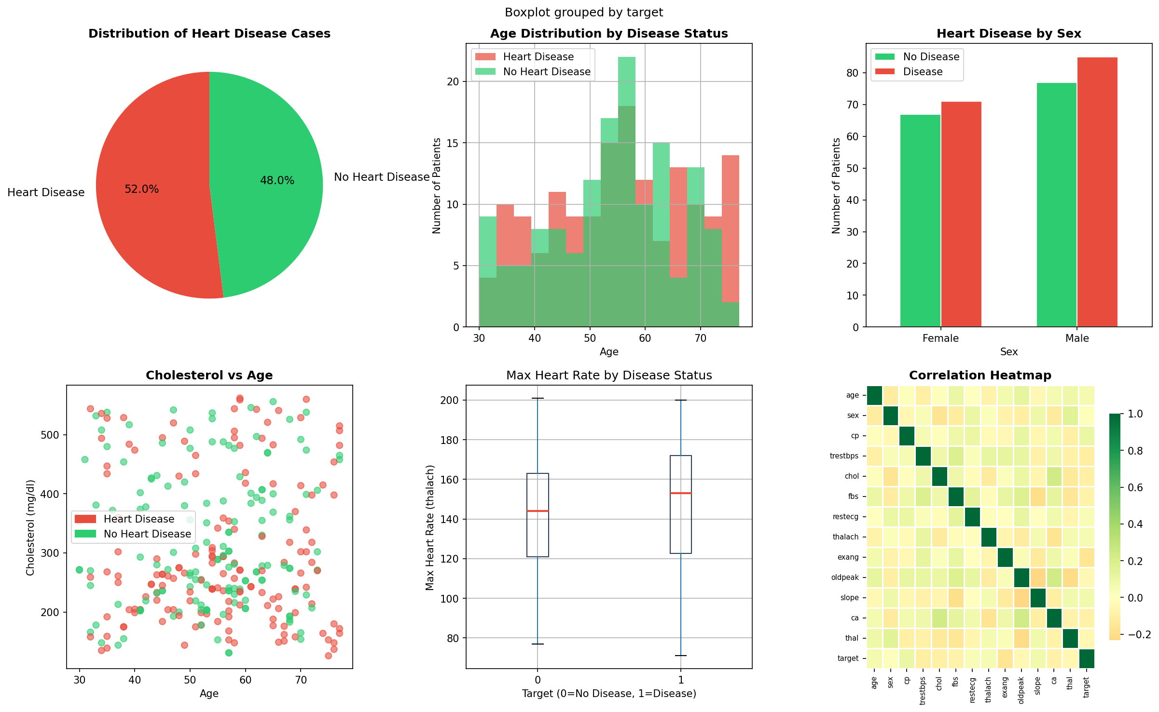
EXPLORATORY DATA ANALYSIS (EDA)
Figure 1: EDA Plots — Disease Distribution | Age | Sex | Cholesterol vs Age | Heart Rate | Correlation Heatmap

Slide 6
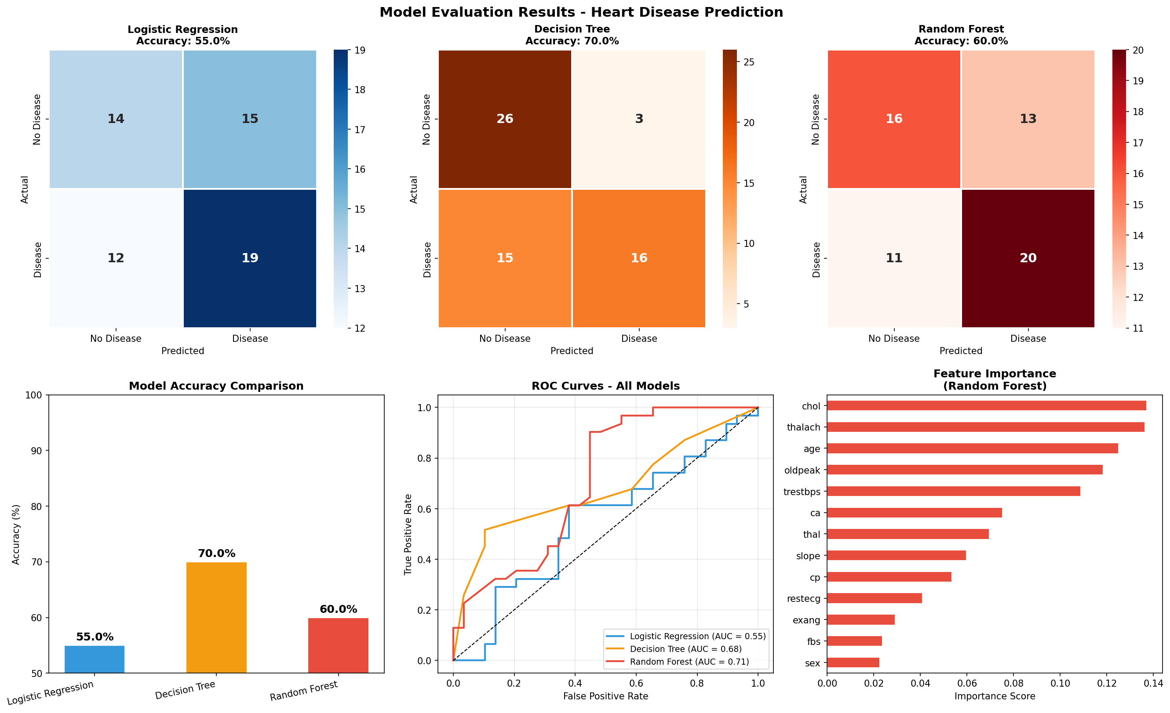
MODEL EVALUATION RESULTS
Figure 2: Confusion Matrices | Accuracy Comparison | ROC Curves | Feature Importance

Slide 7
MODEL PERFORMANCE SUMMARY
Baseline
⭐ BEST
Ensemble
Logistic Regression
Decision Tree
Random Forest
55%
70%
60%
Accuracy
Accuracy
Accuracy
STRENGTHS
STRENGTHS
STRENGTHS
▸ Simple & interpretable
▸ Best accuracy (70%)
▸ Good feature importance
▸ Good for linear data
▸ Easy to visualize
▸ Resistant to overfitting
▸ Fast to train
▸ Handles non-linear data
▸ Robust model

Slide 8
KEY FINDINGS & FEATURE IMPORTANCE
Top Predictors of Heart Disease (Random Forest)
Key Findings
Cholesterol (chol)
13.7%
Decision Tree achieved the highest accuracy at 70%
Max Heart Rate (thalach)
13.6%
Cholesterol & Max Heart Rate are the top 2 predictors
Age
12.5%
Males showed higher rates of heart disease in this dataset
ST Depression (oldpeak)
11.8%
Patients aged 55-65 are the highest-risk group
Blood Pressure
10.9%
High oldpeak (ST depression) strongly indicates disease
Major Vessels (ca)
7.5%
300 patients — 52% with heart disease, 48% without
Thalassemia (thal)
7%

Slide 9
CLINICAL RECOMMENDATIONS
Routine Cholesterol Screening
Heart Rate Monitoring
01
Since cholesterol is the #1 predictor, all patients above 45 should have mandatory cholesterol screening during pharmacy visits.
02
Low maximum heart rate (thalach) is a strong indicator. Clinicians should investigate patients with abnormally low exercise heart rate.
Age-Based Risk Flagging
ML-Assisted Decision Support
03
Patients aged 55-65 should be automatically flagged as high-risk in electronic health records for proactive monitoring.
04
The Decision Tree model (70% accuracy) should be integrated as a clinical decision-support tool in outpatient pharmacy settings.
Patient Education
Further Research
05
High-risk patients should receive pharmaceutical counseling on lifestyle modifications — diet, exercise, and medication adherence.
06
A larger, more diverse dataset is recommended to improve model accuracy beyond 70% and reduce prediction bias.

Slide 10
CONCLUSION
This project demonstrates that
Machine Learning can save lives.
We successfully built and compared 3 ML models on heart disease patient data
Decision Tree achieved the best accuracy of 70% on our dataset
Cholesterol, Max Heart Rate, and Age are the top 3 clinical risk factors
Our findings support early pharmaceutical and clinical intervention strategies
This model can be a valuable decision-support tool in pharmacy practice
Pharmaceutical Intelligence with Data Analytics | Heart Disease Prediction | 2026

