Slide 1
College of Western Idaho SWDV 210 Intro to GIT
Week 5
Notes:
Test environment is on lab16

Slide 2
SWDV 210 – GIT Day 2
Questions
GIT

Slide 3
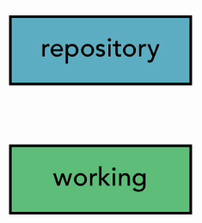
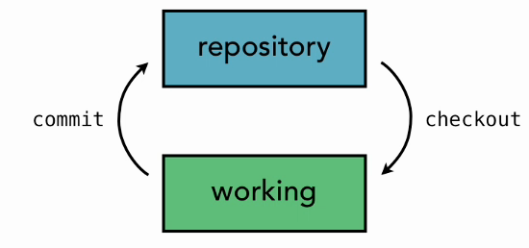
SVC Architecture
Two Tree Architecture
Notes:
SVC resource manager

Slide 4
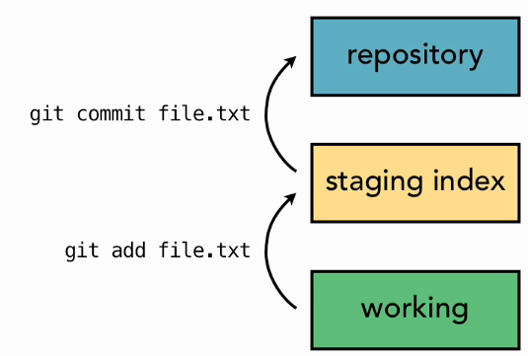
Git Architecture
Three Tree Architecture

Slide 5
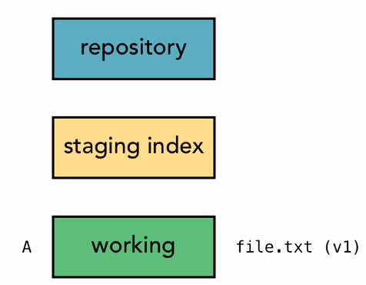
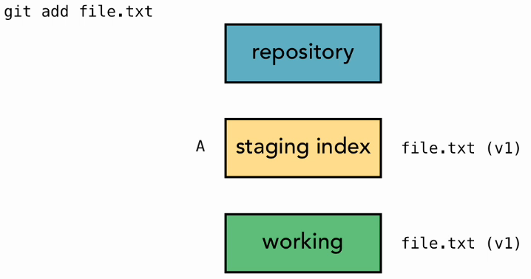
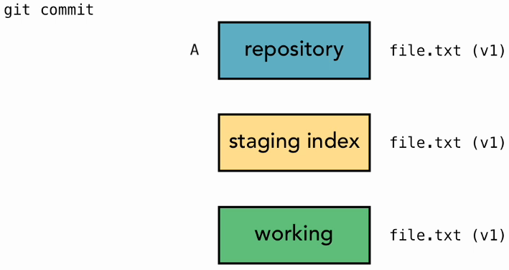
Git Workflow
New File

Slide 6
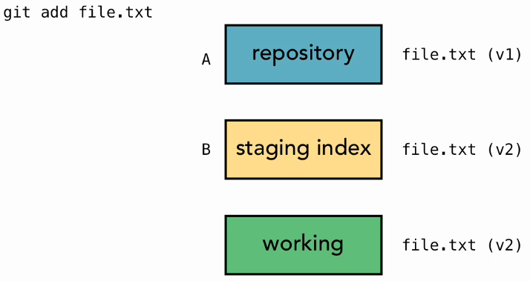
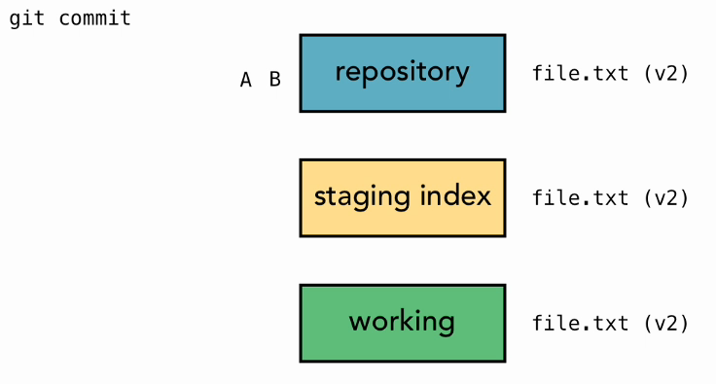
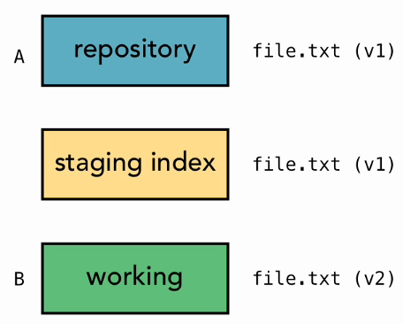
Git Workflow - File Edits
Edited File

Slide 7
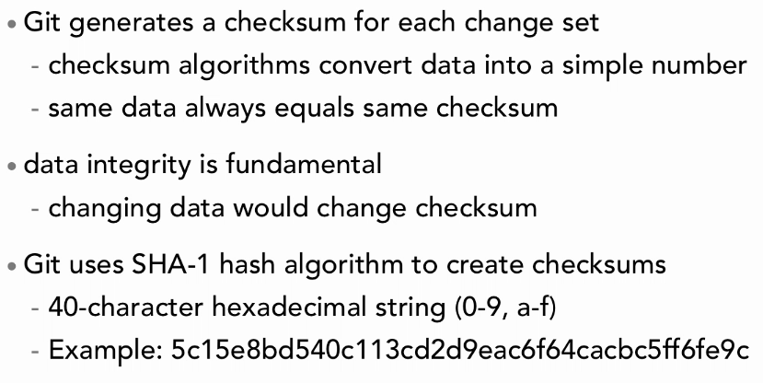
Git Hash Values
Notes:
Shown in git log command

Slide 8
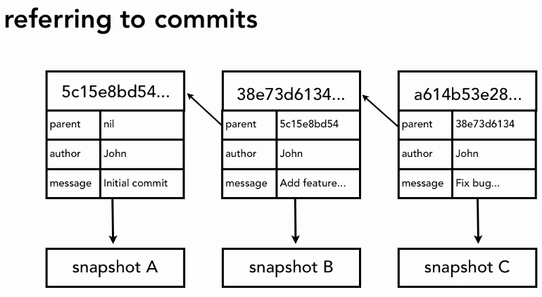
Git Hash Values

Slide 9
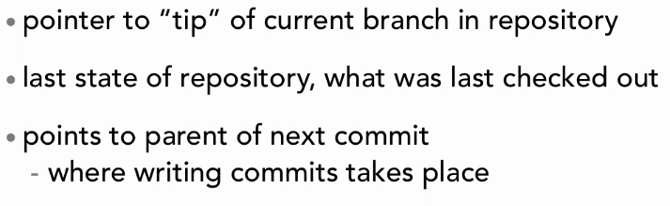
Git HEAD Pointer
Notes:
cd .git
ls -la
cat head
cd refs/heads
cat master
git log

Slide 10
Making File Changes
Return to first_git_project
cd c:/sandbox/first_git_project
Check status of work
git status
Add second & third files to project
git status
git add second_file.txt
git status
git commit -m "Add second file to project."
git status
git log
git add third_file.txt
git commit -m "Add third file to project."
git status
Notes:
Content for second_file.txt:
This is the second file that I added to my project.
Content for third_file.txt:
This is the third file that I added to my project. This is the last file in the project right now.
<ctrl>z to get out of log

Slide 11
Editing a File
Open & edit first_file.txt
git status
git add first_file.txt
Edit second_file.txt & third_file.txt
git status
git add second_file.txt
git status
git commit -m "Made changes to second & third."
git status
git log
git add third_file.txt
git status

Slide 12
Viewing Changes with Diff
Add a line to first_file.txt
git status
git diff
Edit third_file.txt
git diff
git diff third_file.txt
Type Q to quit this command

Slide 13
Deleting Files
Add 2 files for deletion, delete1.txt & delete2
git status
git add .
git status
git commit -m "Add deletion files."
git status
Delete delete1.txt thru file manager
git status
git rm delete1.txt
git commit -m "Delete first deletion file."
git status
git rm delete2.txt **Check recycle bin
git status
git commit -m "Delete second delete file."
Notes:
**
Control Panel | search for desktop common icon |

Slide 14
Renaming Files
Rename first_file.txt to primary_file.txt in File Manager
git status
git add primary_file.txt
git rm first_file.txt
git status
git mv second_file.txt secondary_file.txt
git status
git commit -m "Renamed files. Now is the time for all good developers to use descriptive commit comments."
git status

Slide 15
Use Git Gui
Open Git Gui
Create New Repository
C:/sandbox/second_git_repository
Add files from first_git_repository
Rescan
Stage Changed
Initial Commit message: My initial commit.
Commit
Change a file | Rescan | Stage Changed | Commit

Slide 16
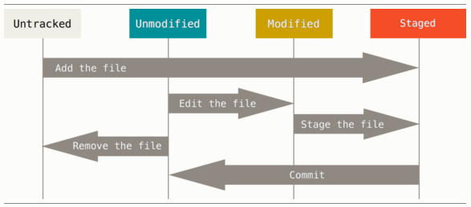
File LifeCycle in Git

Slide 17
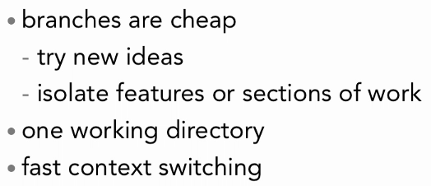
Branching

Slide 18
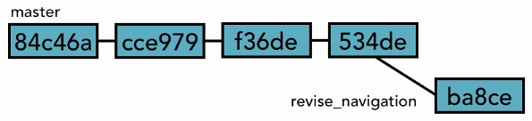
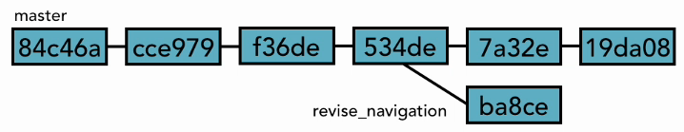
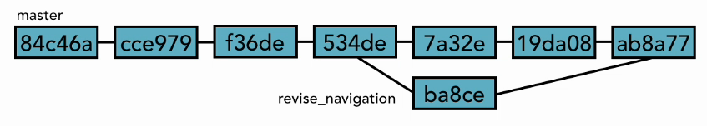
Branching

Slide 19
Viewing & Creating Branches
Navigate to first_git_project
pwd
git branch
cat .git/HEAD
ls -la .git/refs/heads
cat .git/refs/heads/master
git log --oneline
git branch new_feature
git branch
ls -la .git/refs/heads
Notes:
pwd: local path
<ctrl>z to get out of log

Slide 20
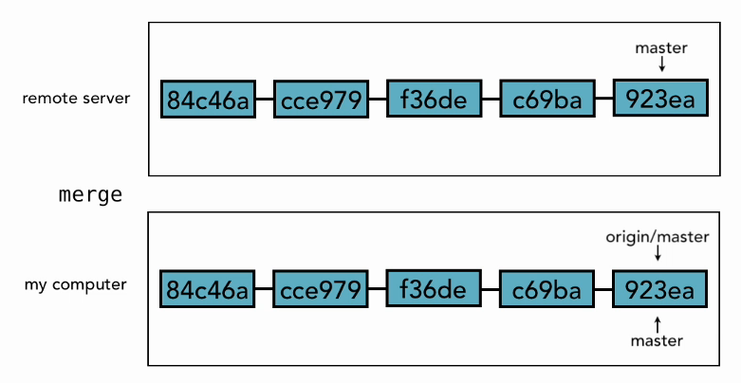
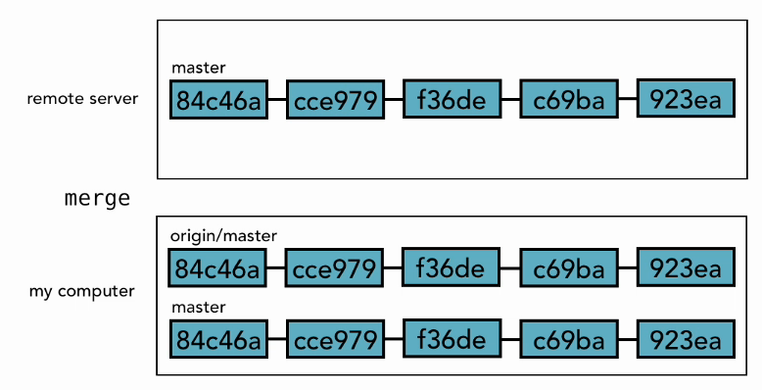
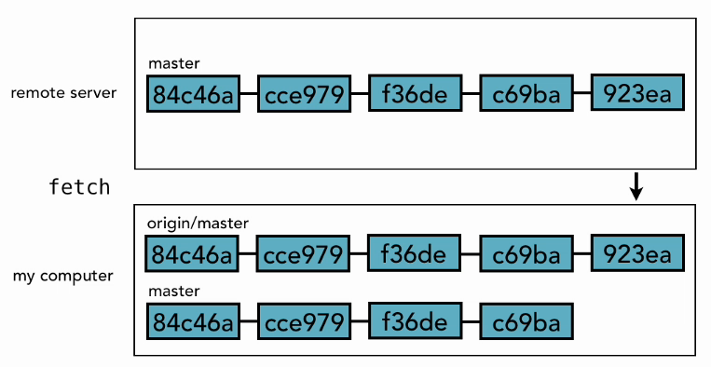
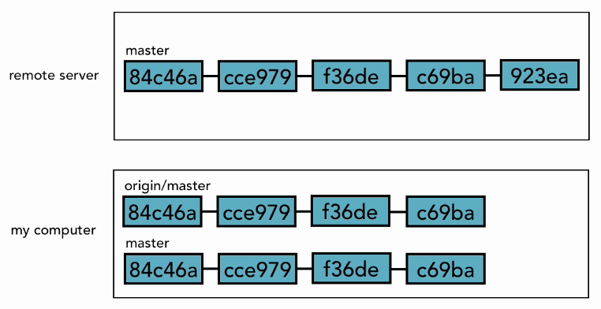
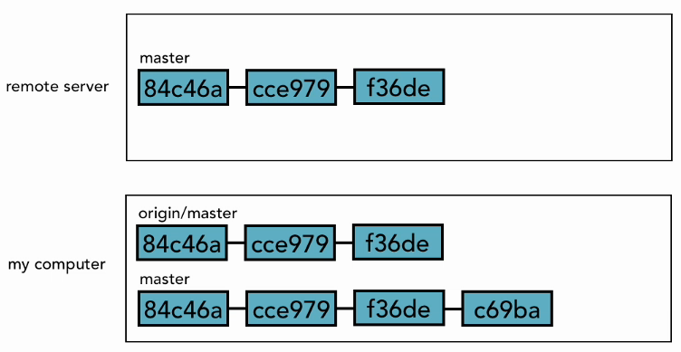
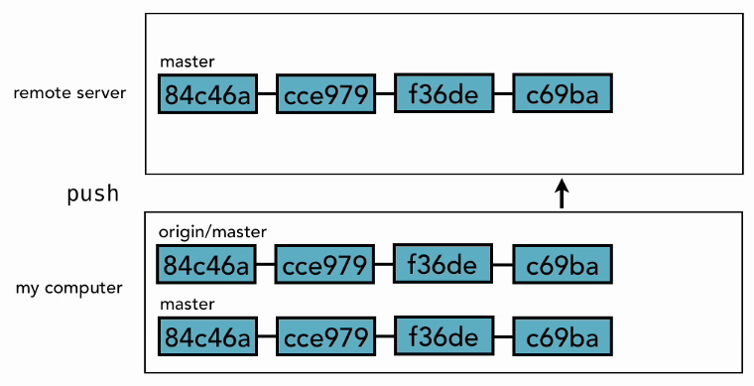
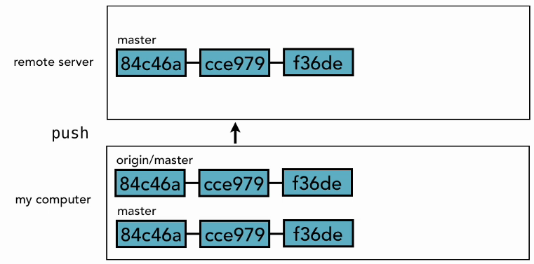
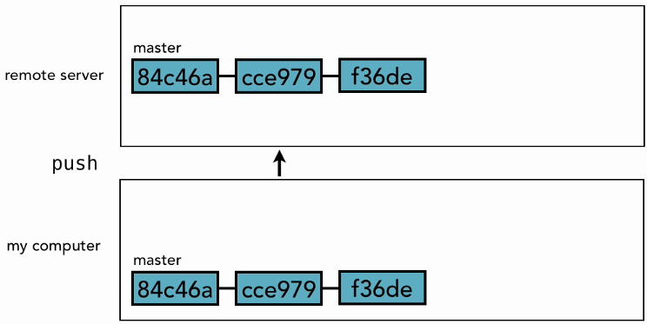

Local & Remote Repositories

Slide 21

GitHub
Notes:
www.github.com

Slide 22
Login to GitHub
www.github.com
Login using username from Git Day 1 Lab
After login, New repository
Name: first-repo
Description: My first repository
Public
Create repository

Slide 23
Add a Remote Repository in GitGui
Switch to local GitGui
Open local repo | Push
Source Branches: master
Arbitrary Location: https://github.com/yourid/first-repo.git
Push | enter credentials
Close
Refresh
Remote URL
Notes:
-v shows the path

Slide 24
Questions

