Slide 1

DS 501 Data scientist express bootcamp

Slide 2

版权声明
所有太阁官方网站以及在第三方平台课程中所产生的课程内容，如文本，图形，徽标，按钮图标，图像，音频剪辑，视频剪辑，直播流，数字下载，数据编辑和软件均属于太阁所有并受版权法保护。
对于任何尝试散播或转售BitTiger的所属资料的行为，太阁将采取适当的法律行动。
C
有关详情，请参阅
https://www.bittiger.io/termsofuse https://www.bittiger.io/termsofservice

Slide 3
Copyright Policy
All content included on the Site or third-party platforms as part of the class, such as text, graphics, logos, button icons, images, audio clips, video clips, live streams, digital downloads, data compilations, and software, is the property of BitTiger or its content suppliers and protected by copyright laws.
Any attempt to redistribute or resell BitTiger content will result in the appropriate legal action being taken.
C
We thank you in advance for respecting our copyrighted content.
For more info:
see https://www.bittiger.io/termsofuse
and https://www.bittiger.io/termsofservice

Slide 4

summary
Database Basics
SQL Basic
Select/from/where/like/group by/order by/having
SQL Intermediate
Join/distinct/union/coalesce/temp table/with
SQL Advanced
Self join/case when/if/Over partition by/date function
SQL Interview
Type of questions, how to approach
Coding Practice

Slide 5
Database Basics

Slide 6
SQL Introduction
Standard language for querying and manipulating data
Structured Query Language
PostgreSQL, SQLite, MySQL, MSSQL, Oracle = relational database management systems (RDBMSes)*
SQL, TSQL = the actual languages used by the aforementioned database systems. Although (in theory) SQL is standardised, in practice each vendor has their own "extensions" (variations) on the language - which means that SQL written for MySQL may not work under Sybase, for example.
*Adapted from this link

Slide 7
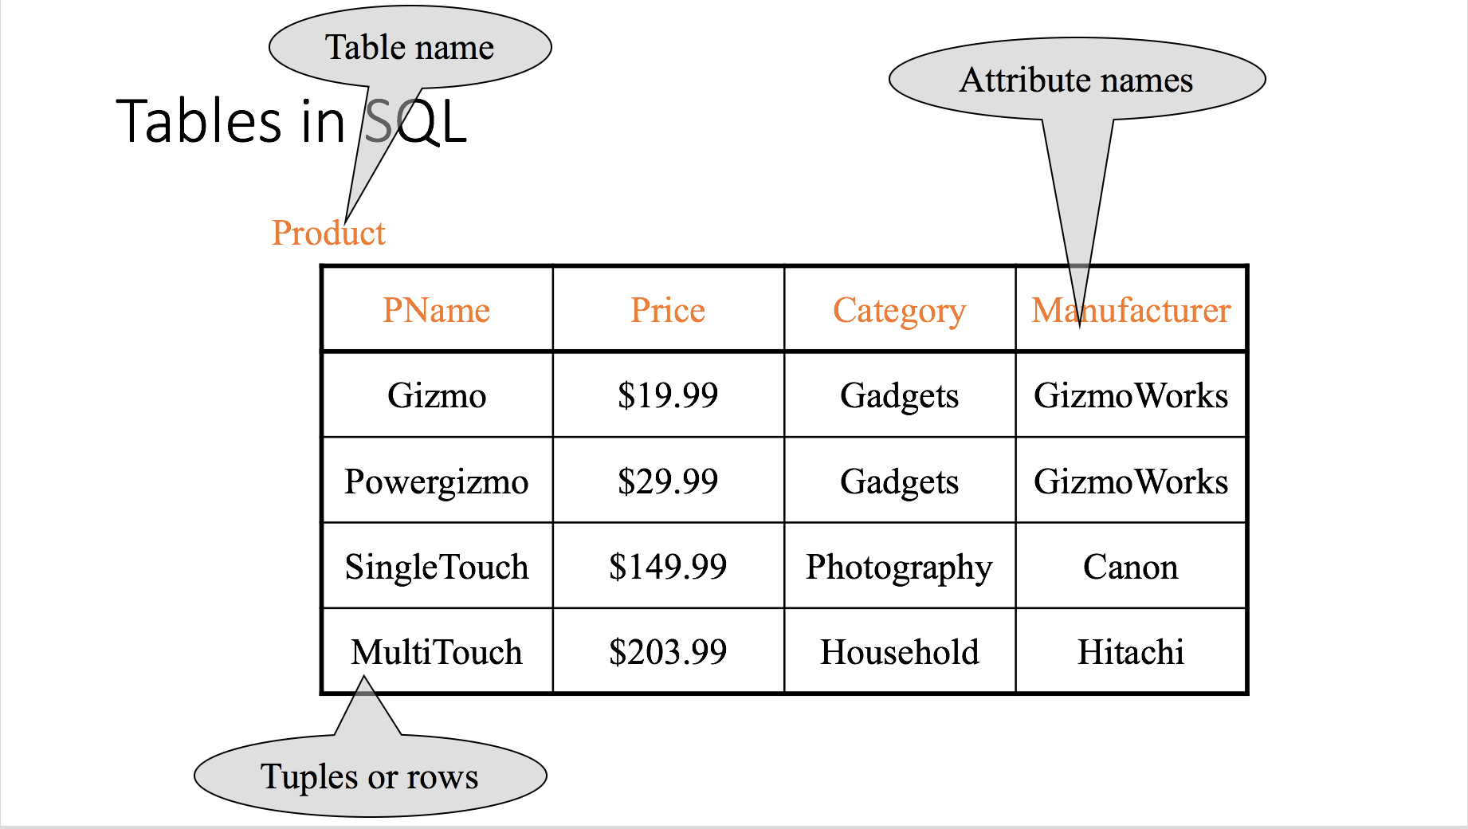

Slide 8
SQL vs. NoSQL
NoSQL = Not Only SQL
SQL databases are table based databases
NoSQL databases are document based, key-value pairs, graph databases or wide-column stores.
Hadoop/Hbase (Wide-column)
MongoDB (Document Based)
Neo4J (Graph)

Slide 9
NoSQL Example (Json, document based)
{ "id":"ew12-res2-234e-544f", "title":"post title", "date":"2016-01-01", "body":"this is an awesome post stored on NoSQL", "createdBy":User, "images":["http://myfirstimage.png","http://mysecondimage.png"], "videos":[ {"url":"http://myfirstvideo.mp4", "title":"The first video"}, {"url":"http://mysecondvideo.mp4", "title":"The second video"} ], "audios":[ {"url":"http://myfirstaudio.mp3", "title":"The first audio"}, {"url":"http://mysecondaudio.mp3", "title":"The second audio"} ] }

Slide 10
SQL Data Types
Atomic types
Characters: CHAR(20), VARCHAR(50)
Numbers: INT, BIGINT, SMALLINT, FLOAT
Others: MONEY, DATETIME, …

Slide 11
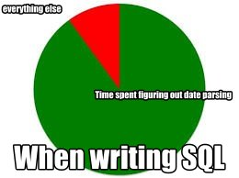
SQL Data Types
Atomic types
Characters: CHAR(20), VARCHAR(50)
Numbers: INT, BIGINT, SMALLINT, FLOAT
Others: MONEY, DATETIME, …
不会复合考察知识点
要不只写code
要不只问知识点

Slide 12
本章常见面试考题
What is the difference between primary key and foreign key?

Slide 13
推荐学习网站
W3School
https://www.w3schools.com/sql/
ModeAnalytics
https://community.modeanalytics.com/sql/tutorial/introduction-to-sql/

Slide 14
SQL Basic Syntax

Slide 15
SQL Syntax
背
SELECT column-names
FROM table-name
WHERE condition (OPTIONAL)
GROUP BY group-name (OPTIONAL)
HAVING condition after aggregated (OPTIONAL)
ORDER BY sort-order [ASC/DESC] (OPTIONAL)
关键词的顺序不能变！

Slide 16
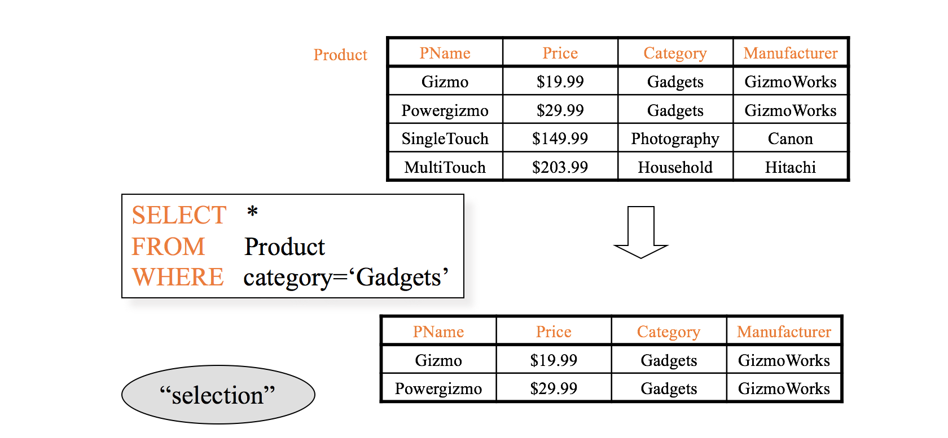
SQL Syntax: SELECT, FROM, WHERE
Practice Link: https://www.w3schools.com/sql/trysql.asp?filename=trysql_select_all

Slide 17
SELECT NOTES
SELECT
*
a1,a2,a3
A1 as b1, a2 as b2
a1 + a2 as b1, a1-a1*a2/a3 as b2
DISTINCT a1, a2, a3
Top 10 (SQL server), LIMIT (MySQL)
Aggregate function (later)
Practice Link: https://www.w3schools.com/sql/trysql.asp?filename=trysql_select_all

Slide 18
WHERE NOTES
WHERE
>, <, =
!=, <>
LIKE
BETWEEN
IN
IS NULL (refer to website)
AND/OR
NOT
Practice Link: https://www.w3schools.com/sql/trysql.asp?filename=trysql_select_all

Slide 19
Like and Wildcards Examples
Different between Like “%plus”, Like “plus%” and Like “%plus%”?
Like “pl_s”

Slide 20
SQL Syntax: AGGREGATE FUNCTIONS
MIN | returns the smallest value in a given column
MAX | returns the largest value in a given column
SUM | returns the sum of the numeric values in a given column
AVG | returns the average value of a given column
COUNT | returns the total number of values in a given column
COUNT(*) | returns the number of rows in a table
Practice Link: https://www.w3schools.com/sql/trysql.asp?filename=trysql_select_all

Slide 21
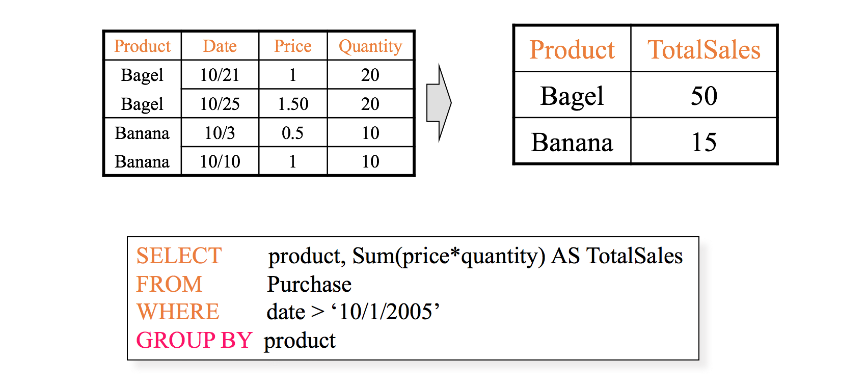
SQL Syntax: GROUP BY
Practice Link: https://www.w3schools.com/sql/trysql.asp?filename=trysql_select_all

Slide 22
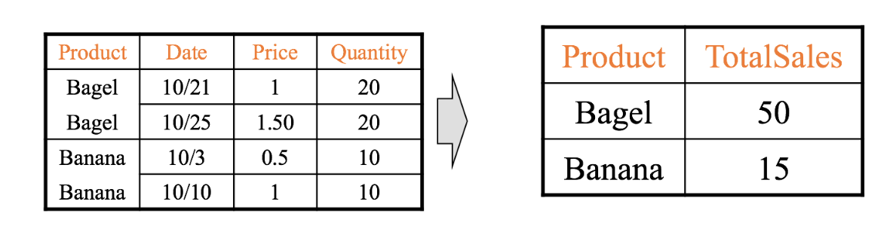
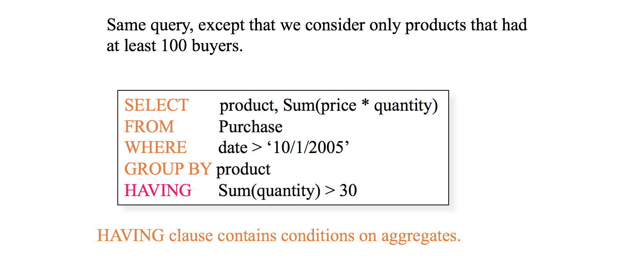
SQL Syntax: HAVING
Having 里的condition并不一定要出现在select里
Practice Link: https://www.w3schools.com/sql/trysql.asp?filename=trysql_select_all

Slide 23
SQL Syntax: HAVING
Interview question:
What is the difference between WHERE and HAVING?
Practice Link: https://www.w3schools.com/sql/trysql.asp?filename=trysql_select_all

Slide 24
如何用R跑sql
https://www.r-bloggers.com/make-r-speak-sql-with-sqldf/

Slide 25
本章常见面试考题
What is the difference between “WHERE” and “HAVING”?
知道怎么用Group By，一般为SQL最简单的coding题

Slide 26
SQL Intermediate Syntax

Slide 27
INNER JOIN, LEFT JOIN, RIGHT JOIN, FULL JOIN
背
The INNER JOIN keyword selects all rows from both tables as long as there is a match between the columns in both tables.
The LEFT (OUTER) JOIN keyword returns all rows from the left table (table1), with the matching rows in the right table (table2). The result is NULL in the right side when there is no match.
The RIGHT (OUTER) JOIN keyword returns all rows from the right table (table2), with the matching rows in the left table (table1). The result is NULL in the left side when there is no match.
The FULL OUTER JOIN keyword returns all rows from the left table (table1) and from the right table (table2). The FULL OUTER JOIN keyword combines the result of both LEFT and RIGHT joins

Slide 28
INNER JOIN, LEFT JOIN, RIGHT JOIN, FULL JOIN
Table 1
SELECT * FROM T1 INNER JOIN T2 ON T1.ID = T2.ID
ID | Age | ID | Grade
1 | 15 | 1 | 98
ID | Age
1 | 15
2 | 16
Table 2
ID | Grade
1 | 98
3 | 80
Notes:
SELECT T1.ID AS ID1, T2.ID AS ID2 FROM temp_tabe

Slide 29
INNER JOIN, LEFT JOIN, RIGHT JOIN, FULL JOIN
Table 1
SELECT * FROM T1 INNER JOIN T2 ON T1.ID = T2.ID
ID | Age | ID | Grade
1 | 15 | 1 | 98
SELECT * FROM T1 LEFT JOIN T2 ON T1.ID = T2.ID;
ID | Age | ID | Grade
1 | 15 | 1 | 98
2 | 16 | NULL | NULL
ID | Age
1 | 15
2 | 16
Table 2
ID | Grade
1 | 98
3 | 80
Notes:
SELECT T1.ID AS ID1, T2.ID AS ID2 FROM temp_tabe

Slide 30
INNER JOIN, LEFT JOIN, RIGHT JOIN, FULL JOIN
Table 1
SELECT * FROM T1 INNER JOIN T2 ON T1.ID = T2.ID
ID | Age | ID | Grade
1 | 15 | 1 | 98
SELECT * FROM T1 LEFT JOIN T2 ON T1.ID = T2.ID;
ID | Age | ID | Grade
1 | 15 | 1 | 98
2 | 16 | NULL | NULL
ID | Age
1 | 15
2 | 16
Table 2
ID | Grade
1 | 98
3 | 80
SELECT * FROM T1 RIGHT JOIN T2 ON T1.ID = T2.ID
ID | Age | ID | Grade
1 | 15 | 1 | 98
NULL | NULL | 3 | 80
Notes:
SELECT T1.ID AS ID1, T2.ID AS ID2 FROM temp_tabe

Slide 31
INNER JOIN, LEFT JOIN, RIGHT JOIN, FULL JOIN
Table 1
SELECT * FROM T1 INNER JOIN T2 ON T1.ID = T2.ID
ID | Age | ID | Grade
1 | 15 | 1 | 98
SELECT * FROM T1 LEFT JOIN T2 ON T1.ID = T2.ID;
ID | Age | ID | Grade
1 | 15 | 1 | 98
2 | 16 | NULL | NULL
ID | Age
1 | 15
2 | 16
Table 2
ID | Age | ID | Grade
1 | 15 | 1 | 98
2 | 16 | NULL | NULL
NULL | NULL | 3 | 80
ID | Grade
1 | 98
3 | 80
SELECT * FROM T1 RIGHT JOIN T2 ON T1.ID = T2.ID
ID | Age | ID | Grade
1 | 15 | 1 | 98
NULL | NULL | 3 | 80
SELECT * FROM T1 FULL JOIN T2
ON T1.ID = T2.ID
Notes:
SELECT T1.ID AS ID1, T2.ID AS ID2 FROM temp_tabe

Slide 32
INNER JOIN, LEFT JOIN, RIGHT JOIN, FULL JOIN
Table 1
SELECT T1.ID
FROM Table1 AS T1 LEFT JOIN T2 ON T1.ID = T2.ID
Where t2.ID IS NULL
ID | Age
1 | 15
2 | 16
ID | Age | ID | Grade
1 | 15 | 1 | 98
2 | 16 | NULL | NULL
Table 2
SELECT Table1.ID
FROM Table1 LEFT JOIN T2 ON T1.ID = T2.ID
Where t2.ID IS NULL
ID | Grade
1 | 98
3 | 80
Notes:
SELECT T1.ID AS ID1, T2.ID AS ID2 FROM temp_tabe

Slide 33
Common ‘Mistakes’: duplicate created unexpectedly
Table 1
ID | Age | ID | Grade
1 | 15 | 1 | 98
3 | 16 | 3 | 80
3 | 16 | 3 | 90
Q: How many students are in both Table 1 and Table 2?
ID | Age
1 | 15
3 | 16
# 3
SELECT count(*) AS total_count
FROM T1
INNER JOIN T2
ON T1.ID = T2.ID;
# 2
SELECT count(distinct T1.ID)
AS total_count
FROM T1
INNER JOIN T2
ON T1.ID = T2.ID;
Table 2
total_count
3
ID | Grade | Subject
1 | 98 | Chinese
3 | 80 | Chinese
3 | 90 | Maths
total_count
2

Slide 34
Distinct
The SELECT DISTINCT statement is used to return only distinct (different) values.
SELECT DISTINCT column_name1,column_name2
FROM table_name;
SELECT COUNT(DISTINCT column_name)
FROM table_name

Slide 35
Count distinct without using distinct
Select count(*)
From
(SELECT customer_id
FROM table
GROUP BY 1);
>> select count(distinct customer_id) from table

Slide 36
UNION and UNION ALL
背
The UNION operator is used to combine the result-set of two or more SELECT statements.
The UNION operator selects only distinct values by default. To allow duplicate values, use the ALL keyword with UNION.
SELECT column_name1,column_name2 FROM table1 UNION (ALL) SELECT column_name1,column_name2 FROM table2;
Interview question: What is the difference between UNION and JOIN?

Slide 37
UNION (DISTINCT)
Kobe | Bryant | 40
Michael | Jordan | 50
Tim | Duncan | 42
Kobe | Bryant | 40
Michael | Jordan | 50
UNION ALL
Kobe | Bryant | 40
Tim | Duncan | 42
Kobe | Bryant | 40
Michael | Jordan | 50
Kobe | Bryant | 40
Tim | Duncan | 42

Slide 38
COALESCE
Set default value if missing
SELECT COALESCE( s.spend, 0) AS spend
FROM user u
LEFT OUTER JOIN spend s
ON u.tsid = s.tsid

Slide 39
Creating CTE with ‘WITH’
To make queries reusable, you can specifies a temporary named result set, known as a common table expression (CTE) in WITH statement. A CTE can refer to itself and previously defined CTE, cannot forward reference. You
WITH cte1 (column1, column2, ...) AS (SELECT ...),
cte2 (column1, column2, …) AS (SELECT …)
SELECT ...
e.x.WITH Sales_CTE (SalesPersonID, SalesOrderID) AS
( SELECT SalesPersonID,
SalesOrderID
FROM Sales.SalesOrderHeader
WHERE SalesPersonID IS NOT NULL )
SELECT SalesPersonID,
COUNT(SalesOrderID) AS TotalSales
FROM Sales_CTE
GROUP BY 1;

Slide 40
TEMP TABLE
The SELECT INTO statement copies data from one table and inserts it into a new table.
Temp table is much more preferred than sub-query in terms of readability.
SELECT column_name(s) INTO newtable [IN externaldb] FROM table1;
Interview Question:
What is the difference between a view table and a temp table?

Slide 41
DON’T
DO
SELECT *
FROM table 1
WHERE user_id IN
(SELECT user_id
FROM order
WHERE order_id IN
(SELECT order_id
FROM product_table
WHERE ...)
);
SELECT order_id
INTO order_temp (name of result table)
FROM product_table
WHERE …;
SELECT user_id
INTO user_temp (name of result table)
FROM order o1
INNER JOIN order_temp ot
ON o1.order_id = ot.order_id;
...

Slide 42
本章常见面试考题
What is the difference between “INNER JOIN” and “LEFT JOIN”?
What is the difference between “UNION” and “UNION ALL”?
SELECT COUNT(DISTINCT id); What is the more efficient way to achieve count distinct ids?
A: select count(1) from (select id from table1 group by 1);
知道怎么用LEFT/INNER JOIN，一般为SQL最普遍的coding题，难度从简单到困难都有。

Slide 43
SQL Advanced

Slide 44
SELF JOIN
Question: Count how many category instances do each parent category name have?
Category_ID | Category_Name | Parent_Category_ID
1 | Cars | NULL
2 | Honda | 1
3 | Toyota | 1
4 | Flowers | NULL
5 | Lily | 4
6 | Rose | 4
7 | Sakura | 4
Select c2.Category_Name,
count(1) as count
FROM category c1
LEFT JOIN category c2
ON c1.Parent_Category_ID = c2.Category_ID
GROUP BY 1

Slide 45
SELF JOIN
并不Fancy，知道关键词就好
c1 |  |  | c2
Category_ID | Category_Name | Parent_Category_ID | Category_ID | Category_Name | Parent_Category_ID
1 | Cars | NULL | NULL | NULL | NULL
2 | Honda | 1 | 1 | Cars | NULL
3 | Toyota | 1 | 1 | Cars | NULL
4 | Flowers | NULL | NULL | NULL | NULL
5 | Lily | 4 | 4 | Flowers | NULL
6 | Rose | 4 | 4 | Flowers | NULL
7 | Sakura | 4 | 4 | Flowers | NULL
Notes:
NULL = NULL 错

Slide 46
SELF JOIN
Question: Count how many category instances do each top category have?
Category_ID | Category_Name | Parent_Category_ID
1 | Cars | NULL
2 | Honda | 1
3 | Toyota | 1
4 | Flowers | NULL
5 | Lily | 4
6 | Rose | 4
7 | Sakura | 4
SELECT t2.Category_ID
, COUNT(1) AS count
FROM category AS t1
INNER JOIN category AS t2
ON t1.Parent_Category_ID = t2.Category_ID
WHERE t2.Category_ID IS NOT NULL
GROUP BY 1;

Slide 47
CASE WHEN
Field | Type
Month | Int
Revenue | Float
SELECT CASE ("column_name")
WHEN "value1" THEN "result1"
WHEN "value2" THEN "result2"
...
[ELSE “NOT”]
END
FROM "table_name";
SELECT CASE
WHEN month in (1,2,3) THEN ‘Q1’
WHEN month in (4,5,6) THEN ‘Q2’
WHEN month in (7,8,9) THEN ‘Q3’
WHEN month in (10,11,12) THEN ‘Q4’
(ELSE “N/A”) #it is optional, but could be a common mistake
END AS Quarter
, SUM(Revenue) as sum_rev
FROM table
GROUP BY 1

Slide 48
IF
Field | Type
Month | Int
Revenue | Float
SELECT IF( condition, value if yes, value if no)
FROM "table_name";
Can replace CASE WHEN when there is only one condition
SELECT IF(month in (11, 12), ‘Holiday_Season’,
‘Other’) as seson
, SUM(Revenue) as sum_rev
FROM table
GROUP BY 1

Slide 49
Over Partition By
FUNCTION() OVER (PATITION BY x ORDER BY y ASC/DESC)
Ex. RANK() OVER (PARTITION BY x ORDER BY y DESC)
Apply rank() function
OVER- for the set of rows….
PARTITION BY x – with the same value of x
ORDER BY y DESC – in descending order of y
Frequently used functions:
RANK(), ROW_NUMBER() AND DENSE_RANK()
Not available in MySQL

Slide 50
RANK(), ROW_NUMBER() AND DENSE_RANK()
背
ACTUAL Data | ROW_NUMBER | RANK | DENSE_RANK
1 | 2 | 1 | 1
1 | 1 | 1 | 1
1 | 3 | 1 | 1
3 | 5 | 5 | 3
3 | 6 | 5 | 3
4 | 7 | 7 | 4
9 | 8 | 8 | 5
2 | 4 | 4 | 2

Slide 51
SELECT *
, ROW_NUMBER() OVER (PARTITION BY Team ORDER BY Avg_pts DESC) AS rk
FROM table
Team | Name | Avg_pts
Lakers | Kobe Bryant | 25
Bulls | Michael Jordan | 30
Lakers | Louis Williams | 25
Bulls | Scottie Pippen | 20
Team | Name | Avg_pts | rk
Lakers | Kobe Bryant | 25 | 1
Bulls | Michael Jordan | 30 | 1
Lakers | Louis Williams | 25 | 2
Bulls | Scottie Pippen | 20 | 2

Slide 52
SELECT *
, RANK() OVER (PARTITION BY Team ORDER BY Avg_pts DESC) AS rk
FROM table
Team | Name | Avg_pts
Lakers | Kobe Bryant | 25
Bulls | Michael Jordan | 30
Lakers | Louis Williams | 25
Bulls | Scottie Pippen | 20
Team | Name | Avg_pts | rk
Lakers | Kobe Bryant | 25 | 1
Bulls | Michael Jordan | 30 | 1
Lakers | Louis Williams | 25 | 1
Bulls | Scottie Pippen | 20 | 2

Slide 53
Date Time functions
DATE_ADD(date, INTERVAL expr unit) (Oracle)
E.x. SELECT DATE_ADD('2010-12-31 23:59:59', -> INTERVAL 1 DAY);
DATEDIFF(expr1,expr2)
E.x. SELECT DATEDIFF('2007-12-31 23:59:59','2007-12-30’);
DAYOFWEEK(date)
E.x. SELECT DAYOFWEEK('2007-02-03’);
DATE_FORMAT(date,format)
E.x. SELECT DATE_FORMAT('2009-10-04 22:23:00', '%W %M %Y'); -> 'Sunday October 2009'
Use Oracle syntax as example https://docs.oracle.com/cd/E17952_01/mysql-5.6-en/date-and-time-functions.html

Slide 54
Other advanced topics
Query Optimization (JOIN or Sub-query?)
Functions? (Other PL)?
Self defined functions
Different Data format? CAST
Different Timezone?

Slide 55
SQL Interview

Slide 56
SQL interview questions
SQL coding (90%) sometimes within a case study -- Understand problems + Coding
Knowledge question (sometimes embedded in coding). -- 小公司或entry level position或电话面试可能问
Important Evaluation Factors:
Logic (the key!!!!)
Understand real problem & translate to a data problem
Communication
Not very important but good to have:
Format
Bug Free
Query optimization

Slide 57
How to approach SQL interview questions
背
Step 1, make sure you are 100% clear what is the question.
“Give me the distribution of app acquisition over time”
“Give me the performance of YoY revenue growth”
Ask clarifying question if you are not sure! (A lot of time you are supposed to)
Step 2, build the join in head, and if too many, build temp table.
Step 3, write the SQL (better if you can at the same time talk through it)
Step 4, double check (table prefix, distinct, left/inner/right join, etc.). Think about ways to optimize it

Slide 58
What to notice
Take your time! (A bit slow is fine, quick but buggy code ~= nothing)
Clarify, summarize
Fine writing
Double check when you finish
Make sure you talk through your thinking process
Help yourself to think
Help interviewer to understand and help you if you are going in a wrong direction
很好的‘消耗’时间的地方
对着同学／镜子练习，至少一次！

Slide 59
Steps in Syntax
FROM
JOIN
WHERE
SELECT, GROUP BY, HAVING
ORDER BY

Slide 60
Coding Practice

Slide 61
SQL question 1: Get 1000th highest spend value
order_table
ID | Date | Spend
1 | 01/01/1990 | $x1
2 | 01/01/1990 | $x2
2 | 01/03/1990 | $x3
... | ... | ...

Slide 62
SQL question 1: Get 1000th highest spend value
order_table
ID | Date | Spend
1 | 01/01/1990 | $x1
2 | 01/01/1990 | $x2
2 | 01/03/1990 | $x3
... | ... | ...
1) Use TOP / LIMIT keyword
SELECT *
FROM(
SELECT Spend
FROM order_table
ORDER BY Spend DESC
LIMIT 1000)
ORDER BY Spend LIMIT 1;
What can be better?

Slide 63
SQL question 1: Get 1000th highest spend value
order_table
ID | Date | Spend
1 | 01/01/1990 | $x1
2 | 01/01/1990 | $x2
2 | 01/03/1990 | $x3
... | ... | ...
1) Use TOP / LIMIT keyword
SELECT spend
FROM (
SELECT spend
FROM order_table
ORDER BY 1 DESC
LIMIT 1000)
ORDER BY 1
LIMIT 1;

Slide 64
SQL question 1: Get 1000th highest spend value
order_table
2) Use rank() over keyword
SELECT
FROM (SELECT *
, RANK() OVER (ORDER BY Spend DESC)
AS rk
FROM order_table)
WHERE rk = 1000;
ID | Date | Spend
1 | 01/01/1990 | $x1
2 | 01/01/1990 | $x2
2 | 01/03/1990 | $x3
... | ... | ...
Any problems with this code?
What if you have records with same spending?

Slide 65
SQL question 1: Get 1000th highest spend value
order_table
ID | Date | Spend
1 | 01/01/1990 | $x1
2 | 01/01/1990 | $x2
2 | 01/03/1990 | $x3
... | ... | ...
2) Use row_number() over keyword
SELECT spend
FROM (
SELECT spend
, row_number() over (order by spend desc) as spend_rank
FROM order_table)
WHERE spend_rank = 1000;
Need to clarify with interviewer.
用row_number() 才能保证肯定有spend_rank = 1000的那一行

Slide 66
SQL 面试题 - 示例2
The Trips table holds all taxi trips. Each trip has a unique Id, while Client_Id and Driver_Id are both foreign keys to the Users_Id at the Users table. Status could be (‘completed’, ‘cancelled_by_driver’, ‘cancelled_by_client’).
Table 1: trips
Id | Client_Id | Driver_Id | City_Id | Status | Request_at
1 | 1 | 10 | 1 | completed | 10/1/13
2 | 2 | 11 | 1 | cancelled_by_driver | 10/1/13
3 | 3 | 12 | 6 | completed | 10/1/13
4 | 4 | 13 | 6 | cancelled_by_client | 10/1/13
5 | 1 | 10 | 1 | completed | 10/2/13
6 | 2 | 11 | 6 | completed | 10/2/13
7 | 3 | 12 | 6 | completed | 10/2/13
8 | 2 | 12 | 12 | completed | 10/3/13
9 | 3 | 10 | 12 | completed | 10/3/13
10 | 4 | 13 | 12 | cancelled_by_driver | 10/3/13

Slide 67
SQL 面试题 - 示例2
The Users table holds all users. Each user has an unique Users_Id, and Role is one of (‘client’, ‘driver’, ‘partner’).
Write a SQL query to find the cancellation rate of requests made by unbanned clients for each day
Table 2: Users
Users_Id | Banned | Role
1 | No | client
2 | Yes | client
3 | No | client
4 | No | client
10 | No | driver
11 | No | driver
12 | No | driver
13 | No | driver

Slide 68
SQL 面试题 - 示例2
Write a SQL query to find the cancellation rate of requests made by unbanned clients for each day
SELECT request_at AS day,
SUM(IF(status like 'cancel%', 1, 0))/COUNT(1) AS cancellation_rate
FROM trips t
JOIN users u
ON t.client_id = u.users_id
AND u.role = 'client'
AND u.banned = 'No'
GROUP BY request_at

Slide 69
SQL 面试题 - 示例3
Self served accounts on your platform has the trend to first increase spending then decrease. Your team want to send out marketing emails before accounts’ spending decline. With the following data, help the team decide when to send out email.
Table 1: Campaigns
Table 2: Spend
Account ID (AID) | Campaign ID (CID)
1 | 123
1 | 130
1 | 140
2 | 235
2 | 236
2 | 237
3 | 300
Campaign_id (CID) | Date | spend | Currency
123 | 8/1/17 | 200 | USD
123 | 8/2/17 | 150 | USD
234 | 9/1/17 | 500 | USD
140 | 9/15/17 | 300 | USD
235 | 7/1/17 | 100 | USD
236 | 8/1/17 | 200 | USD
237 | 9/1/17 | 150 | USD
300 | 8/20/17 | 100 | USD

Slide 70
SQL 面试题 - 示例3
Self served accounts on your platform has the trend to first increase spending then decrease. Your team want to send out marketing emails before accounts’ spending decline. With the following data, help the team decide when to send out email.
1. Understand the question. What is the number wanted?
2. Any data should be excluded from the calculation?
A: Average # of days from first spending to highest spending
A: Accounts which have not seen spending decline

Slide 71
SQL 面试题 - 示例3
SELECT AVG(DATEDIFF(first_date, maxspend_date)) AS time
FROM (SELECT aid,
MIN(date) AS first_date
FROM cs
GROUP BY aid) first
JOIN (SELECT aid,
date AS maxspend_date
FROM cs
WHERE rank() OVER (PARTITION BY aid ORDER BY daily_spend DESC) = 1) max
JOIN (SELECT aid, max(date) AS last_date
FROM cs
GROUP BY aid) last
ON first.aid = max.aid
AND first.aid = last.aid
WHERE maxspend_date != last_date
WITH cs AS
(SELECT aid, date, sum(spend) AS daily_spend
FROM campaigns c
JOIN spend s
ON c.cid = s.cid
GROUP BY 1, 2)

Slide 72
SQL 面试题 - 示例4
1, How would you design a system to recommend 2nd degree friends to user?
Table: Friend
UID1 | UID2
A | B
A | C
B | A
B | C
B | D
C | A
D | C

Slide 73
SQL 面试题 - 示例4 - 1
How would you design a system to recommend 2nd degree friends to user?
1. What kind of users do you want to recommend
2. How would you like to show your result?
A: Have mutual friend but not friend
A: Pair of users. With duplicates?

Slide 74
SQL 面试题 - 示例4 - 1
SELECT second.uid1,
second.uid2,
mutual_friends
FROM (SELECT f1.uid1 AS uid1,
f2.uid2 AS uid2,
COUNT(distinct f1.uid2) AS mutual_friends FROM friend f1
JOIN friend f2
ON f1.uid2 = f2.uid1
AND f1.uid1 < f2.uid2
GROUP BY f1.uid1, f2.uid2) second
LEFT OUTER JOIN friend
ON second.uid1 = friend.uid1
AND second.uid2 = friend.uid2
WHERE friend.uid2 IS NULL

Slide 75
SQL 面试题 - 示例4 - 2
2, You have another table of user’s job applications. You want to find users’ friends who have applied to at least 3 job postings as them as their career buddy and recommend jobs that the user’s career buddy have applied to but the user haven’t
Table: Friend
Table: Job
UID1 | UID2
A | B
A | C
B | A
B | C
B | D
C | A
D | C
UID | Jobid
A | 11
A | 12
A | 13
A | 14
B | 11
B | 12
B | 13
B | 15

Slide 76
SQL 面试题 - 示例5
Can you use SQL to transpose a table without pivot/unpivot function?
user | product | volume
1 | A | 20
1 | B | 14
1 | C | 8
2 | A | 12
2 | B | 1
2 | C | 18
3 | A | 10
3 | B | 2
3 | C | 3
user | ProductA | ProductB | ProductC
1 | 20 | 14 | 8
2 | 12 | 1 | 18
3 | 10 | 2 | 3

Slide 77
Summary
Q1: Limit, Order by
RANK() OVER () function
Q2: GROUP BY, JOIN, CASE WHEN, CAST
Q3: define your metrics to calculate
WITH, multiple JOINs
Q4: SELF JOIN, LEFT OUTER JOIN, add ON condition to optimize query
HAVING, FULL OUTER JOIN
Q5: CASE WHEN, UNION ALL

Slide 78
Other types of SQL questions

Slide 79
Contraints
What is PRIMARY KEY?
A PRIMARY KEY constraint is a unique identifier for a row within a database table. Every table should have a primary key constraint to uniquely identify each row and only one primary key constraint can be created for each table. The primary key constraints are used to enforce entity integrity.
What is UNIQUE KEY constraint?
A UNIQUE constraint enforces the uniqueness of the values in a set of columns, so no duplicate values are entered. The unique key constraints are used to enforce entity integrity as the primary key constraints.
What is FOREIGN KEY?
A FOREIGN KEY constraint prevents any actions that would destroy links between tables with the corresponding data values. A foreign key in one table points to a primary key in another table. Foreign keys prevent actions that would leave rows with foreign key values when there are no primary keys with that value. The foreign key constraints are used to enforce referential integrity.
What is CHECK Constraint?
A CHECK constraint is used to limit the values that can be placed in a column. The check constraints are used to enforce domain integrity.
What is NOT NULL Constraint?
A NOT NULL constraint enforces that the column will not accept n

Slide 80
CAST/CONVERT
Cast functions and operators enable conversion of values from one data type to another. CONVERT() with a USING clause provides a way to convert data between different character sets:
Examples:
SELECT CONVERT('test', CHAR CHARACTER SET utf8); SELECT CAST('test' AS CHAR CHARACTER SET utf8);

Slide 81
SQL good practice
Primary Key 字段的长度尽量小，能用 small integer 就不要用 integer。例如员工数据表，若能用员工编号当主键，就不要用身分证号码。
一般字段亦同。若该数据表要存放的数据不会超过 3 万笔，用 small integer 即可，不必用 integer。
文字数据字段若长度固定，如：身分证号码，就不要用 varchar 或 nvarchar，应该用 char 或 nchar。
文字数据字段若长度不固定，如：地址，则该用 varchar 或 nvarchar。除了可节省存储空间外，存取硬盘时也会较有效率。
设计字段时，若其值可有可无，最好也给一个默认值，并设成「不允许 NULL」(一般字段默认为「允许 NULL」)。因为 SQL Server 在存放和查询有 NULL 的数据表时，会花费额外的运算动作 [2]。
若一个数据表的字段过多，应垂直切割成两个以上的数据表，并可用同名的 Primary Key 一对多连结起来，如：Northwind 的 Orders、Order Details 数据表。以避免在存取数据时，以「集簇索引 (clustered index)」扫描时会加载过多的数据，或修改数据时造成互相锁定或锁定过久。

Slide 82
Others
Find the maximum value without using max or min function
What's the difference between DELETE TABLE and TRUNCATE TABLE commands?

