Slide 2


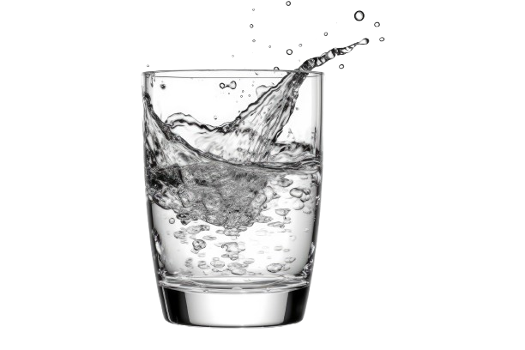
Water Conneisseur
Mmhh… tasty…
but besides the fact of the water’s hardness being able to reduce the lifespan of your brand-new coffee machine, the amount of trihalomethanes could cause little side-effects inside your delicate human flesh such as bladder cancer.
I’d pour this liquid away...
Denis Stephan 1

Slide 3
Water Conneisseur
Mmhh… tasty…
but besides the fact of the water’s hardness being able to reduce the lifespan of your brand-new coffee machine, the amount of trihalomethanes could cause little side-effects inside your delicate human flesh such as bladder cancer.
I’d pour this liquid away...
Denis Stephan 1

Slide 4
Water Conneisseur
Denis Stephan 1

Slide 5
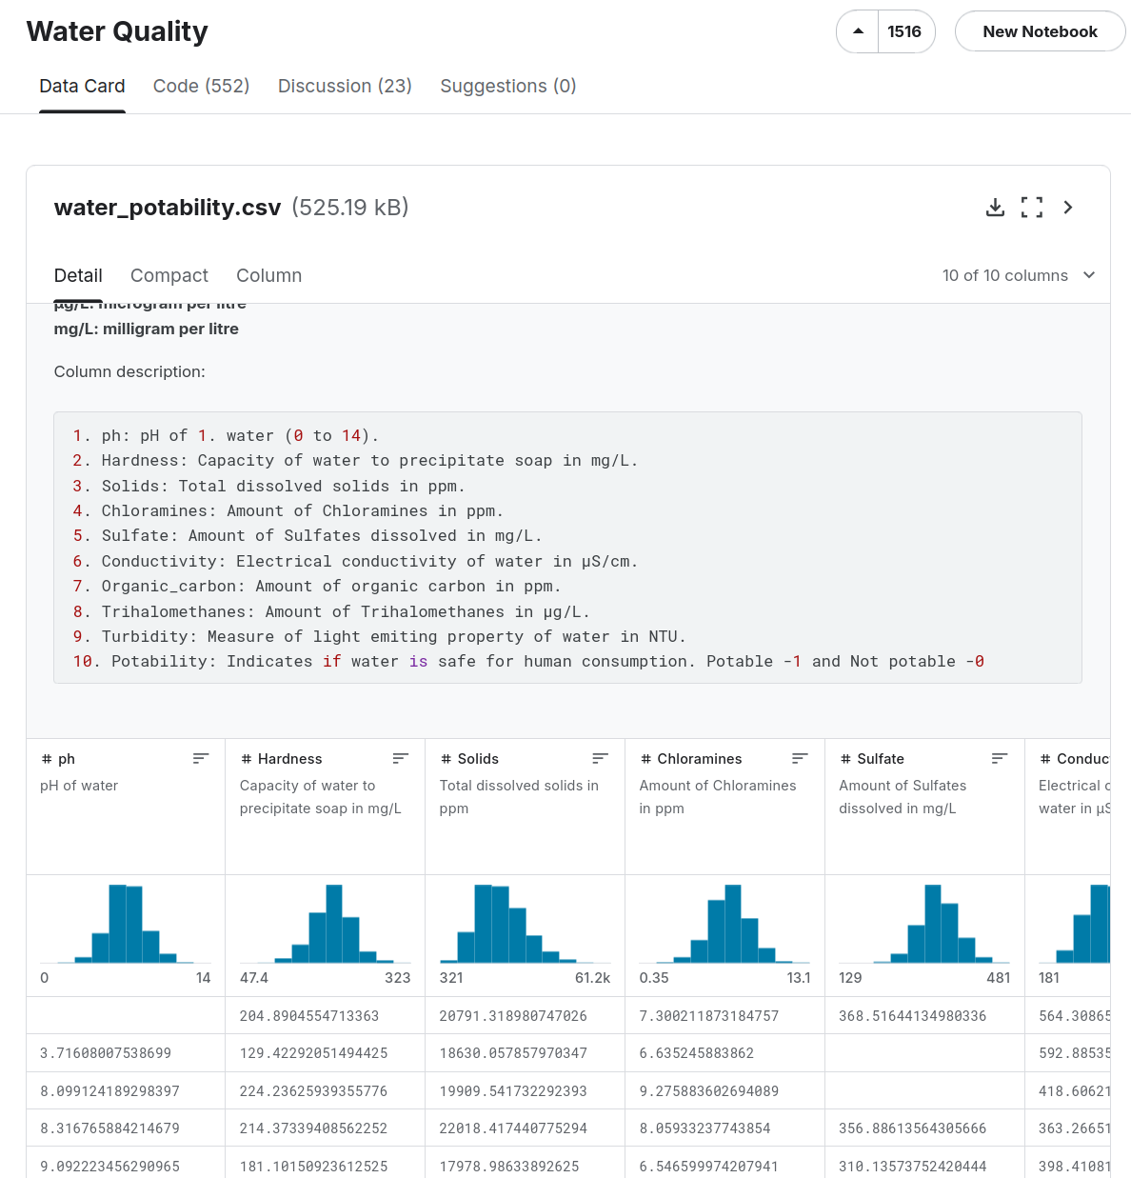
Denis Stephan 2

Slide 6
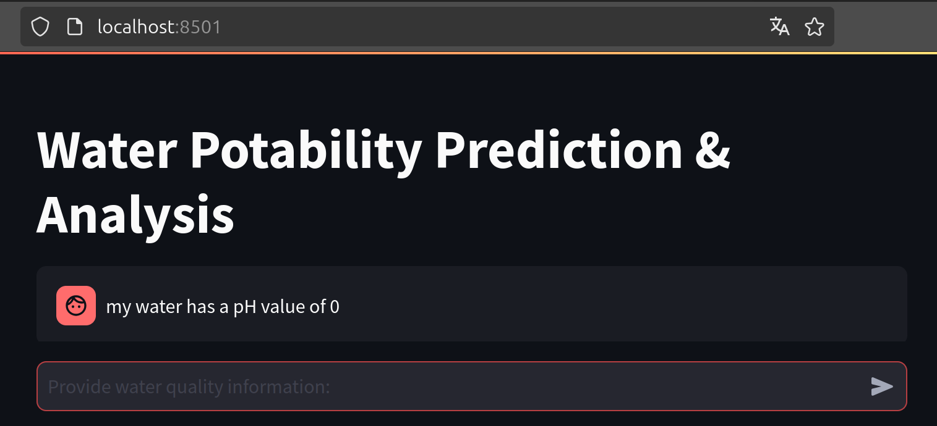
→LLM should format user data
to be used as input for model prediction
Denis Stephan 3

Slide 7
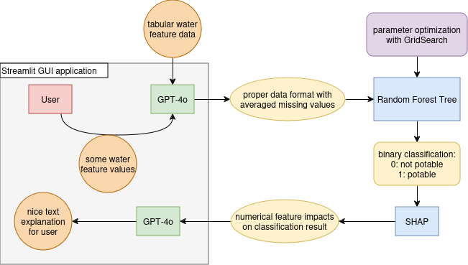
Denis Stephan 4

Slide 8
Constraints:
Averaged missing values too pessimistic in Germany
(→ not to be taken seriously, just as Proof of Concept)
Minimize false positives
SHAP calculation not required in case of result == potable
GPT-4o should distinguish in explanation of final decision:
user provided values vs kaggle database
(positive / negative influences each)
Feedback questions of users are out of scope
→ next message = new request
Denis Stephan 5

