Slide 1
RESEARCH PROTOTYPE · SYNTHETIC DATA
Early Detection of Alzheimer's from MRI and Handwriting
Design and analysis of an explainable multimodal prototype
MS
Malhar Srivatsav
SB
Sathwik Hejamady Bhat
HR
Harit Raval
SJ
Shreya Jain
TP
Taneesha Rajiv Prasad
NH
Nithyashree Hebbar
AG
Arshi Garg
Notes:
Good morning everyone. We are presenting an explainable prototype for the early detection of Alzheimer's disease, using two signals: MRI scans and handwriting. Before we start, one sentence that frames everything: all of our data is synthetic, so what we show you is how the system works and how it behaves, not how it would perform on patients.

Slide 2

Who is presenting what
THE TEAM
MS
SLIDES 3–4
SB
SLIDES 5–6
HR
SLIDES 7–8
SJ
SLIDES 9–10
Malhar Srivatsav
Sathwik Hejamady Bhat
Harit Raval
Shreya Jain
Problem and system overview
Data, imputation and balancing
The MRI model
MRI results and benchmarks
TP
SLIDES 11–12
NH
SLIDES 13–14
AG
SLIDES 15–16
SLIDE 17
Taneesha Rajiv Prasad
Nithyashree Hebbar
Arshi Garg
Live demo and questions
Explainability and robustness
The handwriting module
Performance, limits and next steps
Upload a scan, draw a spiral
Notes:
There are seven of us, and each person covers one part of the project, in pipeline order. I will explain the problem and how the system fits together. Sathwik covers the data, Harit the MRI model, Shreya the results, Taneesha the explanations and robustness, Nithyashree the handwriting module, and Arshi finishes with performance, limits and next steps. We will finish with a short live demo and questions.

Slide 3
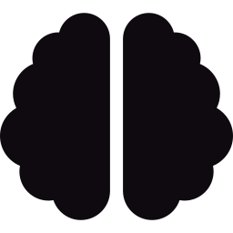


Early detection needs evidence you can check
MS
MALHAR SRIVATSAV · Problem and system overview
NC Normal cognition
›
EMCI Early MCI
›
LMCI Late MCI
›
AD Alzheimer's
THREE PROBLEMS
OUR ANSWER
Early MRI changes are subtle
1
Stage classifier
Explanation
A bare label gives a clinician nothing to check
VGG19, four ordered stages
Grad-CAM map + attention audit
2
Records have gaps, and healthy cases dominate
3
Data pipeline
Second signal
Hot-deck imputation, ADASYN
Spiral handwriting kinematics
Notes:
Hi everyone, I'm Malhar, and I'll start with why we built this. Alzheimer's does not arrive overnight. It moves through stages: normal cognition, early mild cognitive impairment, late mild cognitive impairment, and then Alzheimer's disease. The earlier we can see that shift, the more options a patient has. But there are three problems. First, the early changes in an MRI are subtle: slightly larger ventricles, slightly thinner cortex. Second, a model that only outputs a label gives a doctor nothing to check. And third, real clinical data is messy. Records have gaps, and most people in a cohort are healthy, so a lazy model can look accurate while missing the people who are ill. Our project answers each of those. A VGG19 network classifies the stage. Grad-CAM shows where it looked, and an automatic check flags a suspicious explanation. A cleaning pipeline handles missing values and class imbalance. And we added a second, cheap signal: handwriting.

Slide 4
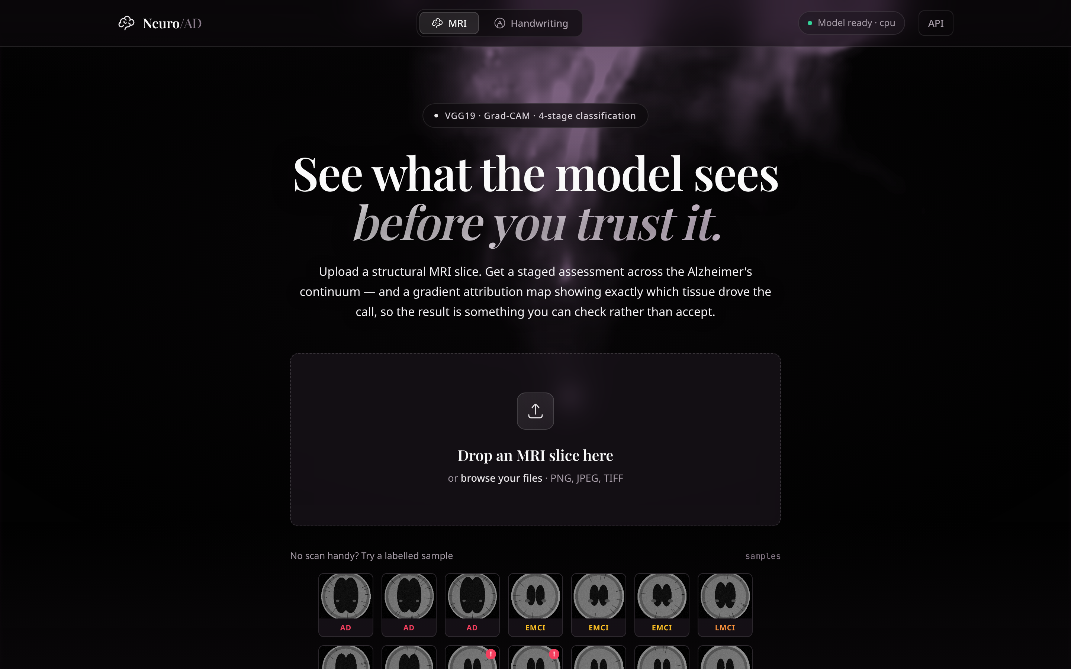

One app, two signals, every answer explained
MS
MALHAR SRIVATSAV · Problem and system overview
Browser
MRI tab · handwriting canvas · results
FastAPI service
size limits · validation · typed errors · /health
MRI predictor
Handwriting analyzer
VGG19 · probabilities · Grad-CAM
9 features · logistic regression
The running prototype: upload a slice or click a labelled sample
Checkpoint
Saved model
All data are synthetic: scores describe the pipeline, not patients
best_model.pt · 132 MB
trains itself in about 6 s
Notes:
Here is how it fits together. The browser talks to one FastAPI service. Behind it sit two analyzers. The MRI predictor returns stage probabilities plus a Grad-CAM map, and the handwriting analyzer scores a spiral drawing from the pen's motion. On the right is the real prototype, running. One important point before we go on: all of our data is synthetic. The MRI slices are generated phantoms, not real scans, and the drawings are simulated. So every number you will hear tells you that the pipeline works and how it behaves, not that it detects disease in patients. We state that in the paper and we will keep stating it today. Next, Sathwik will explain the data.

Slide 5
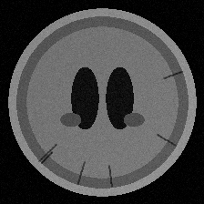
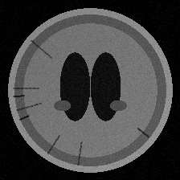
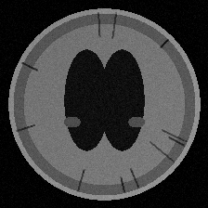
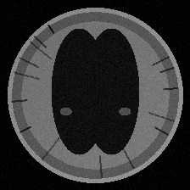
Why we generate our own data
SB
SATHWIK HEJAMADY BHAT · Data, imputation and balancing
3.2 : 1 class imbalance in the 285-slice cohort
NC
EMCI
LMCI
AD
ADNI access takes weeks: a generator lets the whole pipeline run today
As the stage advances: ventricles larger, cortex thinner, hippocampus smaller
Clinical table of 7 measures; gaps rise with stage, CSF amyloid most often missing
Notes:
Thanks, Malhar. I'm Sathwik, and I'll cover the data. Getting real ADNI scans needs an application that takes weeks, so we built a generator. It draws axial phantoms where, as the stage advances, the ventricles get bigger, the cortex gets thinner and the hippocampus shrinks. You can see the four stages on the left. Alongside the images it generates a clinical table: age, MMSE, CDR, ADAS-Cog, hippocampal volume, APOE4 and CSF amyloid. Two realistic problems are built in. The classes are imbalanced, about three point two to one, with healthy controls the biggest group, as the chart shows. And values go missing more often in the later stages, which is exactly what happens in real records. If you simply delete incomplete rows, you throw away the sickest patients first.

Slide 6
Hot-deck kept the spread; ADASYN did not help
SB
SATHWIK HEJAMADY BHAT · Data, imputation and balancing
Mean imputation: variance 0 and AD hippocampal volume 1.47 sd too large. Hot-deck: variance ≈ 1.0, bias −0.05 sd, at the cost of noisier single guesses.
ADASYN balances exactly (+455 synthetic rows, 3.26 → 1.00) but macro F1 moves -0.002 ± 0.015, ahead in 14 of 30 splits: no measurable gain.
* Class mean uses the true label, so it is only a reference.
Notes:
So we handle this in two steps. First, hot-deck imputation. Every gap is filled with a real value copied from a similar complete patient, chosen among the five nearest, and from the same stage during training. We tested it by hiding twenty percent of known values and scoring the guesses. Mean imputation destroys the spread of the data. Its variance ratio is zero, and it fills Alzheimer's patients with a hippocampal volume far too large. Hot-deck keeps the variance at about one. The trade-off is that each individual guess is a little noisier. Second, ADASYN, which creates synthetic minority records. It balances the classes exactly, but when we tested it downstream over thirty splits the macro F1 did not change in any meaningful way: minus 0.002, with a spread bigger than that. So we report it as correctly implemented, but not proven useful on this data. Harit will take it from here.

Slide 7

A pretrained VGG19, fine-tuned where it matters
HR
HARIT RAVAL · The MRI model
Input
Conv blocks 1–4
Conv block 5
New head
Output
224 × 224 MRI slice
›
Frozen · ImageNet filters
›
Fine-tuned on MRI
›
25088 → 512 → 256 → 4 · dropout
›
4 stage probabilities
33.0 M
22.4 M
4
parameters in total
trainable: block 5 + new head
ordered stages: NC < EMCI < LMCI < AD
A small detail that matters: in-place ReLUs are replaced with normal ones, because in-place layers overwrite the activations that Grad-CAM must read.
Notes:
Thanks, Sathwik. I'm Harit, and I'll explain the MRI model. We did not train a network from scratch, because with a few hundred slices that is hopeless. Instead we use VGG19, pretrained on ImageNet, and keep its early layers frozen, because edges and textures are useful for any image, including the way enlarged ventricles look. We unfreeze only the last convolutional block so it can adapt to MRI texture, and we replace the old thousand-class head with a small new one: down to 512, then 256, then four outputs, one per stage, with dropout in between. In total the network has 33 million parameters, of which 22.4 million are trainable. We also swap the in-place activations for normal ones. It is a small detail, but Grad-CAM has to read those values, and in-place layers overwrite them.

Slide 8
How it was trained, and what we evaluated
HR
HARIT RAVAL · The MRI model
TRAINING RECIPE
Epoch 1
1.000
AdamW: backbone 1e-4, new head ten times higher
Label smoothing 0.05, inverse-frequency class weights
Cosine decay, up to 25 epochs, early stopping (patience 6)
Checkpoint chosen by validation macro F1, not accuracy
Mild augmentation: flip, 7° rotation, 3% shift, 10% jitter
selected checkpoint
validation macro F1
Validation is saturated. A perfect score at epoch 1 on 43 slices means model selection carried almost no information.
We did not retrain. Every result that follows comes from running the released checkpoint.
Notes:
For training we used AdamW with a learning rate ten times higher for the new head than for the backbone, so the head converges without damaging the pretrained filters. The loss uses label smoothing and weights that favour the rare stages, and we pick the checkpoint by validation macro F1, not accuracy, because accuracy rewards a model that ignores Alzheimer's. Early stopping watches the same metric. Now an honest point about the checkpoint we evaluated. It was selected at the very first epoch, with a validation macro F1 of exactly one. That tells us the validation set is saturated, because synthetic phantoms are easy, so model selection carried almost no information. And we did not retrain it: every result you will see comes from running the released checkpoint. Shreya will show what it does.

Slide 9
Reproduced exactly, then tested on fresh data
SJ
SHREYA JAIN · MRI results and benchmarks
REPRODUCED
95.35%
43-slice test split · macro F1 0.9653 · kappa 0.9783 · confusion matrix identical to the documentation
FRESH, UNSEEN COHORTS
97.8%
1,065 slices from 3 new seeds · macro F1 0.978 (95% CI 0.968–0.986)
Notes:
Thanks, Harit. I'm Shreya, and I'll go through the benchmarks. The first question: can we trust the numbers the project already reported? We regenerated the original cohort, applied the same split, and ran the released checkpoint. We got 95.35 percent accuracy, a macro F1 of 0.9653, and a confusion matrix identical to the one in the documentation, so it reproduces exactly. But that test set is only 43 slices. So we generated three fresh cohorts the model had never seen, 1,065 slices in total, and got 97.8 percent accuracy and a macro F1 of 0.978, with a 95 percent confidence interval from 0.968 to 0.986. Every seed lands between 97.5 and 98.6 percent. So the original figure was a small-sample estimate, not a lucky result.

Slide 10
Every error is between neighbouring stages
SJ
SHREYA JAIN · MRI results and benchmarks
Pooled confusion matrix · rows are the true stage
True \ Pred | NC | EMCI | LMCI | AD
NC | 447 | 3 | 0 | 0
EMCI | 5 | 257 | 14 | 0
LMCI | 0 | 0 | 201 | 0
AD | 0 | 0 | 1 | 137
0.992
23
98.6 vs 91.8
14 early-MCI slices read as late MCI · 5 as normal · 3 normal as early MCI · 1 AD as late MCI
early-detection recall
errors, all adjacent
accuracy vs mean confidence (%)
Notes:
Where does it go wrong? Of the 23 errors, every single one is between neighbouring stages. The model never confuses normal with Alzheimer's directly. The weakest class is early MCI: 14 of those slices are read as late MCI and 5 as normal. That matters because our screening metric, early-detection recall, is 0.992: five of 615 impaired slices were called normal. We also measured calibration and found something unusual. The model is underconfident. On one cohort the accuracy is 98.6 percent, but the average confidence is 91.8 percent. And the confidence is still informative: about 0.92 when it is right and 0.74 when it is wrong. So the model is cautious, not overconfident, although we have not investigated why. Now Taneesha will show how we check what the model is actually looking at.

Slide 11
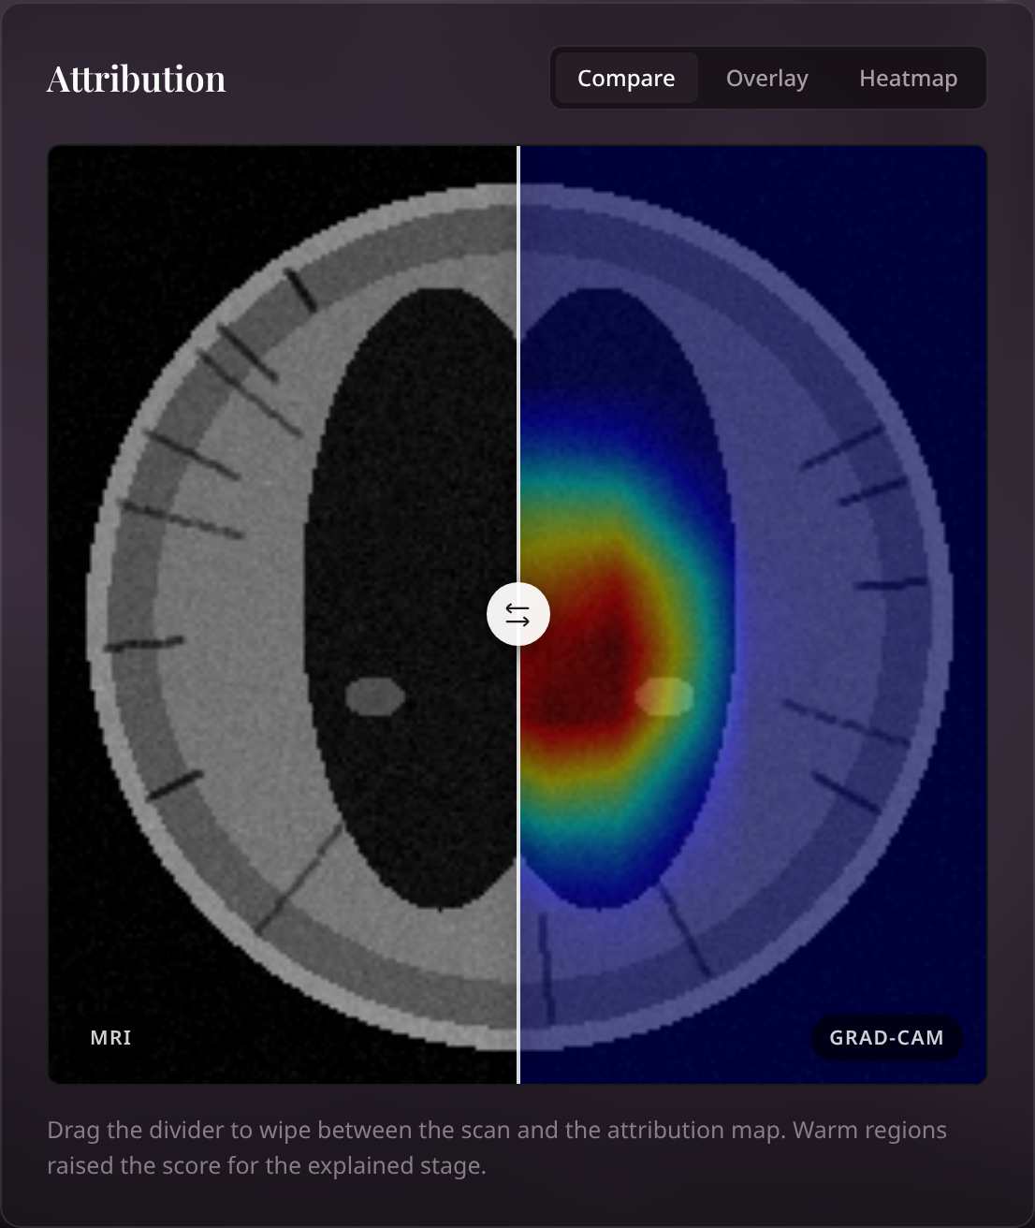
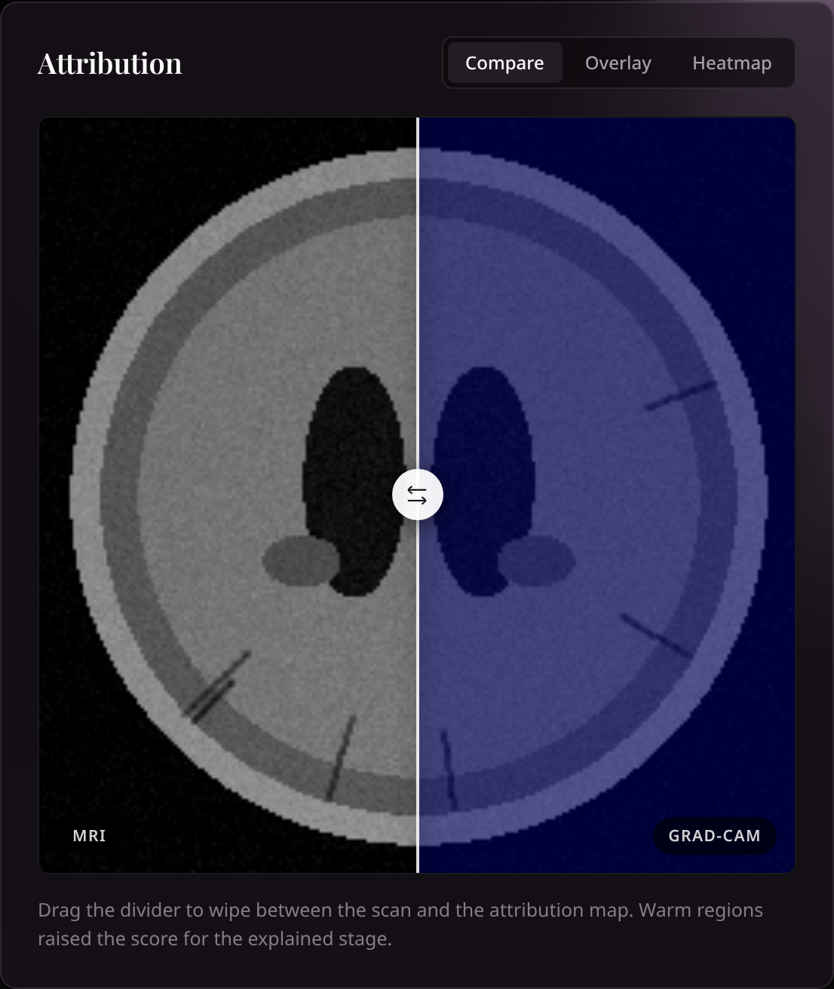
Explanations you can check, not just trust
TP
TANEESHA RAJIV PRASAD · Explainability and robustness
Weight Gradient of the stage score weights the last conv feature maps
1
Map Weighted sum + ReLU: warm regions pushed the score up
2
Audit Central share of the map below 40% flags the prediction
3
0 of 710 maps flagged
Drag to compare: scan vs map
Counterfactual: “what would make this AD?”
Notes:
Thanks, Shreya. I'm Taneesha, and I'll cover explainability. A label alone invites trust; a picture invites checking. For every scan we compute a Grad-CAM map. We take the gradient of the predicted stage's score with respect to the last convolutional layer and use it to weight the feature maps, so warm regions are the ones that pushed the score up. In the interface you drag a slider to wipe between the scan and the map. You can also ask a counterfactual. On this healthy scan we asked what would make it Alzheimer's, and the map is almost entirely cold: the model finds no evidence. On top of that we built an attention audit. It measures how much of the map falls in the central half of the frame, where brain tissue is, and flags the prediction if that drops below forty percent.

Slide 12
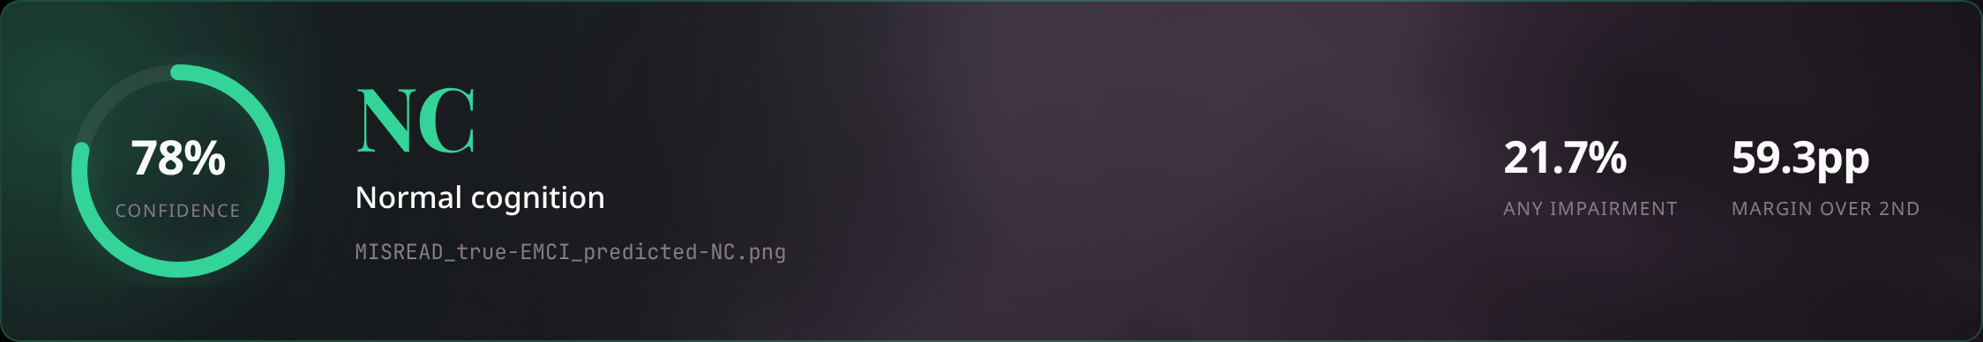
Clean-data scores do not survive degraded images
TP
TANEESHA RAJIV PRASAD · Explainability and robustness
0.987 → 0.648
macro F1 with Gaussian noise σ = 0.10
≈ 0.89
early-detection recall under brightness or contrast shifts: impaired read as normal
A real miss from the prototype: true EMCI read as NC
Notes:
Now the part we think it is most important to be honest about. On 710 slices the audit never fired, the lowest central share was 0.587, and it did not separate right predictions from wrong ones. On clean phantoms it is a sanity check, not a detector. And when we degraded the images, performance dropped fast. Noise at 0.10 took macro F1 from 0.987 to 0.648, and blur and JPEG compression took it to around 0.81 to 0.82. Brightness and contrast shifts barely change macro F1 but cut early-detection recall to about 0.89, so impaired scans are read as normal, which is the costly direction. Here is a real miss from the prototype: a true early-MCI slice predicted normal with 78 percent confidence. The lesson is that a score on clean synthetic data says very little about messy real acquisitions. Nithyashree will now introduce our second signal.

Slide 13
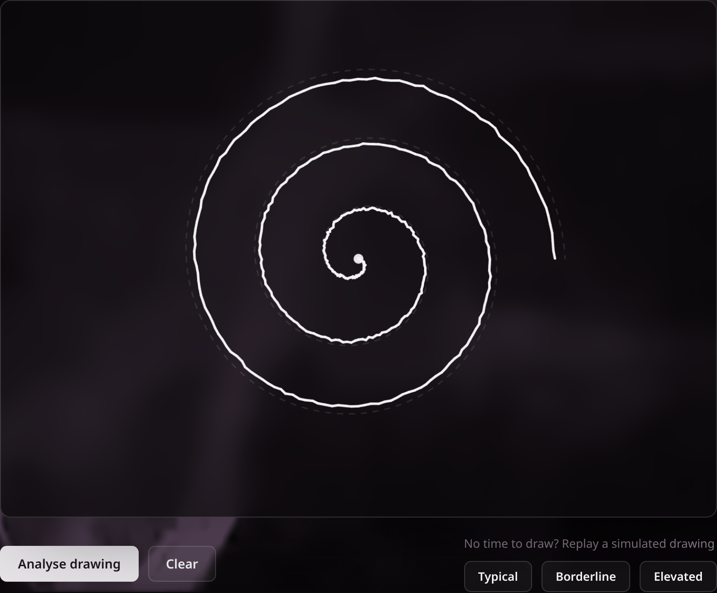
Handwriting: the pen's motion, not the picture
NH
NITHYASHREE HEBBAR · The handwriting module
NINE MEASUREMENTS FROM (x, y, t)
Drawing time
Mean pen speed
Speed variability
seconds
path per second
stop-start motion
Stalled time
Pen-up time
Speed peaks
hesitation
pen lifted
fluency
Tremor
Spiral irregularity
Drawing size
4–12 Hz wobble
radial residual
micrographia
Lengths are relative to the canvas diagonal, so screen size does not matter. A mouse or finger gives no pressure.
A live drawing: every pen point is stored with its timestamp
Notes:
Thanks, Taneesha. I'm Nithyashree, and I'll present the handwriting module. Studies report that people with cognitive decline draw more slowly, with more hesitation, more time with the pen lifted, and a wobblier line. So we built a spiral-drawing test. In the browser you draw a spiral outward from the centre, and we record every pen point with its timestamp. The screenshot on the left is a live drawing. From the trace we compute nine measurements: drawing time, pen speed, how variable the speed is, stalled time, pen-up time, speed peaks, tremor in the four-to-twelve hertz band, spiral irregularity and drawing size. All lengths are measured relative to the canvas, so screen size does not matter. A mouse or a finger gives no pressure data, so that is a limitation compared with a tablet.

Slide 14
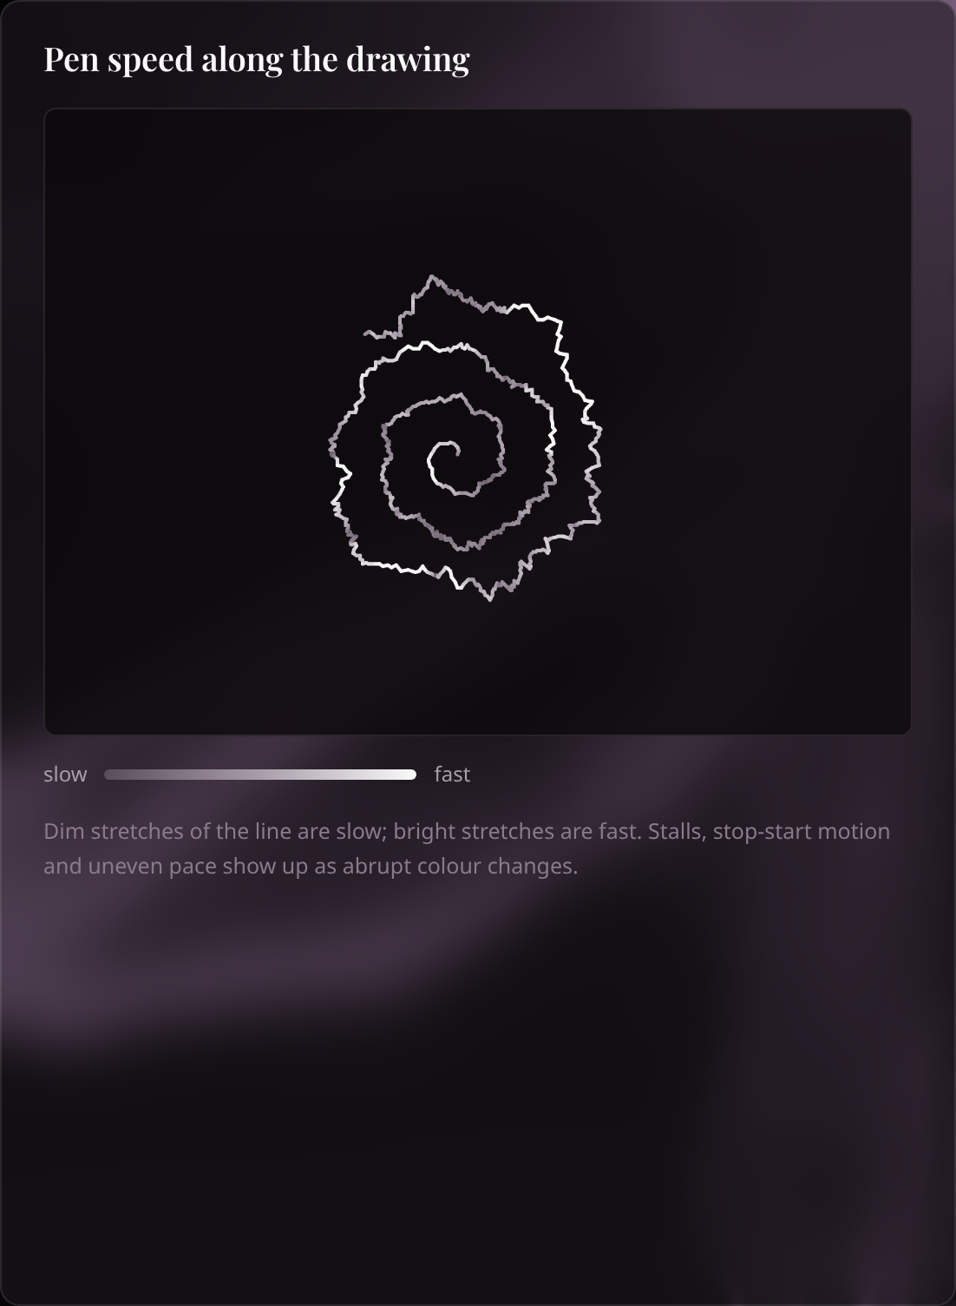
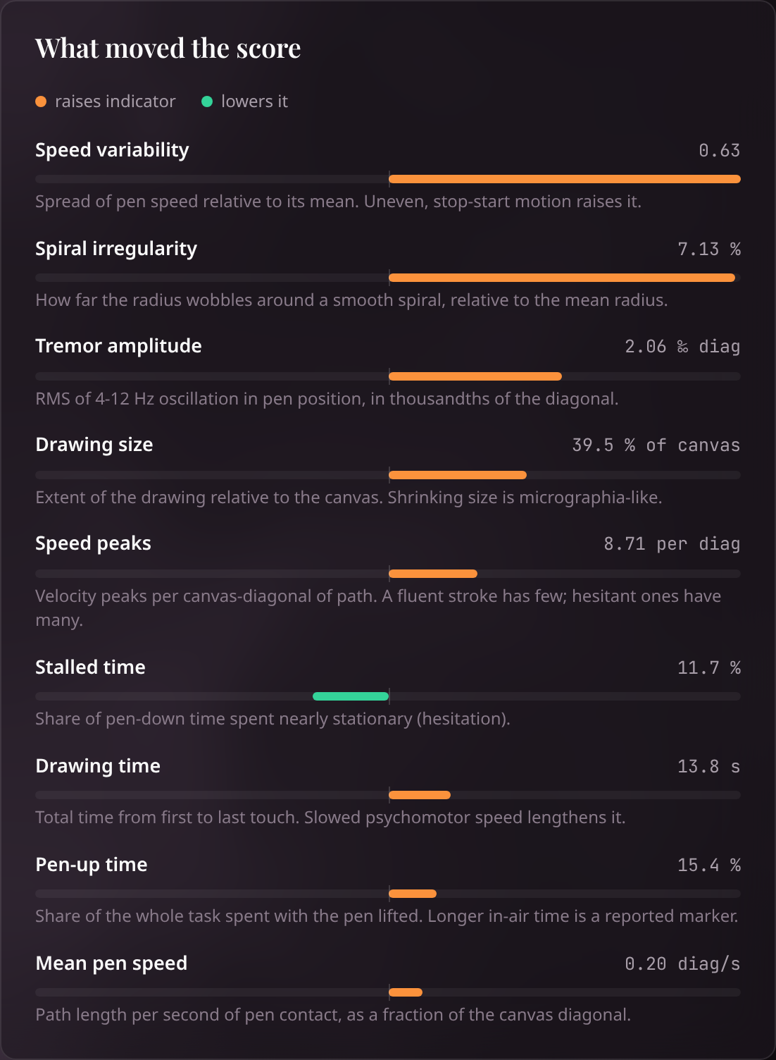
An interpretable score, with one big caveat
NH
NITHYASHREE HEBBAR · The handwriting module
0.962
89.3%
AUC · 600 held-out drawings
accuracy at threshold 0.5
Trained on simulated drawings: it learned our assumptions
Notes:
The classifier is deliberately simple: a logistic regression. That means every prediction splits exactly into per-feature contributions. The bar chart in the screenshot shows what pushed the score up or down, and the drawing is coloured by speed, so stalls and stop-start motion are visible. On 600 held-out drawings it reaches an AUC of 0.962 and about 89 percent accuracy. Now the caveat, and it is a big one: there is no real handwriting data in our repository, so the model was trained on drawings from a simulator that we wrote. It learned our assumptions. We also stress-tested it. Dropping samples, timestamp jitter and cutting the drawing short barely matter, but heavy coordinate noise breaks the decision threshold. Accuracy falls to 65 percent at four pixels of noise while the AUC stays at 0.93. So the ranking holds, but the cut-off does not. Arshi will wrap up with performance and next steps.

Slide 15
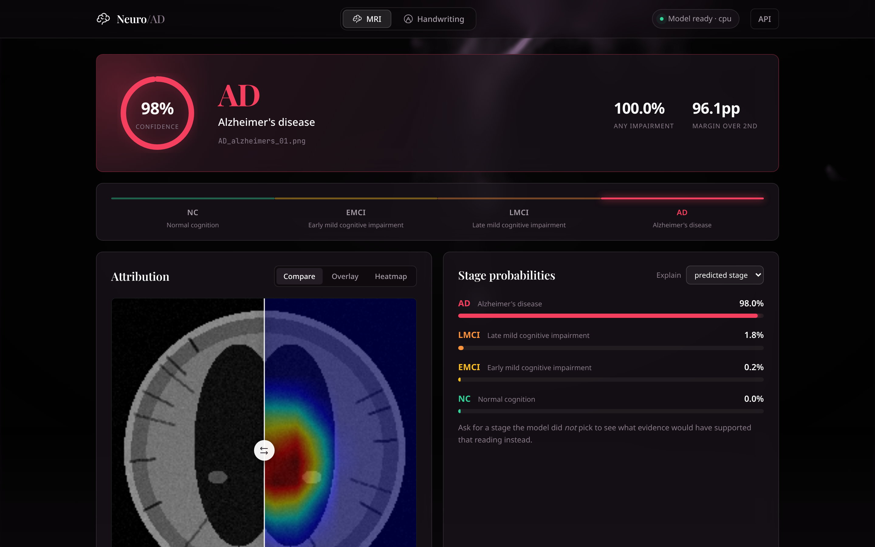
Responsive on four CPU cores, with one bottleneck
AG
ARSHI GARG · Performance, limits and next steps
9.4
3.6
11.6 s
The finished interface (real screenshot)
predictions / s per worker
explanations / s per worker
cold start to ready
Bottleneck: more clients do not add throughput; each request runs a blocking forward pass in one worker.
Notes:
Thanks, Nithyashree. I'm Arshi, and I'll finish with performance, limits and next steps. We measured everything on four CPU cores with no GPU. The handwriting score takes about 10 milliseconds. An MRI prediction takes 111 milliseconds, and adding the Grad-CAM explanation takes 293, because of the extra backward pass. Over HTTP the overhead is tiny. There is one honest bottleneck: throughput did not increase with more clients. It stays at about 9 predictions or 3.6 explanations per second per worker, because each request runs a blocking forward pass in a single worker. So serving more people needs more workers or a GPU. On the right is the finished interface: the verdict, the stage track, the draggable attribution, the probabilities and the attention audit.

Slide 16

What we can claim, and what comes next
AG
ARSHI GARG · Performance, limits and next steps
WHAT WE CAN CLAIM
NEXT STEPS, IN ORDER
Works end to end and reproduces exactly
1
Real data (ADNI, DARWIN) with subject-level splits
Handwriting explanation is exact; MRI map is checkable
Calibration and thresholds for the cost of a miss
2
Fast enough to demo on a laptop
3
Robustness training: noise, blur, compression
WHAT WE CANNOT CLAIM
4
Faithfulness tests for the explanations
Clinical performance: all data are synthetic
5
A learned fusion once paired data exists
Robustness: noise and blur break it
A trained multimodal model: the combined score is an average
6
Engineering: browser tests, CI, pinned versions
Notes:
So what can we claim? The pipeline works end to end, it is reproducible, the explanations are exact for the handwriting model and checkable for the MRI model, and it is fast enough to demo on a laptop. What we cannot claim is clinical performance. The data are synthetic, the model is brittle to image degradation, and the combined score in the interface is just an average, not a trained multimodal model. The next steps, in order: real data, with ADNI for MRI and a tablet dataset such as DARWIN for handwriting, and subject-level splits; calibration and thresholds chosen for the cost of missing a patient; training for robustness; faithfulness tests for the explanations; a learned fusion once paired data exists; and engineering hardening. Thank you. We are happy to take questions, and we can run the live demo.

Slide 17
Thank you
Questions, and a live demo
Malhar Srivatsav
Sathwik Hejamady Bhat
Harit Raval
Shreya Jain
Taneesha Rajiv Prasad
Nithyashree Hebbar
Arshi Garg
Research prototype · not a medical device · all data synthetic
github.com/ByteSizedMe/alzheimers-early-detection
Notes:
Thank you. We are happy to take questions. If it helps, Malhar can run the live demo: upload a scan, drag the attribution slider, then draw a spiral and watch the speed trace and feature contributions appear.

