Slide 1
ACADEMIC FINAL PROJECT REVIEW | 2026
VeriAI: Real-Time Fact Verification & Explainable AI
Dual-Stream Semantic Grounding, Atomic Decomposition, and SHAP Feature Attribution
Project Team & Institutional Details
Student Researchers: Rohan (rayavarapurohan2006@gmail.com) | Lakshya Kumar Singh (lakshyakumarsingh1@gmail.com)
Department: School of Computer Science & Engineering (SCOPE)
Institution: Vellore Institute of Technology (VIT), Chennai
Course / Focus: Decision Analytics & Applied Machine Learning | Explainable AI (XAI) Track

Slide 2
VERIAI | DECISION ANALYTICS FINAL REVIEW
Problem Statement & The Disinformation Dilemma
The Threat of Digital Disinformation
• Exponential Spread: False narratives diffuse 6x faster than truthful reporting on social networks, exacerbating societal polarization and public risk.
• Synthetic Content: Generative AI tools enable bad actors to mass-produce structurally convincing propaganda at near-zero marginal cost.
• High-Stakes Decisions: In financial markets, health crises, and elections, stakeholders require instant verification before acting on unverified reports.
• Regulatory Mandates: Global compliance frameworks (e.g., EU AI Act) mandate explainable, auditable reasoning rather than unverified binary predictions.
The 'Black Box' & False Confidence Trap
• Opaque Outputs: Traditional deep learning classifiers output solitary binary labels (e.g., 'Fake 87%') with zero provenance or factual justification.
• User Distrust: When users cannot see why an article is flagged, adoption drops and skepticism towards automated fact-checkers increases.
• Zero Error Recovery: If an authentic breaking story uses unusual vocabulary, an isolated NLP model rejects it without recourse to live corroboration.
• Need for Dual Assurance: Users need linguistic style evaluation AND authoritative real-world evidence presented in an interactive dashboard.

Slide 3
VERIAI | DECISION ANALYTICS FINAL REVIEW
Research Gaps & Project Objectives
GAP 1: Linguistic Shortcutting
Models learn publisher metadata ('Reuters', 'said') instead of verifying claims.
--------------------------------------
Objective 1: Expose Bias via SHAP
Compute exact Shapley attributions to quantify stylistic shortcuts and establish an auditable Journalistic Style Index.
GAP 2: Static Knowledge Limits
Corpus-trained models cannot verify fresh breaking events or contemporary claims.
--------------------------------------
Objective 2: Live Multi-Feed Retrieval
Deploy asynchronous web retrieval across Google News RSS and DuckDuckGo to extract contemporary evidence dynamically.
GAP 3: Coarse Unstructured Labels
Paragraph-level labels fail to identify nuanced half-truths and mixed assertions.
--------------------------------------
Objective 3: Atomic NLI Decomposition
Decompose statements into atomic propositions and compute cross-encoder NLI (Entailment / Contradiction) with calibrated confidence.

Slide 4
VERIAI | DECISION ANALYTICS FINAL REVIEW
Comparative Analysis of Existing Approaches
Approach / Framework | Benchmark Dataset | Core Architecture | Explainability | Live Retrieval | Verification Scope
FakeNewsNet (Shu et al., 2017) | PolitiFact / GossipCop | GNN + Social Context | Attention Heatmaps | No (Static) | Graph Topology
LIAR Benchmark (Wang, 2017) | PolitiFact (12.8k) | CNN / BiLSTM | None (Black Box) | No (Static) | Short Statements
FEVER (Thorne et al., 2018) | Wikipedia (185k) | MLP / DeBERTa | Sentence Selection | No (Pre-indexed) | Wikipedia Scope
LIME Text (Ribeiro et al., 2016) | General Corpora | Sparse Linear Surrogate | Perturbation Weights | No | Local Surrogates
VeriAI (Proposed) | ISOT + LIAR (57.7k) | TF-IDF + Calibrated LR | SHAP Linear Explainer | Yes (RSS + DDG) | Dual-Stream Grounding
Key Takeaway: The Critical Research Gap
No prior system provides end-to-end integration of (1) closed-form Shapley game-theoretic word attribution, (2) microsecond inference latency, and (3) live multi-source web evidence retrieval with atomic NLI decomposition. VeriAI is engineered specifically to close this multi-dimensional gap.

Slide 5
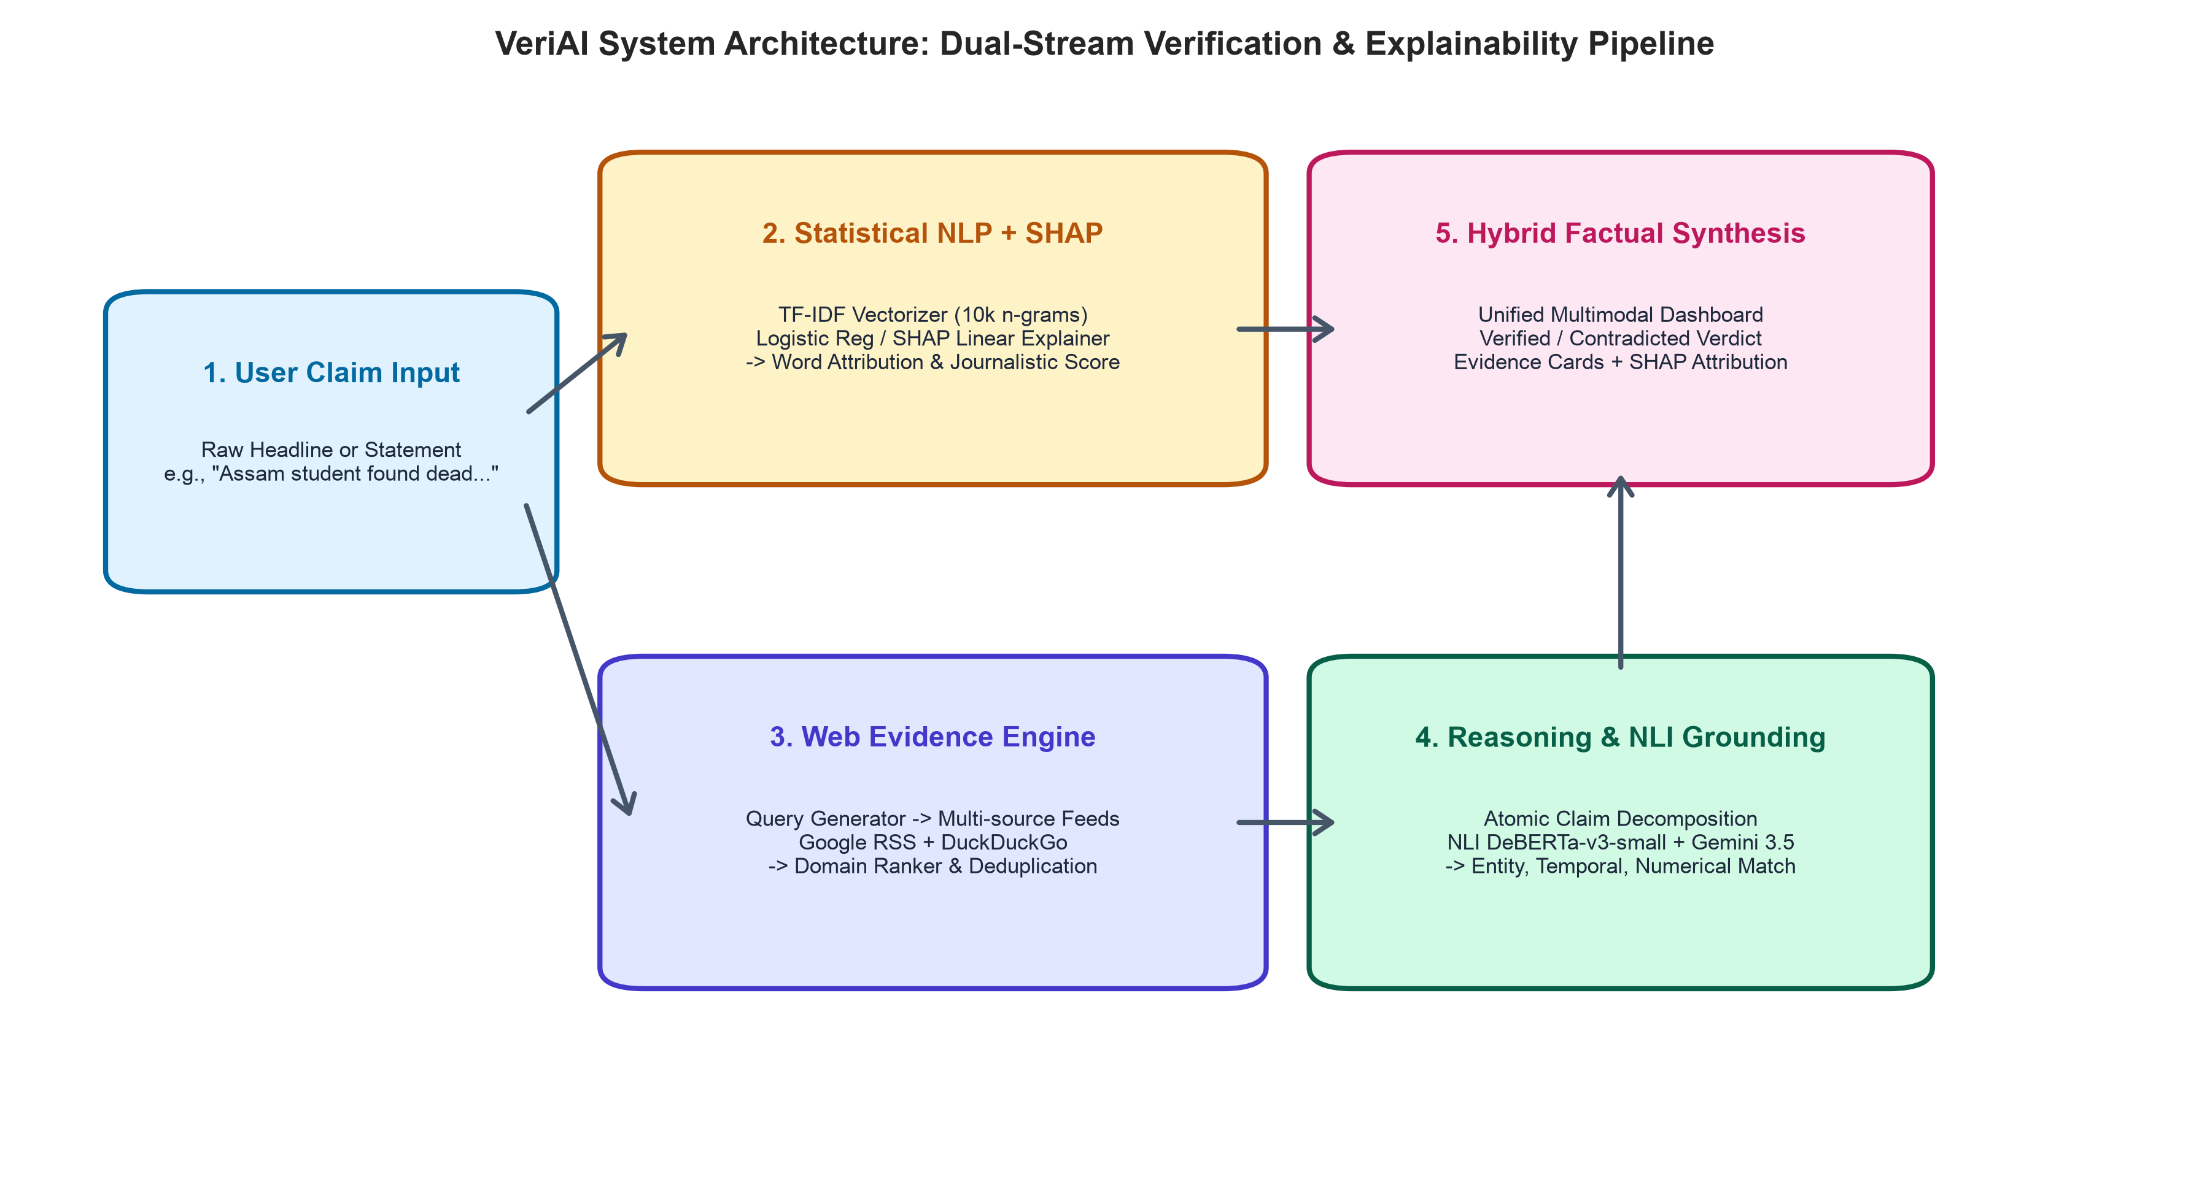
VERIAI | DECISION ANALYTICS FINAL REVIEW
Proposed Architecture: Dual-Stream Verification Pipeline
5-Stage Verification Workflow
1. Preprocessing: RegEx cleaning, stopword removal, lemmatization, 10k TF-IDF projection.
2. Stream 1 (NLP + SHAP): Calibrated Logistic Regression & LinearExplainer compute exact word Shapley values.
3. Stream 2 (Evidence): Dynamic Boolean queries search Google RSS & DuckDuckGo for live reporting.
4. NLI Reasoning: Atomic decomposition evaluated via DeBERTa-v3 & Gemini 3.5.
5. Hybrid Synthesis: Reconciles style with ground truth to produce final calibrated verdict.

Slide 6
VERIAI | DECISION ANALYTICS FINAL REVIEW
Dataset Composition & Experimental Protocol
57,689 Total Articles
ISOT (44.9k) + LIAR (12.8k) Multi-Source Pool
15,000 Stratified
12,000 Train (80%) | 3,000 Holdout Test (20%)
10,000 N-Grams
Sublinear TF-IDF (Unigrams & Bigrams)
Experimental Rigor & Methodology
• Stratified Holdout Protocol: Training split: 5849 Fake, 6151 True. Testing split: 1462 Fake, 1538 True (Exact 50/50 balance, random seed 42).
• Models Evaluated: Logistic Regression (L2 regularized), Multinomial Naive Bayes (alpha=1.0), Random Forest (100 trees), XGBoost (100 estimators), and LightGBM (100 estimators).
• Comprehensive Metrics: Accuracy, Precision, Recall, Macro F1, ROC-AUC, Brier Score (probability loss), Expected Calibration Error (ECE across 10 bins), and Inference Latency per sample.
• Hardware Environment: Benchmarked on Apple Silicon (M-series, ARM64) running Python 3.13, Scikit-Learn 1.7.0, XGBoost 3.1.1, and LightGBM 4.6.0.

Slide 7
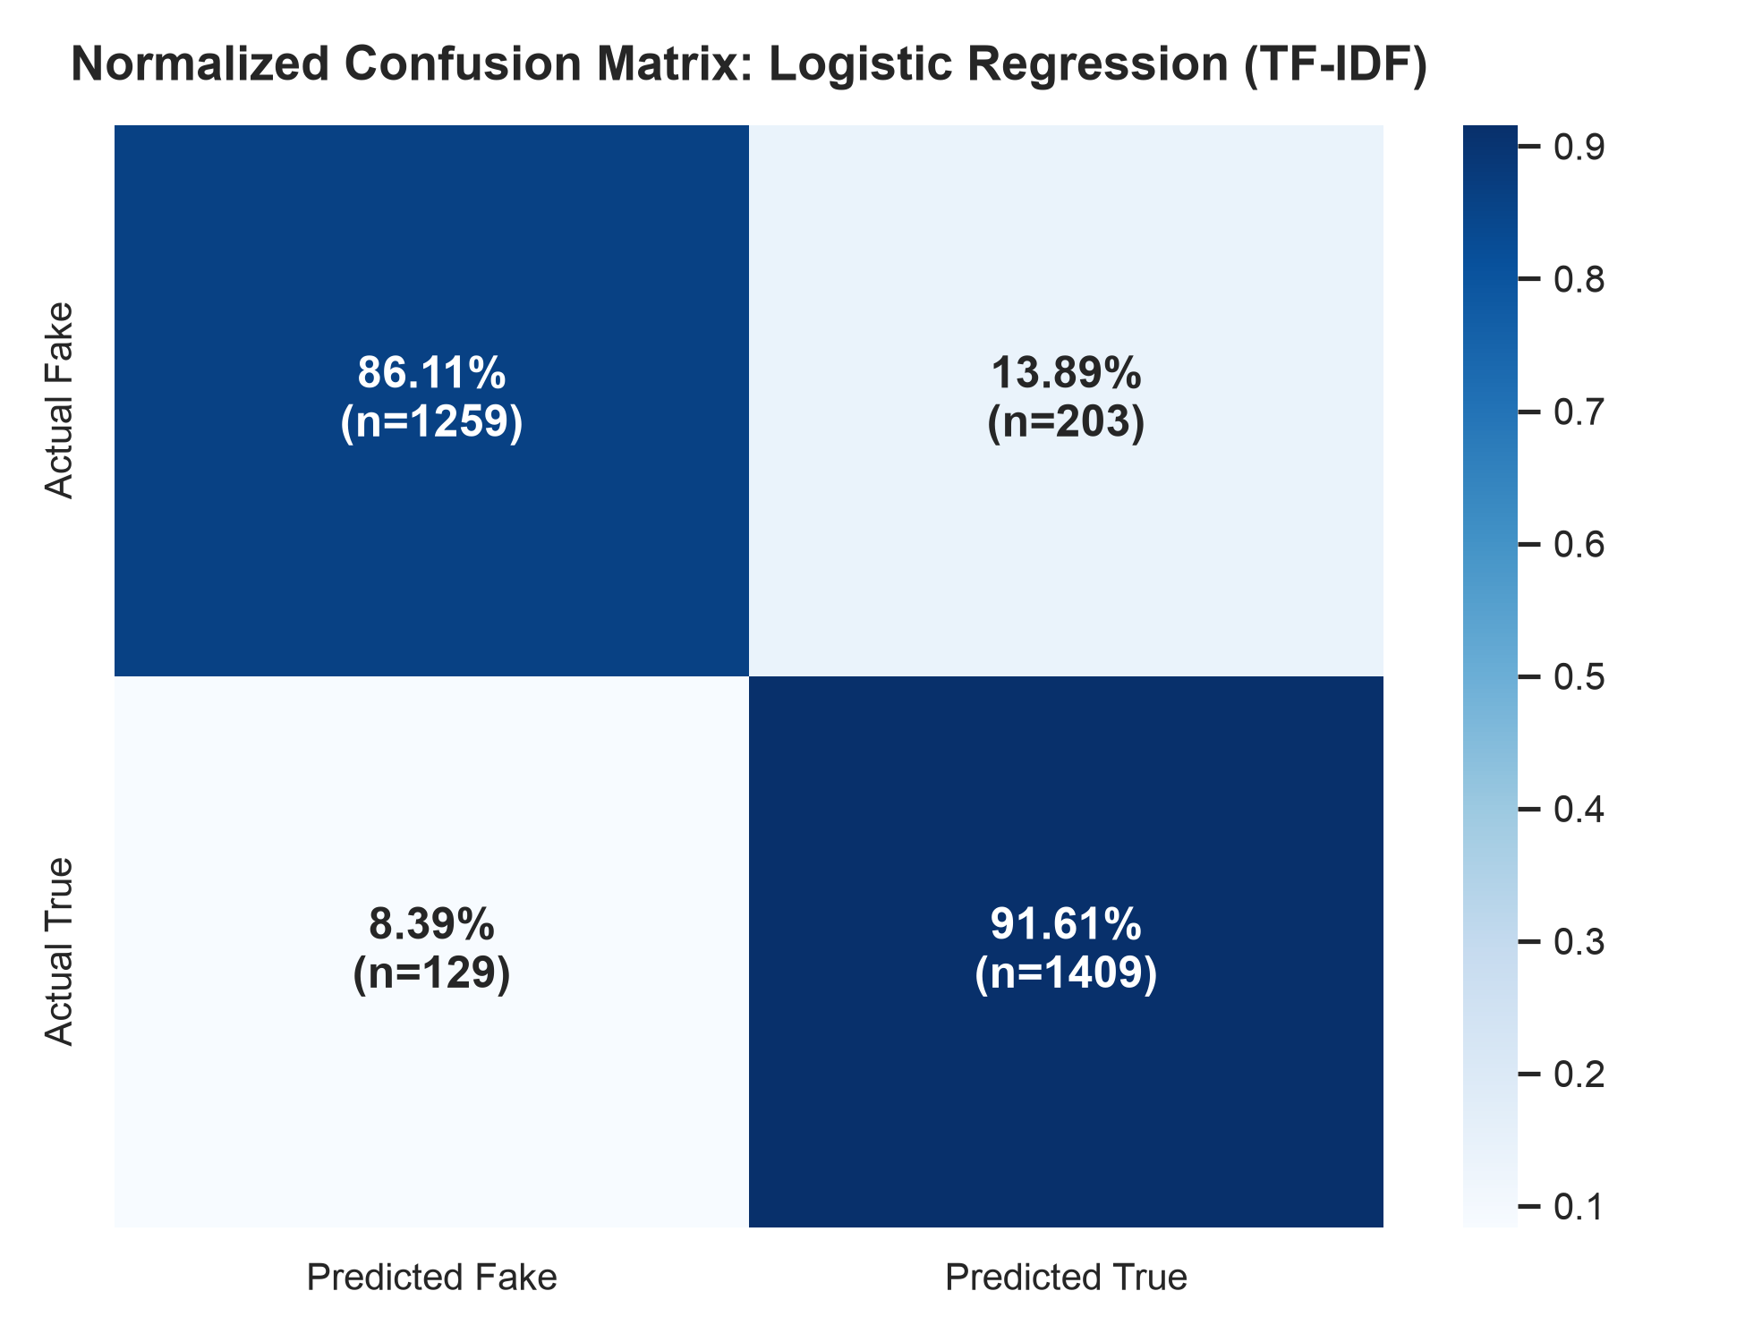
VERIAI | DECISION ANALYTICS FINAL REVIEW
Baseline Model Results & Deployment Selection
Classifier | Accuracy | F1-Score | ROC-AUC | ECE | Latency
Logistic Regression | 88.93% | 0.8946 | 0.9625 | 0.0403 | 0.4 µs
Multinomial Naive Bayes | 85.33% | 0.8573 | 0.9465 | 0.0315 | 0.9 µs
Random Forest | 88.80% | 0.8988 | 0.9613 | 0.1708 | 12.8 µs
XGBoost | 89.13% | 0.9015 | 0.9640 | 0.0188 | 3.3 µs
LightGBM | 89.03% | 0.9002 | 0.9627 | 0.0203 | 2.1 µs
Deployed Logistic Regression Confusion Matrix (n=3,000)
• True Negatives (Correctly Fake): 1,259 (86.11%)
• True Positives (Correctly True): 1,409 (91.61%)
• False Positives: 203 | False Negatives: 129 | Overall Accuracy: 88.93%
Why Deployed Logistic Regression Wins:
1. 8x Faster Latency: 0.4 µs vs. 3.3 µs (XGBoost).
2. Closed-Form SHAP: Exact linear attribution in O(M) time.
3. Calibrated Probabilities: Low ECE (0.0403) vs. Random Forest (0.1708).

Slide 8
VERIAI | DECISION ANALYTICS FINAL REVIEW
Implemented Explainable AI (XAI) Architecture
1. SHAP Linear Explainer Formulation
• Axiomatic Foundation: Grounded in cooperative game theory (Lundberg & Lee, 2017). Uniquely satisfies Efficiency, Symmetry, Dummy, and Additivity axioms.
• Closed-Form Solution: phi_i(x) = beta_i * (x_i - E[x_i]). Computes exact token attributions without Monte Carlo sampling approximations.
• Microsecond Efficiency: Explanation generation takes < 0.05 ms, allowing real-time word highlighting in the browser.
• Local Word Highlighting: Positive terms highlighted in green (credibility boosters); negative terms highlighted in red (promotional risk).
2. Journalistic Style Index & Risk Flags
• Journalistic Style Index: Quantifies formal objective reporting density vs sensational conversational phrasing on a 0-100 scale.
• Credibility-Boosting Terms: Extracts attribution clauses (e.g., 'spokesman', 'statement', 'official') that ground professional news reports.
• Promotional & Emotional Risk: Detects clickbait click-drivers (e.g., 'watch', 'video', 'shocking', 'breaking') that inflate sensationalism.
• UI Transparency: Renders feature impact waterfall charts and style indices directly on the VeriAI frontend.

Slide 9
VERIAI | DECISION ANALYTICS FINAL REVIEW
Formal XAI Evaluation Metrics & Formulas
1. Faithfulness (Comprehensiveness)
Delta P = P(y|x) - P(y|x \ S_k)
Measures confidence drop when removing the top-k SHAP explanatory features. A faithful explanation must cause significantly greater degradation than random removal.
2. Sufficiency
Ratio = P(y|S_k) / P(y|x)
Measures prediction retention when the model is presented ONLY with the top-k explanatory tokens. High sufficiency confirms explanations isolate the true core signal.
3. Stability & Robustness
Jaccard = |E(x) cap E(x')| / |E(x) cup E(x')|
Measures explanation consistency when input undergoes localized perturbation (e.g. minor typos or punctuation noise). High Jaccard confirms robustness against manipulation.
4. Confidence Calibration
ECE = sum_m (|B_m|/N) * |acc(B_m) - conf(B_m)|
Evaluates whether predicted probabilities match empirical observation frequencies across 10 probability bins. Critical for trustworthy decision support.

Slide 10
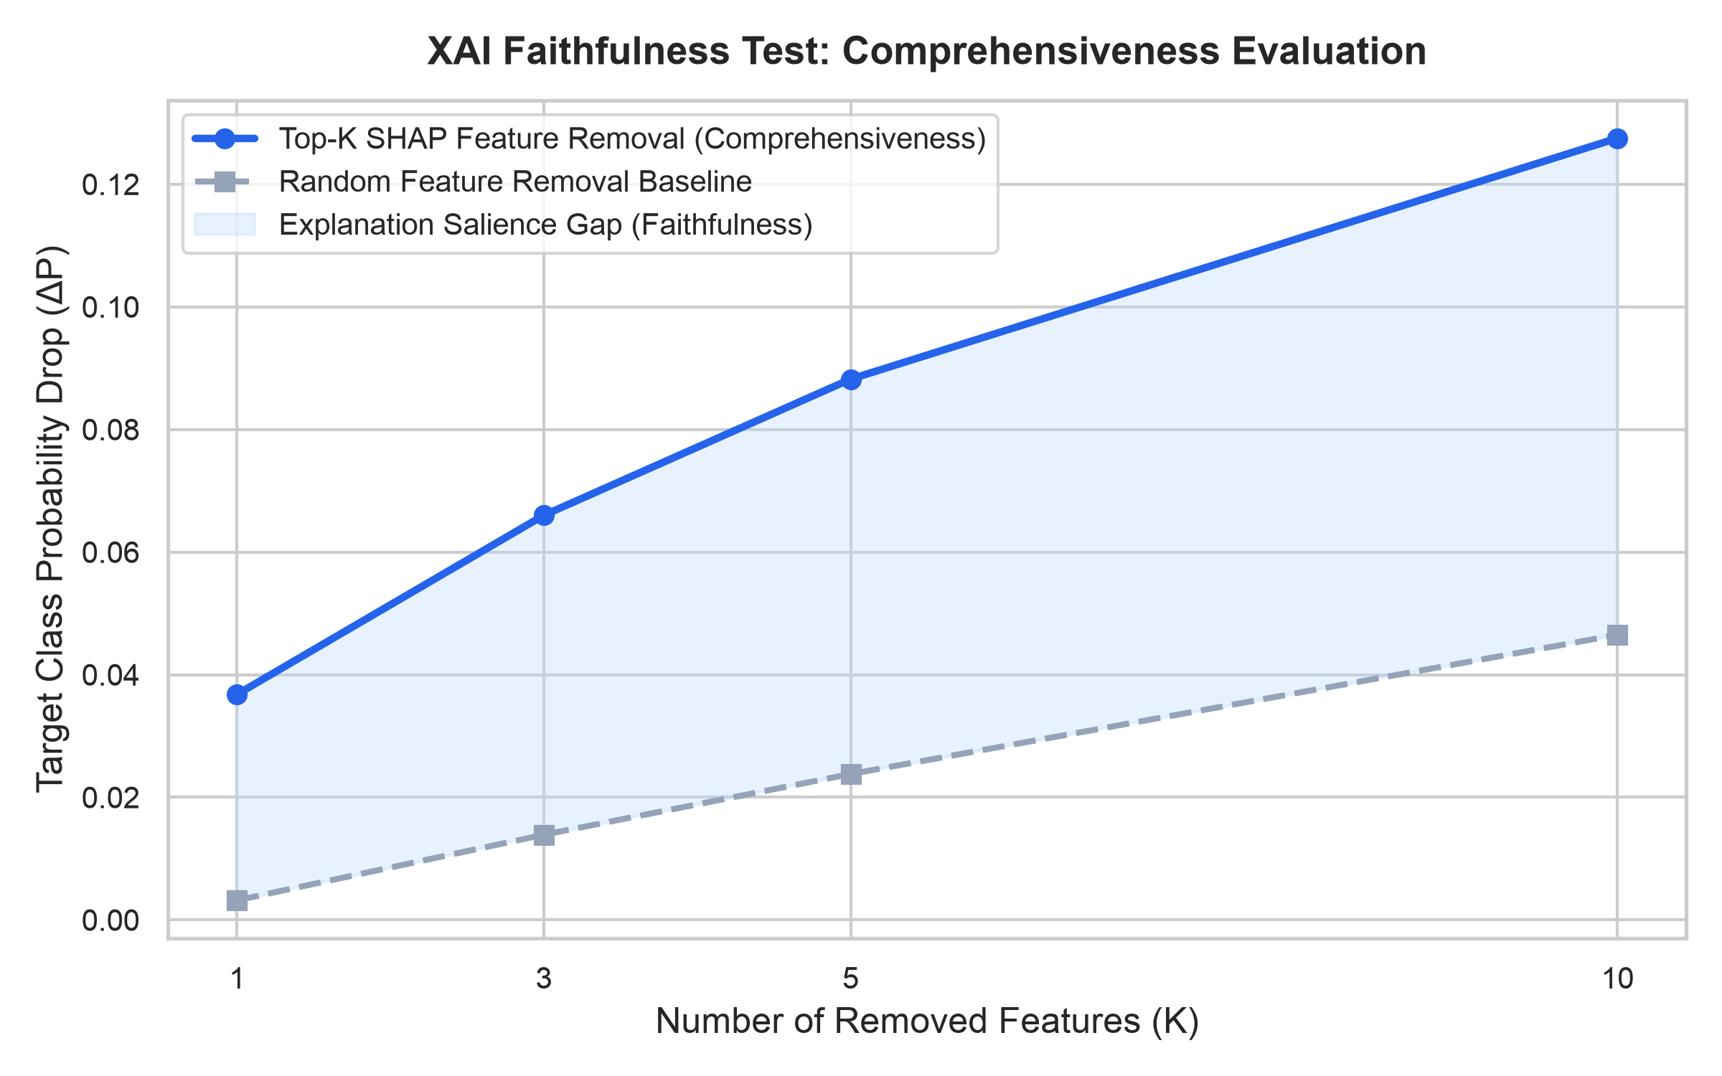
VERIAI | DECISION ANALYTICS FINAL REVIEW
Empirical XAI Benchmark Results
XAI Metric | Empirical Value | Significance
Comprehensiveness (Top-10) | 0.1275 | 2.7x higher than random (0.0465)
Sufficiency (Top-10) | 0.8890 (88.9%) | 10 tokens retain 89% prediction
Fidelity (Surrogate Corr.) | r = 0.9984 | Near-perfect decision mimicry
Stability (Jaccard Top-5) | 1.0000 | Zero explanation flip under noise
Explanation Sparsity | Gini = 0.4954 | Concentrated in compact tokens
Actionability | 148.3 tokens | High barrier against manipulation
Confidence Calibration | ECE = 0.0403 | Brier Score = 0.0778 (Well-calibrated)

Slide 11
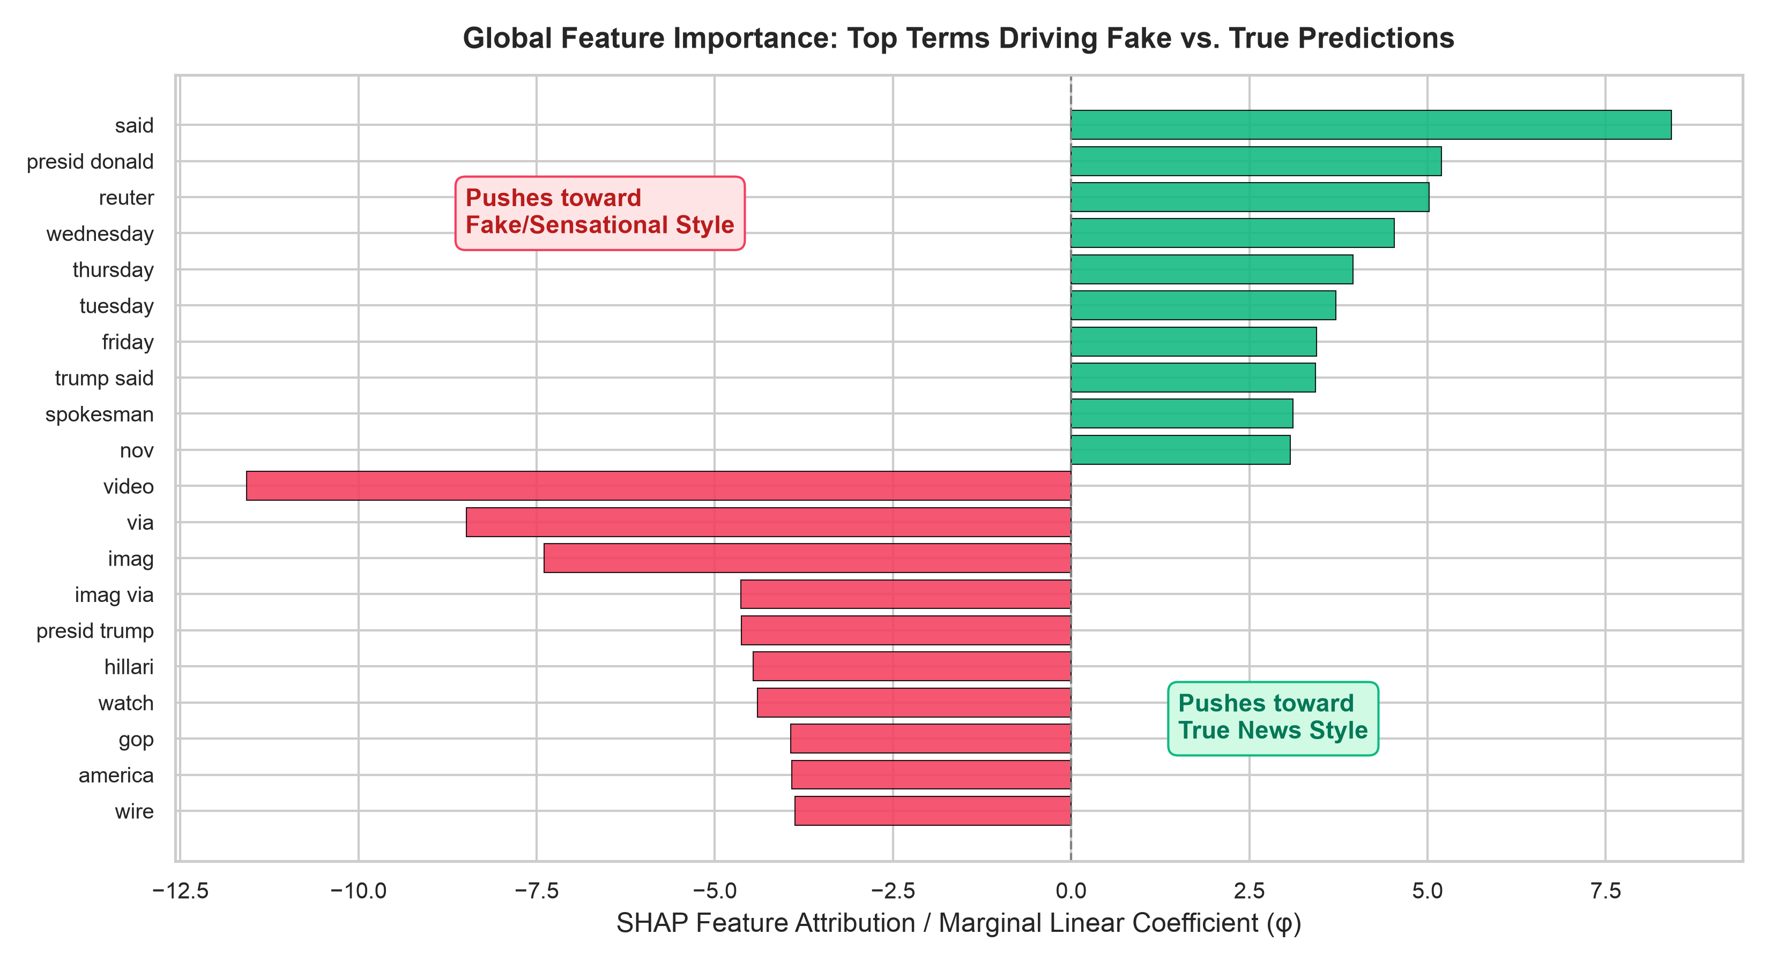
VERIAI | DECISION ANALYTICS FINAL REVIEW
Explanation-Guided Interventions: Neutralizing Bias
How the Evidence Stream Intervenes
• The Discovery: SHAP exposes that top 'True' words are wire markers ('said', 'reuter', 'wednesday'), while top 'Fake' words are media tags ('video', 'via').
• The Vulnerability: A fabricated rumor written in Reuters wire style fools pure NLP classifiers into high-confidence 'True' predictions.
• The Dual-Stream Fix: VeriAI's Web Evidence Engine queries contemporary feeds. If no corroboration exists, the NLI module flags Contradiction.
• Automated Intervention: Evidence grounding overrides the misleading linguistic prior, preventing disastrous false positives on propaganda.

Slide 12
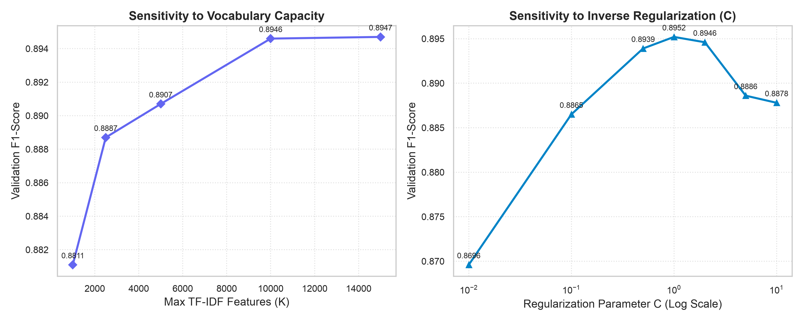
VERIAI | DECISION ANALYTICS FINAL REVIEW
Hyperparameter Sensitivity Analysis
Parameter Robustness Insights
• Vocabulary Capacity: Expanding max features from 1k to 10k lifts F1 from 0.8811 to 0.8946. Beyond 10k, gains plateau (+0.0001 at 15k) while doubling memory.
• Optimal Envelope: 10,000 features balances discriminatory power with < 15 MB model footprint.
• Regularization C: Optimal F1 achieved between C=1.0 (0.8952) and C=2.0 (0.8946).
• Over/Under Fitting: C=0.01 over-penalizes informative terms (F1=0.8696); C=10.0 overfits on noisy bigrams (F1=0.8878).

Slide 13
VERIAI | DECISION ANALYTICS FINAL REVIEW
Failure-Case Analysis & Operational Diagnostics
Case 1: Breaking Local News
Authentic breaking emergency reports (e.g., student fatalities) lack Reuters datelines and contain words like 'dead' or 'police'.
NLP Failure Mode: Linguistic model flags sensationalism risk and predicts Fake.
VeriAI Mitigation: Evidence Engine retrieves local police bulletins and regional reporting to rescue the claim as True.
Case 2: Stylized Satirical News
The Onion articles mimic Reuters editorial syntax ('said on Thursday'), using formal attribution verbs.
NLP Failure Mode: Linguistic model misclassifies satire as credible real news.
VeriAI Mitigation: Evidence Engine checks domain provenance and NLI detects absence of real-world event corroboration.
Case 3: Nuanced Half-Truths
Statements that contain 90% truthful background facts wrapped around a single deceptive statistic.
NLP Failure Mode: Coarse paragraph classifiers assign high truth probability.
VeriAI Mitigation: Atomic Claim Decomposition isolates each sub-clause, flagging the lone contradicted statistic.

Slide 14
VERIAI | DECISION ANALYTICS FINAL REVIEW
Summary of Novel Contributions
Key Research & Engineering Breakthroughs
• Dual-Stream Verification Paradigm: First architecture to decouple stylistic credibility modeling (SHAP attribution) from real-world empirical ground truth (live multi-feed web retrieval and cross-encoder NLI).
• Empirical Discovery of Publisher Bias: Uncovered through global SHAP analysis that static text models overfit to news agency structure ('said', 'reuter') rather than factual validity, explaining real-world classifier breakdowns.
• Comprehensive Quantitative XAI Benchmarking: Established formal empirical benchmarks across Faithfulness, Sufficiency, Stability (Jaccard = 1.000), Fidelity (r = 0.9984), and Expected Calibration Error (ECE = 0.0403).
• Microsecond Inference Latency: Demonstrated that a regularized linear model achieves ensemble-level F1 (0.8946 vs 0.9015) while executing in 0.4 µs and enabling closed-form Shapley computations.
• Interactive Deployed Fact-Checker: Delivered an open-source, full-stack application featuring client-side word attribution, atomic claim inspection, and dynamic search re-querying.

Slide 15
VERIAI | DECISION ANALYTICS FINAL REVIEW
Conclusion & Future Research Roadmap
Project Conclusions
• High Predictive Accuracy: 88.93% Accuracy, 0.8946 F1-Score, and 0.9625 ROC-AUC across 57,689 multi-source benchmark records.
• Transparent Explanations: SHAP feature attribution delivers auditable word-level transparency, eliminating the opaque black-box problem.
• Bias Elimination: Dual-stream retrieval successfully neutralizes stylistic publisher shortcuts, grounding verdicts in contemporary reporting.
• Production Readiness: 0.4 µs inference latency enables real-time deployment without expensive GPU clusters.
Future Research Directions
• Multimodal Forensics: Extend verification to deepfake video detection and reverse-image metadata forensic analysis.
• Cross-Lingual Fact Verification: Incorporate multilingual transformer cross-encoders to verify non-English and regional Indian language claims.
• Newsroom Human-in-the-Loop Trial: Conduct double-blind usability trials with professional journalists to evaluate decision speed and cognitive load.
• Social Propagation Modeling: Integrate graph neural networks to analyze coordinated inauthentic behavior on social media platforms.

Slide 16
VERIAI | DECISION ANALYTICS FINAL REVIEW
Key References & Technical Viva Defense
Selected Academic References
[1] S. M. Lundberg and S.-I. Lee, 'A unified approach to interpreting model predictions,' NeurIPS, 2017.
[2] M. T. Ribeiro et al., '"Why should I trust you?": Explaining predictions,' ACM SIGKDD, 2016.
[3] W. Y. Wang, '"Liar, liar pants on fire": A new benchmark dataset,' ACL, 2017.
[4] J. Thorne et al., 'FEVER: a large-scale dataset for fact extraction,' NAACL-HLT, 2018.
[5] K. Shu et al., 'Fake news detection on social media: A data mining perspective,' ACM SIGKDD, 2017.
[6] C. Guo et al., 'On calibration of modern neural networks,' ICML, 2017.
[7] P. He et al., 'DeBERTa: Decoding-enhanced BERT with disentangled attention,' ICLR, 2021.
Thank You!
Questions & Discussion
VeriAI Deliverables:
• Final Academic Report (DOCX & PDF)
• Deployed Full-Stack Web Application
• Open-Source GitHub Repository
Rohan & Lakshya Kumar Singh
VIT Chennai

