Slide 1

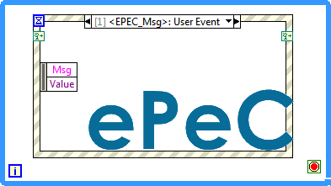
EPEC
Event Producer Event Consumer
This is only our excercize to create a design pattern, that have some help to create subpanel and multiple gui applications.
Nicola Bavarone Bytelabs.it

Slide 2
SubPanel Issues
Main
SubPanels Vis
SubPanels
How Pass Data?
How End SubVis Panel?
Yes We can Use queues!
But why we need to use other API when we have ready User Event, thats has queues working?

Slide 3
Event based Message Handler
Why event instead of queue message handler?
In Our Team we use frequently QMH.
We have some case in wich we need to use event based message command.
One case is using subpanel or other vi with proper GUI.
Now we can ask about why we don’t use for process vi and main vi, an interprocess communication based in event?
Pros
Event can message N:N or N:1 features.
Event can handle callback vis.
Cons.
Event don’t have naming, but we can use DVR or AE to solve this.

Slide 4
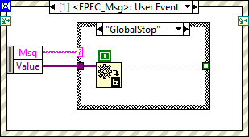
Epec Msg : Global
Epec message are Global message.
Message sent to this EQ is received to all
Process and main.
Uses case of this is for Global Stop.

Slide 5
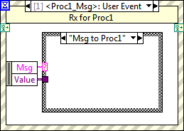
Process EQ is specific for each process.
This message is in N:1

