Slide 1
HUMAN RESOURCES(HR) ANALYTICS PROJECT
Made by Josiane Byukusenge
& Hope

Slide 2
INTRODUCTION ON HUMAN RESOURCES (HR) ANALYTICS PROJECT
This presentation explores employee attrition trends using HR analytics data.
By applying exploratory data analysis (EDA), statistical testing, and data visualization techniques, we aim to:
- Identify key patterns driving attrition
- Understand which employee groups are most at risk
- Provide actionable recommendations to support data-informed HR decisions
The analysis was conducted using Python libraries such as `pandas`, `plotly`, and `scipy.stats`, focusing on metrics like job role, age group, department, gender, and overtime.

Slide 3
HR Analytics Dataset overview
We’re working with detailed HR data for 1,470 employees. This includes personal demographics, job characteristics, income, and multiple satisfaction indicators. Most importantly, we can track whether an employee left or stayed. allowing to explore why people leave and who is most at risk.
Now, using exploratory data analysis, I identified key areas where attrition risk is highest and what factors might be influencing it. so, allow me walk you through the most important findings.

Slide 4
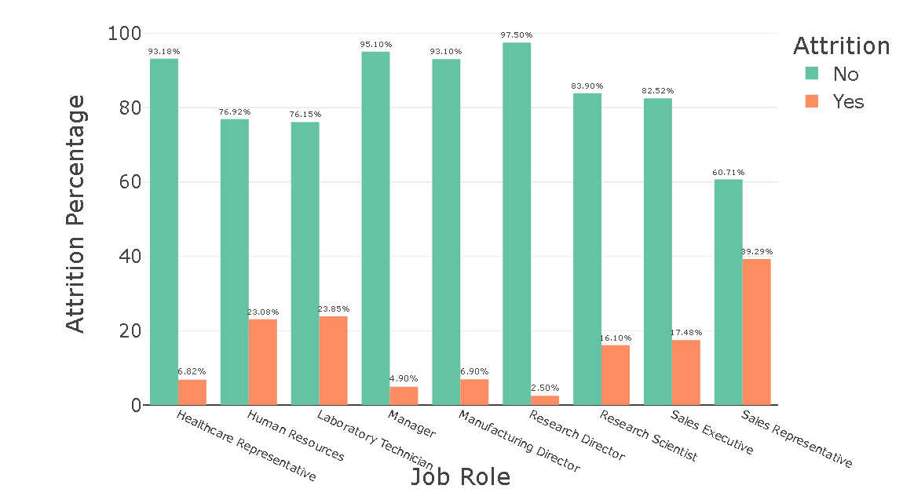
Visualizing Attrition by Job Role
The analysis shows that Sales Representatives and Laboratory Technicians are leaving the company more often than others, while roles like Research Directors and Manufacturing Directors have very low attrition.
A statistical test confirms this difference is real and significant, not random. However, the strength of the relationship is weak, which means job role alone doesn’t fully explain why people leave, but it’s still an important factor.

Slide 5
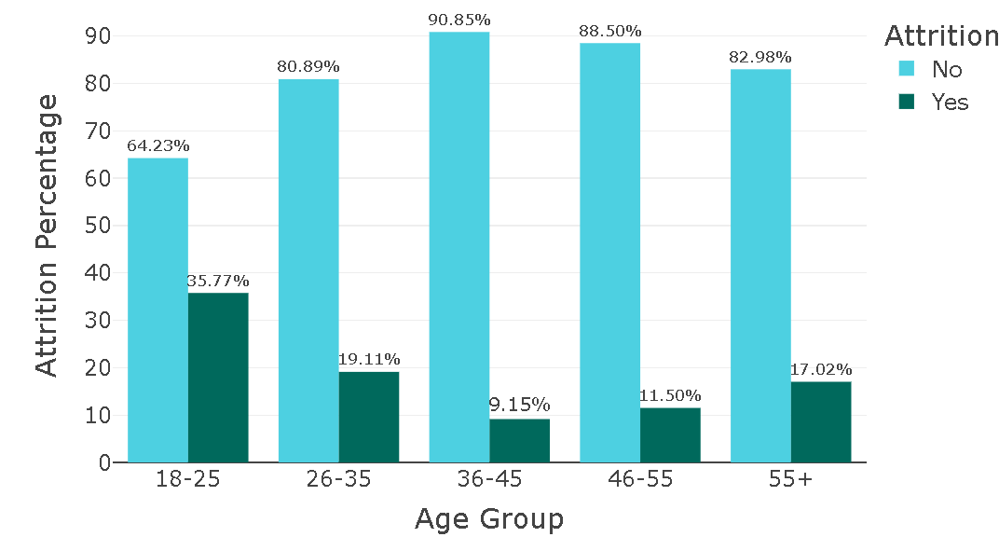
Visualizing Attrition by Age group
Employees aged 20–29 have the highest attrition rates, while older employees are more likely to stay. Attrition decreases as age increases.
A statistical test shows this trend is real, but the link between age and attrition is not very strong.
This suggests that younger staff may be leaving to explore careers, look for better opportunities, or due to job dissatisfaction.

Slide 6
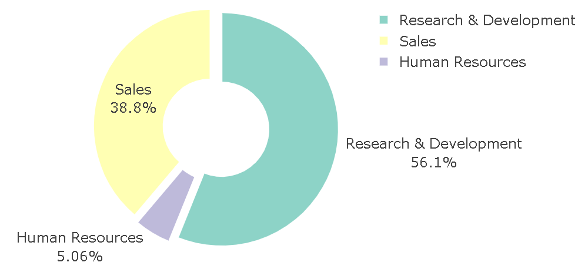
Visualizing Attrition by Department
The pie chart analysis of attrition by department shows that the Sales department accounts for the largest proportion of employee departures, followed by Research & Development, while Human Resources has the lowest share of attrition. This suggests that department-specific factors—such as workload, leadership style, or growth opportunities—may influence employee turnover. The Chi-square test confirms that attrition is significantly associated with department (p-value < 0.05), meaning the differences in attrition across departments are unlikely to be due to chance. However, the strength of this association, measured by Cramér's V, falls into the weak range, implying that while department is a factor in attrition, it is not a strong predictor on its own.

Slide 7
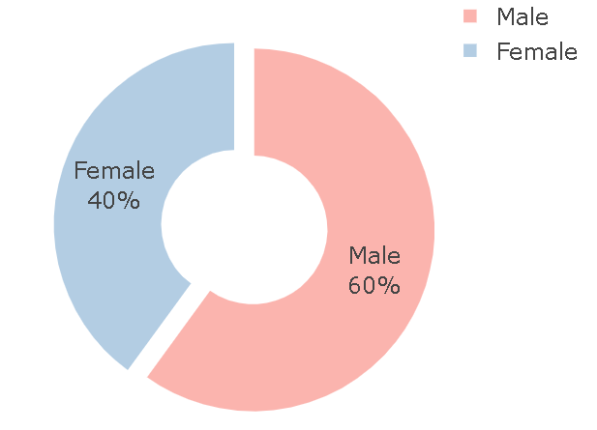
Visualizing Gender Distribution in the Company
The gender distribution chart shows a relatively balanced workforce, though there may be a slight dominance of one gender depending on the exact values in your dataset. To understand if gender influences employee attrition, a Chi-square test was conducted. The results show that there is no statistically significant association between Gender and Attrition (p-value > 0.05), meaning that attrition does not differ meaningfully between male and female employees. Furthermore, Cramér’s V confirms this with a value indicating a negligible association, reinforcing that gender is not a driving factor in attrition within this organization.

Slide 8
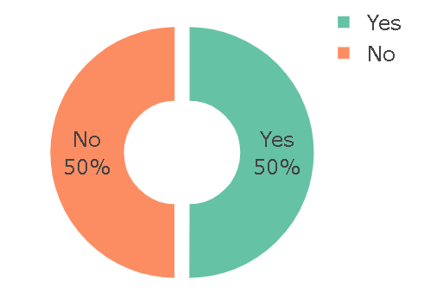
Average Performance Rating by OverTime Status
The analysis of average performance ratings by overtime status reveals minimal visual differences between employees who work overtime and those who don’t. This observation is supported by the independent t-test, which shows no statistically significant difference in performance ratings between the two groups (p-value > 0.05). Additionally, the effect size (Cohen’s d) is small or negligible, indicating that even if a difference exists, it is practically insignificant. In other words, working overtime does not appear to impact performance ratings in a meaningful way.

Slide 9
Recommnendations on each visual
Attrition by Job role: Focus on reducing employee's attrition in roles like sales representatives and Laboratory Technicians, where attrition is high by understanding why people are leaving like are they satisfied, how their worklife balance and compensation like monthly income for them are enough? After that take action based on those findings use targeted solutions like training, flexible hours and bonuses tailored to that role.
Attrition by Age group: Since we found younger employees Are more likely to leave, I recommend them to design retention strategies specifically for them like flexible work options, Accelerated development paths. These help address the needs and expectations of younger employees making them more likely to stay.
Attrition by Department: Investigate the sales department more deeply to understand why people are leaving , this can be done by using tools like surveys, exit interviews or their monthly rates and these steps can help to uncover the real reason behind that after those it would be helpful to create tailored strategies to keep employees such as offering leadership support, performance rewards.

Slide 10
Recommendations
Gender distribution: Gender doesn’t significantly affect attrition, so efforts to reduce turnover should focus else where like Job role and age group but keep monitoring gender equity in different areas like in how they are both paying if they are equally and if they promote them equally.
Performance rating by overtime: Working more hour doesn’t always mean better performance, so manage and reward people based on their results and growth.
OVERALL
I used to identify where employee's attrition is worst mostly among younger staff, people in sales, and some departments. Rather than trying to fix everything everywhere, I recommend focusing on those specific high-risk groups. At the same time, I suggest improving how they measure employee's performance and manage overtime, so that people stay productive without burning out.

Slide 11
THANK YOU ALL FOR YOUR ATTENTION
&
LORD BLESS YOU!!!!

