Slide 1
Practical on Week 2~3
Deep Learning Study
Computer Vision Lab
고 병 건

Slide 2
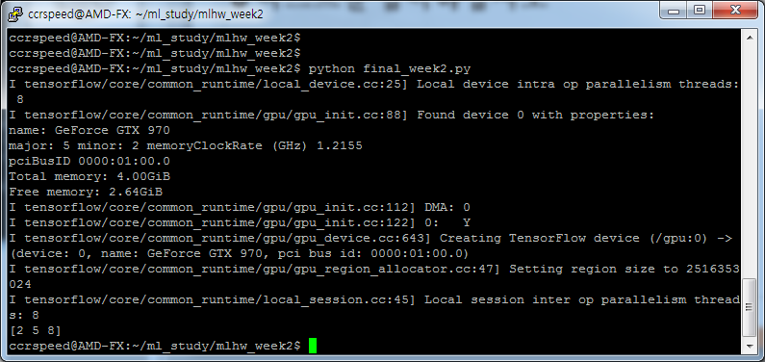
Week2 – handin1
Using…
tf.slice()
tf.reshape()

Slide 3
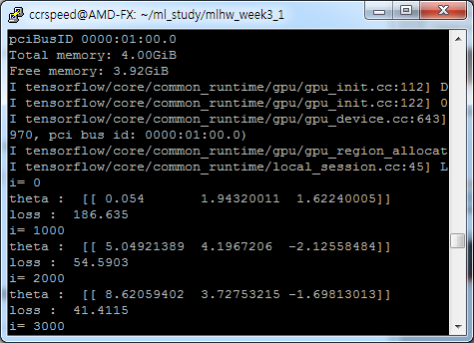
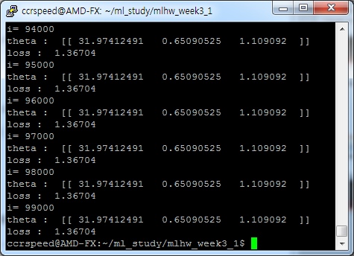
Week3-handin2
Using…
tf.train.GradientDescentOptimizer()

Slide 4
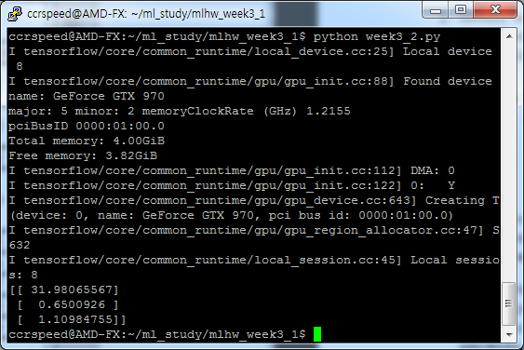
Week3-handin3
Using…
tf.matmul()
tf.matrix_inverse()

Slide 5
Ch1. Introduction
Deep Learning Study
Computer Vision Lab
고 병 건

Slide 6
1.2.1 Many Names and Changing Fortunes of Neural Networks

Slide 7
Ch2. Linear Algebra
Deep Learning Study
Computer Vision Lab
고 병 건

Slide 8

2.5 Norms
Norm : ${|\left|x\right||}_{p}= {\left(\sum_{i}{{|x_{i}|}^{p}}\right)}^{1/p}$
Max Norm : ${|\left|x\right||}_{p}= \max_{i}{|x_{i}|}$

Slide 9
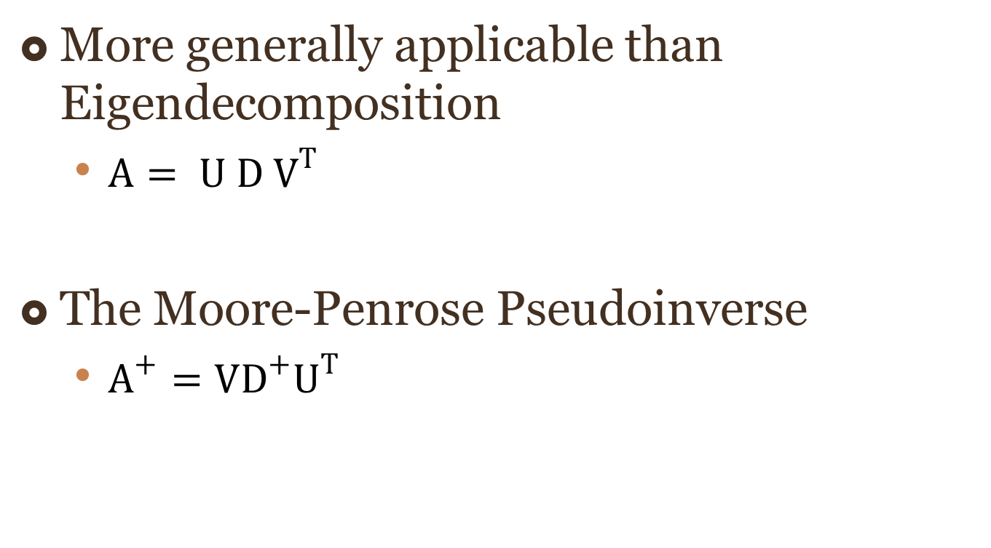
2.8 Singular Value Decomposition
More generally applicable than Eigendecomposition
${A= U D V}^{T}$
The Moore-Penrose Pseudoinverse
$A^{+}=VD^{+}U^{T}$

Slide 10
Ch3. Probability and Information Theory
Deep Learning Study
Computer Vision Lab
고 병 건

Slide 11
3.9 Common Probability Distribution
Name | Formula
Bernoulli
Multinoulli |  | - Multiple events of Bernoulli
Gaussian |  | Most common ( central limit theorem ) Maximum uncertainty w/ same variance
Exponential and Laplace |  | - Sharp dense point
Dirac and Empirical |  | - Used when choose training sets

