Slide 1
Practical on Week 4
Deep Learning Study
Computer Vision Lab
고 병 건
Feb.05.2016

Slide 2
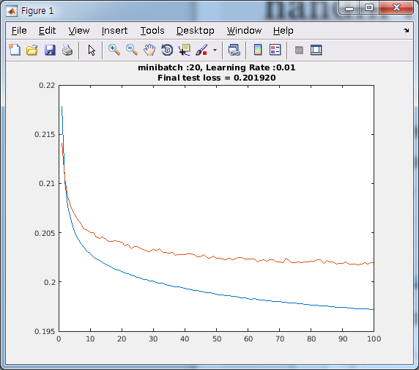
handin : Train vs Test Error
After every 1 epoch, Using…
sess.run(cross_entropy, feed_dict={x:x_train, y:y_train} )
sess.run(cross_entropy, feed_dict ={x:x_test , y:y_test } )

Slide 3
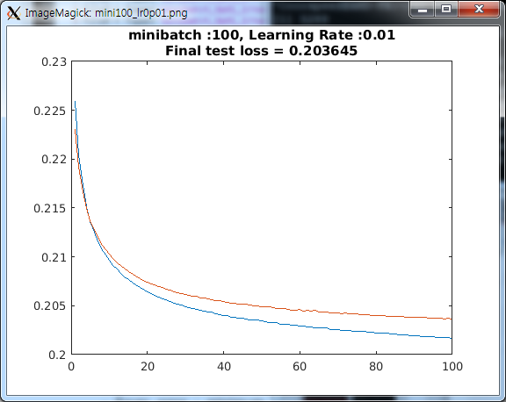
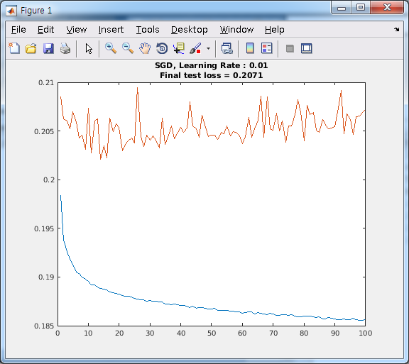
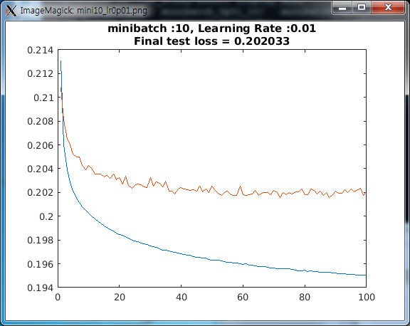
handin : depends on minibatch size
Batch size 20 is best
SGD is too stochastic
Batch size 100 updates parameter too slowly
CIFAR-10 has 10 classes, so minibatch 10
might be unstable.

Slide 4
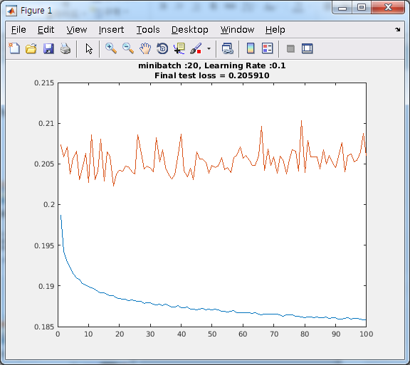
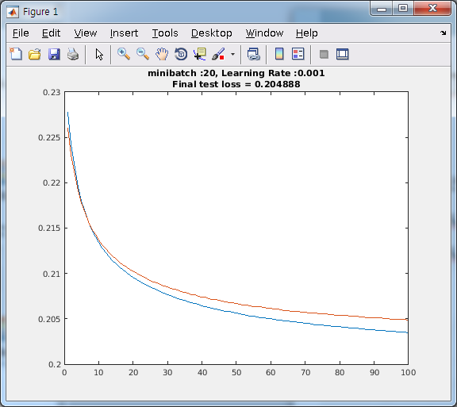
Handin : depends on learning rate
Learning rate 0.01 best
For learning rate 0.1, each step is too big to converge
For learning rate 0.001, it is stable but too slow

