Slide 1
3,4주차 Practical on Week 6
Deep Learning Study
Computer Vision Lab
고 병 건
Feb.16.2016

Slide 2
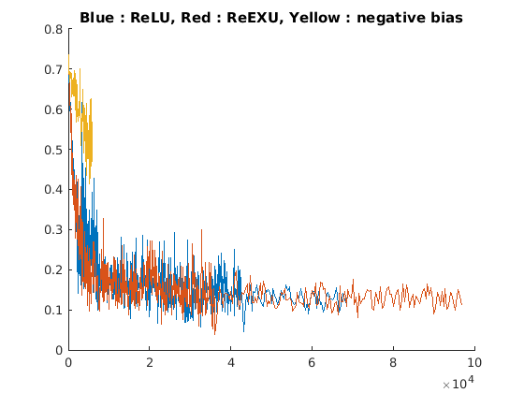
1. Advanced: conceptual question
CNN에 많이 사용하는 ReLU나, 이번 실험에 사용한 ReEXU모델의 경우 음수의 영역에서의 기울기가 0이므로, training이 제대로 되지 않는다.
실제로 아래의 노란색 loss graph에서 negative bias를 사용한 경우, 제대로 학습이 되지 않음을 확인 하였다. 초반 이후에는 nan값이 출력되어 graph에 표시 되지 않는다.

Slide 3
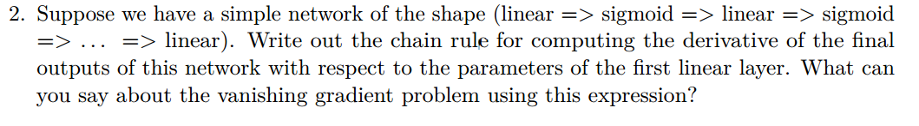
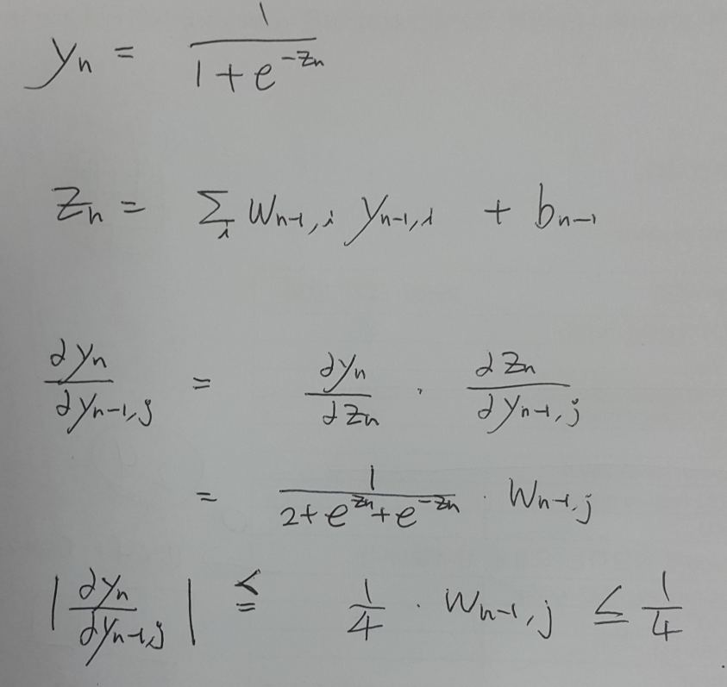
1. Advanced: conceptual question
Unless, there have many not dropped out paths, This gradient goes near zero.

Slide 4
2. Loss Graph

Slide 5
3. Code Description
1. ellipse2rect.py
Read ellipse label to rectangular form
2. PreparePS.py
Crop Positive Sample by referring result of (1)
3. PreparePatch.py
Save pyramids of training set image file, which will be used for generating Negative Sample
4. train.py
Train network and save weights and bias
Choose random patch with 1:1 ratio between Positive Sample and Negative Sample
Data Augmentation : Flip, Rotate, Gaussian Noise
rotate / mirror method of ImageOps Library

Slide 6
3. Code Description
5. eval.py
Receiving 100by100 patch for fact detection ( Using 4by4 convolution layer )
Save detected face in text format
6. NonMaximum.py
Applying Non Maximum Suppression on result of (5)
IOU (Intersection Of Union )
In case of one belongs/includes another
7. RedRectangle.py
Save new images by using result of (6) and original images

Slide 7

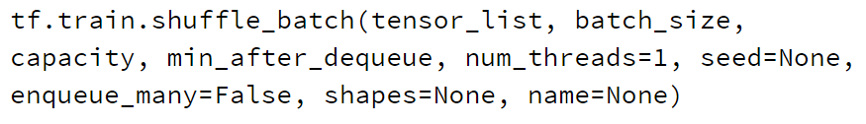
To Do more..
Many useful methods for data augmentation in Tensorflow
with batch queue methods

Slide 8
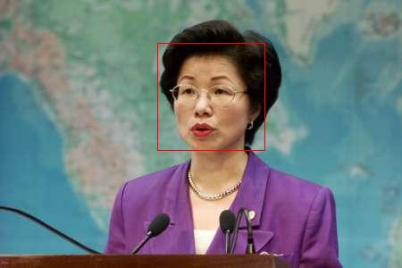
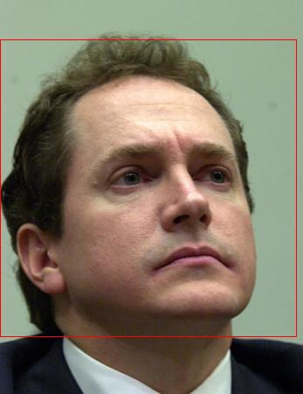
4. Test Result Images

Slide 9
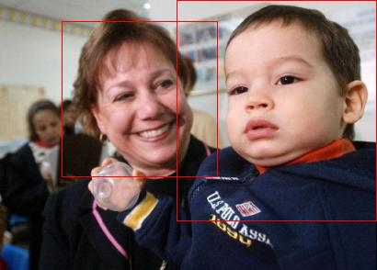
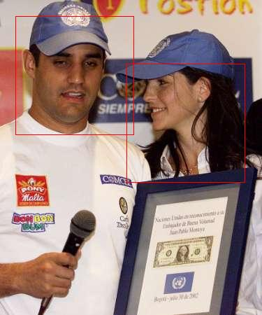
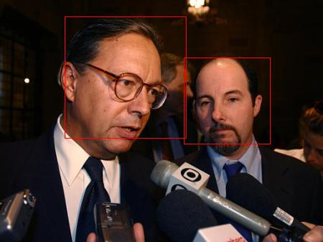
4. Test Result Images

Slide 10
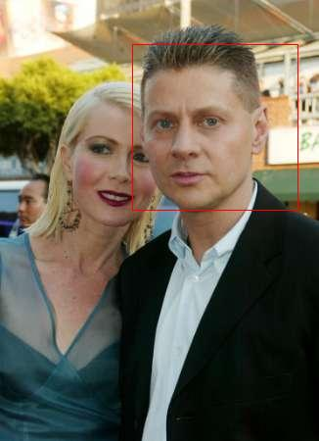
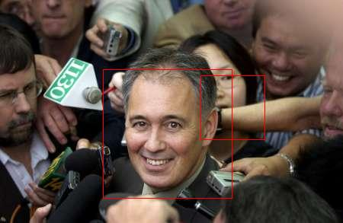
4. Test Result Images

Slide 11
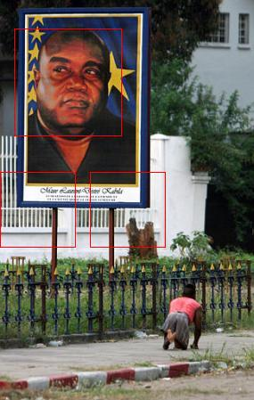
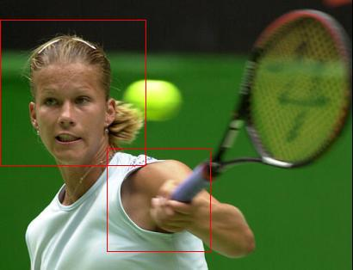
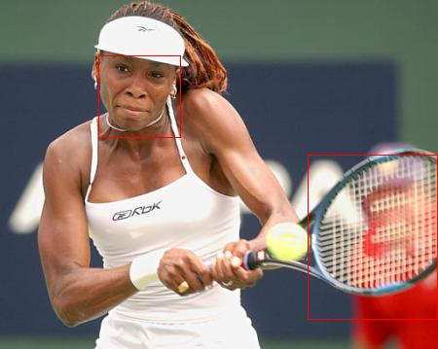
4. Test Result Images

Slide 12
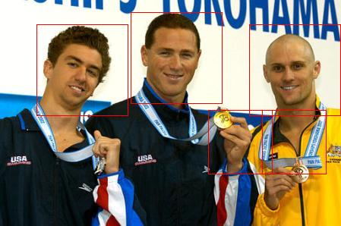
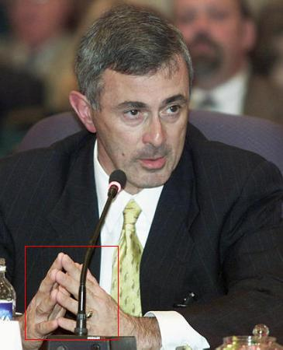
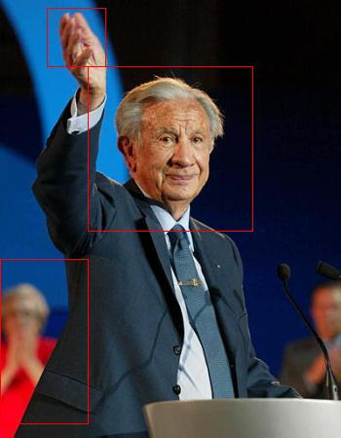
4. Test Result Images

Slide 13
4. Test Result Images

