Slide 1


RECYCLE W4R – AR Edition
PRELUDE
A project made by Alexis SERRANO, Sébastien PINTA, Tom LEARDI,
inspired by one of our creation : Recycle W4R.
As part of our ASAIoT project, we developed a serious game in Python using hand recognition, leveraging the knowledge we gained from working with Raspberry Pi devices and the manipulation of images and their interaction.
The goal of this project is to raise awareness about recycling in student life, including the context of meals at the university cafeteria (CROUS), but more broadly extending to recycling at home.
Problem statement: How can we make a game that is both enjoyable to play and educational?

Slide 2
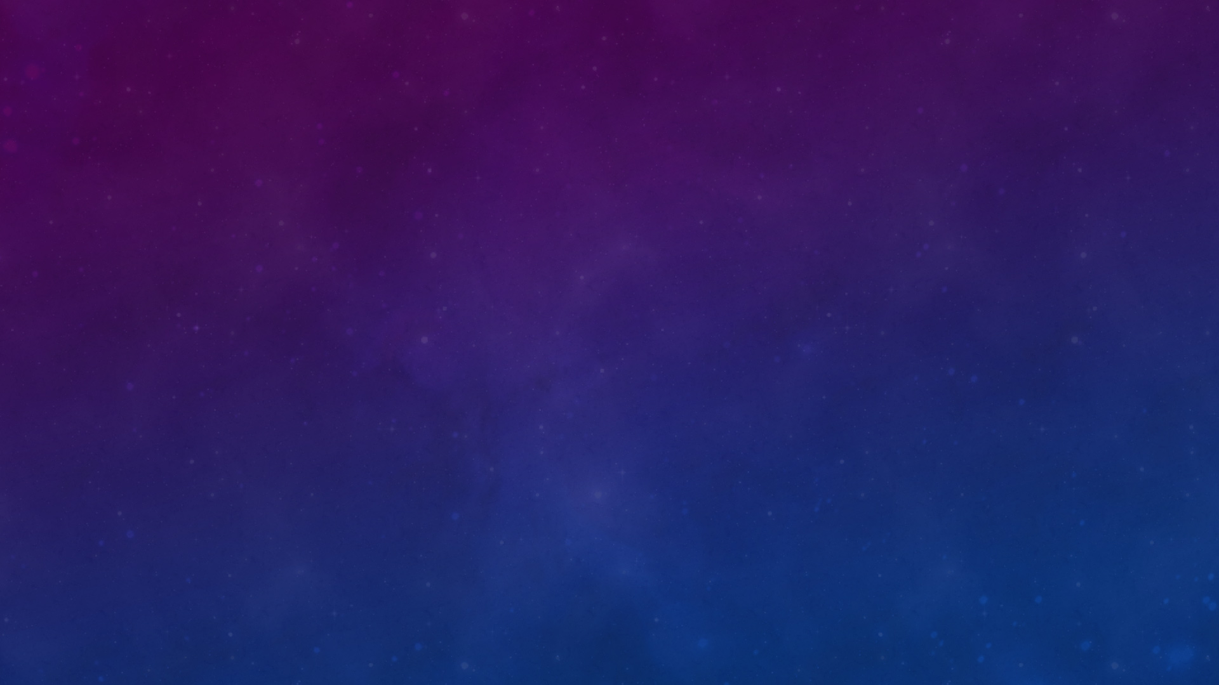
PRELUDE
As part of our ASAIoT project, we developed a serious game in Python using hand recognition, leveraging the knowledge we gained from working with Raspberry Pi devices and the manipulation of images and their interaction.
The goal of this project is to raise awareness about recycling in student life, including the context of meals at the university cafeteria (CROUS), but more broadly extending to recycling at home.
Problem statement: How can we make a game that is both enjoyable to play and educational?

Slide 3
How did we bring this project to life?
To make the game fun, it’s important to add enjoyable mechanics for the user: slicing, collecting.
To encourage improvement: stats, leaderboard.
To keep the player engaged: a pleasant and responsive interface.
All while addressing important topics, such as recycling.

Slide 4

Our game
Or this link

Slide 5
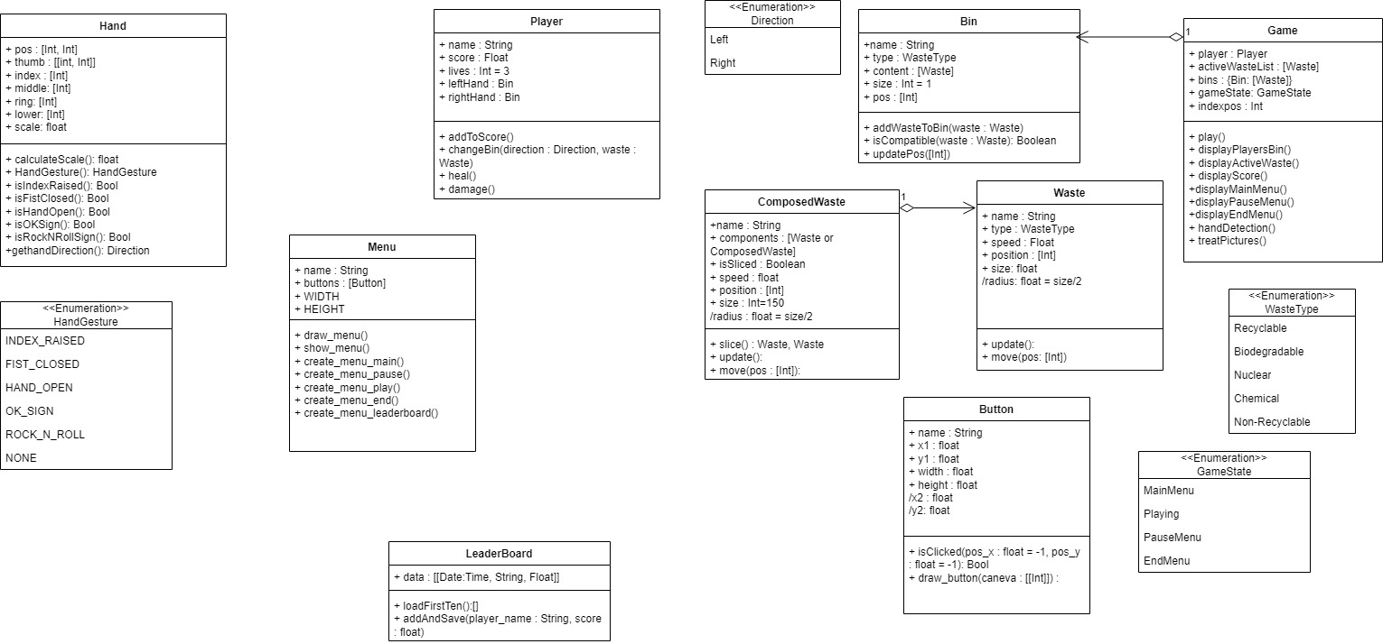
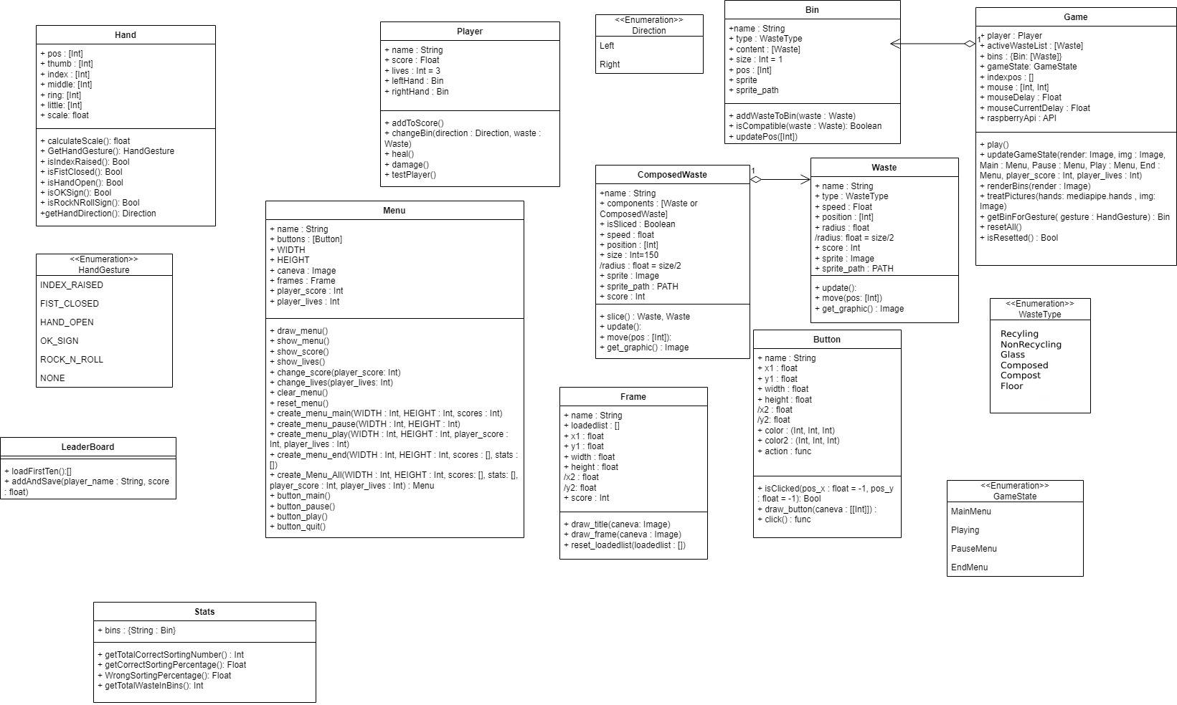
UML DIAGRAMM
Before
After

Slide 6
UML DIAGRAMM
After
Before

Slide 7
Before
After

Slide 8
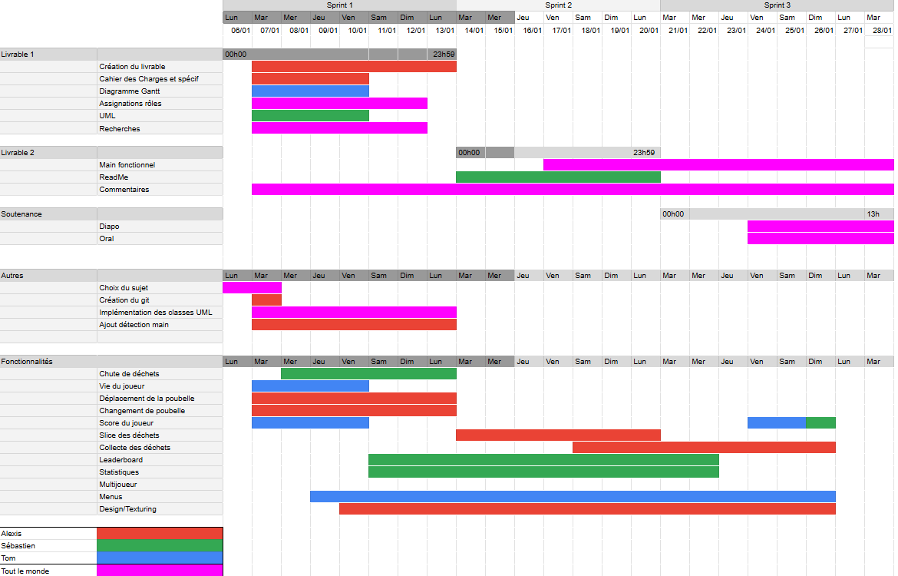
GANT DIAGRAMM

Slide 9
GANT DIAGRAMM
CONCLUDE
This project was very interesting to develop, pushing our image processing optimization skills in Python to create a responsive game. We also learned to use external tools to enhance a program (in this case, a Raspberry Pi).
This project not only aims to provide an engaging gaming experience but also serves as an educational tool to teach players about recycling. Through interactive gameplay, users can learn how to properly sort waste, and be aware of their current knowledge of waste sorting.

Slide 10
CONCLUDE
DIAGRAMME DE GANTT
This project was very interesting to develop, pushing our image processing optimization skills in Python to create a responsive game using image analysis. We also learned to use external tools to enhance a program (in this case, a Raspberry Pi).
This project not only aims to provide an engaging gaming experience but also serves as an educational tool to teach players about recycling. Through interactive gameplay, users can learn how to properly sort waste, and be aware of their current knowledge of waste sorting.
In dedication to Sébastien SERRANO, co-creator of Recycle W4R.

