Slide 1
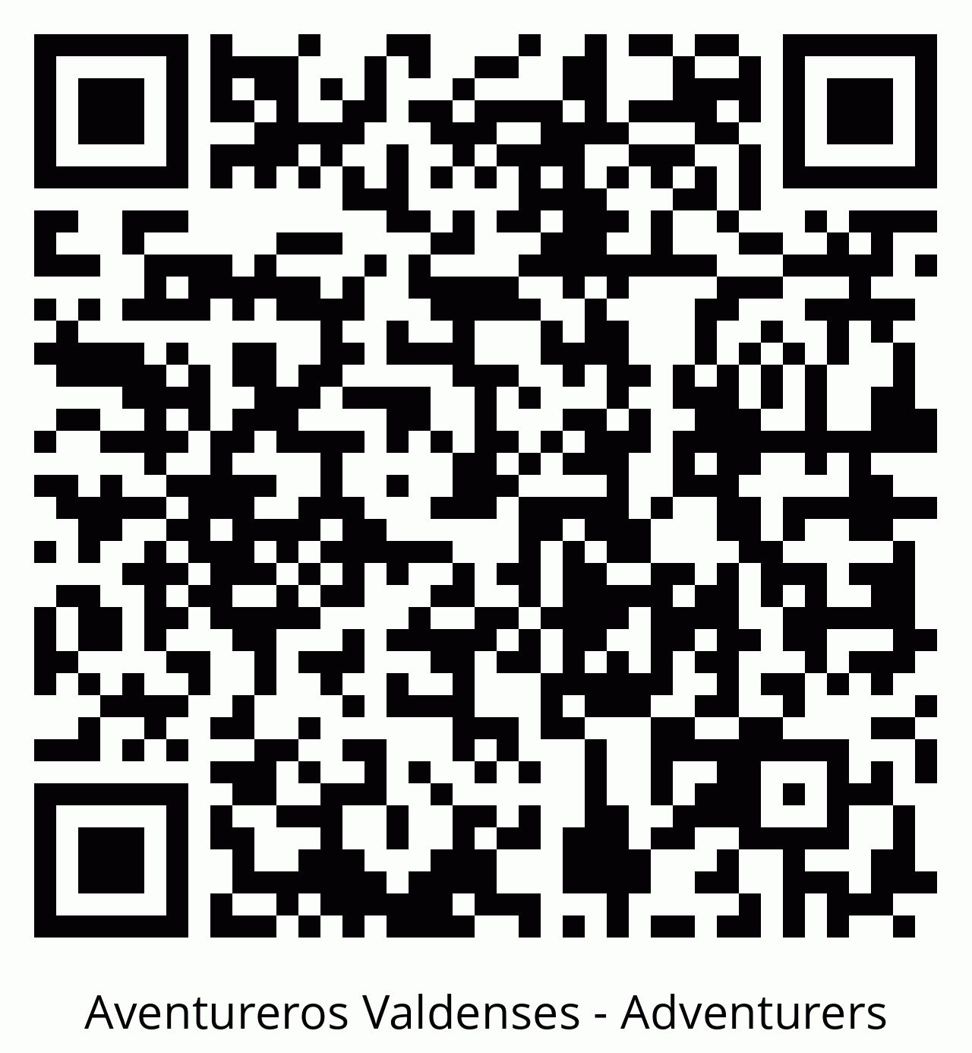
AVENTUREROS VALDENSES | ADVENTURERS
Escanea y regístrate ahora
Scan and register now
1. Abre la cámara
2. Escanea el código
3. Completa tu cuenta
Open your camera • Scan the code • Create your account
Si no puedes escanear / If you cannot scan:
https://adminmyclub.com/register-parent/secure/
NO4MS29mqMWkZCzI66nI3tA0KoSV1a2SbMY7MtHCAw
s7TXxJtzj88BcwJ86KNnYm
adminmyclub.com
1
Notes:
[Sources]
- QR image and secure registration link supplied by the user.
- Secure URL: https://adminmyclub.com/register-parent/secure/NO4MS29mqMWkZCzI66nI3tA0KoSV1a2SbMY7MtHCAws7TXxJtzj88BcwJ86KNnYm

Slide 2
PORTAL DE PADRES | PARENT PORTAL
Tu cuenta de padre
en 3 pasos
Your parent account in 3 steps
Enlace seguro • Verifica tu correo • Registra a tu hijo(a)
adminmyclub.com
2
Notes:
[Sources]
- Content derived from the nadClubs parent onboarding workflow.

Slide 3
Solo necesitas tres pasos
You only need three steps
1
2
3
Crea tu cuenta
Confirma tu correo
Registra al menor
Create your account
Confirm your email
Register the child
adminmyclub.com
3
Notes:
[Sources]
- Content derived from the nadClubs parent onboarding workflow.

Slide 4
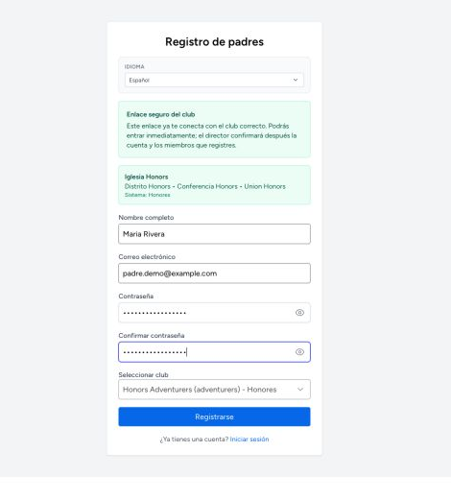
1. Abre el enlace seguro
1. Open the secure link
El club ya está seleccionado.
Completa tu nombre, correo y contraseña.
The club is already selected.
Enter your name, email, and password.
No compartas el enlace en redes sociales.
adminmyclub.com
4
Notes:
[Sources]
- Screenshot: local secure-registration demo from nadClubs.
- Content derived from the nadClubs parent onboarding workflow.

Slide 5
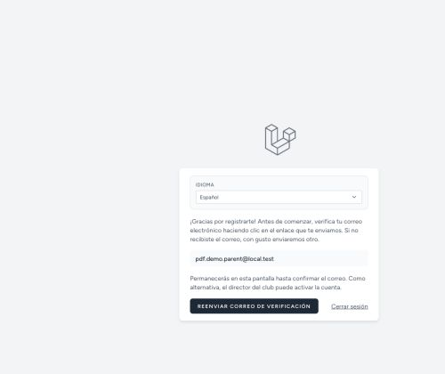
2. Revisa tu correo
2. Check your email
Verás el mensaje:
“Gracias por registrarte”
You will see:
“Thanks for registering”
Ahora abre tu bandeja de entrada.
adminmyclub.com
5
Notes:
[Sources]
- Screenshot: local email-verification notice from nadClubs.
- Content derived from the nadClubs parent onboarding workflow.

Slide 6
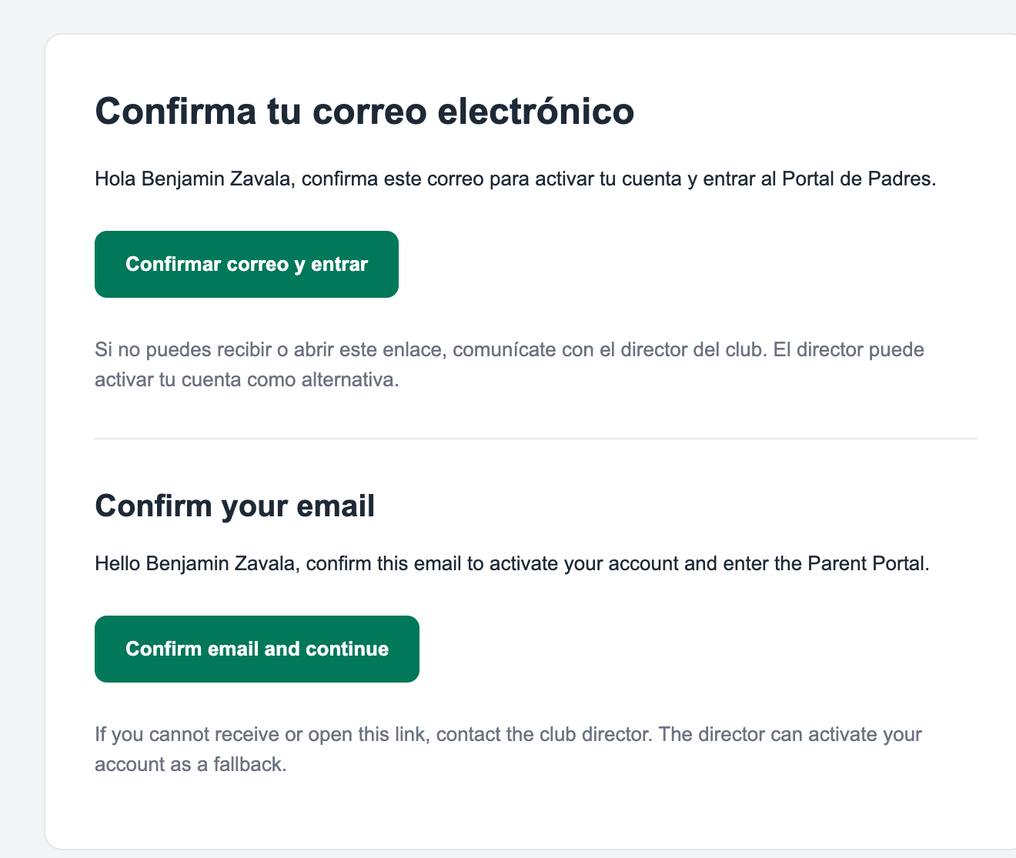
2. Pulsa el botón verde
2. Select the green button
Confirma tu correo y entra.
El enlace es válido por 24 horas.
Confirm your email and continue.
The link is valid for 24 hours.
Debe abrir adminmyclub.com
adminmyclub.com
6
Notes:
[Sources]
- Screenshot: user-provided bilingual verification email.
- Content derived from the nadClubs parent onboarding workflow.

Slide 7
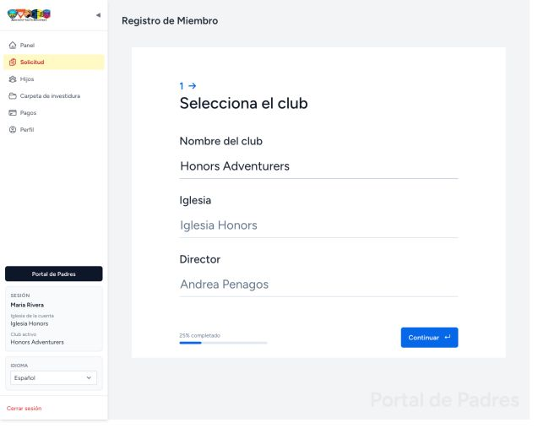
Paso 3: Registra a tu hijo(a)
Step 3: Register your child
Abre Solicitud.
Confirma el club.
Completa y firma.
Open Application.
Confirm the club.
Complete and sign.
Una solicitud por cada menor.
adminmyclub.com
7
Notes:
[Sources]
- Screenshot: local child-application demo from nadClubs.
- Content derived from the nadClubs parent onboarding workflow.

Slide 8
LISTO | YOU ARE READY
Tu Portal de Padres
ya está preparado
Your Parent Portal is ready
Ve a Hijos para confirmar el registro.
Si necesitas ayuda, contacta al director del club.
Open Children to confirm the registration. Contact the club director if you need help.
adminmyclub.com
8
Notes:
[Sources]
- Content derived from the nadClubs parent onboarding workflow.

