Slide 1
假设你是中学生李华，你的美国交换生好友Sofia因为新型冠状病毒爆发而无法去学校参加汉语课程，因此向你咨询如何在家学习汉语，请你给出相应的建议。
1. 写信目的；
2. 提出建议并说明理由。
注意:
1. 可适当增加细节，以使行文连贯；
2. 词数：80词左右
参考词汇：新型冠状病毒 the novel coronavirus

Slide 2
Dear Sofia,
Knowing that you are unable to attend your Chinese lessons due to the outbreak of the novel coronavirus, I am quite willing to offer you some advice on how to improve your Chinese competence at home.
First, you can register for some online courses and practice by yourself as mastering a language do require large amounts of practice. I'd also like to recommend that you read some Chinese storybooks online, which will contribute a lot to enlarging your vocabulary.
I genuinely hope the suggestions will turn out beneficial.
Yours sincerely,
Li Hua
90 words

Slide 3


Slide 4
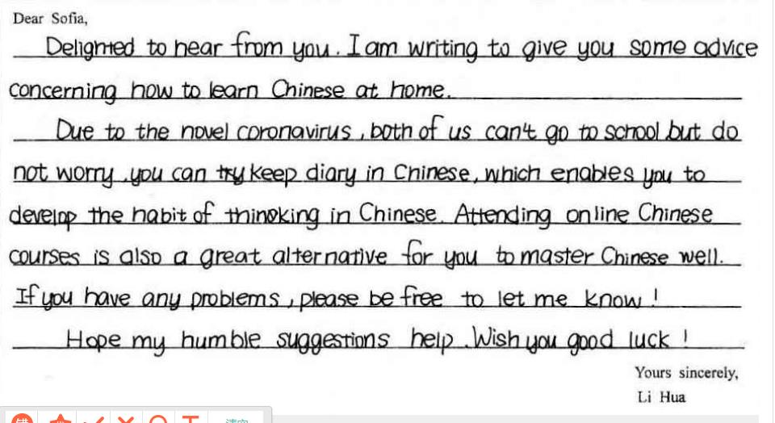

Slide 5
Retirement is the point where a person stops employment completely. The"standard" retirement age varies from country to country, but it is generally between 50and 70, according the latest statistics, 2011. However, for a long time, people have got into an argument about whether the age of retirement should be increased or reduced in their countries.
There are several arguments for allowing older people to continue working as long as they are able. Many people think that older employees have a large amount of knowledge and experience which can be lost to a business or organization if they are made to retire. Besides, older employees are often extremely faithful employees and are more willing to implement company policies than the young. A more important point is regarding the attitudes in society to older people. To force someone to resign or retire at 60 or 65 indicates that the society does not value the input of these people and that their useful life is over.
Allowing older people to work indefinitely (无限地), however, is not always a good policy. Some people took the strong view that age alone is no guarantee of ability. Many young employees have more experience or skills than older staff, who may have been stuck in one area for most of their working lives. Having compulsory retirement allows new ideas in an organization. On the other hand, older people should be rewarded by society for their life's labor by being given generous pensions and the freedom to enjoy leisure. They can have time to do whatever they like, that is, they can have their own plans or roles and achieve their retirement goals.
With many young people unemployed or frustrated in low-level positions, there are often calls to compulsorily (强制地) retire older workers. However, this can affect the older individual's freedom and right to work. In my opinion, giving workers more choices over their retirement age will benefit society and the individual.

Slide 6
Retirement is the point where a person stops employment completely. The"standard" retirement age varies from country to country, but it is generally between 50and 70, according the latest statistics, 2011. However, for a long time, people have got into an argument about whether the age of retirement should be increased or reduced in their countries.
There has been a debate about the right retirement age. (要点1)

Slide 7
There are several arguments for allowing older people to continue working as long as they are able. Many people think that older employees have a large amount of knowledge and experience which can be lost to a business or organization if they are made to retire. Besides, older employees are often extremely faithful employees and are more willing to implement company policies than the young. A more important point is regarding the attitudes in society to older people. To force someone to resign or retire at 60 or 65 indicates that the society does not value the input of these people and that their useful life is over.
Some argue that older people should not be forced to retire because of their advantages in workplaces like richer experience, loyalty and implementation capability, otherwise, their contributions are not recognized.(要点2)

Slide 8
Allowing older people to work indefinitely (无限地), however, is not always a good policy. Some people took the strong view that age alone is no guarantee of ability. Many young employees have more experience or skills than older staff, who may have been stuck in one area for most of their working lives. Having compulsory retirement allows new ideas in an organization. On the other hand, older people should be rewarded by society for their life's labor by being given generous pensions and the freedom to enjoy leisure. They can have time to do whatever they like, that is, they can have their own plans or roles and achieve their retirement goals.
However, opponents believe in more strengths possessed by young employees and earlier retirement as a reward for the elderly.(要点3）

Slide 9
With many young people unemployed or frustrated in low-level positions, there are often calls to compulsorily (强制地) retire older workers. However, this can affect the older individual's freedom and right to work. In my opinion, giving workers more choices over their retirement age will benefit society and the individual.
Maybe it will be beneficial to both society and individual by leaving the issue to the elderly themselves. （要点4）

Slide 10
There has been a debate about the right retirement age. (要点1) Some argue that older people should not be forced to retire because of their advantages in workplaces like richer experience, loyalty and implementation capability, otherwise, their contributions are not recognized.(要点2) However, opponents believe in more strengths possessed by young employees and earlier retirement as a reward for the elderly.(要点3）Maybe it will be beneficial to both society and individual by leaving the issue to the elderly themselves. （要点4）
77 words

Slide 11
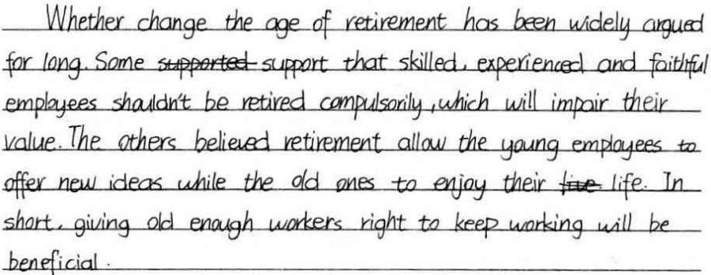

Slide 12
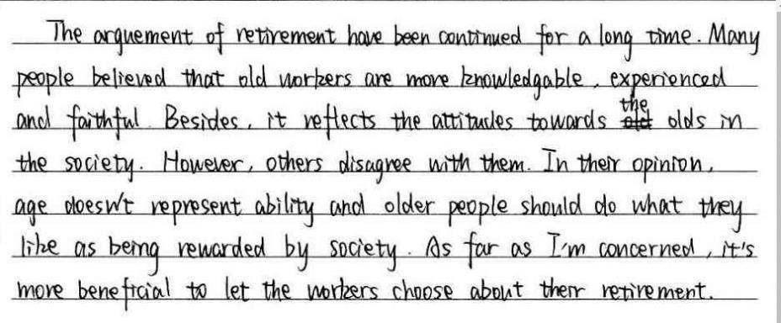

Slide 13
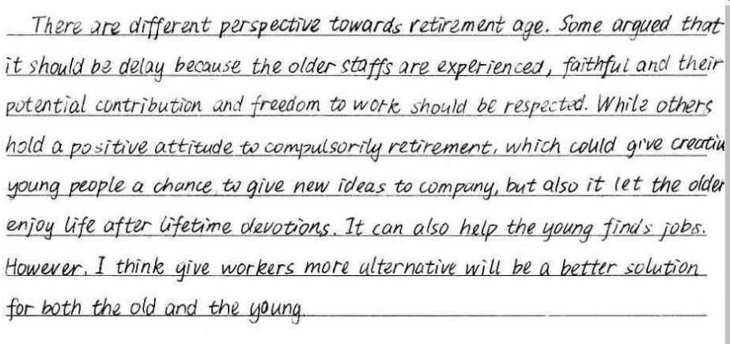

Slide 14
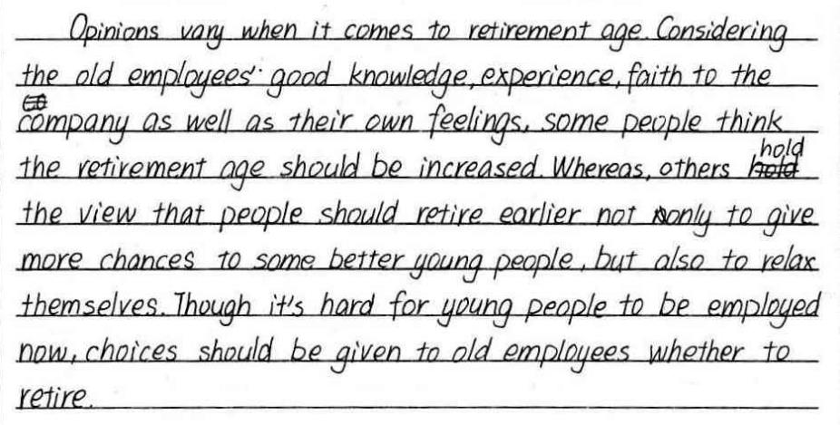

Slide 15
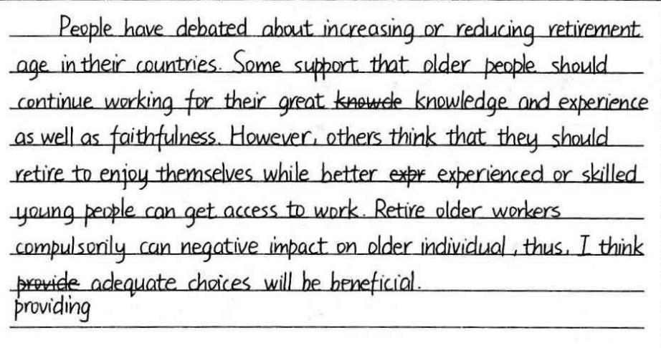

Slide 16
