Slide 1
Developing R Scripts using RStudio
Notes:
Overview of R as a Data Analytics Platform - Installing Microsoft R Open and RStudio - R Programming Language Primer - Writing and Testing Scripts in RStudio - Generating Custom Visuals using R Packages

Slide 2
Agenda
Overview of R as a Data Analytics Platform
Installing Microsoft R Open and RStudio
R Programming Language Primer
Writing and Testing Scripts in RStudio
Generating Custom Visuals using R Packages

Slide 3
Agenda
Understanding R as an Analytics Platform
Installing Microsoft R Open and RStudio
Writing R Code in RStudio
Integrating R with Power BI Desktop

Slide 4
What is R?
What is R?
Platform for statistics, data analysis and visualization
Free, cross-platform, open source software
Programming language + Runtime layer + Libraries
R code distributed and versioned using packages
Flourishing ecosystem of R package authors
Why do you need it?
Analyzing data and generating statistics
Creating rich graphs and charts
Fitting statistical models for predictive analysis

Slide 5
R Packages
Package is versioned redistributable unit of code
Package contains functions, data and compiled code
R is installed with a default set of packages
Other packages can be downloaded and installed
Examples of available domain-specific packages
Packages to download and unpack data in zip archive
Packages to create fancy charts and graphs
Packages to optimize financial portfolios
Packages predict component failure times
Packages to analyze genomic sequences

Slide 6
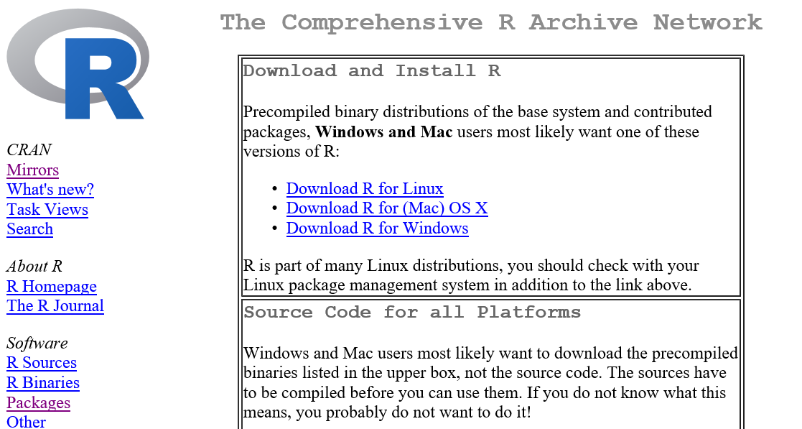
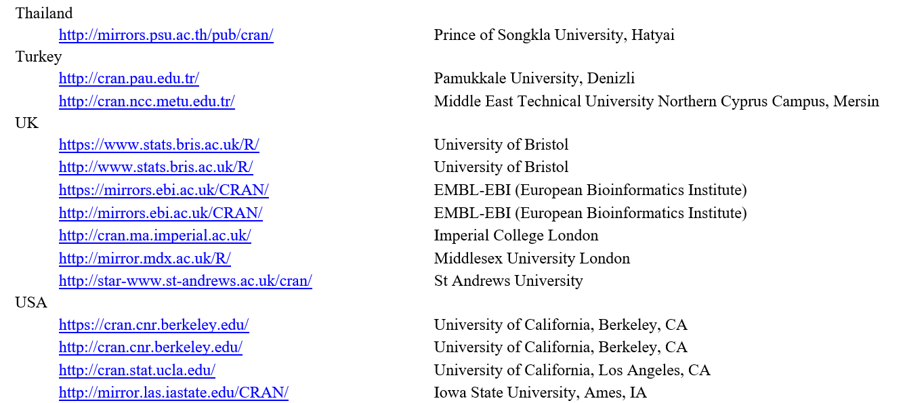
CRAN
The Comprehensive R Archive Network
Public archive with over 8,000 downloadable packages
http://cran.us.r-project.org/

Slide 7
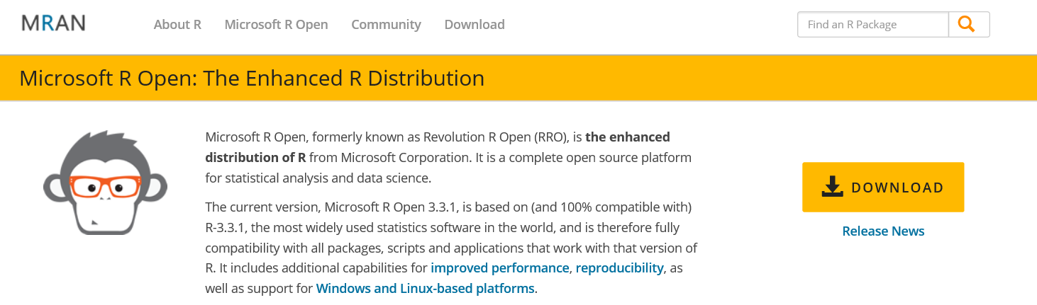
Microsoft R Open
What is Microsoft R Open?
An enhanced distribution of R from Microsoft
Improved performance and multithreading
Reproducibility through package versioning stability
Free, cross-platform, open source software
Available at https://mran.microsoft.com/open/

Slide 8
Stages of R Awareness
Stage 1: Standing Up
Installing the environment and playing with data
Stage 2: Walking
Writing & testing R code and creating graphs and charts
Stage 3: Jogging
Crunching numbers to generate advanced statistics
Stage 4: Running
Creating a domain-specific predictive model
Stage 5: Sprinting
Distributing your predictive model as a CRAN package

Slide 9
Agenda
Understanding R as an Analytics Platform
Installing Microsoft R Open and RStudio
Writing R Code in RStudio
Integrating R with Power BI Desktop

Slide 10
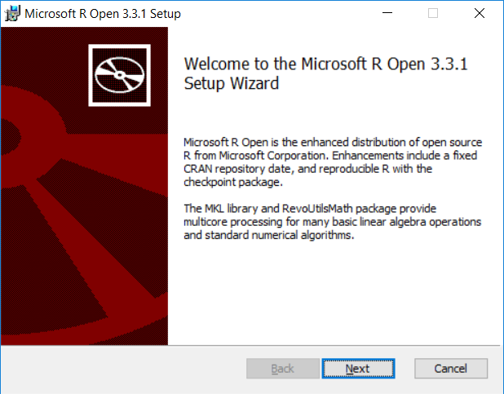
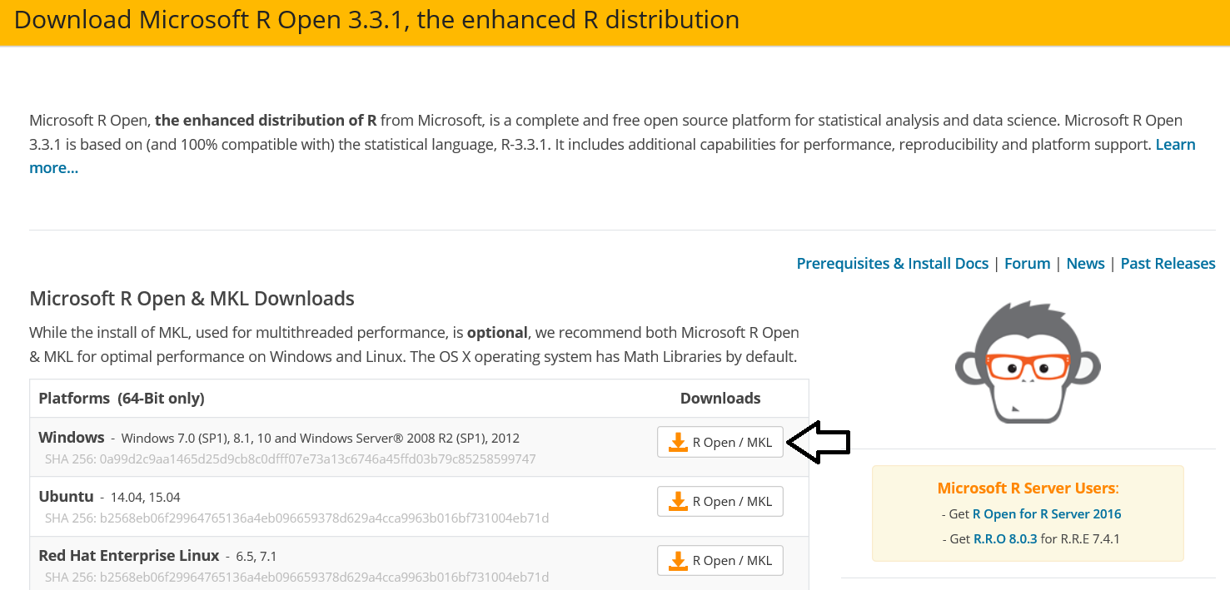
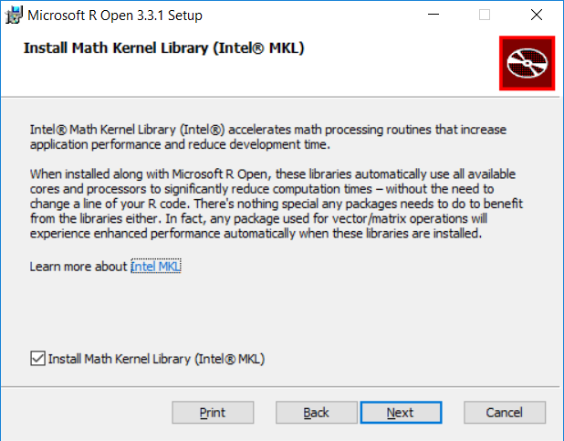
Install Microsoft R Open
https://mran.microsoft.com/download/

Slide 11
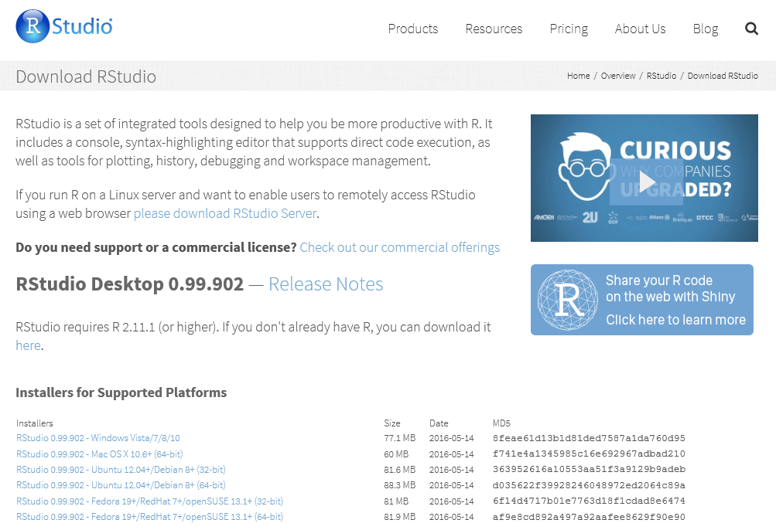
Installing R Studio
https://www.rstudio.com/products/rstudio/download/

Slide 12
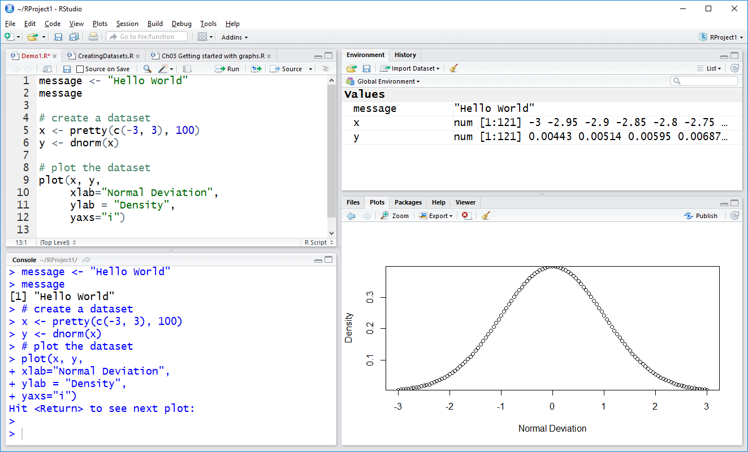
The RStudio IDE

Slide 13
Agenda
Understanding R as an Analytics Platform
Installing Microsoft R Open and RStudio
Writing R Code in RStudio
Integrating R with Power BI Desktop

Slide 14
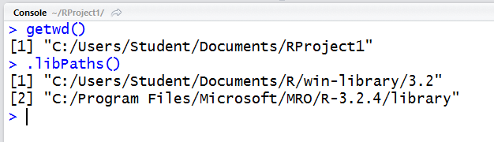
R Projects and Workspaces
R projects based on folder structure
Data and scripts added to current working directory
Each R project defines a workspace
Workspace tracks set of user-defined objects
Workspace defines set of loaded packages
Workspace data saved/loaded using .RData files

Slide 15
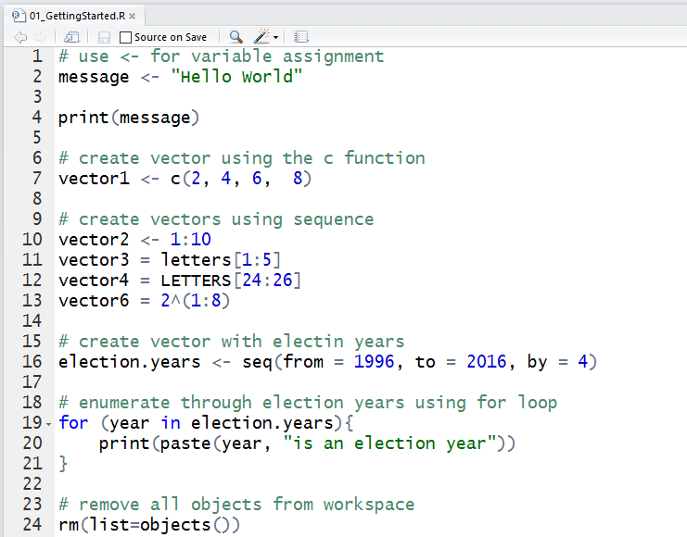
Writing and Testing R Code in Scripts

Slide 16
R Objects
In R, variables represent named objects
Object names can contain
Letters
Numbers
Underscores (_)
Dots (.)

Slide 17
Essential Data Structures in R
Vector
One-dimensional, single-mode array
Matrix
Two-dimensional, single-mode array
Array
N-dimensional, single-mode array
List
Ordered collection of multi-mode objects
Data frame
Two-dimensional, multi-mode array
Factor
Integer-backed list of categorical values

Slide 18
Writing and Testing R Code in RStudio

Slide 19
Creating Graphs using RStudio

Slide 20
Agenda
Understanding R as an Analytics Platform
Installing Microsoft R Open and RStudio
Writing R Code in RStudio
Integrating R with Power BI Desktop

Slide 21
Where Can You Use R Code in PBIDT?
As a data source to a query
You can use R code to import and reshape data
Within a Query Applied Step
You can use R code to add transforms to a query
Inside an R Visual in a Power BI Report
You can use R code to creates charts from your data

Slide 22
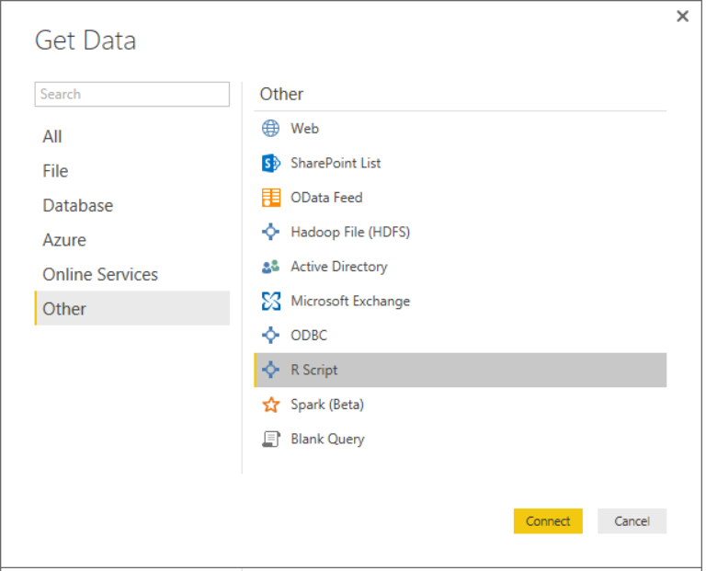
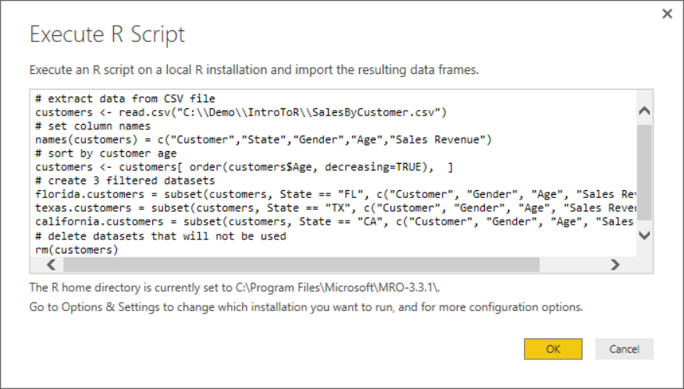
Using R Code as a Query Data Source
Create new query based on R script
Copy and paste code from RStudio into PBIDT

Slide 23
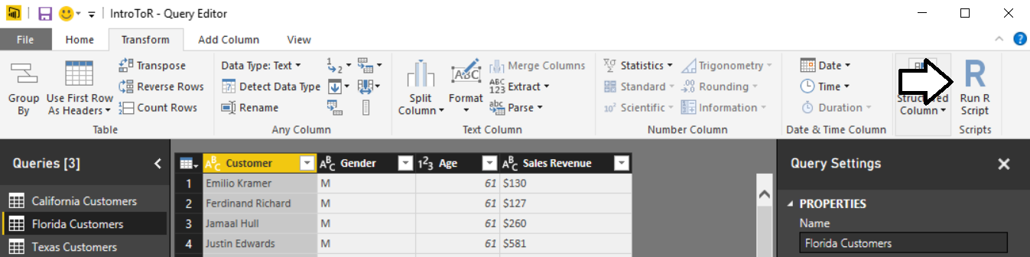
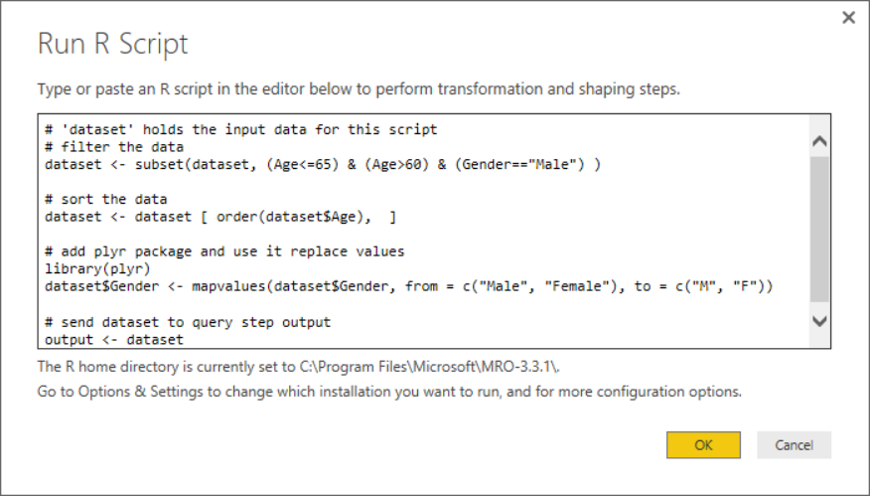
Using R Code as an Applied Query Step
Add new Run R Script step to query
Use R code and R packages to transform data

Slide 24
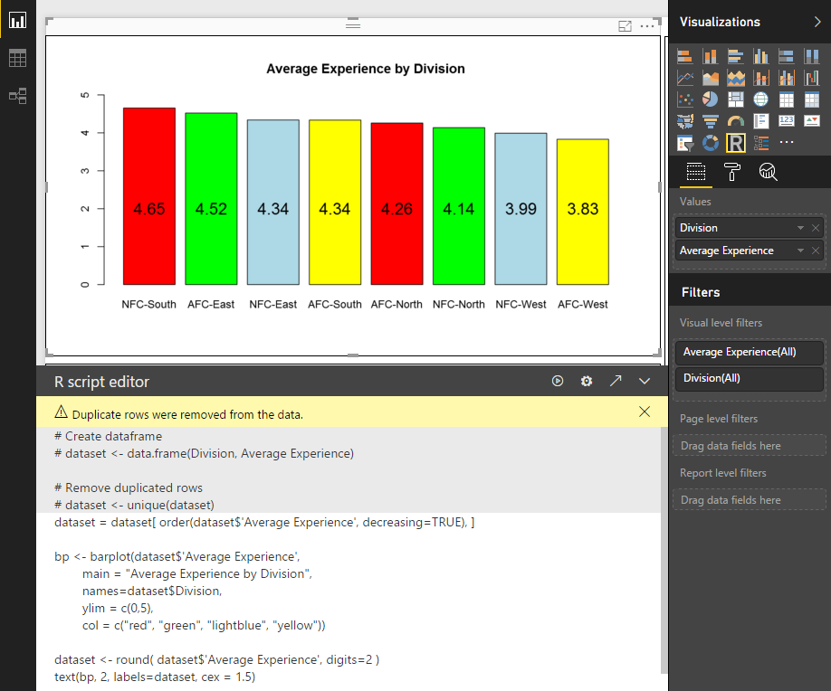
R Visuals in Power BI

Slide 25
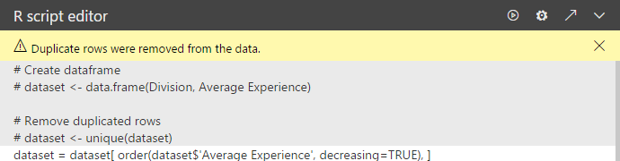
New R Features in September Release
Edit R code in external editor
Run the script
Go to Data Load settings
Expand/collapse R coding pane

Slide 26
R Integration Limitations with Power BI
Power BI Desktop R Limitations
Only data frames are imported
Complex columns and Vector columns are not imported
Values that are N/A are translated to NULL values
Prompting for user input halts script
R visual data for plotting is limited to 150,000 rows
R visual calculation times out with error after 5 minutes
R visual is not interactive – no highlighting support
Plots can only be displayed to R default display device

Slide 27
Summary
Understanding R as an Analytics Platform
Installing Microsoft R Open and RStudio
Writing R Code in RStudio
Integrating R with Power BI Desktop

