Slide 1
Models

Slide 2
Review
Chi-squared
Student’s T
ANOVA
Regression
General linear models

Slide 3
Review
Chi-squared → evenly spread
Student’s T → one or two means
ANOVA → multiple means
Regression → straight line (y~a+ bx)
General linear models → combinations

Slide 4
Review
These are all models
They reflect our guesses about underlying phenomena, e.g.:
Chi-sq (smoking): Cancer rates equal
T-test (Mile End heights): rich vs. poor lifestyles
ANOVA (fertiliser): Fertiliser A supplies Ca⁺, Fert. B doesn’t
Regression (height~rain): more watering → more growth
Which to use?

Slide 5
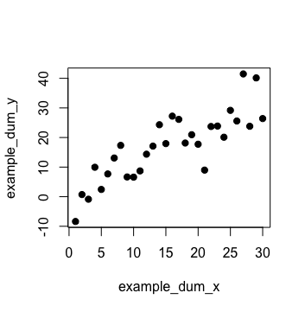

Slide 7
Selection and fitting
X
Choose → fit → compare → result

Slide 8
Our Method
results
Optimise fit
Fit
data
(refine)
model
simulation
Parametise simulation
theory

Slide 9
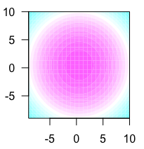
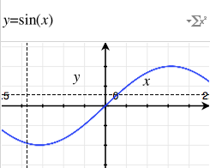
Other models are available
Left: x² ⁺ y² ≤ 1
Below: y = sin(x)

Slide 10
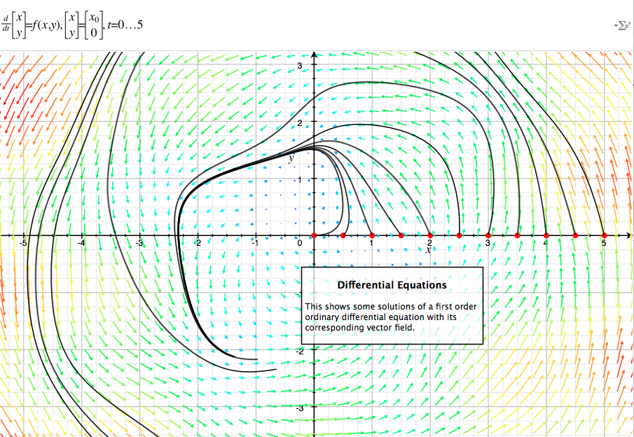
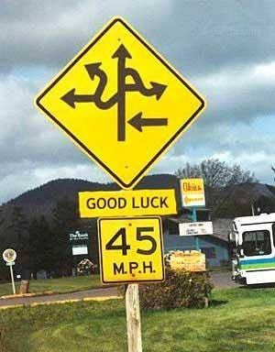
Other models are available
Above: particle motion
Right: regular shapes

Slide 11
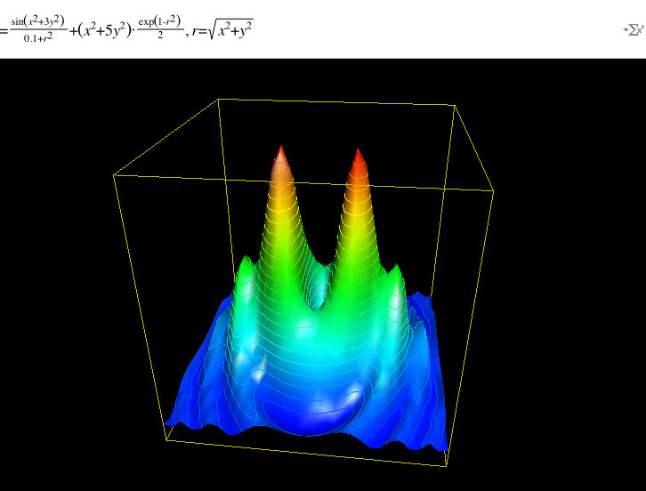
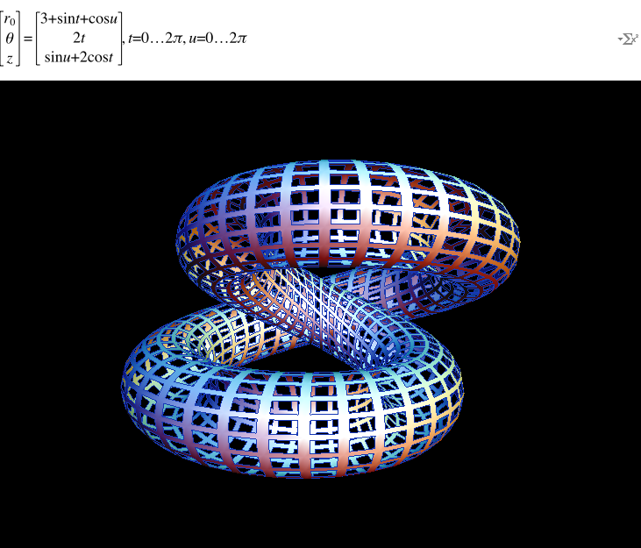
Other models are available
Patterns in 2, 3, 4 or n-dimensional space

Slide 12
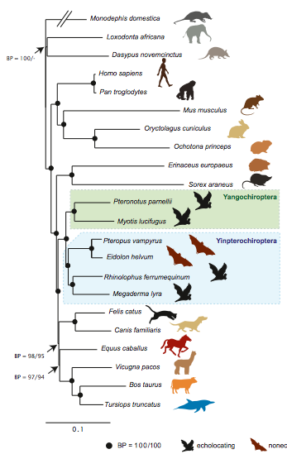
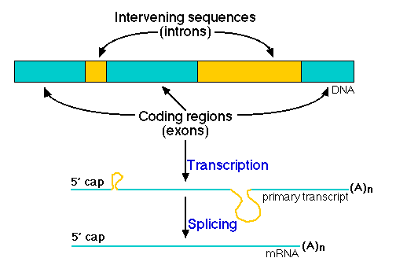
Biological models
VL 4 length
≤ 34
≤ 27
Chronic
> 34
VL 1 length
> 27
Remission
Average
Biological models (clockwise from top):
Decision model: HIV virus hypervariable loop vs. health; phylogenetic tree: DNA sequence vs. evolutionary history; annotation: DNA sequence vs. transcription role

Slide 13
What is a model?
A model is any statement that explains structure in the data
Usually related to our guess about underlying phenomena
Might describe:
Numerical observations, space, time
Genome structure, evolutionary relationships
Human language, anything else
Usually expressed mathematically

Slide 14
Errors and residuals
The real world is noisy
This is why spotting models is hard
And why fitting parameters is also hard
Probability gives us a language to express our belief that a particular sequence of events (the data) have occurred due to some underlying process (the model), accounting for random disturbances (the error)

Slide 15

Simulation
Simulation, modelling, error and inference are intimately linked
“Does Model A describe x?”
“Does Model A-simulated data resemble x?”
Model
Data
Simulation

Slide 16
Parameters
‘A’ model really only makes general statements about the nature of the phenomenon
To make specific, predictive statements, we need to parametise the model
E.g. collect and interpret height data:
“Height is normally distributed”
Height_{MILE END} = 1.78m ± 15.2cm
95% of people chosen randomly between 1.63m and 1.93m
“Don’t stock XXS or XXL jeans”

Slide 17
Null hypotheses
The ‘null hypothesis ’ is usually how we infer and test a model
It is not special!
Usually a minimal ‘business as usual’-type description of the data
But for complex data types (genomes; molecular interactions; evolution) even simple null models will still be very complicated

Slide 18
Model choice
Sadly, relationships are rarely clear-cut
Which model to use?
Distribution: uniform? normal? exponential?
How many means? 1? 2? k?
Spatial shape: circle? polygon? irregular?
Substitution model: equal-rates? codon-bias?
Model selection doesn’t just influence results; it is the results

Slide 19
Model comparison
We’ve met the basic principles
Efficiency – we like models that are simple to understand
Tractability – we like models that are simple to fit/parametise
Significance – we like models that explain variation
Model comparison: statistically trading competing models off

Slide 20
Model comparison
Number of d.f. / parameters
Total variation / variance
Mean variation
Test statistics (Chi-sq, T, F)
Information criteria, odds-ratios (AIC)
(…. and: Bayesian vs. frequentist traditions….)

Slide 21
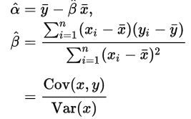
Algorithms
Some models are straightforward to fit/parametise, because mathematicians have derived solutions, e.g.:
Usually life is harder
Especially in many dimensions

Slide 22
Algorithms
We use algorithms for two purposes, then:
Model parametisation: if we have a model to fit to complex data, we need a scheme to determine model coefficients
Model selection: even if parametising a given model is trivial, there is an omnishambles of possible models to choose from

Slide 23
Search strategies
Numerical answer (or approximation) easily derived
Brute-force
Stepwise / incremental search with gradient descent
Random search (walk)
Markov-chain Monte Carlo
Combinations

Slide 24
Probability and confidence
p – Probability of seeing data, if H₀ correct:
p = Pr ( D|H₀ )
Not perfect but we’re stuck with it
For simple models p is straightforward to calculate; e.g. for coin-toss (P_{heads}=0.5) a sequence of k heads from n tosses {H,T,H,H} k determined from the binomial distribution:

Slide 25
Probability and confidence
For other models (normally-distributed, and related) solutions to exact or approximate probabilities are available (T, F etc) allowing us to construct p-values and “accept or reject H₀”
For more complex models (complicated distributions, high dimensions) calculating probability exactly becomes harder or impossible
Reminder: Variances, confidence intervals and p all depend on our ability to quantify belief

Slide 26
Estimating confidence
Where we can’t calculate directly we may have to try our best:
How sensitive is this estimate to the data? (bootstrap estimates)
How sensitive is this estimate to the model? (vary parameters, empirically)
How closely does this dataset resemble the null? (simulations)

Slide 27
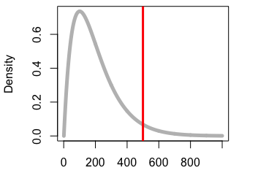
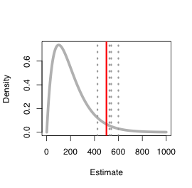
Estimating confidence
Where we can’t calculate directly we may have to try our best:
How sensitive is this estimate to the data? (bootstrap estimates)
How sensitive is this estimate to the model? (vary parameters, empirically)
How closely does this dataset resemble the null? (simulations)

Slide 28
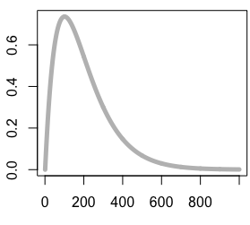
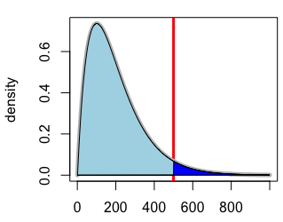

Estimating confidence
Where we can’t calculate directly we may have to try our best:
How sensitive is this estimate to the data? (bootstrap estimates)
How sensitive is this estimate to the model? (vary parameters, empirically)
How closely does this dataset resemble the null? (simulations)

Slide 29
Our Method
results
Optimise fit
Fit
data
(refine)
model
simulation
Parametise simulation
theory

Slide 30
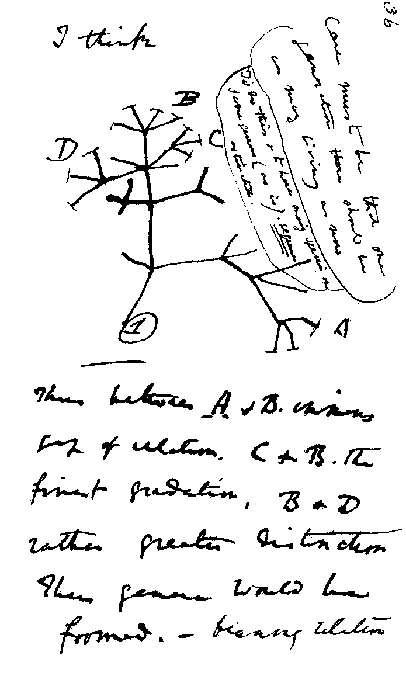
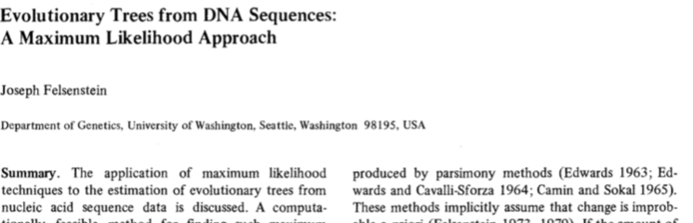
Example: Phylogenetics
An evolutionary tree is a hypothesis
e.g., a model, of DNA sequence evolution
Many trees are possible
For neutral sites, approximate as a stochastic process on a fixed tree, then compare to successive proposed trees (Felsenstein, 1981)

Slide 31
Example: Phylogenetics
Consider two DNA sequences (A,B) with n orthologous sites, over time t. Assume mutations follow iid. Total will be a product:
At each site k, probability that a base i mutates j to is given by:
where: u denotes substitution rate (‘speed’); delta the change function; pi the equilibrium frequency
After Felsenstein (1981)

Slide 32
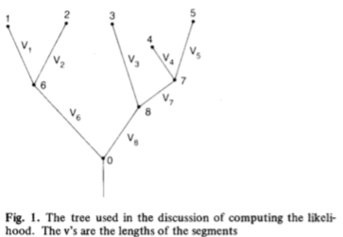
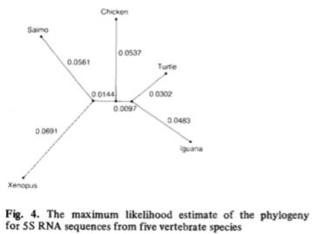
Example: Phylogenetics
Felsenstein (1981)
Simply divide the tree up into segments
Sequences for unobserved (ancestral) taxa are unknown – so we compute for all possible states
Sum of possible states: site likelihood
Product of site likelihoods: tree likelihood (or sum, in lnL)
Simple algorithm:
For starting tree, parametise branches to optimise (maximise) likelihood
Propose new trees and accept if they improve on the current one

Slide 33
Summary
Statistics is the proposal and fitting of models to explain data
Some models are simple, others complex. Some, we might invent ourselves
Models must be parametised, or fitted, to be useful
Null hypotheses are just models, too
With infinitely many possible models to choose from, they have to be compared to give the ‘best’ for our data
Goodness-of-fit and likelihood cannot always be computed exactly – we may need to approximate, measure as ratios, or guess

