Slide 1
Big data in bioinformatics

Slide 2
Recap

Slide 3
Experimental design
Experimental design affects which tools we can use:
Categories? Continuous?
Nested? Orthogonal?
Blocks?
Time-series?
Fixed or random factors?
Replicates?

Slide 4
Blocks
Experiments are typically divided into blocks
Blocks may be used to collect replicates accounting for unknown systemic errors, or random ones

Slide 5
Blocks
Where treatment levels are used, they can be arranged onto blocks randomly or regularly.

Slide 6
Blocks
If systemic confounding variables are known to exist but aren’t of interest, we can use block effect to account for them – if appropriately laid out…

Slide 7
Blocks
… or not
If we want to account for unknown random effects we can use a random effects model

Slide 8
Orthogonality
We get our information by comparing levels of our different factors, e.g. drug Hi/Low vs age Old/Young
This is why we may refer to these as contrasts
Ideally we want every possible combination to be represented, and with equal samples
This is the ideal of orthogonality and simplifies analysis

Slide 9
Factorial designs
Most of our designs aim to be factorial, e.g. we have multiple levels of one or more treatments, and we collect/test them simultaneously
This (hopefully) controls for some of the variation that could arise if we collected and analysed data sequentially
Big genomic data can violate this fairly frequently, e.g. several transcriptomes collected and sequenced over a year

Slide 10
Nested designs
We may want/need to perform a nested experiment
In a nested experiment, replicates at different levels

Slide 11
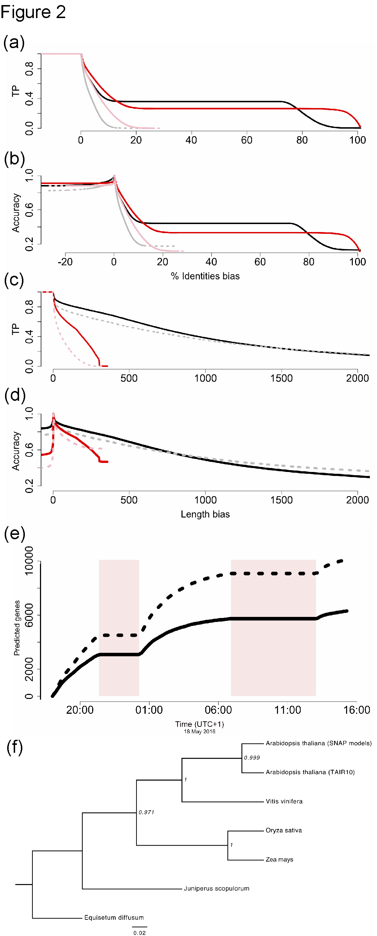
Types of error and statistic choice
 | There is an effect | There isn’t an effect
We detect an effect | ☺ Power; 1-β | ☹ Type I rate (α)
We don’t detect an effect | ☹ Type II rate (β) | ☺

Slide 12
Types of error and statistic choice
 | There is an effect | There isn’t an effect
We detect an effect | ☺ Power; 1-β | ☹ Type I rate (α)
We don’t detect an effect | ☹ Type II rate (β) | ☺
Not all statistics are created equal: error rates may vary
Neither are all effects: a statistic which efficiently detects with large effects may perform poorly with weak ones, and vice versa
To compare statistics we may use a ROC plot, or power curve

Slide 13
Power and effect size
Based on the assumed power and the expected effect size, we can calculate the sample size needed to detect an effect (if one is there)
Equivalently, if we have a finite sampling resource, and know which approach we will use, we can determine what magnitude effects we will realistically be able to detect.

Slide 14
Null model choice
The comparison between a/the null mode is our primary means for assigning significance to findings
Only works if null is valid
Valid nulls should be as simple as possible (but no simpler)
We must state the null model before we get to work collecting data/designing work

Slide 15
False discoveries and multiple tests
Multiple tests or linked p-values carry an inherent risk that we wrongly reject the null hypothesis.
Recall that e.g. ‘p≤0.05’ is equivalent to P(D|H₀) = 0.05 = 5%
20 x 5% = 100%(!)
Corrections:
Raise ‘significance’ threshold (p≤0.001)
Adjusted / synthetic p-values (K-S; Benjamini-Hochberg
Explicitly combine models to eliminate repeated tests in the first place

Slide 16
Uses of simulation
We love to simulate. We may use simulation to:
Evaluate significance by estimating the null distribution, where we cannot compute it directly
Save time and/or €€€€
Discover where boundary conditions are, and what goes on there
Explore the consequences of the fitted model
Some studies may even be wholly simulational

Slide 17
GWAs
Genome-wide association studies(GWAS) are extremely common
Compare 100s, or even 1000s of loci for SNP/haplotypes etc, millions of dimensions
Very large numbers of p-values effectively, so controlling for multiple tests essential.

Slide 18
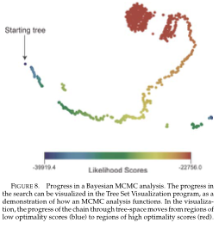
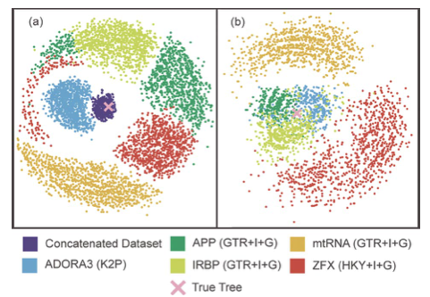
PCA and multidimensional reduction
Many datasets are extremely high-dimensional
Visualising and model selection are extremely hard
Often most variation contained in a handful of parameters / dimensions
Techniques to reduce dimensionality e.g.:
PCA (principal component analysis)
MDS (multidimensional scaling)
AI-type approaches

Slide 19
Validation and ‘ground truthing’
Frequently we may be developing a new model to fit unusual data
Great. But remember to keep checking against intuition / previous / partial results, especially if high-dimensional
Previous results, predictions, slices of the data and boundary cases can all help reassure us we’re not bonkers

Slide 20
Reproducibility
Everyone wants to live longer. Datasets aren’t any different
Reproducing results is central to the scientific methods
Be extremely suspicious of apparently ‘landmark’ studies which are hard to reproduce
Applies to software, environments, etc
Also applies to model selection if done using in silico criteria/algorithms (‘best’ model selection should be stable/robust)
As you prepare to publish your Big Finding, make sure
All code is accessible and documented;
Data and metadata available;
Methods are clearly described, including software versionsing and dependencies

Slide 21
Summary
Experimental design is the biggest factor in what we can infer
Power, sensitivity, and effect size can all help us calculate samples needed
We must have a valid null
We need to select models, checking assumptions
Beware of multiple tests, whatever the context
If working with highly multidimensional data, keep constantly validating results
Do reproducible science

