Slide 1
Deep Reinforcement Learning for Trading
Hao Wang, Haolan Cheng, Yuting Lun

Slide 2
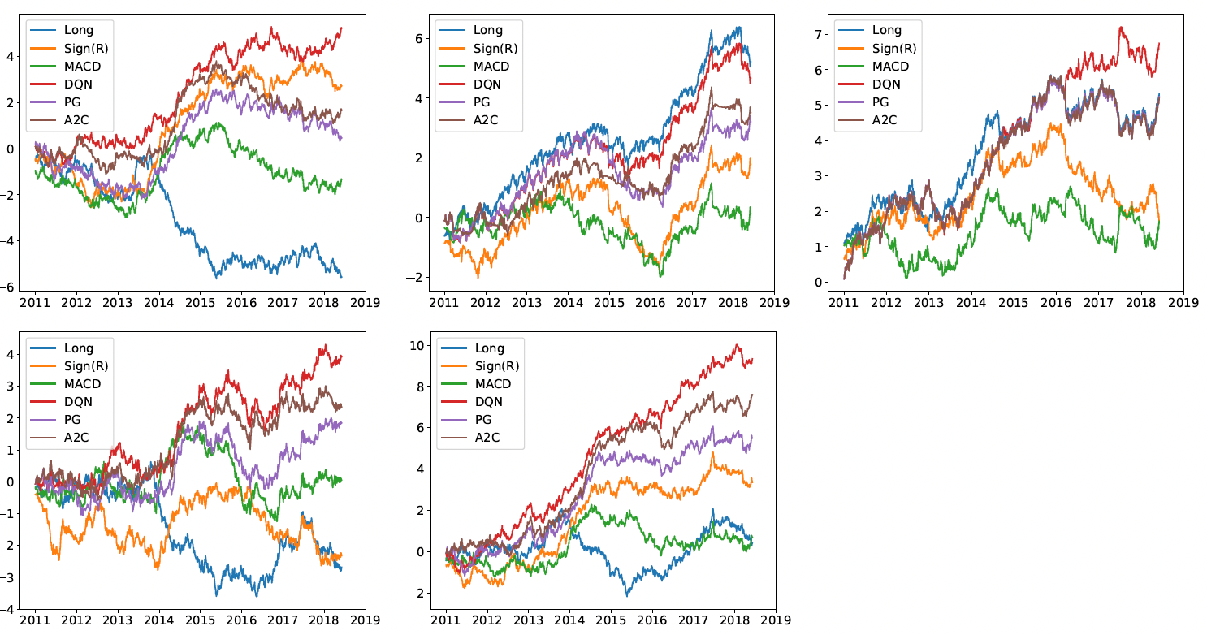
Summary of Original Paper
Traditional Methods
Proposed RL Methods
Fundamental & Technical Analysis: Often lack precise timing for entering and exiting trades, leading to potential drawdowns.
Time-Series Momentum: Highly effective in trending markets, but severely vulnerable to sideways or mean-reverting markets (like FX).
Classical RL (Q-Learning): Frequently relies on discrete action spaces (fully long/short), which is highly risky during volatile periods.
Deep Q-Networks (DQN): Evaluates the value of discrete actions in a given state.
Policy Gradients (PG): Optimizes the policy directly, useful for continuous action spaces.
Advantage Actor-Critic (A2C): Updates policies in real-time by combining an 'actor' network with a 'critic' network.
Figure 1: Cumulative trade returns.
First row: commodity, equity index and fixed income;
Second row: FX and the portfolio of using all contracts.

Slide 3
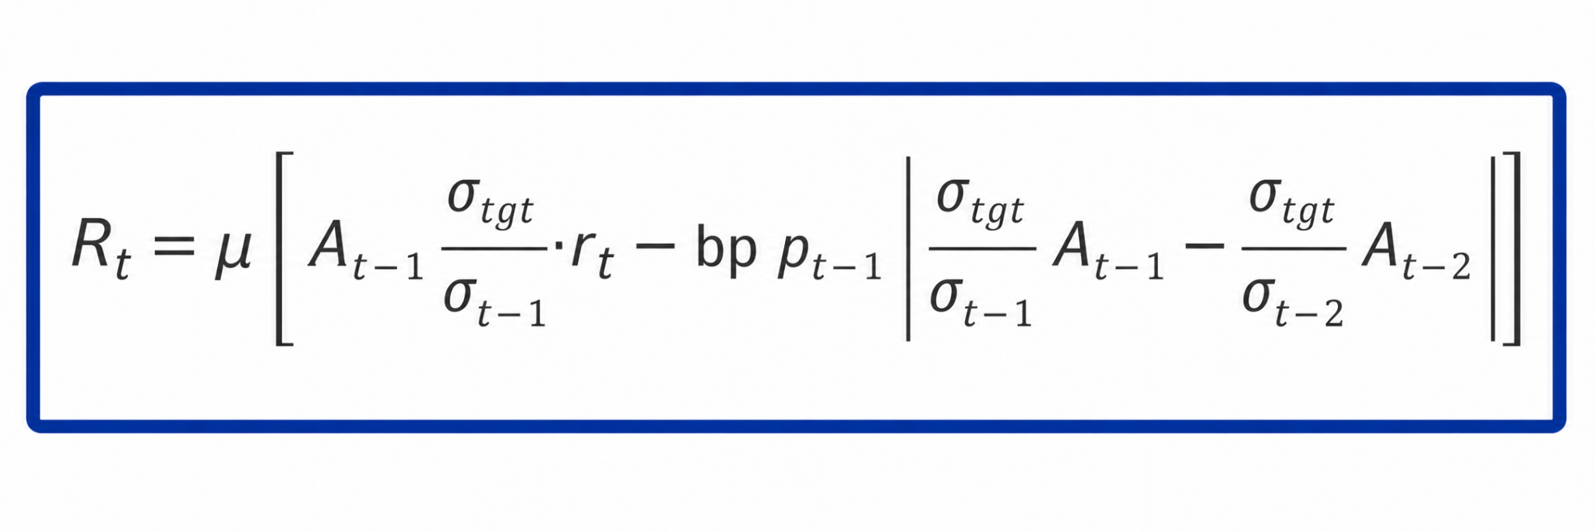
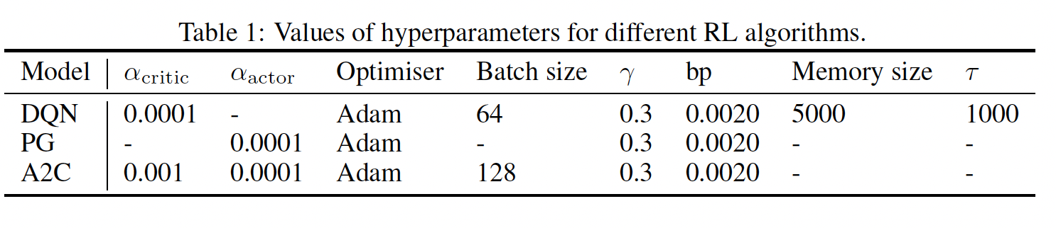
Summary of Original Paper
1. Data
2. Methodology
3. Evaluation Metrics
50 most liquid futures contracts (2011-2019).
Commodities (25)
Equity Indices (11)
Fixed Income (5)
Forex (9)
Markov Decision Process (MDP) formulation.
State: 60-day lookback (Price, Returns, MACD, RSI).
Action: Target orders [-1, 1].
Reward: Volatility-scaled additive profits.
Portfolio-level performance assessment.
Annualised Expected Return
Sharpe & Sortino Ratios
Maximum Drawdown (MDD)
Calmar Ratio
Market State
Price, Vol, MACD
DRL Agent
(Actor-Critic LSTM)
Action Portfolio Weights

Slide 4
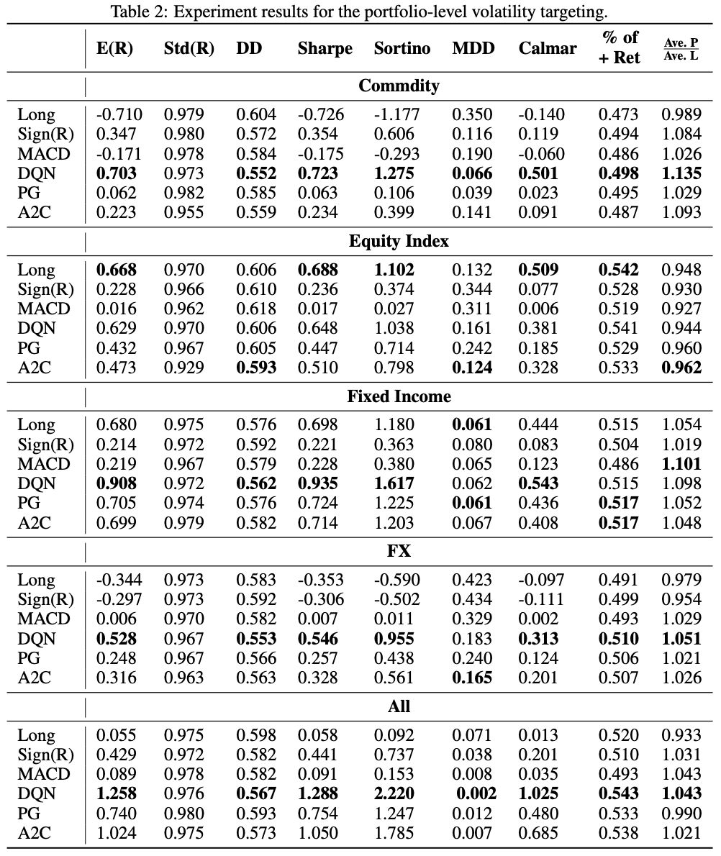
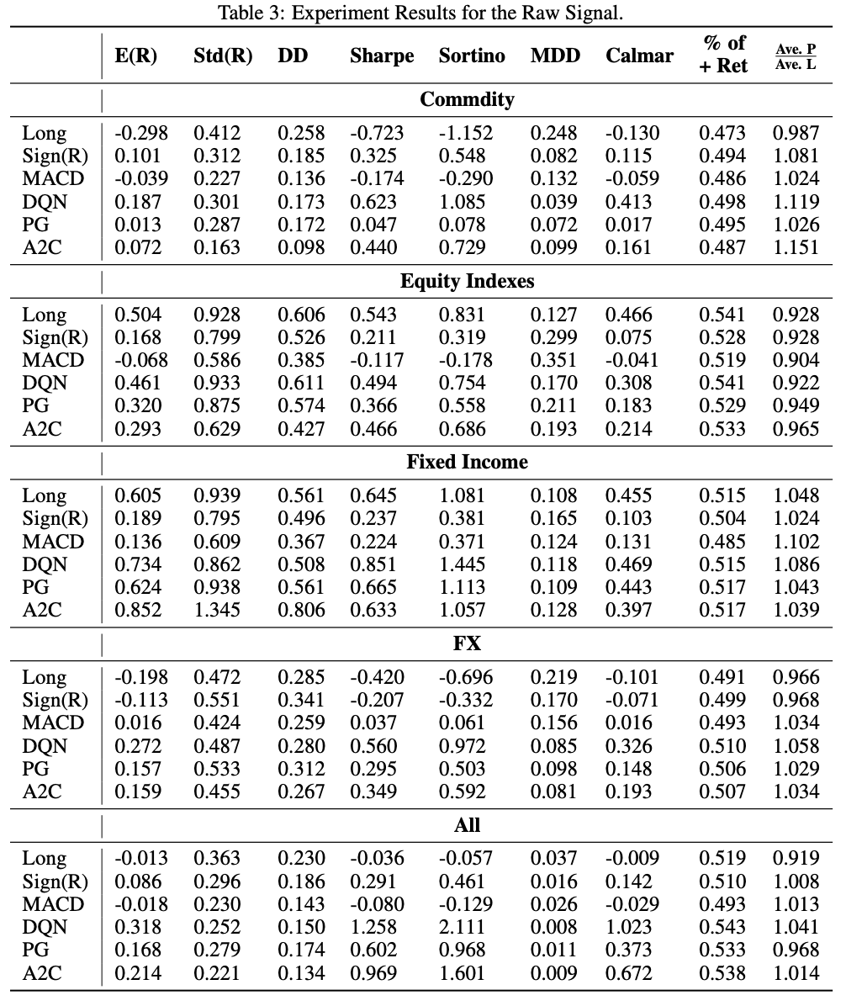
Summary of Original Paper – Table2 & Table3

Slide 5
Summary of Original Paper – Table 2 & Table 3
With portfolio-level volatility targeting (Table 2), DRL methods (DQN, A2C) achieve the best overall risk-adjusted performance across most asset classes.
﻿﻿DQN delivers the highest Sharpe and Sortino ratios in 4 out of 5 asset classes and overall, with Sharpe = 1.288 in the "All" portfolio.
﻿﻿A2C performs best among baselines in Equity Index and ranks second overall.
﻿﻿Without volatility scaling (raw signals, Table 3), returns are generally lower and risk-adjusted performance deteriorates, highlighting the importance of volatility targeting.
﻿﻿DRL models are able to capture large trends while scaling down or holding during consolidation periods, generating positive profits after transaction costs.

Slide 6
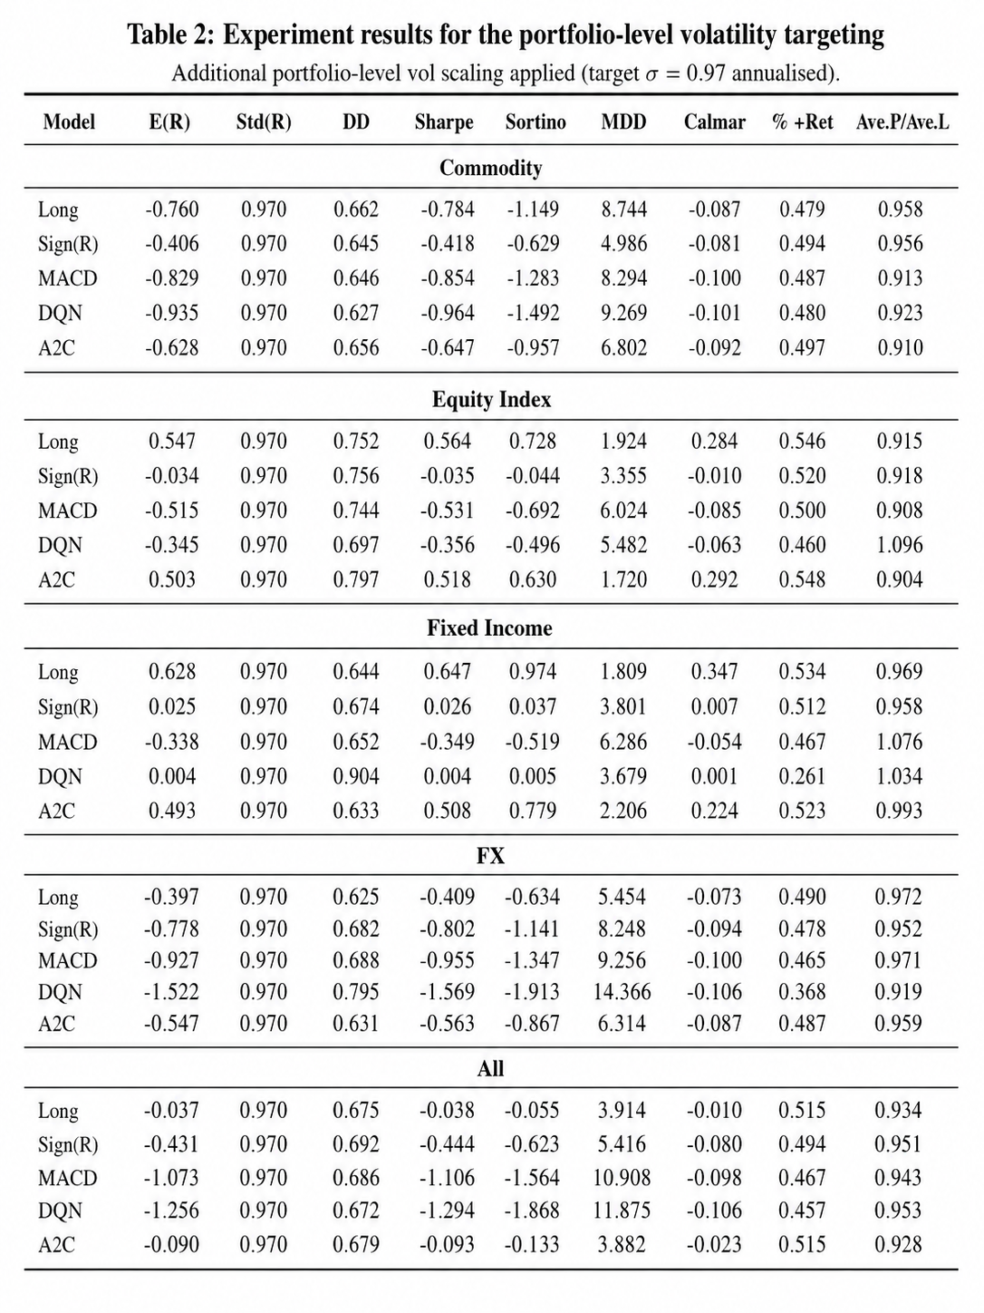
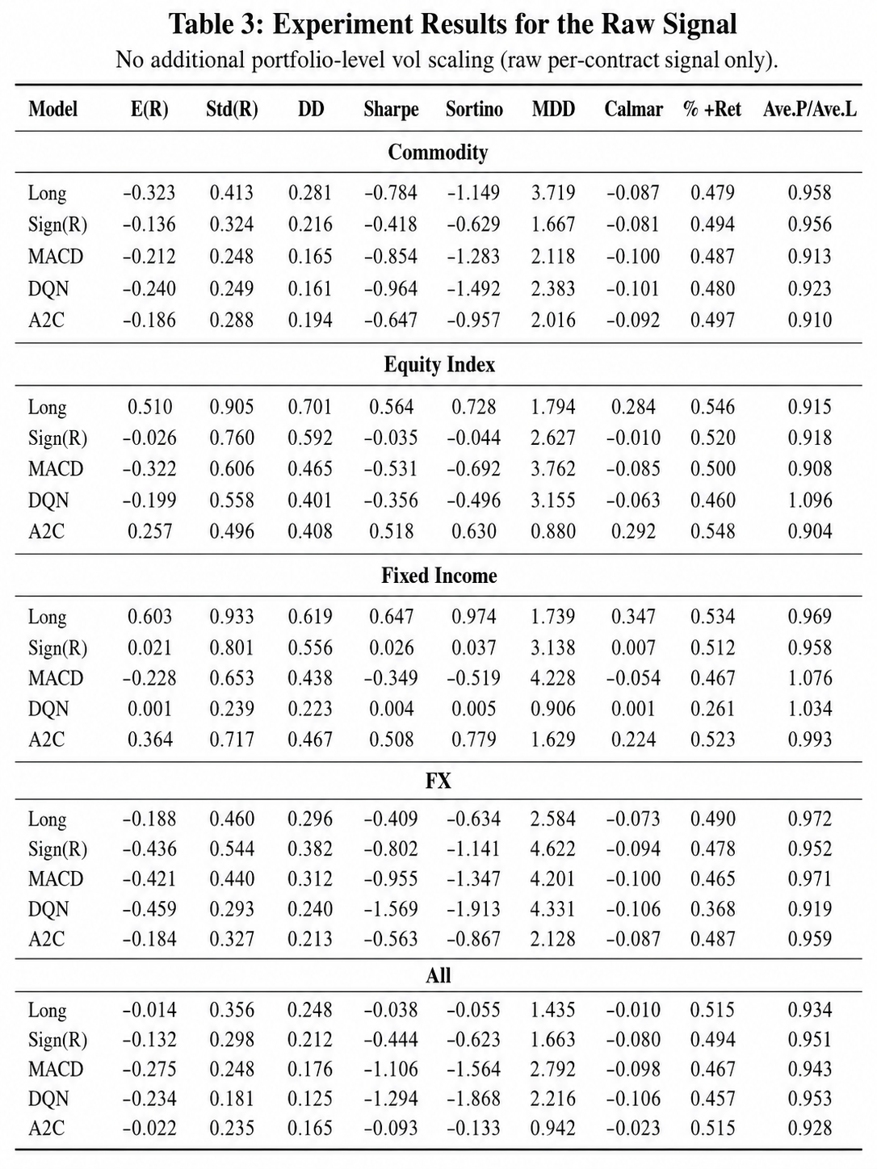
Reproduction Results

Slide 7
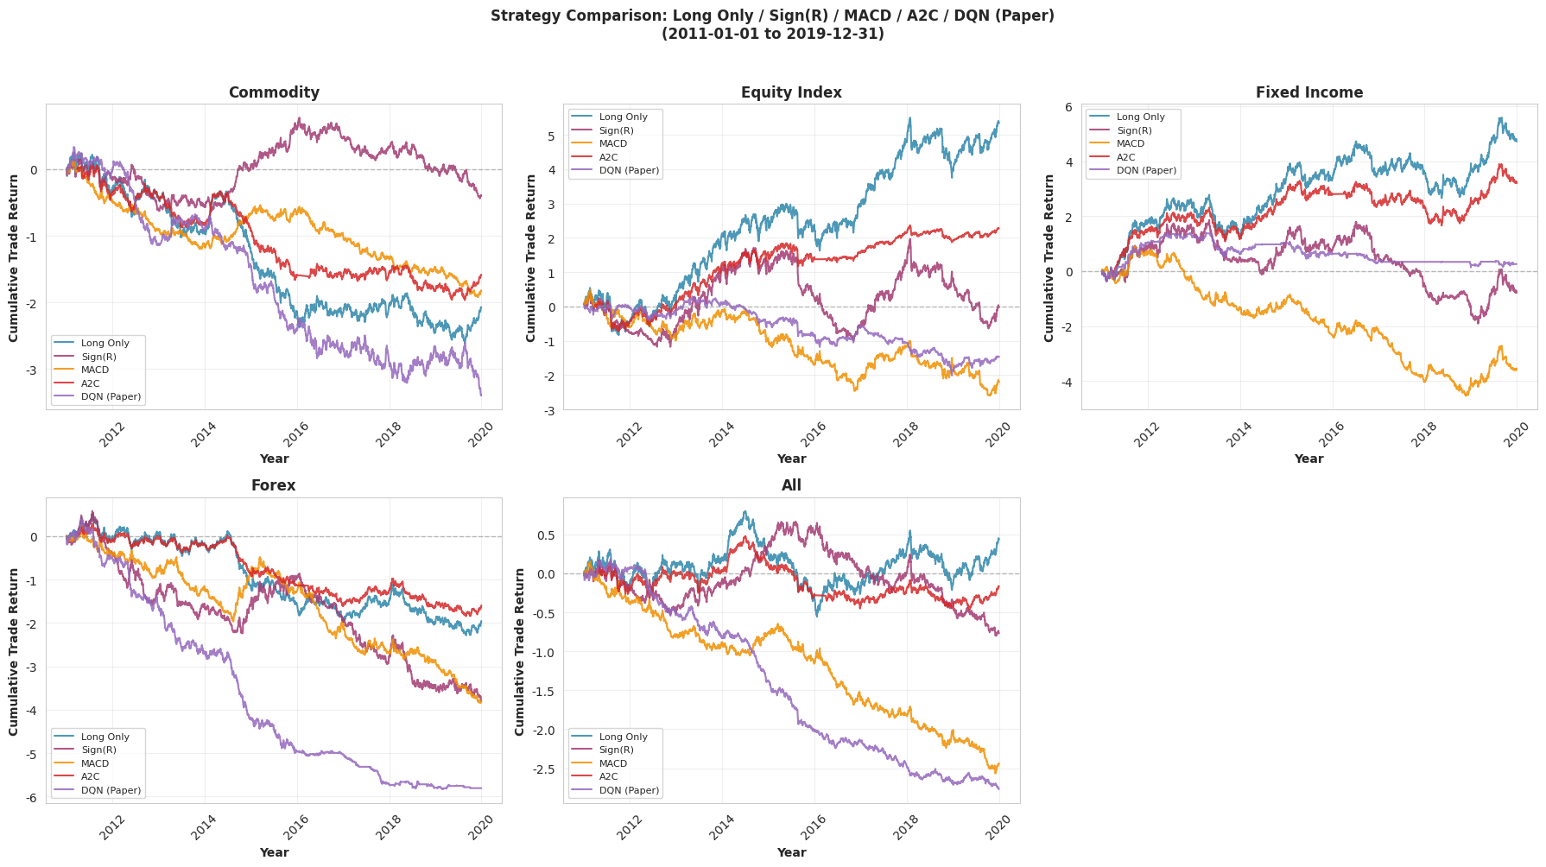
Reproduction Results

Slide 8
Differences vs Original
Original paper: DQN and A2C generate strong positive cumulative returns in most asset classes, especially Commodity, Fixed Income, FX, and All portfolio.
Our reproduction: RL models do not show stable alpha. DQN often trends downward and underperforms simple baselines.
Equity Index is the only asset class where the reproduced pattern is broadly consistent with the paper: Long Only performs best due to the strong upward equity market trend.
Commodity and FX show the largest discrepancy. The paper claims RL can handle volatile or mean-reverting markets, but our reproduced DQN suffers large cumulative losses.
All portfolio fails to show the diversification benefit reported in the paper. The reproduced DQN remains negative even after combining all contracts.

Slide 9
Reasons for Differences
1. Data quality issues
Three contracts contained only missing values.
Some RAD files showed abnormal price jumps.
2. Ambiguous LSTM-RL implementation
The paper states that LSTM networks are used for the RL models, but the exact implementation is not fully specified.
It is unclear how LSTM is integrated into DQN and A2C.
3. Missing key hyperparameters
The paper does not fully specify some important parameters required for exact reproduction. The most important missing parameter is the sigma target used in portfolio-level volatility scaling.
Volatility scaling directly affects rewards, position sizes, and cumulative returns.
4. Original Figure 1 has visual inconsistencies
The cumulative return curves in the original Figure 1 do not appear to start from the same level across all asset classes. This suggests that additional normalization or plotting adjustments may have been applied.

Slide 10
Robustness Checks

Slide 11
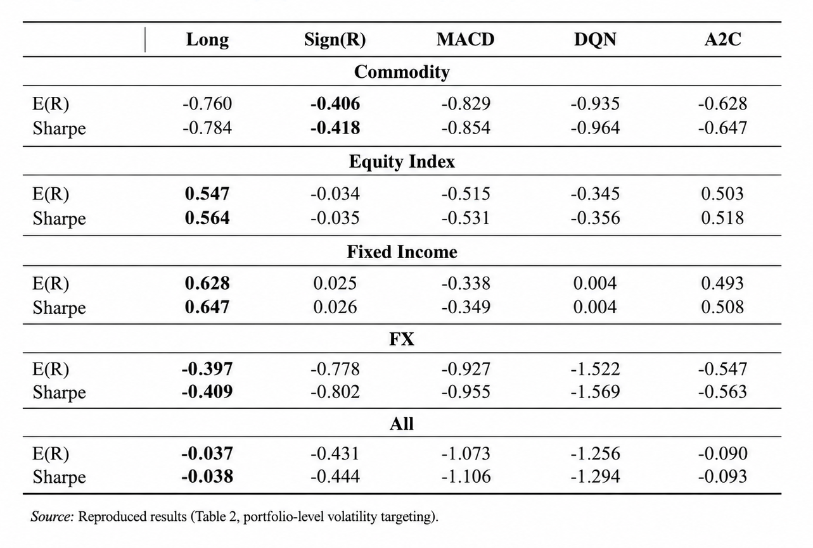
Risk diagnostics
The diagnostic table shows that Sharpe performance is mainly driven by E(R), since volatility is fixed around the portfolio target. Positive Sharpe only appears when the strategy generates positive expected returns, mainly in Equity Index and Fixed Income. In contrast, Commodity, FX, and the All portfolio show mostly negative E(R) and Sharpe, suggesting weak return generation rather than excessive volatility as the main source of underperformance.

Slide 12
Extension - Regime Detection:
Build State Matrices
For each asset at each time point
Construct 60x9 matrix
Extract FFT Features
9 columns independent FFT → 10
Real + 10 Imaginary
= 180-dimensional vector
Load Data of 50 Contracts
GMM Clustering
n_components = 3
Fit Gaussian Mixture Model
Output Regime
Hard Labels: predict() Each time point → 0/1/2
Soft Prob: predict_proba() Each time point → P = [p0, p1, p2]

Slide 13
Extension - Regime Detection:
TRAINING
Get Regime Soft Probabilities predict_proab
[p0,p1,p2]
Original State Features
9-dim: price, MACD, RSI, etc.
Concatenate Augmented State 12-dim
Train Single A2C with full training data
Regime Features
3-dim: P0, P1, P2
TEST
Get Augmented State [Original 9-dim + Soft prob 3-dim] = 12 dim input
Single A2C inference LSTM automatically handles regime conditioning
Load test data
Output action directly

Slide 14
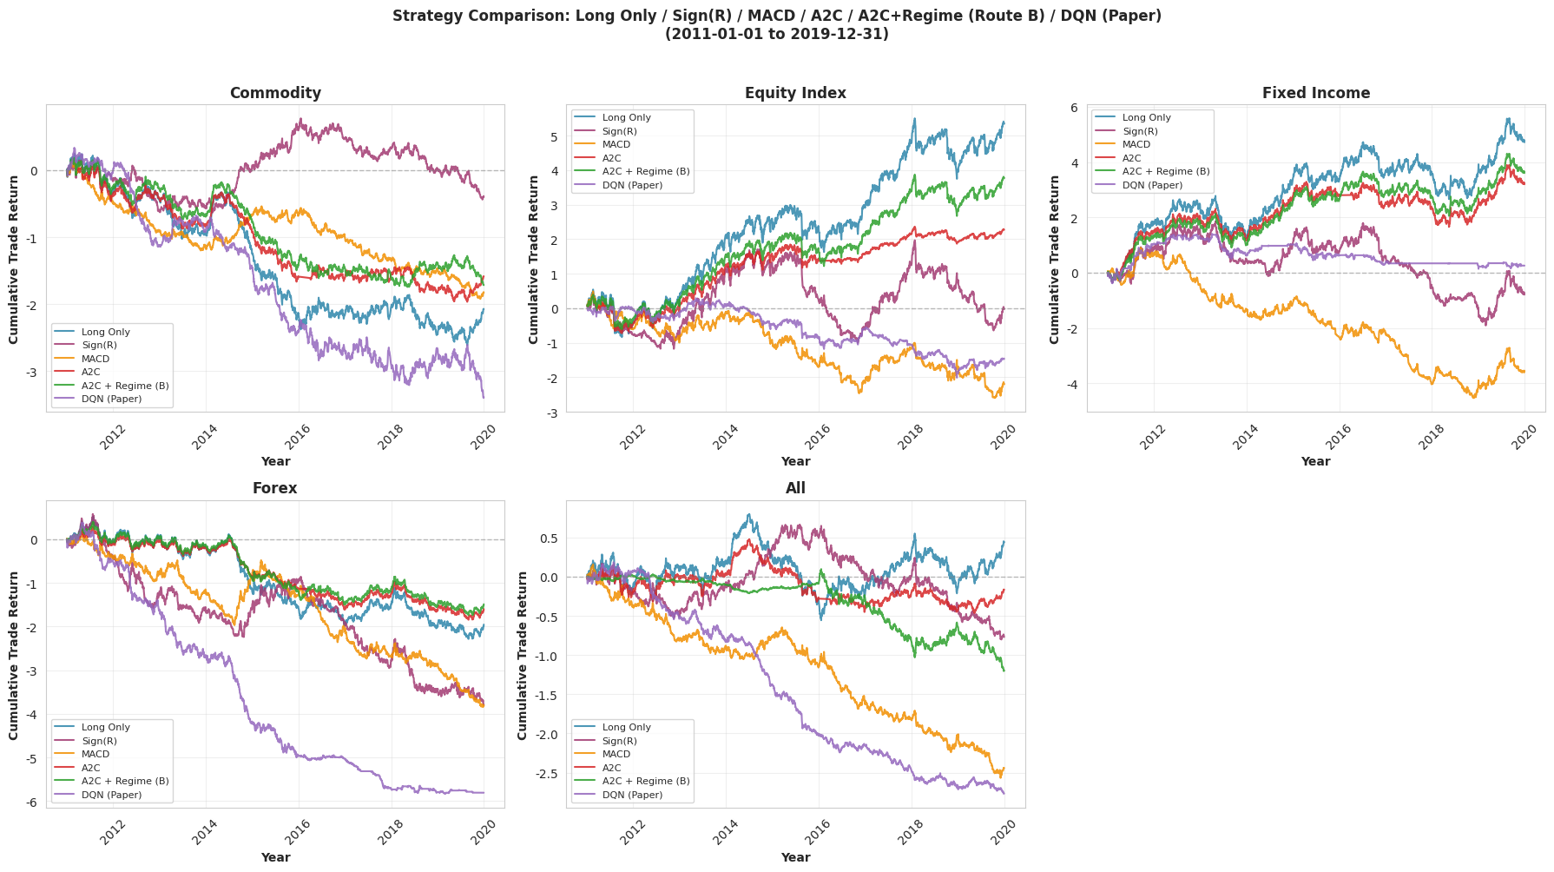
Extension - Regime Detection:
A2C + Regime Detection improves performance in Equity Index and Fixed Income, where market trends are more persistent and easier to identify. The improvement is limited in Commodity and FX, where the adjusted A2C still produces negative cumulative returns. At the All portfolio level, the benefit is not robust: the regime-adjusted A2C becomes unstable after 2016 and eventually trends downward.

