Slide 1
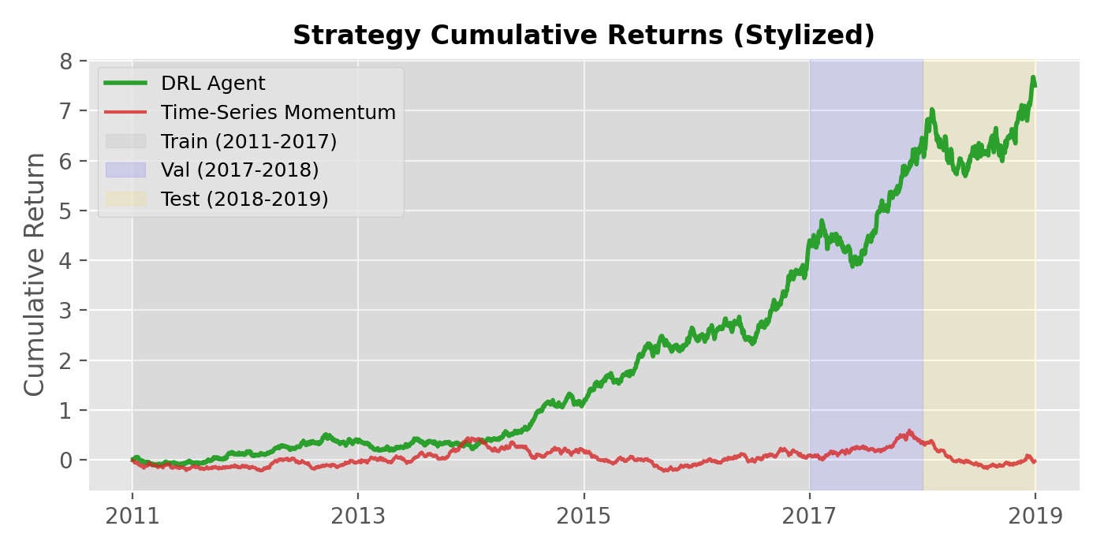
Topic & Brief Introduction
Topic: Deep Reinforcement Learning (DRL) for optimal trading strategy development. Brief Introduction: • Explores training DRL agents to output trade positions directly, bypassing traditional explicit forecasting steps. • Instead of relying on static rules, the agent learns to maximize a reward function based on expected cumulative trade returns. • The system operates dynamically, learning to navigate market frictions by directly incorporating transaction costs into its optimization.

Slide 2
Overview of Literature and Methods
Overview of Literature (Existing Approaches): • Fundamental & Technical Analysis: Often lack precise timing for entering and exiting trades, leading to potential drawdowns. • Time-Series Momentum: Highly effective in trending markets, but severely vulnerable to sideways or mean-reverting markets (like FX). • Classical RL (Q-Learning): Frequently relies on discrete action spaces (fully long/short), which is highly risky during volatile periods. The DRL Methods Utilized: • DQN (Deep Q-learning Networks): Evaluates the value of discrete actions in a given state. • PG (Policy Gradients): Optimizes the policy directly, useful for continuous action spaces. • A2C (Advantage Actor-Critic): Updates policies in real-time by combining an 'actor' network with a 'critic' network.

Slide 3
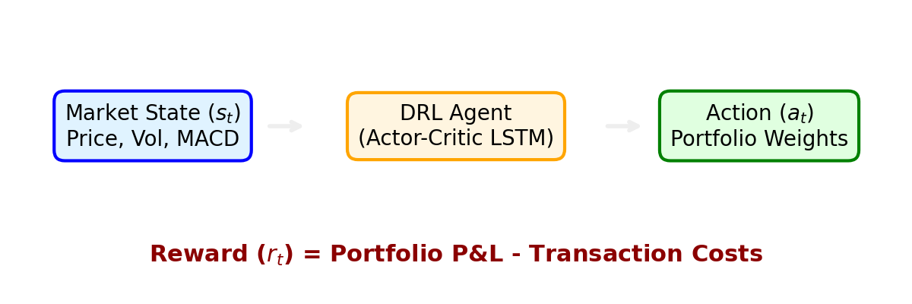
Strategy Overview
Data: • 50 highly liquid continuous futures contracts spanning from 2011 to 2019. • Covers four asset classes: Commodities, Equity Indices, Fixed Income, and Forex. Methodology: • States: Built using past prices, returns, MACD, and RSI (60-day lookback). • Agents: Modeled using two-layer Long Short-Term Memory (LSTM) neural networks. • Rewards: Utilizes volatility scaling to scale up positions when volatility is low, and scale down when high. Evaluation Metrics: • Performance judged using Expected Return, Sharpe Ratio, Maximum Drawdown (MDD), Sortino Ratio, and Calmar Ratio.

Slide 4
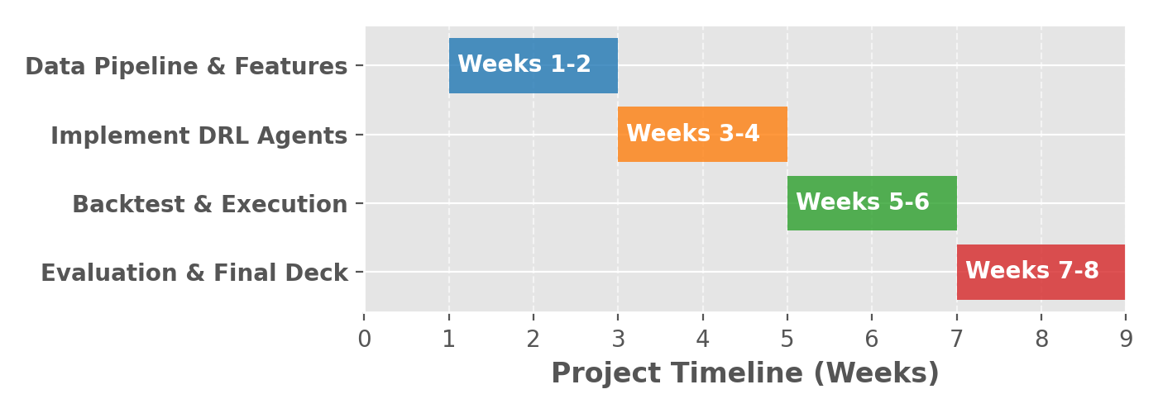
Identified Weaknesses & Project Timeline
Identified Weaknesses in Existing Methods: • Baseline momentum algorithms suffer from deteriorating predictability and excess turnover during market consolidation. • Critic-only RL approaches struggle with the large, continuous action spaces needed to dynamically scale positions down. Planned Extension of the Project: • Strategy Change: Shift the utility function from maximizing simple linear returns (risk-neutral) to optimizing a risk-adjusted metric like the Sharpe Ratio (concave utility for risk-averse behavior).

