Slide 1
Topic & Brief Introduction
Topic:
Deep Reinforcement Learning (DRL) for optimal trading strategy development.
Brief Introduction: • Explores training DRL agents to output trade positions directly, bypassing traditional explicit forecasting steps. • Agent learns to maximize a reward function based on expected cumulative trade returns. • Dynamically incorporates transaction costs into the optimization process. Paper: Zhang, Zohren, Roberts (Oxford-Man Institute, 2019) | arXiv:1911.10107

Slide 2
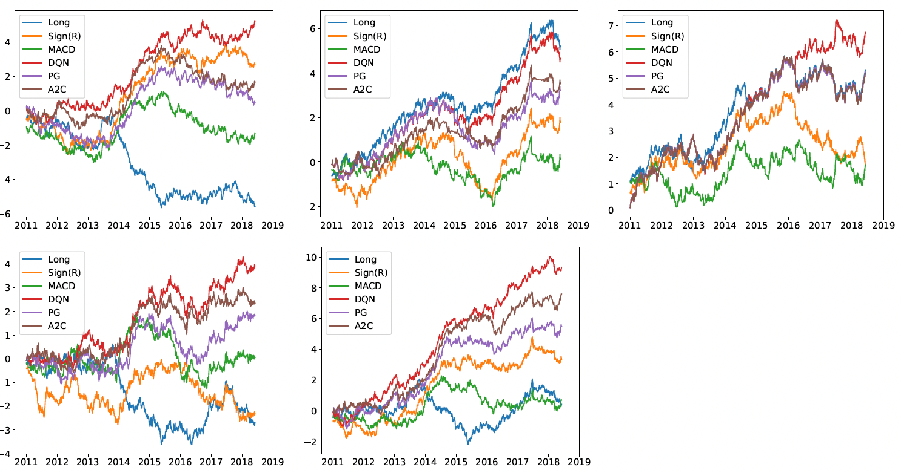
Overview of Literature and Methods
Traditional Methods
Proposed RL Methods
Fundamental & Technical Analysis: Often lack precise timing for entering and exiting trades, leading to potential drawdowns.
Time-Series Momentum: Highly effective in trending markets, but severely vulnerable to sideways or mean-reverting markets (like FX).
Classical RL (Q-Learning): Frequently relies on discrete action spaces (fully long/short), which is highly risky during volatile periods.
Deep Q-Networks (DQN): Evaluates the value of discrete actions in a given state.
Policy Gradients (PG): Optimizes the policy directly, useful for continuous action spaces.
Advantage Actor-Critic (A2C): Updates policies in real-time by combining an 'actor' network with a 'critic' network.
Figure 1: Cumulative trade returns for
First row: commodity, equity index and fixed income;
Second row: FX and the portfolio of using all contracts.

Slide 3
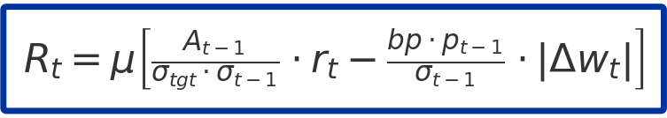
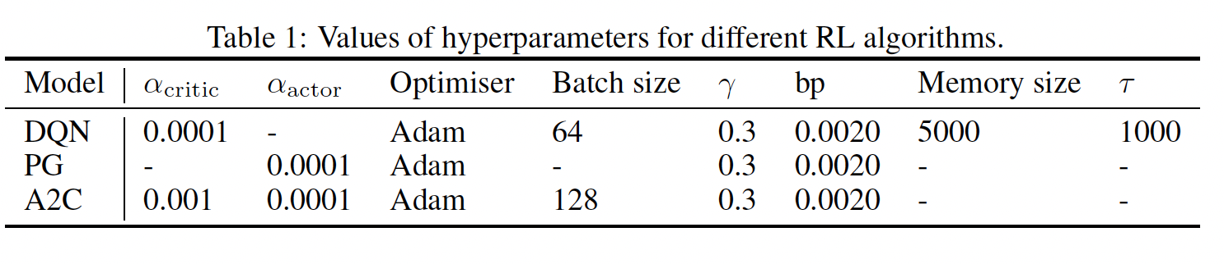
Strategy Overview
1. Data
2. Methodology
3. Evaluation Metrics
50 most liquid futures contracts (2011-2019).
Commodities (25)
Equity Indices (11)
Fixed Income (5)
Forex (9)
Markov Decision Process (MDP) formulation.
State: 60-day lookback (Price, Returns, MACD, RSI).
Action: Target orders [-1, 1].
Reward: Volatility-scaled additive profits.
Portfolio-level performance assessment.
Annualised Expected Return
Sharpe & Sortino Ratios
Maximum Drawdown (MDD)
Calmar Ratio
Market State
Price, Vol, MACD
DRL Agent
(Actor-Critic LSTM)
Action Portfolio Weights

Slide 4
Identified Weaknesses & Tentative Timeline
Weaknesses: 1. Risk-Neutral Objective Function • Paper maximizes E[Σ Rt] (linear utility, risk-neutral) • Problem: Ignores downside risk → large drawdowns possible 2. No Regime Awareness • Same policy for all market conditions (bull/bear/sideways) • Paper notes: 'Long-only better in trending equity markets' 3. Fixed Transaction Costs • Constant bp = 0.0020 (20 bps) used throughout • Real costs vary with volatility and liquidity
4. Lack of considering cross-class correlation
• The paper grouped contracts according to asset classes then trained a model for each asset class, failing to capture strong coupling between different asset classes.
Proposed Extensions: (A) Alpha Decay Analysis • Replicate on 2019-2024 data • Test if DRL advantage persists (B) Risk-Averse Objective • Change: max E[ΣRt] → max Sharpe Ratio • Expected: Lower MDD, higher Sortino (C) Regime-Aware Policy • Detect regime (VIX/HMM) • Train separate policies per regime
(D) Add Correlation into the objective function
Project Timeline
Data Pipeline & Features 3.16-3.22
Implement DQN/PG/A2C 3.23-3.29
Replicate Paper Results 3.30-4.5
Alpha Decay Test (2019-2024) 4.6-4.12
Risk – Aversion Extension 4.13-4.19
Dashboard & Final Deck 4.20-4.26

