Slide 1
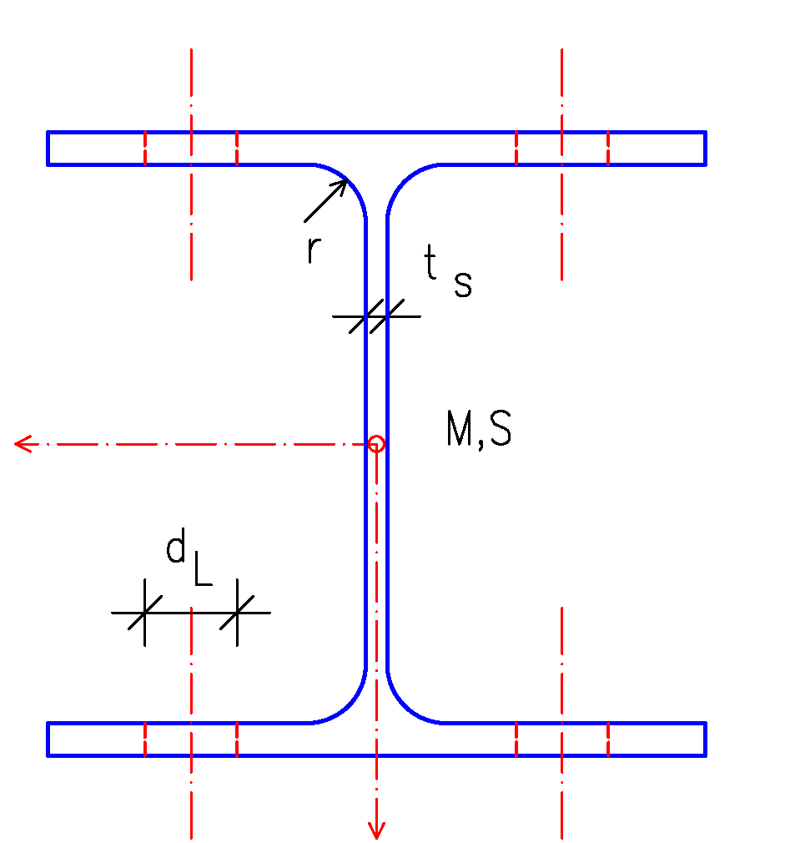
#create_profile_HEA(profile_name='HEA100', h=96, b=100, tw=5, tf=8, r=12)
y
(0,h,0)
(b,h,0)
tf
(0,h-tf,0)
(b/2-tw-r,h-tf,0)
(b/2+tw+r,h-tf,0)
(b,h-tf,0)
(b/2-tw,h-tf-r,0)
(b/2+tw,h-tf-r,0)
tw
(b/2-tw-r,tf+r,0)
(b/2+tw,tf+r,0)
(0,tf,0)
(b/2-tw-r,tf,0)
(b/2+tw+r,tf,0)
(b,tf,0)
x
(0,0,0)
(b,0,0)

