Slide 1
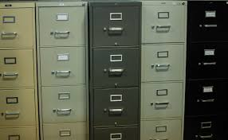

Pilot: Cambridge Historical Commission Building Files Digitize > Catalog > Expose > Explore
February 21, 2020 Paul Cote
1
1/5/2024
cultivating spatial intelligence®

Slide 2
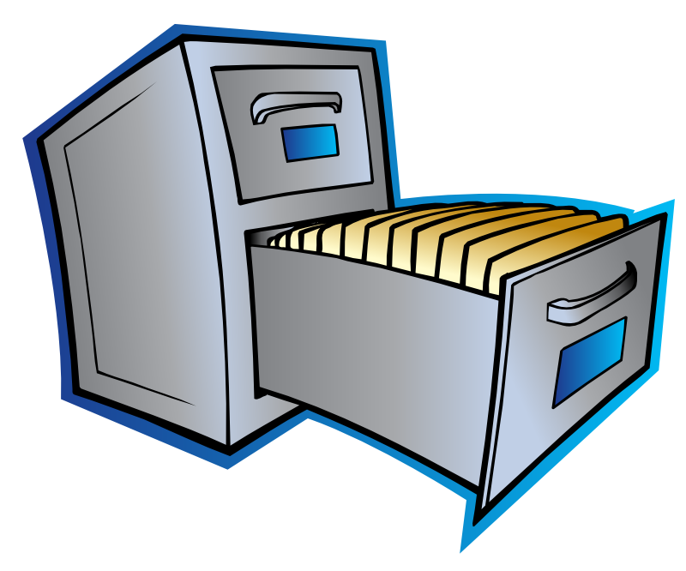




Digitizing and Publishing the Building Files
The Cambridge Historical Commission creates and develops, preserves and maintains many collections of information regarding people, places, things and events.
This document provides an overview of the digitization of one document collection known as The Building Files. Ten file cabinets with 16,000 folders of clippings and other documentation related to buildings, and other places in the city.
Flynn_St
0300
0015
38 File drawers of documentation about Cambridge Buildings
16,000 Folders, each more or less related to a building, block of buildings, streetscape, monument or park.
262-266 Cambridge St
Cover Sheet for Each folder
Item
Item
Digitization Step 1:
Prepare batches of folders for scanning.
Item
Multi-Page Documents, Photo Front and Reverse

Slide 3

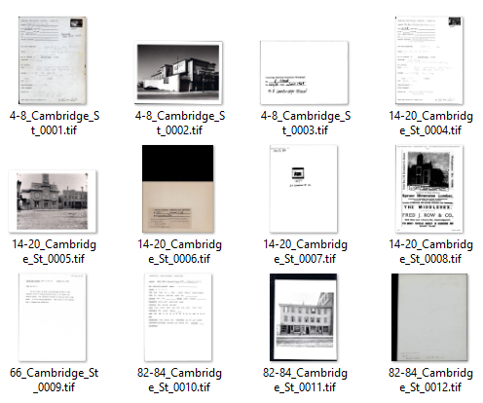
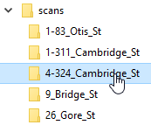
Scanning Workflow & Naming Scheme
Flynn_St
Ordered File Names:
4-8_Cambridge_St_0001.tif
4-8_Cambridge_St_0002.tif
…
14-20_Cambridge_St_0003.tif
0300
0015
4-324 Cambridge St
725 Mass Ave City Hall Mortar Studies
3
1/5/2024

Slide 4
CDASH Document Types
The digital collection system relies on titles, and tags to help users find information of interest.
Before uploading bulk-scanned images we can sort them according to rough types that can be evaluated quickly by just looking at the previews for files.
95 percent of all documents in the Building Files collection fit into one of these categories.
These categories allow us to set many useful keywords and generate meaningful default titles for each document upon our initial upload into the system.
Text Document Types
AI - Architectural Inventory Form
HS - Historic Building Survey
RF - Research Form
RN- Research Notes
CD - Correspondence
OB - Official Business
AM – Article or Monograph
EP - Ephemera (Pamphlet, Program, Ads)
UC - Unclassified
Photograph
PI - Interior
PE - Exterior
PB - Birds-Eye
PD - Detail
PC - Contact Sheet
PP - People Pics (Photo or Drawing)* *Not implemented in CDASH
Illustration
II - Interior
IE - Exterior
IB - Birds-Eye
ID - Detail
IP – Plan/Map
4
1/5/2024

Slide 5
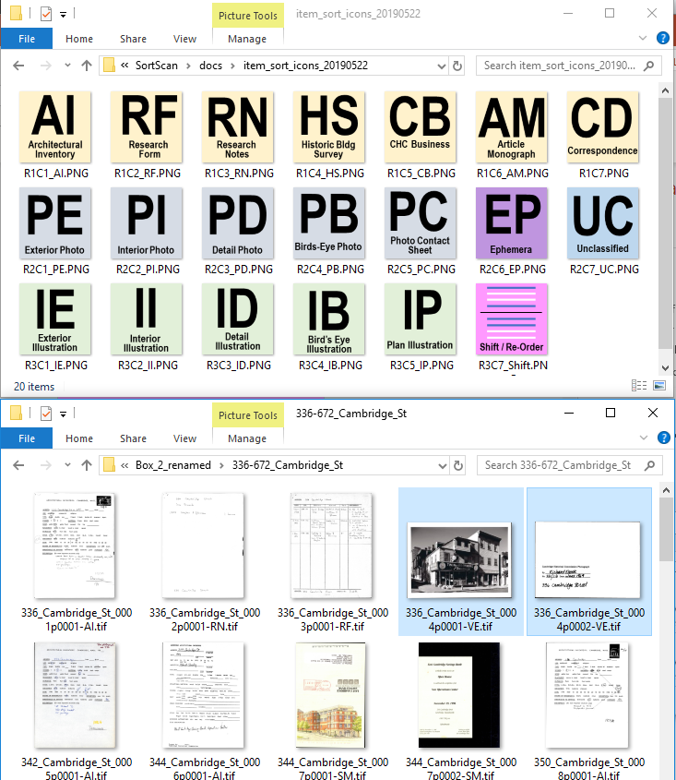
Itemization, Rough Sort and Application of Logical File Names
The rough sort and pagination is accomplished by a tool-kit we call the CDASH Itemizer.
The user browses a folder of scans in Windows Explorer.
Pages belonging to a document are selected, dragged and dropped onto the appropriate renaming tool.
Street Name Spelling is validated or repaired based on our street listing.
Media files are renamed, with codes that assigning an Item Type, Item ID and Page Number.
A CSV manifest of Items is created, which assigns default titles and other keywords to items
A CSV manifest of media is created which assigns a title and item identifier to each media file.
These renamed files are now ready for geo-coding and application of automatically assigned titles and tags.
Select Item Pages
Initial Scan Names
336_Cambridge_St_001.tif 336_Cambridge_St_002.tif
Drag and Drop
Assign New Logical File Names:
336_Cambridge_St_001p001-PE.tif
336_Cambridge_St_001p002-PE.tif
5
1/5/2024

Slide 6
Place-Item-Page Name Encoding
described in another sequence of slides.
262-266 Cambridge St
Accession Folder
Item Name
Place Name
336_Cambridge_St_001p001-PE.tif
336_Cambridge_St_001p002-PE.tif

Slide 7




C-Dash Architecture:
Documents Linked to Knowledge about People Places, things Events
A digital archive for the building files entails a conception of a system for keeping and developing information about architectural objects in the city.
This project begins with a system for cataloging, annotating and linking Documents.
These documents will be used in descriptions of Buildings and other Named Places,
In the future, our information system can be used to organize Accounts of Events and Biographical information, and information about other sorts of things.
This holistic conceptualization will remind us that we will have a container for information about Buildings that is independent from information about documents.
Information Stewardship & Development
Digital Resources
Information about Documents
Documents
Links & References
Stories
Exhibits & Scholarship
Observations
Ideas
Information about Buildings & Places
Attach
The City Through Time
Information about People, Events, Things
Scans
Users:
Search & Discover
Access
Re-Use
Reference & Link
Born Digital
7
1/5/2024

Slide 8
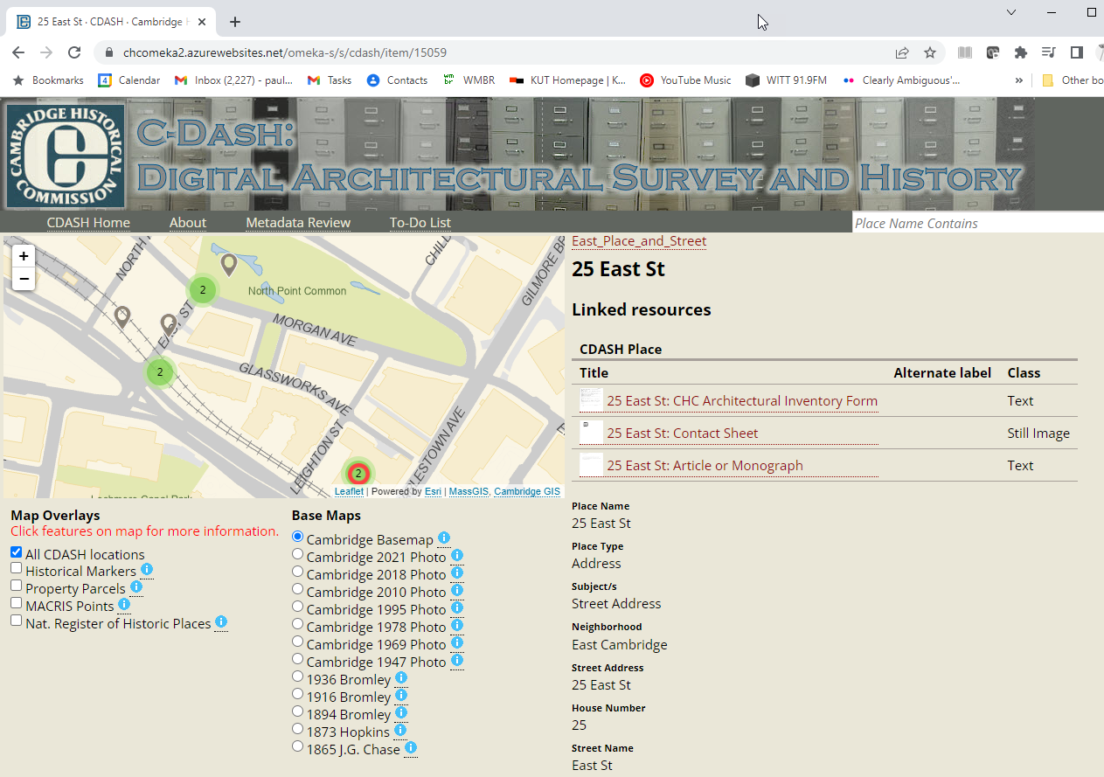
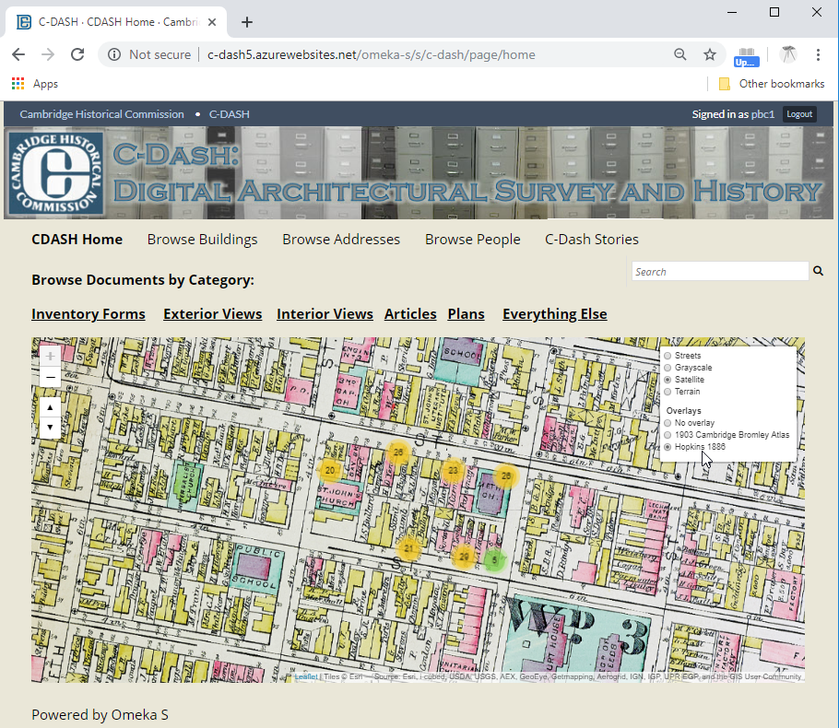
Introducing Omeka-S
Omeka-S is an open source Content Management System designed for the Library, Archive and Museum Community.
Omeka has functions for attaching metadata to digitized documents, and for linking information together across collections and systems – e.g. building photos to building records of other types.
Omeka has been under development since 2008, has a very active community of users and developers. Many high-profile installations use Omeka-S to develop searchable digital collections and to integrate archival information into web-based exhibits.
Omeka_S is a PHP application similar to the popular content management system, word-press. It is relatively easy to install, configure and modify for someone with basic linux skills.
Visit the C-Dash Omeka-S Pilot Site at the temporary URL:
http://chcomeka.azurewebsites.net/omeka-s
8
1/5/2024

Slide 9
Omeka-S Resource Templates and Vocabularies
The descriptive metadata for documents and places is based primarily on the archival conventions such as Dublin Core.
A few additional metadata fields (CDASH Terms) have been added by means of the Custom Ontology Plugin.
The template files for these resource templates and custom cdash terms can be found in the folder, cdash-persist/vocabularies.

Slide 10
Omeka-S Items: Documents Related to Places
As a document archive, catalog and public-facing discovery tool, Omeka is concerned with Items. An Item could be a multipage document made up of multiple scanned pages, An Item could be an audio file or a three-dimensional model.
At the moment, there are two major Item Types:
Documents: may be collections of scanned pages, or single-page ephemera or PDF documents.
Places: references to buildings, bridges or monuments.
Places have locations that can be represented on a map. Every item in CDASH is related to a place.
The most common type of Place item is a Street Address or Address Range, which was the fundamental organizing framework of the Building Files collection.
Document and Place Items have specific sets of metadata fields that are defined with Omeka Resource Templates.

Slide 11
CDASH Place Types
The descriptive metadata for documents and places is based primarily on the archival conventions such as Dublin Core.
A few additional metadata fields (CDASH Terms) have been added by means of the Custom Ontology Plugin.
The template files for these resource templates and custom cdash terms can be found in the folder, cdash-persist/vocabularies.

Slide 12
CDASH Custom Omeka Theme
The descriptive metadata for documents and places is based primarily on the archival conventions such as Dublin Core.
A few additional metadata fields (CDASH Terms) have been added by means of the Custom Ontology Plugin.
The template files for these resource templates and custom cdash terms can be found in the folder, cdash-persist/vocabularies.

Slide 13
Omeka Modules: Stock and Custom
The descriptive metadata for documents and places is based primarily on the archival conventions such as Dublin Core.
A few additional metadata fields (CDASH Terms) have been added by means of the Custom Ontology Plugin.
The template files for these resource templates and custom cdash terms can be found in the folder, cdash-persist/vocabularies.

Slide 14
CDASH Development and Collaboration
The descriptive metadata for documents and places is based primarily on the archival conventions such as Dublin Core.
A few additional metadata fields (CDASH Terms) have been added by means of the Custom Ontology Plugin.
The template files for these resource templates and custom cdash terms can be found in the folder, cdash-persist/vocabularies.

Slide 15
The Digitization and Accession Process
The descriptive metadata for documents and places is based primarily on the archival conventions such as Dublin Core.
A few additional metadata fields (CDASH Terms) have been added by means of the Custom Ontology Plugin.
The template files for these resource templates and custom cdash terms can be found in the folder, cdash-persist/vocabularies.

Slide 16
Create Place Items
Every document in CDASH must reference at least one Place item. Therefore, before adding an item, it may sometimes be necessary to create a nnew Place item.
Place Items may be created or edited ‘by hand’ using the ordinary item creation capabilities of Omeka-S.
The resource template provides a form with useful pick-lists and validation.
The mapping extension provides a means of setting or adjusting the map location.
Automated Batch Geocoding
In the initial population of CDASH it is necessary to create place items based on the address references. This process of automated geocoding and identification of historical districts, etc. is described in another sequence of slides.

Slide 17
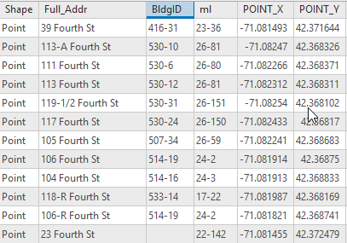
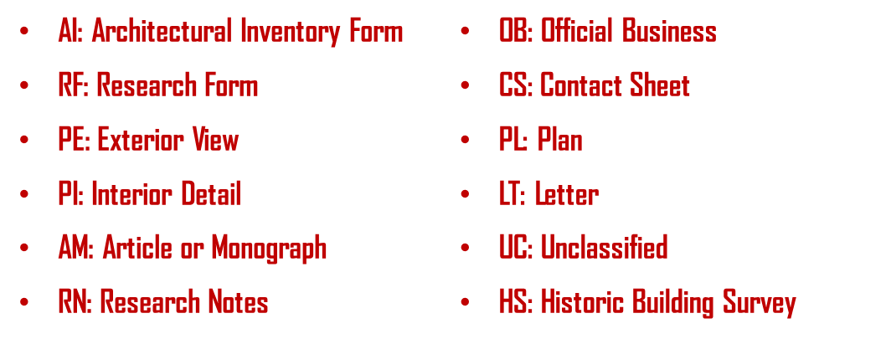

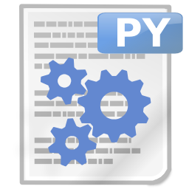
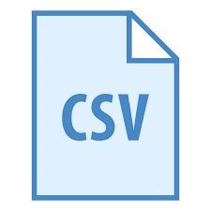
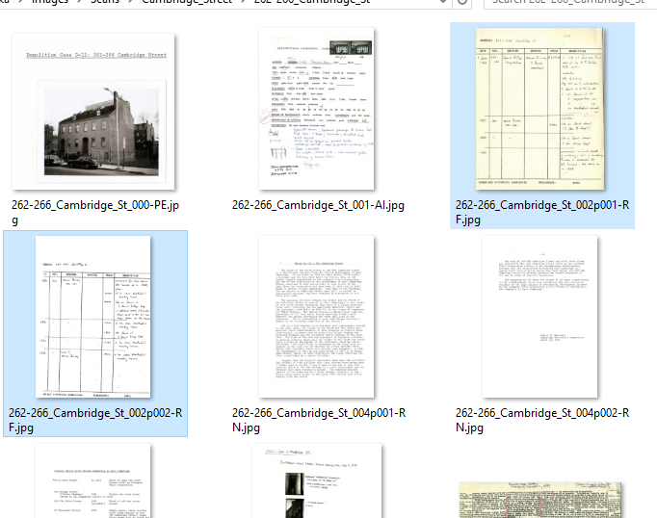
Prepare Batch of Scans with Rough Catalog
For each image file in the scans folder:
Address, Geo-Location & Building and Parcel Links
Rough Item-Type Metadata
Use the item-type dictionary to apply meaningful titles and keywords
Use the Address Points dictionary to look up the coordinates, building-ID and Map-Lot.
Write a comma-delimted table formatted for the Omeka CSV import tool
Python and ArcGIS Procedure
Batch 20180212
Future version could:
Embed the metadata and coordinates into the image files themselves.
Import the collection into any content management system that permits systematic import.
Batch Catalog
Re-Named Images
Batch Rough Archive
17
1/5/2024

Slide 18
Create, Collect and Pre-Process Items
Every document in CDASH must reference at least one Place item. Therefore, before adding an item, it may sometimes be necessary to create a new Place item.
Create a folder to hold the media associated with each item you plan to create.
Scan your pages or copy scans into folder. The names should contain an address or place name following the naming template and rules specified for the renaming tool.
Use the Item Renaming tool to validate that a place exists with the indicated place name.
assign the media files to an item and item type.
The renaming tool generates a CSV manifest for the folder. This file carries the information Omeka needs to create the item and assign paged media to it.
The folder is now a CDASH Accession Batch folder that can be uploaded to the server and imported into CDASH.

Slide 19
A CDASH Document Item Accession Package (Batch)
Document Items are a fundamental element of CDASH.
A CDASH Document typically involves a sequence of scans representing the front and back of a photograph, or the pages of an article. A document may be a single image file it may be a PDF document (preferably, PDFa).
A Document Item in CDASH bundles the pages together and associates these with a catalog record and other descriptive information about the documement.
A document Item is also related to a CDASH Place– which is another sort of item that will be discussed in another part of this slideshow.
The task

Slide 20
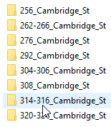
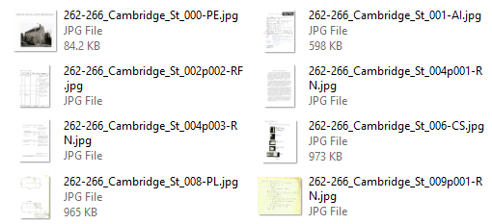
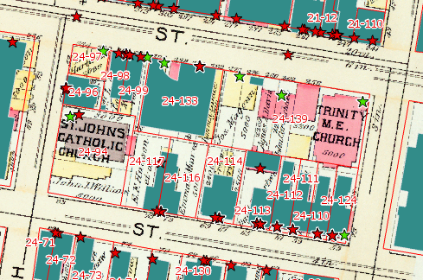
Geocode Addresses and Supplement Master Address List (Using Cambridge Master Address File and Assessing Property Addresses)
Python scripts match CDASH addresses with known address locations form Master Address File and Assessing Database
Many addresses match perfectly. A sequence of steps deals with range addresses and interpolates non-matched house numbers, finally assigning a default location for addresses that find no match.
Result is a dictionary of all CDASH Addresses with:
Latitude
Longitude,
Map-Lot
Building_ID
Match Score
Match Note
20
1/5/2024

Slide 21
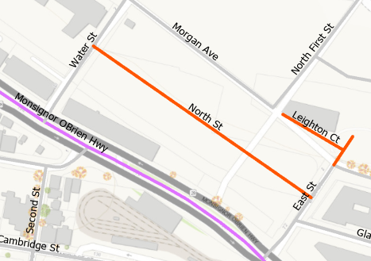
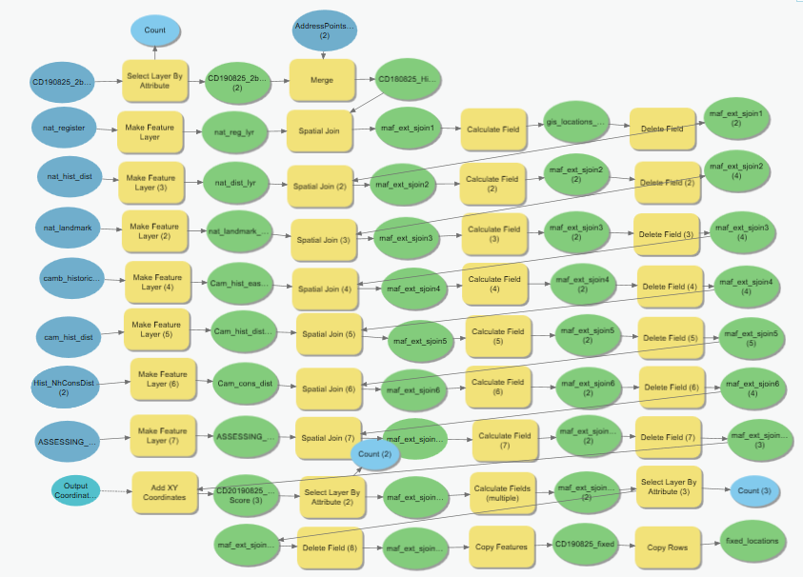
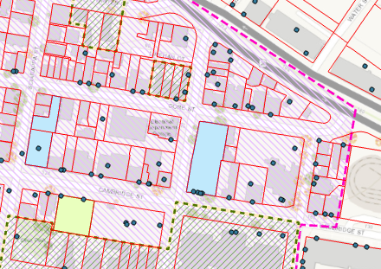
Correction and Augmentation of Address and Street Layers Using GIS (Extending Cambridge Master Address File and Street Centerlines)
The CDASH Address Dictionary is opened in ArcMap
Addresses with low scores are corrected.
Non-Address locations, like water bodies, parks, etc. have names applied.
GIS Overlay techniques are used to assign official district and historic landmark designations to addresses that fall within GIS layers of historic building information, Titles and names for these locations are assigned.
Assessing information is assigned to re-located address points.
Historical street names are added to a CHC Street Centerlines layer.
At the end we have additions to the Extended Address File that includes historic address locations.
Renamed Streets
Abandoned Streets
Assessing Parcels
Cambridge Neighborhood conservation districts
Cambridge Landmark Easements
National Historic Landmarks (not shown)
National Register
National Historic District
Addresses of curent entryways
(Cambridge GIS)
Historic Addresses
Parcel Address Points
(Tax Assessor)
21
1/5/2024

Slide 22
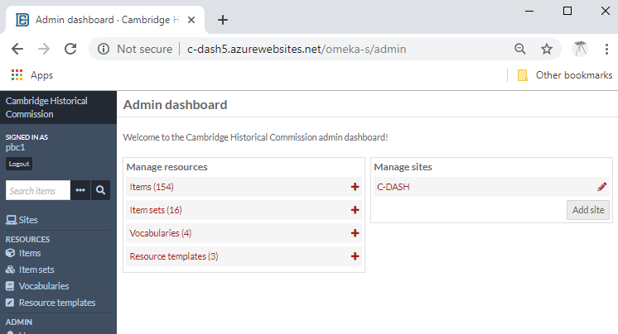
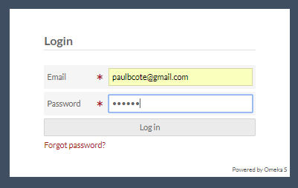
Omeka Tour: Delegate Admin and Contributor Privileges
Control look, feel and Branding of site using pre-fab “Themes”
Create new Items
Upload Files (associate them with Items)
Edit Metadata and Location Info for Items
Create New Item Types
Create new metadata fields and controlled lists (MACRIS-ID)
Inspect and Edit Tags Globally
More Omeka Documentation
22
1/5/2024

Slide 23




Beyond Omeka: Open Archive Strategy
The Open Archive Initiative (OAI) provides a standard for exchanging resources and metadata between digital archive systems
Following the OAI Protocol for Metadata Harvaesting (OAI-PMH) ensures that the collection does not not become “locked in” to a specific software platform.
Our metadata template is based on crosswalk of the Omeka Base Resource and the Digital Commonwealth OAI Interchange template.
Our crosswalk template and other useful resources from digital commonwealth are available at www.pbcGIS.com/cdash/crosswalk.
The C-Dash base resource template is used as a starting point for resource templates specialized for our various document types.
Develop Catalog, Linking
& Annotation
Import Rough Catalog
Publish OAI Packages
Rough Metadata
Improved Metadata
Resources
Resources
Future Archive System
OAI Harvest
Strategic Benefits:
Preservation & Continuity
Enhanced sharing
Enhanced Linking & Discovery
23
1/5/2024

Slide 24

Developing, Using and Preserving Historical Resources with Cloud Application
The next phase of development for the C-Dash involves developing of a production system. A few goals for this system include protecting information assets from:
Disasters
Mistakes
Unplanned obsolescence of software
Existential dependence on Individuals or private firms
Our design addresses these goals in a Microsoft Azure Web Application
Server maintenance and data redundancy are managed by Azure.
The application, data and documentation are easily understood by system administrators with off-the-shelf skills.
Recommend review of Cambridge IT department.
Consider hosting Cambridge Azure Subscription.
Omeka Web Admin and Users
Omeka in Web Browser
Scan Batches W/CSV Catalog Info
Import
Metadata and Exhibits Developed in Omeka
Apache/php Omeka
Container
Item Creation,
Enhancement
Azure
MySQL
Automated Snapshot
Omeka Backup
Original Imports
Azure Console
Azure SSH
Server Deployment and Back-End System Administration
24
1/5/2024
Safe Cloud Storage

Slide 25

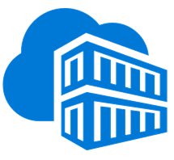

Omeka in Azure Cloud (detail)
Omeka Users
Omeka Contributors
Omeka Admin
Web Admin and Users
Omeka Admin
New Content
Web Browser
Web Server
CHCScans
Original scans and csv files for import
Azure Storage Explorer
Cloud Host
CHCOmeka App
ChcPersist
AzurePrivate Docker Registry
Linux Apache/PHP Omeka
Custom Modules
MariaDB
Media
Files
Omeka Config
CDASH
Theme
Docker
Desktop
Azure Console
Secure Shell
MySQL
Workbench
Azure Storage Explorer
CHCOffline
CDASH Build & Docs
Admin Secrets
Database Snapshots Docker files
Development
Troubleshooting
and Monitoring
Database Setup Routine Backups
Fixes Tweaks
Develop, Deploy, Admin

Slide 26
Roles & Responsibilities (Draft)
CHC Omeka Owner: (Viv? Charlie?)
Is responsible for the long term viability of the Omeka installation and all associated assets.
Makes and maintains agreements with the IT department.
Understands executive view of file management, backup and recovery.
Receives reports of routine snapshot activity
CHC CDASH Administrator (Meta)
Directs ongoing development of resources
Create new Omeka accounts
Understands how to do bulk inports and Routine item import
Delegates design and development
metadata templates
Exhibits
Create and improve Item Metadata and linking.
Omeka/Azure Developer: (pbc)
Designs and implements C-Dash system
Development (test) sandbox
Production environment
Documentation
Training
Handles batch rough-sort, initial catalog and Omeka Imports
Assists C-Dash Owner with developing look/Feel and Features
Assists with developing new metadata templates and linking infrastructure
Monitors regular snapshot activities
Tests and verifies recoverability
Maintains all system rebuild scripts and passwords, up-to-date in a secure location that is accessible to Omeka/Azure Owner.
Azure Owner (Cambridge IT)
Pays monthly Azure bills
Holds full rights to delegate anything on Azure resources
Evaluates and has last word on system design.
Understands enough about the architecture, rebuild scripts, passwords and documentation to delegate full system control to new Omeka/Azure Developer in case of emergency.
Omeka/Azure Developer Capabilities
In the event that the Omeka/Azure developer should need to be replaced, a consultant who has experience with commonphp/linux applications such as wordpress should be able to figure out how this system works from the documentation.
26
1/5/2024

Slide 27
Cambridge-Specific Internet Interfaces (Suggested)
(Optional) CHC SendMail Address
Certain aspects of new user registration and notificationrequire the sending of emails. This requires reference to a sendmail server. Optimally, these emails would come from.
CHC Domain
Ideally, once this service is ready for production, it should have a regular URL within the Cambridgema/CHC branch of the web site.
www.cambridgema.gov/chc/c-dash
HTTPS Certificates:
For now the Omeka service is using plain http. Once users start registering we may want to use HTTPS. Would it make sense to use a Cmabridge certificate, or create a new one for C-Dash?
(Optional) VPN
Currently all files are transferred through the Azure Management Console. The bulk import workflow involves one stage of unzipping the archives using th4e SSH console. Evenmtually, this could be more user friendly to non-linux users if file access was through a VPN connection – which, it seems requires authentication information on the client. This is not urgent, and requires further investigation.
27
1/5/2024

Slide 28
Address, Location, and Building References (in progress)
Most C-Dash documents refer the location of their subject with a street address or an address range.
Part of our workflow for preparing scans for ingest into Omeka is to convert these addresses into simple latitude Longitude locations.
Optimally, we would like these locations and addresses to be positively associated with buildings:
Buildings that exist today
Buildings that have been removed
When there are two items in Omeka that reference the same building, it would be nice if each of these used the same building identifier.
There are several resources and methods for doing this.
The Tax Assessor has mailing addresses for parcels and individual buildings within a parcel. These references also happen to be associated with lots of useful information including year-built. The assessor also has a Building Identifier for each building that is assessed.
Cambridge GIS has polygons for current buildngs with a unique building identifier (not the assessor’s
Cambridge GIS has Address Points for addresses that are observable. These are associated with buildings. Many Assessor addresses are not represented in these GIS Address Points.
A common way of doing rough geocoding is to use street segment lines that have high and low addresses for the even and odd numbered side. These can be used to interpolate addresses
Cambridge GIS is embarking on a project to improve its address points. Here are some recommendations:
Create a list of building addresses associated with assessor building IDs
Match these with current address points. Where you have a match, flag the address point record with the assessor’s building ID.
Where there is no match between the asseor’s address and the GIS address points:
If there is only one building in the parcel, then these points can be moved into the building. These addresses are flagged as assessing addresses.
There wil be many parcel building addresses that may not be automatically associated with GIS buildings. Hopefully it may be easy to manually figure out how to place these into the right polygons.
…to be continued
28
1/5/2024

Slide 29
Resources
These references provide some background on how to organize a digitizing project.
Digital Public Library of America Digital Reformatting and File Management http://dp.la/info/about/projects/public-library-partnerships/digital-reformatting-and-file-management/
National Archives: Technical Guidelines for Digitizing Archival Materials for Electronic Access: Creation of Production Master Files – Raster Images https://www.archives.gov/files/preservation/technical/guidelines.pdf
Smithsonian Institution Digitizing Collections https://siarchives.si.edu/what-we-do/digital-curation/digitizing-collections
Open Archive Initiative Standards for Web Content Interoperability https://openarchives.org/
29
1/5/2024

