Slide 1
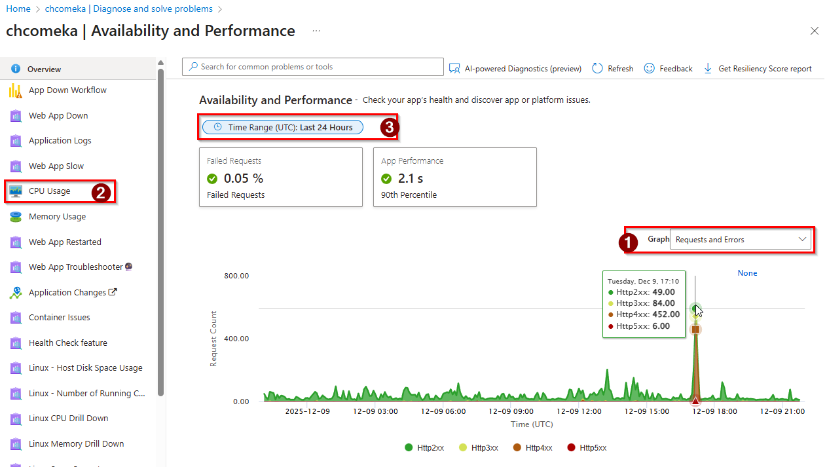

Request Fulfilled
Redirect (?)
Not found (Most Common)
Server Error

