Slide 1
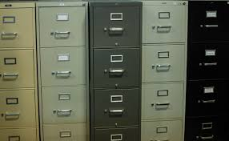
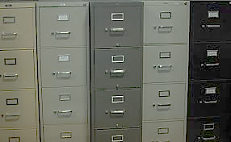
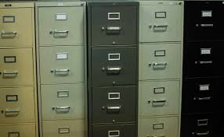

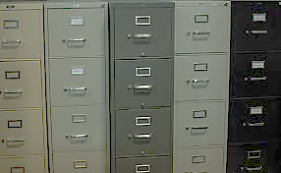

C-Dash:
Digital Architectural Survey and History
C-DASH
Digital Architectural Survey and History

Slide 2
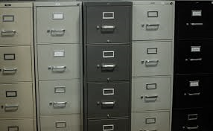
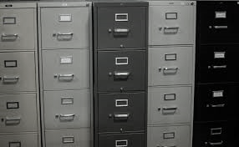
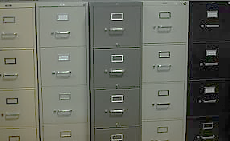
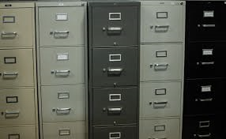
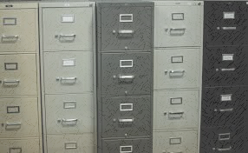


C-Dash:
Digital Architectural Survey and History
C-Dash:
Digital Architectural Survey and History
C-DASH
Digital Architectural Survey and History

Slide 3
C-Dash:
Digital Architectural Survey and History

Slide 4
C-Dash:
Digital Architectural Survey and History
C-Dash:
Digital Architectural Survey and History
C-DASH
Digital Architectural Survey and History

Slide 5
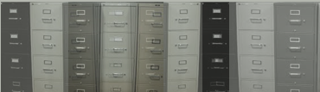
C-Dash:
Digital Architectural Survey and History

