Slide 1
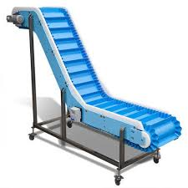
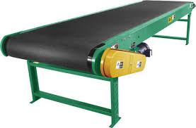
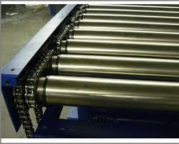
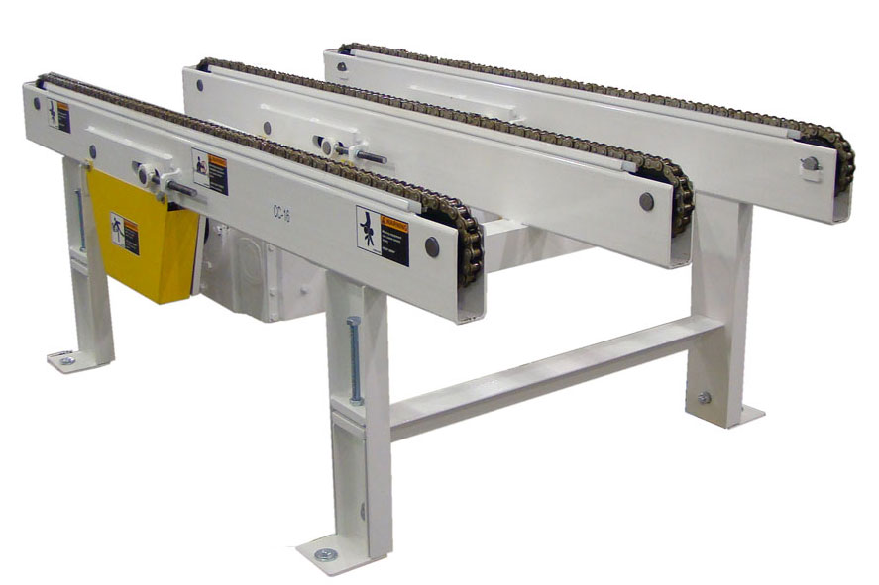
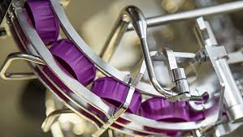
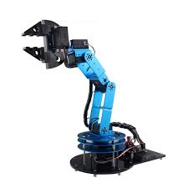
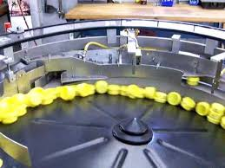
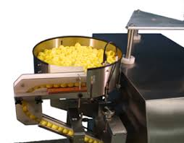
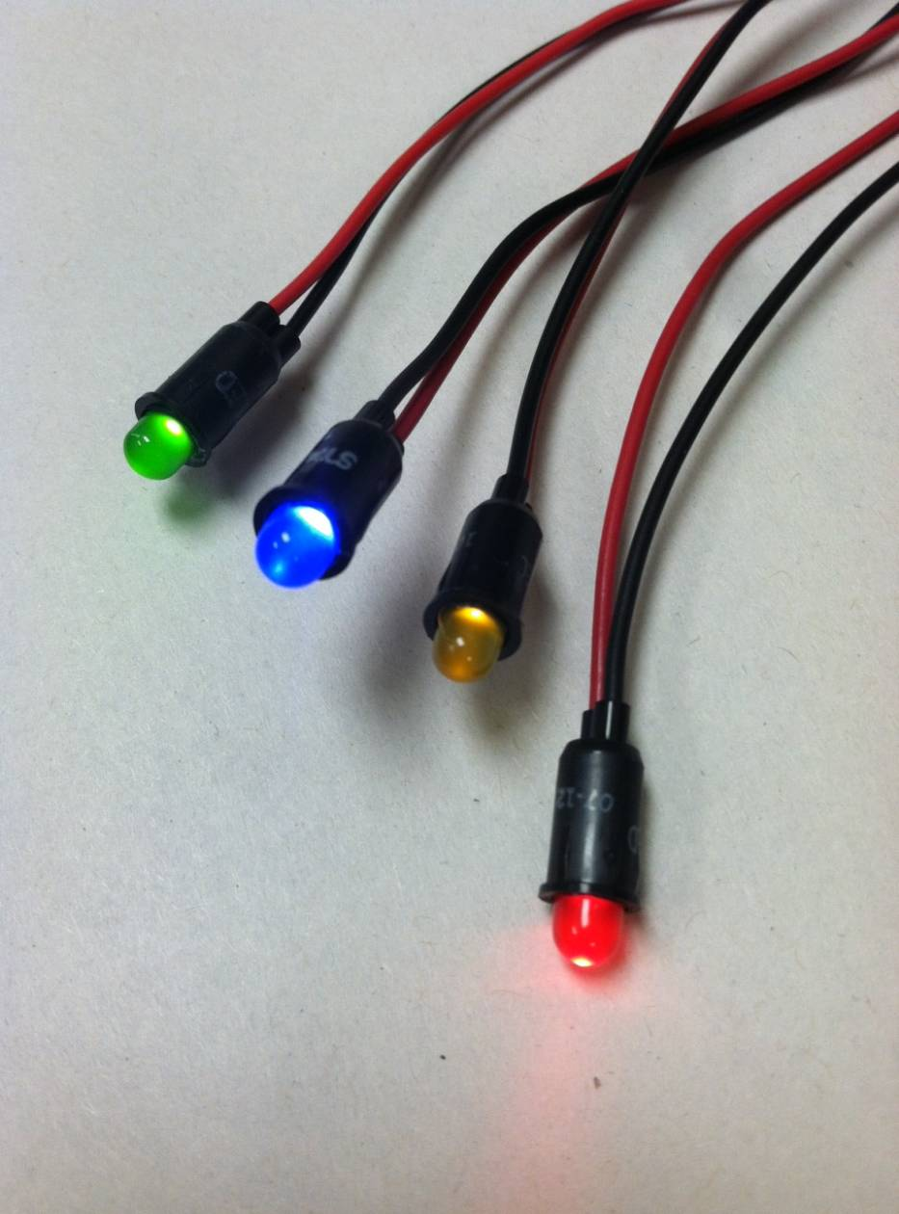
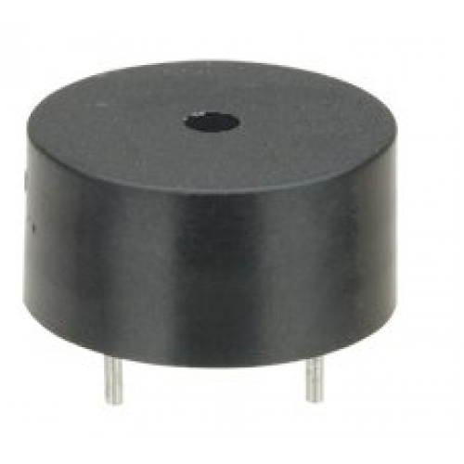
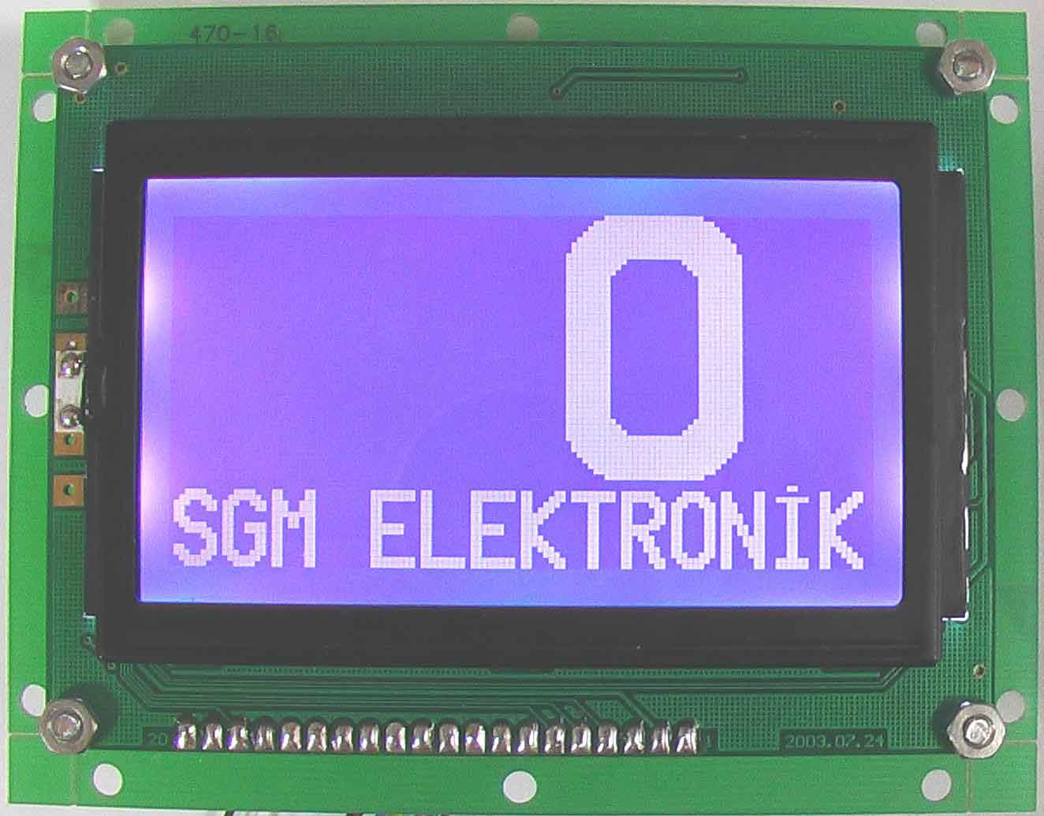
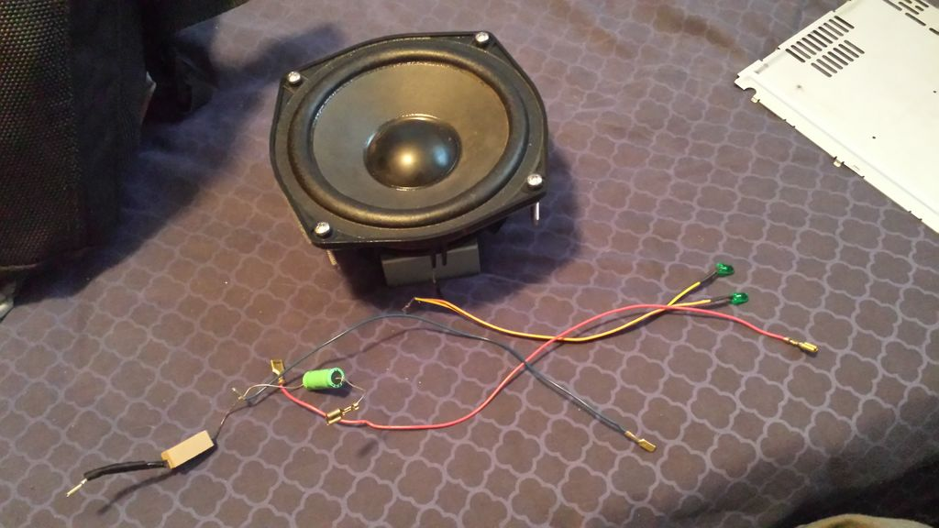
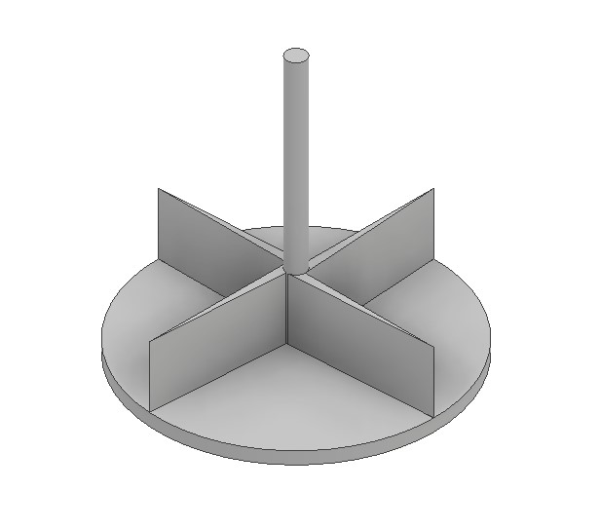
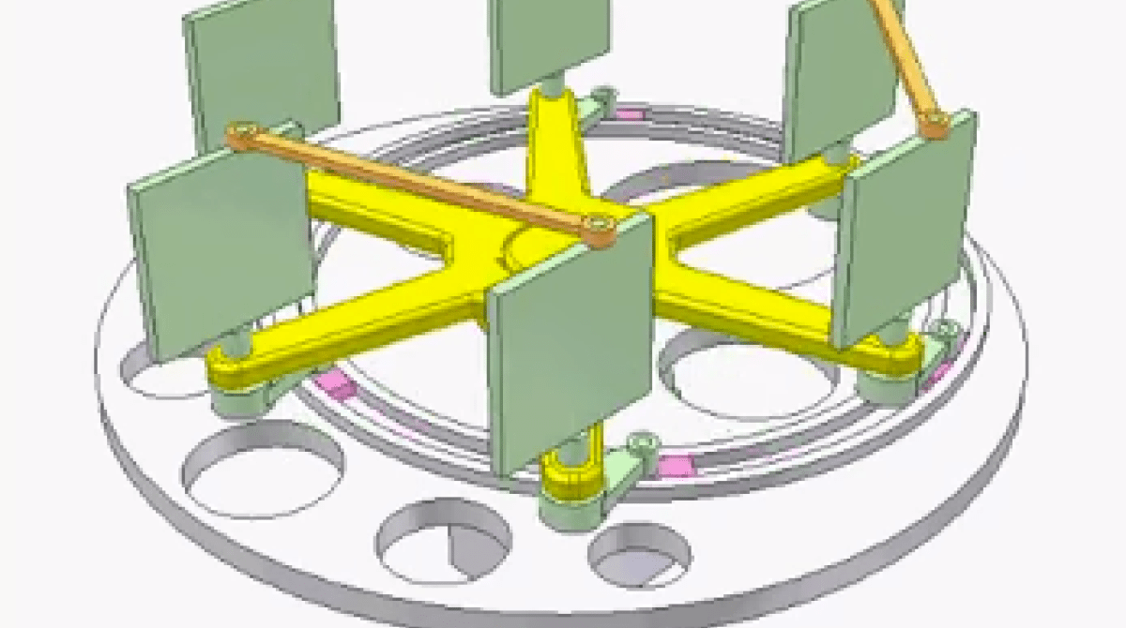
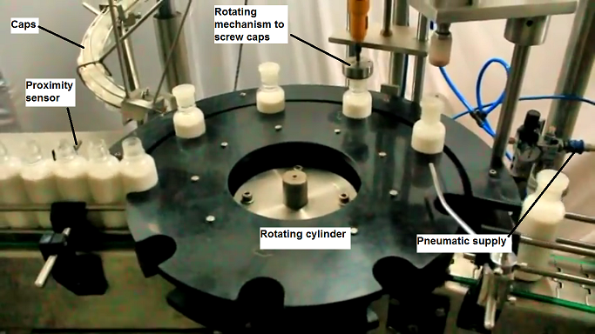
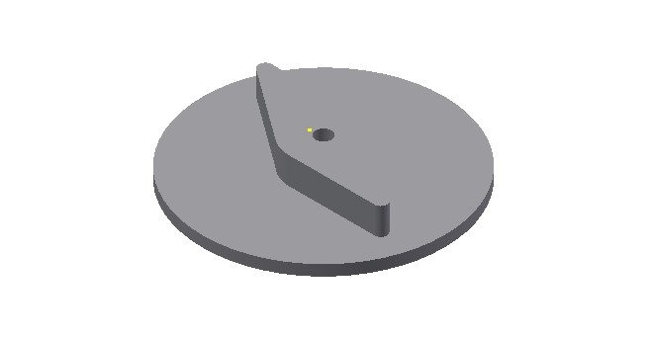
Function | Mean 1 | Mean 2 | Mean 3 | Mean 4
[ 1 ] BOTTLE MOVEMENT | CONVEYOR BELT | ROLLER CONVEYOR | COMPARTMENT CONVEYOR | CHAIN CONVEYOR
[ 2 ] PLACING CAP | SLIDING | MECHANICAL ARM | CENTRIFUGAL CAP SORTER | CAP FILLER
[ 3 ] PROCESS COMPLETION | BEEP SOUND | LCD SCREEN DISPLAY | LED INDICATOR | SPEAKER
[ 4 ] CAPPING BASE | ROTATING DISK | LINKAGE MECHANISM | ROTATING CYLINDER | CAM MECHANISM

