Slide 1

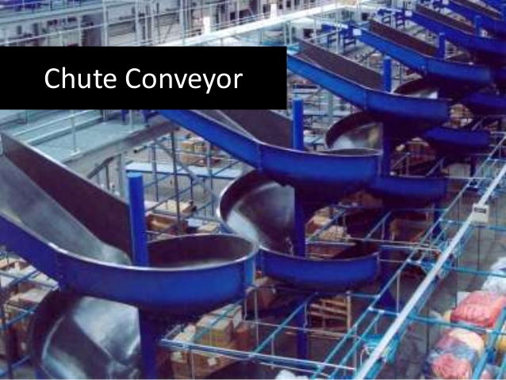
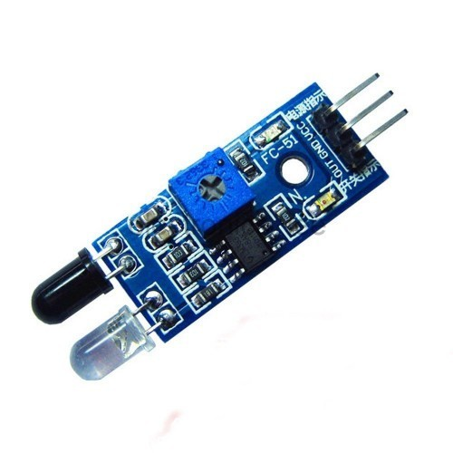
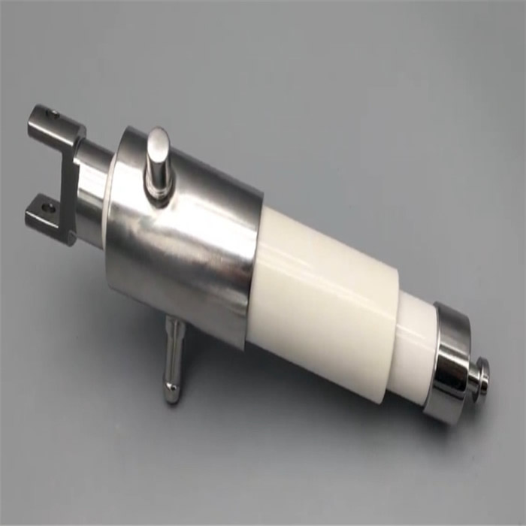
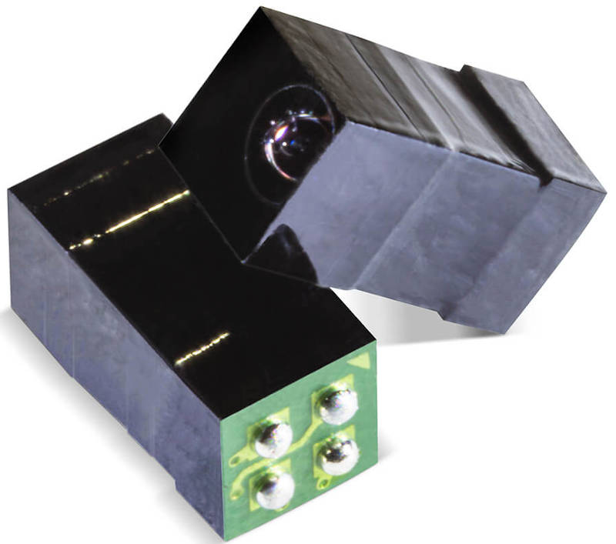
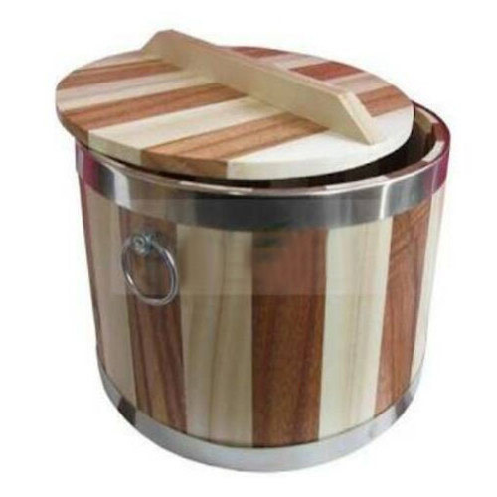
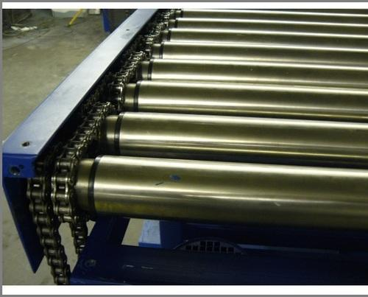
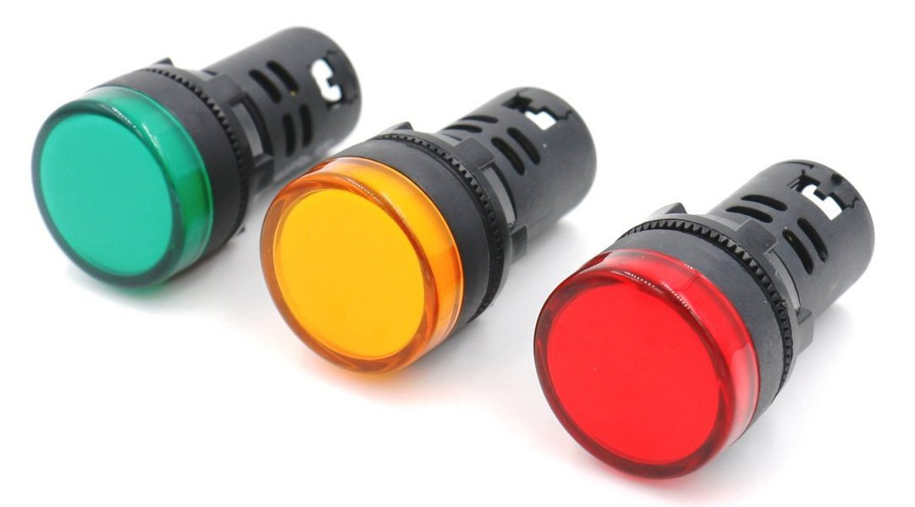
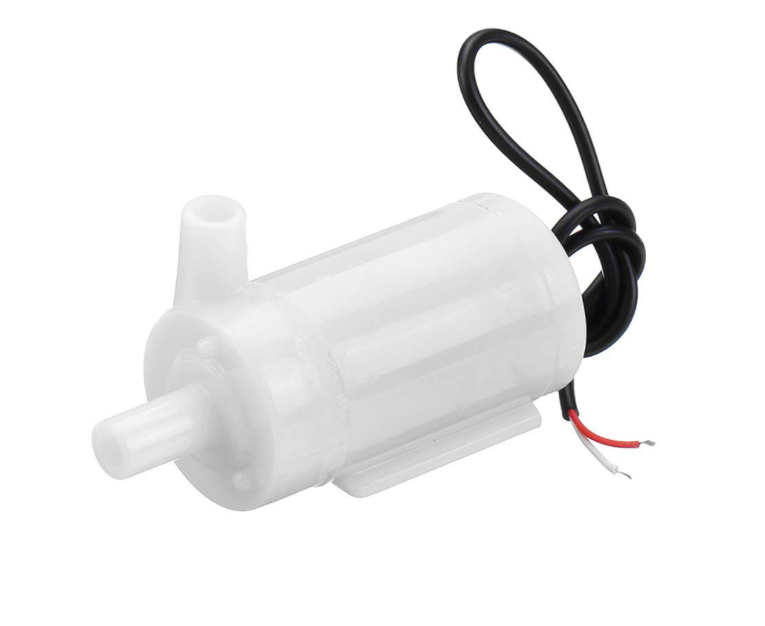
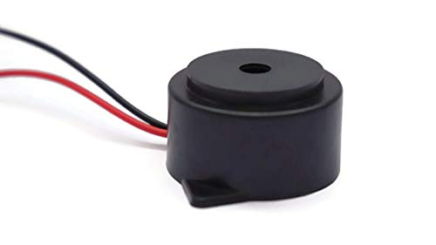
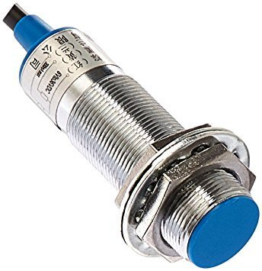
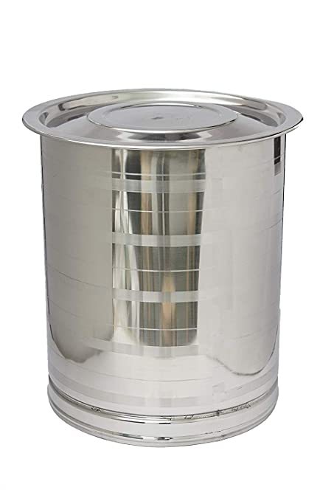
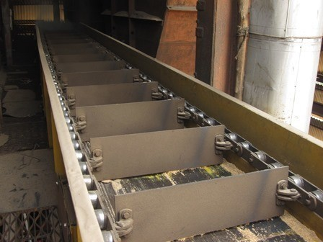
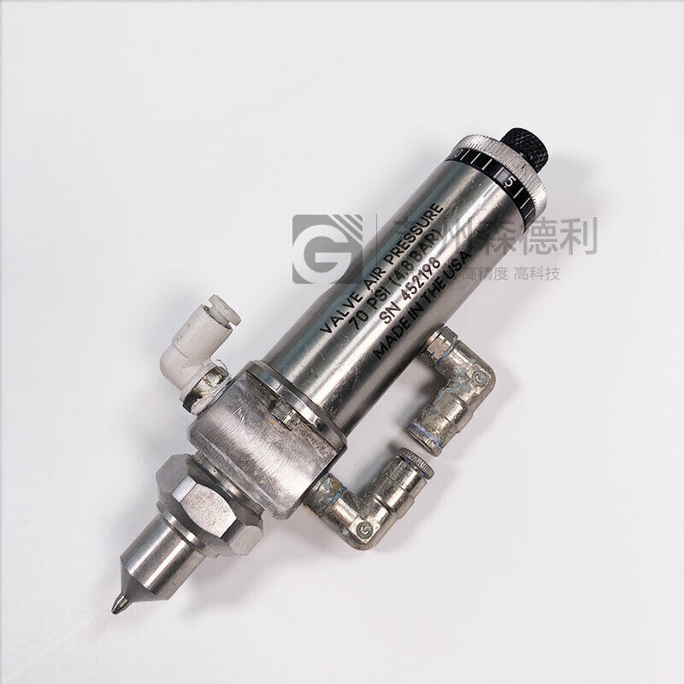
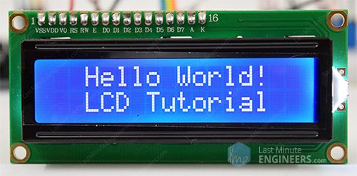
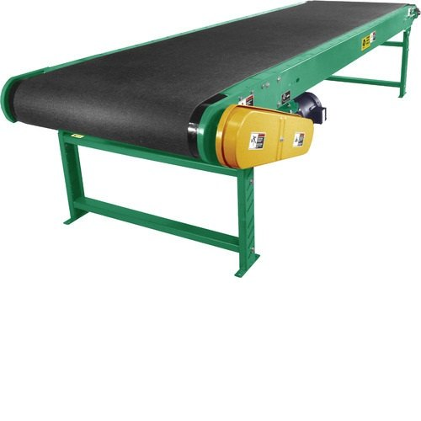
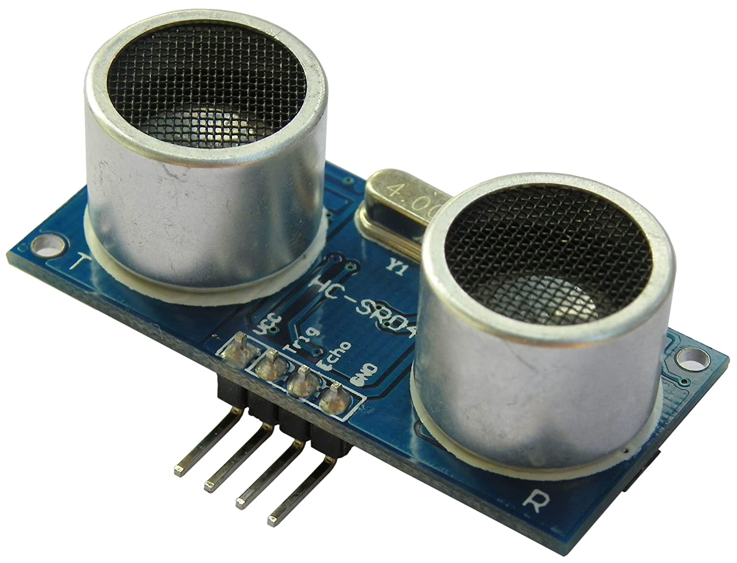
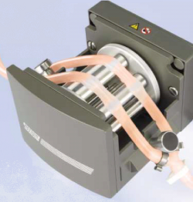
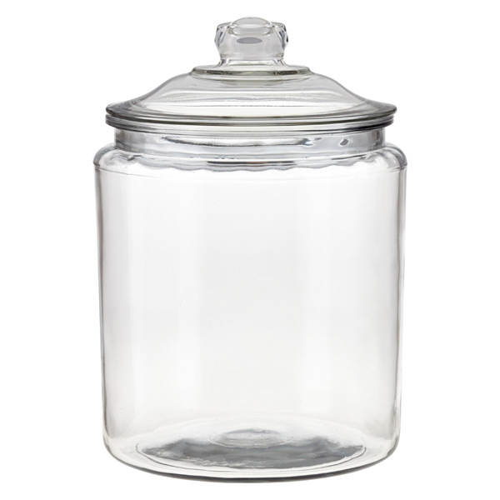
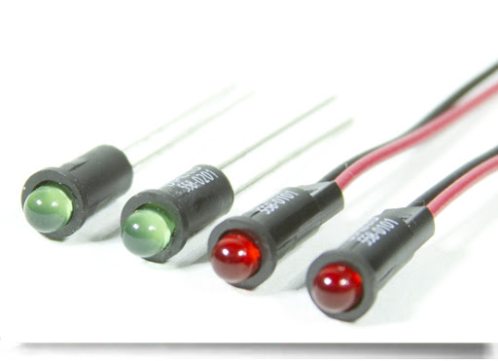
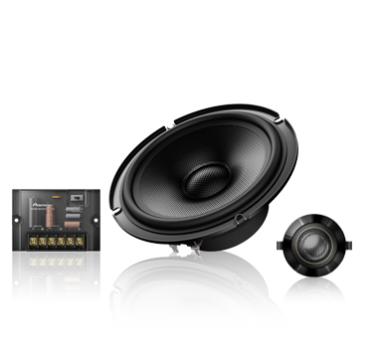
SL.NO | FUNCTIONS | MEAN 1 | MEAN 2 | MEAN 3 | MEAN 4
1. | DISPENSING | SUBMERSIBLE PUMP | CERAMIC PUMP | PERISTALTIC PUMP | EFD VALVE SYSTEM
2. | STORINF THE BREAD | STEEL | WOODEN | PLASTIC | GLASS
3. | MOVEMENT OF BREAD | CONVEYER BELT | DRAG CONVEYER | ROLLER CONVEYER
4. | ON/OFF MACHINE | LED INDICATORS |  | BUZZER | LAMP INDICATORS
5. | SENSE BREAD | INFRARED SENSOR | ULTRASONIC SENSOR | PROXIMITY SENSOR | CAMERA SENSOR
6. | PROCESS COMPLETION | SPEAKER | LED INDICATORS |  | LAMP INDICATORS

