Slide 1
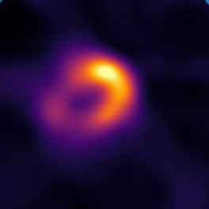
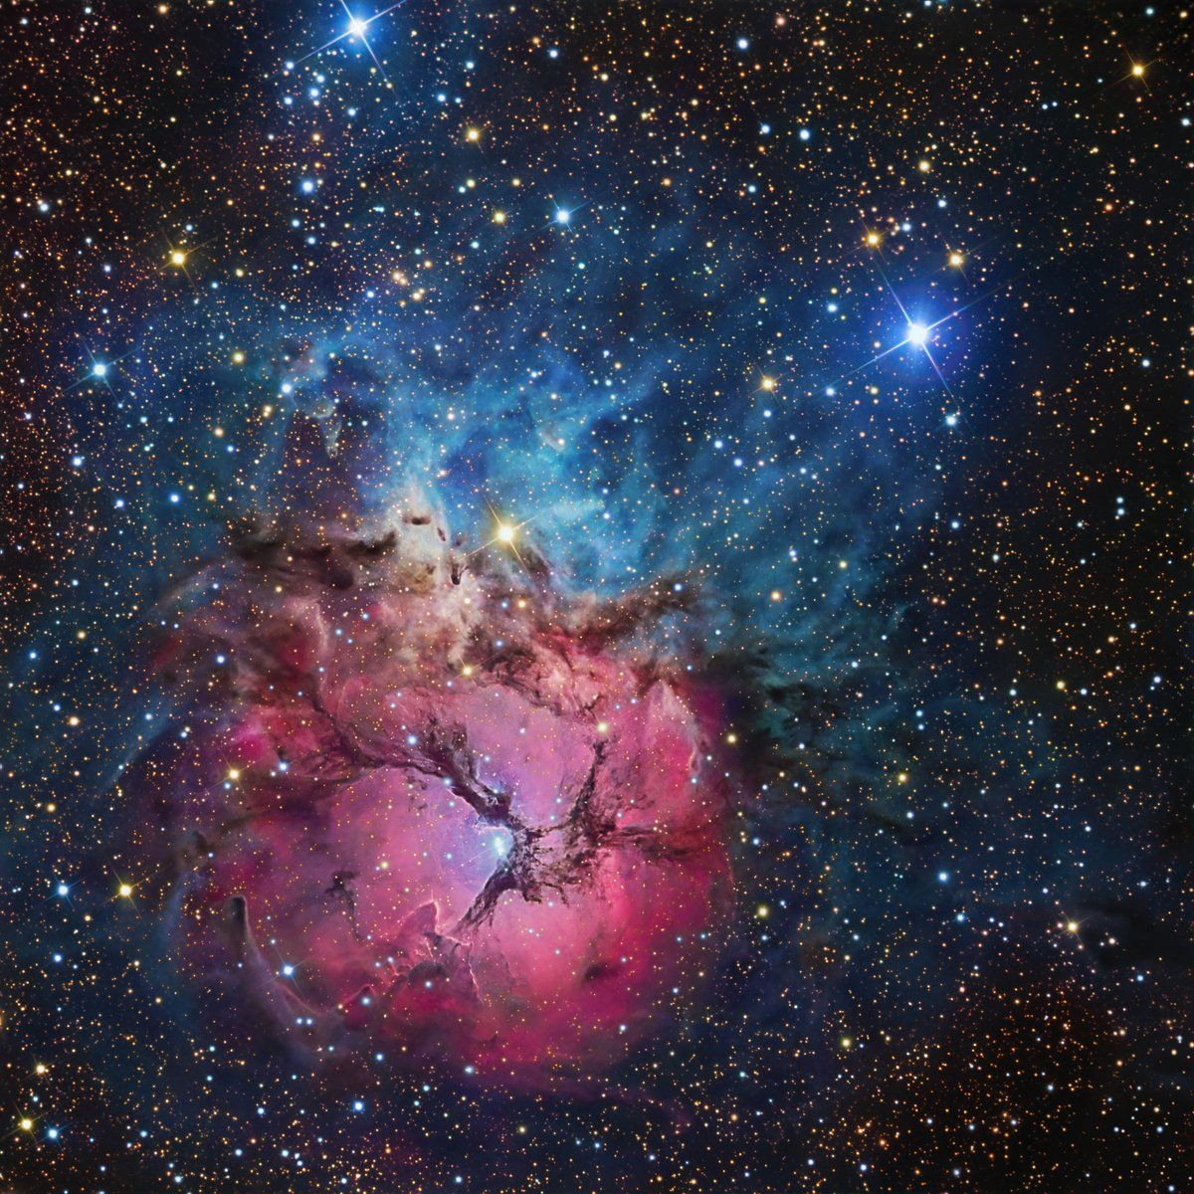
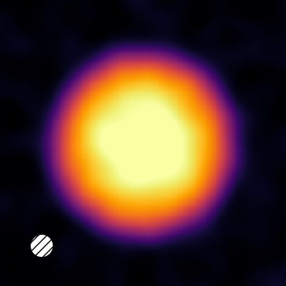
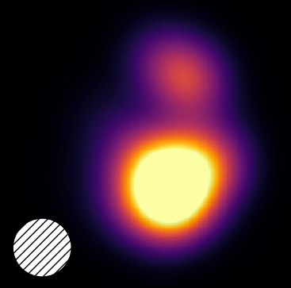
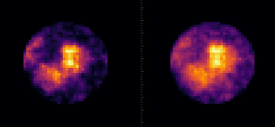
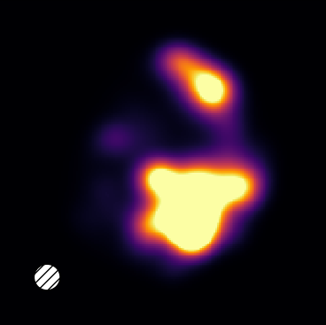
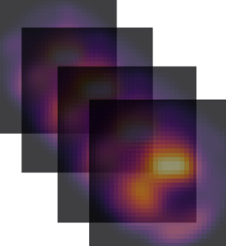
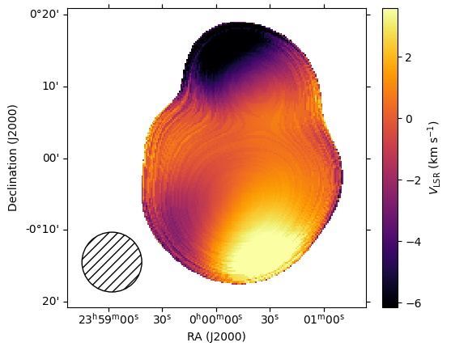
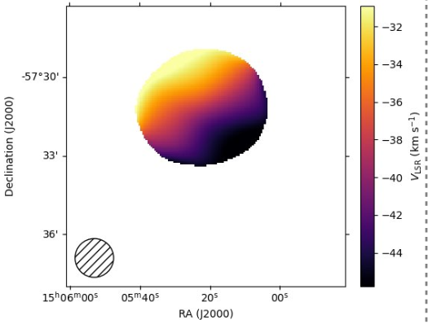
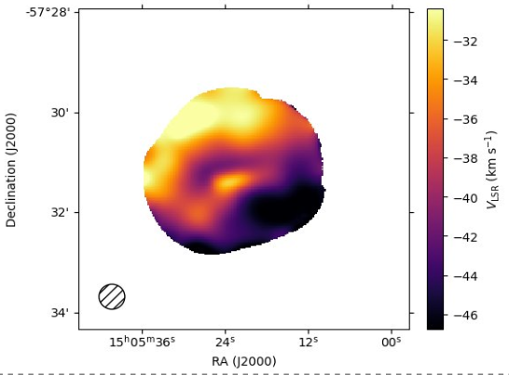
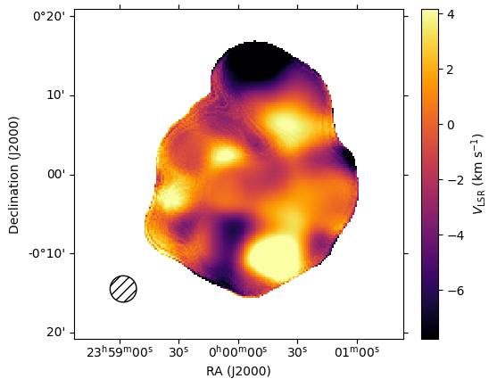




Billowing Hydrogen:
Simulating Turbulence in HII Regions
Eliza Canales¹, Dr. Trey Wenger²
¹New Mexico Institute of Mining and Technology, ²University of Wisconsin - Madison
A
Introduction
Results
HII regions are areas of ionized hydrogen surrounding young, hot stars, as pictured in Figure 1. Observing them can help us probe star formation. Most of the visible light is diffused out on the way to Earth, so we turn to a tracer that isn’t absorbed as much by the interstellar medium, radio recombination lines (RRLs). RRLs are generated from hydrogen with high characteristic numbers (n = ~100) undergoing an electromagnetic emission.
Adding turbulence to these simulated HII regions appears to give a non-spherical shape, much like what we see with observation. We compare Figures 5 and 7 to see this. In addition, the phenomenon where details are smeared out in such a way that creates a gradient is recreated in the simulation. This turbulence is a necessary addition in order to get these results, as Figure 4 shows one of these regions without the added turbulence.
We also note the range of velocities we get in Figures 3 and 6. For the upper and lower bounds (first and last 5% of velocities), we get a range in the lower tens of kilometers per second for a velocity for a typical average velocity of the gas.
Figure 7: Region observed to create moment maps shown in Figure 3.
Conclusion
Figure 1: A picture of an HII region [1].
Figure 4: HII region without added turbulence.
We find that turbulence alone can explain the visual behavior of HII regions when they are resolved and unresolved. This is because the gradient-like behavior is recreated for unresolved and the granular features show for the resolved. Additionally, the ranges of velocity for the motions of the cloud in the simulation are realistic.
When we do research with radio recombination lines, we need to make special considerations. This is because their emission is sensitive to the density squared of the hydrogen, rather than just the density by itself that is expected for a regular tracer.
Future Work
Currently, we are working to predict the velocity of the gas contained by the HII region by looking at the spatial randomness of the region and other measurable attributes. These key traits will help us to better our understanding of the motions of the gas within. Additionally, we will compare these simulations to more images similar to the one provided in Figure 2 to get a better understanding of how our simulation responds to different conditions.
Figure 2: Images showing the difference between a linearly sensitive tracer (left) and a squarely sensitive tracer (right).
Looking at Figure 2, we see that there is a noticable difference between the images due to the square sensitivity, so it must be accounted for in simulation.
Research Question
Previous studies [2] have looked at HII regions and concluded rotation may be a good explanation for the velocity of the region. This velocity is measured via the first moment map, where each position of the sky in a data cube has an average spectral shift of an RRL taken to get the velocity. However, later observations of one HII region in particular has shown a different story, as pictured in Figure 3.
Figure 5: Generated observations of the same region, but with different resolutions.
Figure 8: More simulations to come.
References
[1] M20 | Trifid Nebula HII Region in Sagittarius 6° from Kaus Borealis (top of the teapot) taken by R Jay GaBany.
[2] Balser, D. S., Wenger, T. V., Anderson, L. D., et al. 2021, The Astrophysical Journal, Vol. 921 (American Astronomical Society), 176, http://dx.doi.org/10.3847/1538-4357/ac1db3
Acknowledgements
Figure 3: First moment maps of the initial and then follow-up observation.
This work was supported by the National Science Foundation's REU program in Astrophysics through NSF award AST-2150222. Additional support was provided by the Radio Astronomy Data Imaging and Analysis Lab (RADIAL) Research & Training Experience program through the National Radio Astronomy Observatory; and by the Alfred P. Sloan Foundation's Creating Equitable Pathways to STEM Graduate Education Program.
The first image shows one side travelling toward the observer (relative to the center of the HII region). It suggests the aforementioned rotation of the region, whereas the second image has much more detail to it. There are three main types of mass motions of the HII region, being rotation, expansion, and turbulence.
Our question is, can turbulence alone explain both the gradient appearance of the first image as well as the more structured appearance of the second?
Figure 6: The first moment maps for our generated regions for two different resolutions.

