Slide 1
Simulating Turbulence in HII Regions
Eliza Canales and Trey Wenger

Slide 2
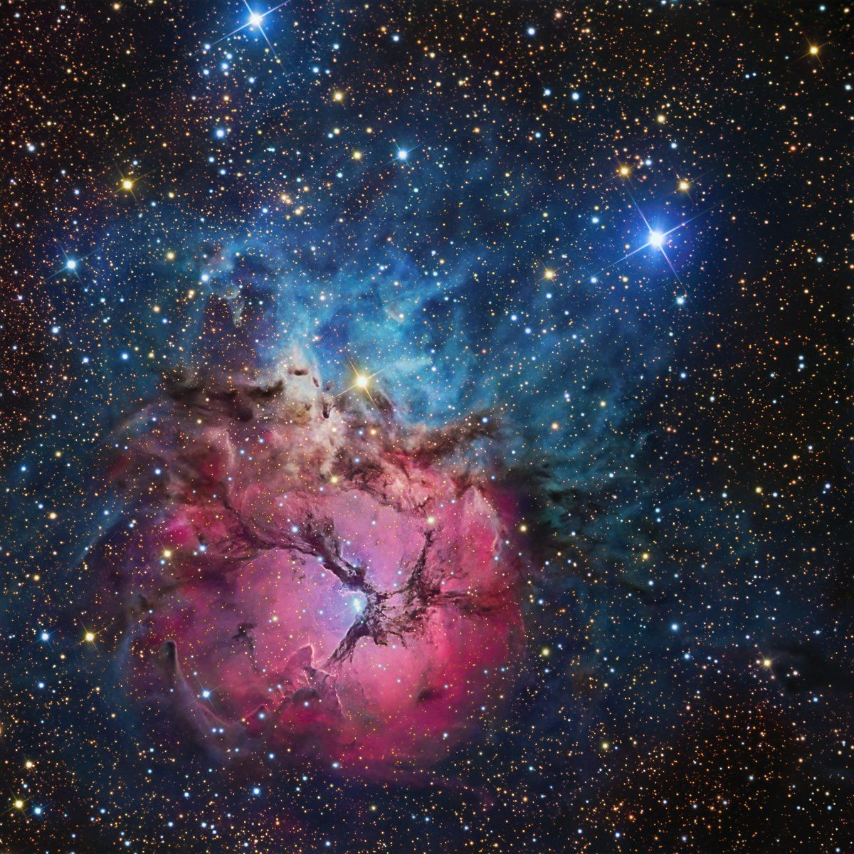
Introduction to HII Regions
What does the HII mean?
Physical traits
Powered by hot stars
Roughly 1 parsec in size
A type of nebulae
Image attribution: M20 | Trifid Nebula HII Region in Sagittarius 6° from Kaus Borealis (top of the teapot) taken by R Jay GaBany
Notes:
Explain figures

Slide 3
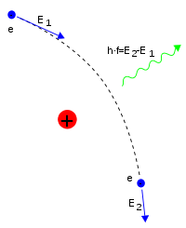
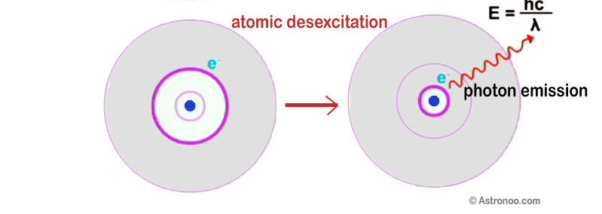
More on HII Regions
How do we observe them?
Free-free emission
Radio recombination lines (RRLs)
Image attribution: https://astronoo.com/images/lumiere/absorption-et-emission.jpg https://en.wikipedia.org/wiki/Bremsstrahlung#/media/File:Bremsstrahlung.svg
Notes:
Compare to H alpha (n=3 to n=2)

Slide 4
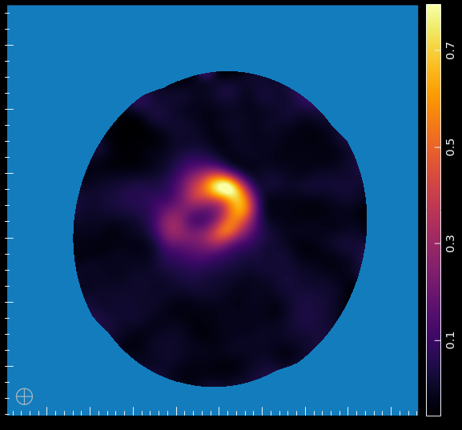
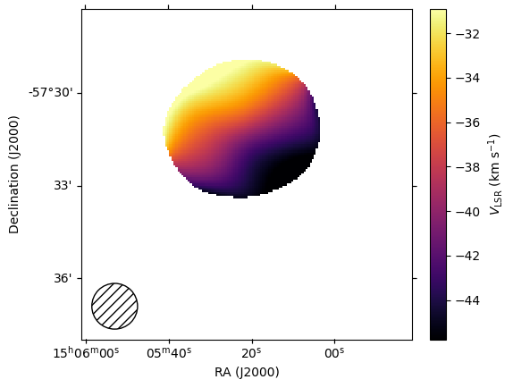
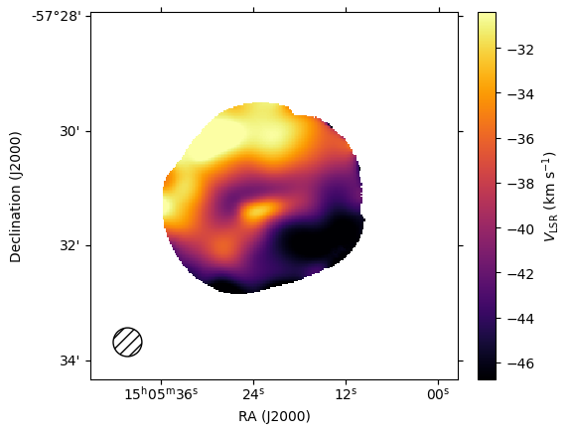
Motivation for Project
Previous work suggested rotation of HII regions
New data doesn't match prediction
Could turbulence explain the differences?
Notes:
Explain figure very well, show the actual data to help ground some ideas

Slide 5
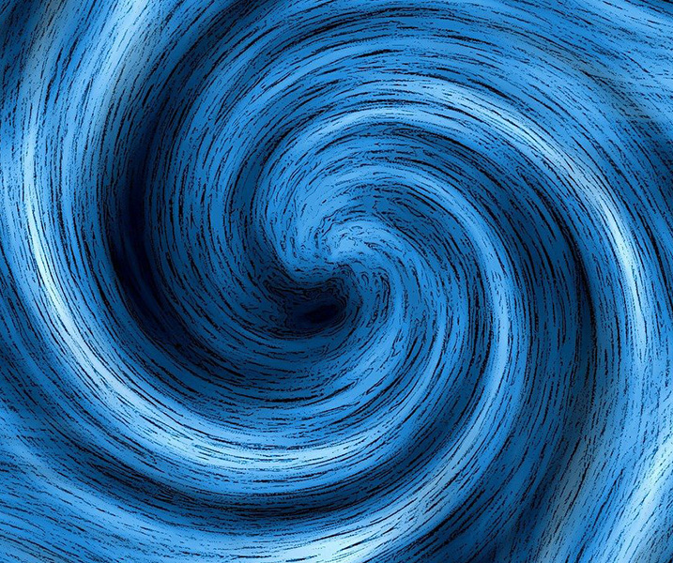
Project Goals
Simulate turbulence in HII regions
Calculating emission for each pixel
Overlaying density and velocities
Test different turbulence parameters
Comparing to reality
Use statistical models to compare
Image attribution: https://www.advancedsciencenews.com/wp-content/uploads/2023/07/swirl-g52ac5d4ac_1280.jpg
Notes:
Ignore base simulation case

Slide 6
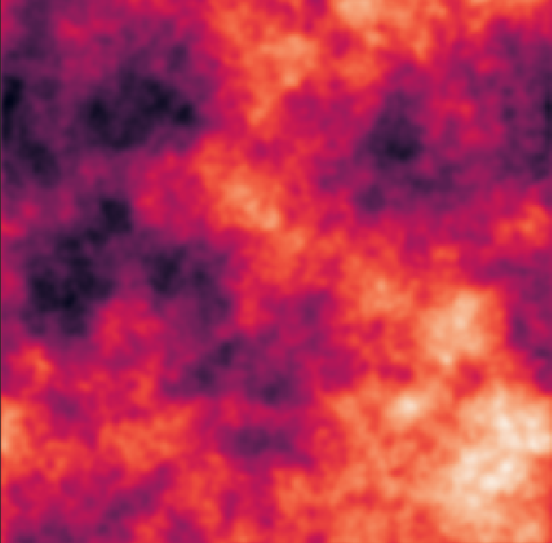
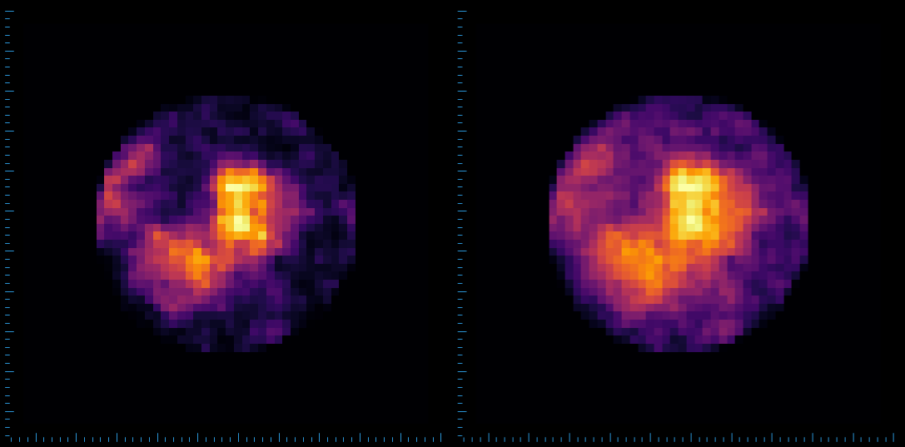
Exploring Turbulence
Not all turbulence is made equal
Using Turbustat
Python package
Cubes of density and velocity
Special case for RRLs
Image attribution: https://turbustat.readthedocs.io/en/latest/generating_test_data.html#three-dimensional-fields
Density squared Density
Notes:
Cut slide, replace with turbulence explorations, turbustat, talk about the mean squared problem, make pictures comparing integrated column density to emission measure

Slide 7
Work Done So Far
Simulation in working order
Turbulence can be added to our region
Turbulence currently acting unexpectedly
Simulation looks similar to data
Notes:
Talk about simulation

Slide 8
Work Done So Far
Simulation in working order
Turbulence can be added to our region
Turbulence currently acting unexpectedly
Simulation looks similar to data
But, what does it look like?
Notes:
Talk about simulation

Slide 9
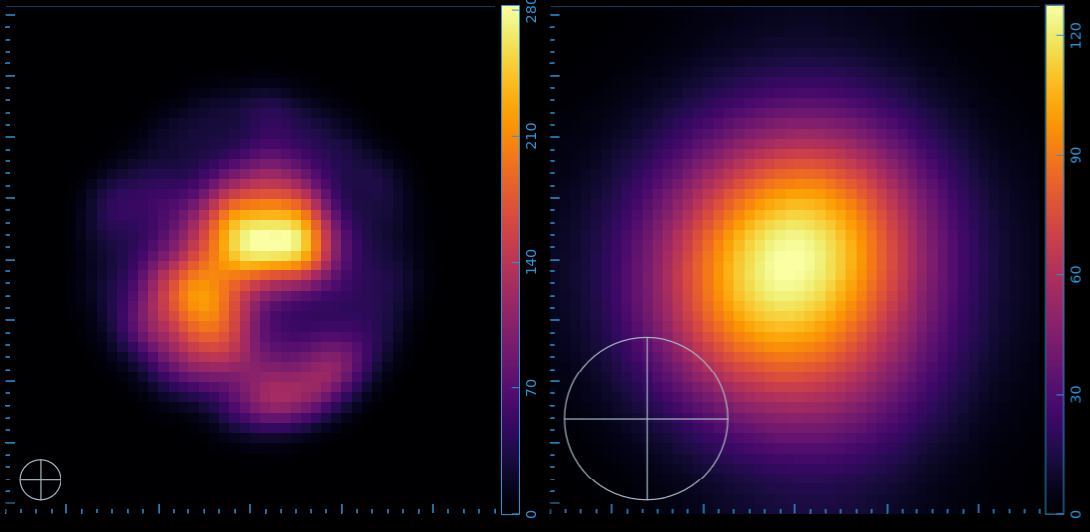
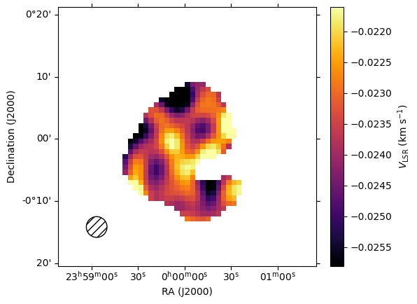
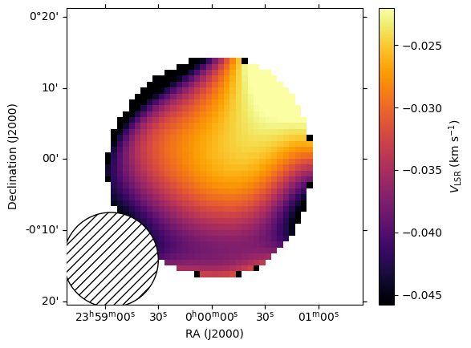
Narrow beam
Wide beam
Notes:
Show cool data

Slide 10
Narrow beam
Wide beam
Notes:
Show cool data

Slide 11
Future Work
Comparing simulation with reality
Using new dataset to test
Calculating different features of simulation
Finding good test values
Making many data cubes

Slide 12
Significance
We don't understand HII region motion
Insight into high-mass star formation
Transfer of energy into surrounding media
Notes:
Can combine with take-home if too much

Slide 13
Takeaways
Goal of project
Progress
Next steps
Notes:
Revise, maybe add bonus slides for hard questions, or skipped content

